Slide 1
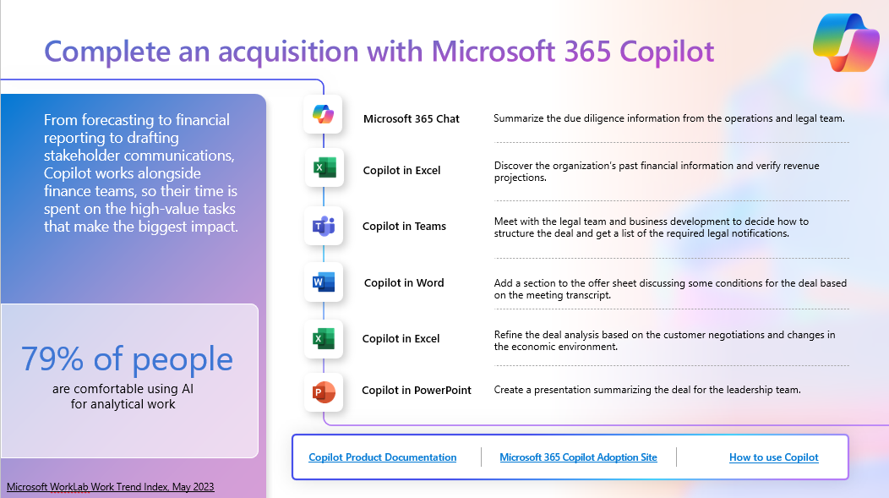
Copilot for Microsoft 365 Persona and Scenario Mapping
Use case by role
Day in the Life by role
Product guidance
Tell the Copilot value story by showing how Copilot can be used to simplify key business processes. Includes detailed prompts, links to support and adoption materials, and so much more!
Get BDMs excited about Copilot by showing how Copilot can simplify their day. Includes detailed prompts.
Answer product capability questions with guidance on what each Copilot app can do with demos and prompt guidance.

Slide 2
Copilot for Microsoft 365 Scenario Library Demos, use cases, instructions, and prompt guidance

Slide 3
The Pace and Volume of Work have only increased
64%
of employees don’t have enough time or energy to do their job
3x
More meetings than 2020
18
Searches per day
Source: 2023 Work Trend Index
Notes:
Based on our research, 64% of employees don’t have enough time or energy to do their job. ​
Over the past few years, the pace and volume of work have only increased. On a given workday, our heaviest users search for what they need 18 times, receive over 250 Outlook emails, and send or read nearly 150 Teams chats. 1 Teams users globally are in three times more meetings each week than they were in 2020. 2 And on Windows, some people use 11 apps in a single day to get their work done.
¹ Data represents top 20 percent of users by volume of searches across M365 services, emails received, and sent and read chats in Teams, respectively
² Microsoft annual Work Trend Index 2023
​
And the primary causes of this time and energy drain are things like searching for information and navigating inefficient meetings. ​
Employees reported spending nearly 60% of their time on communicating and coordinating, leaving just 40% for creation, deep thinking and collaboration. ​
​
​The volume of data, emails and chats has outpaced our ability to process it all. We call it digital debt.​
​
Every minute spent managing this digital debt is a minute not spent on creative work. In a world where creativity is the new productivity, digital debt is more than an inconvenience – it’s impacting business. ​
​

Slide 4
Copilot brings AI to everyone. Support roles like…
Executive
HR
Operations
Sales
CEO CIO CMO GM
President Sr Manager
Team Leader
Employment Specialist HR Assistant
Recruiter
Labor Relations Payroll Specialist
Learning Lead
Operations Analyst
Operations Manager
Quality Control Lead
Account Executive
Quality analyst
Onboarding Specialist
Sales Associate
Sales Engineer
Sales Representative
Marketing
Finance
IT
Brand Manager
Content Strategist
Creative Director
Graphic Designer
Market Researcher
Product Marketing Manager
Accountant
Financial Analyst Finance Manager
Investment Manager Financial Advisor
Risk Specialist
Cybersecurity Analyst
Help desk Support
Hardware Technician
IT Project Manager
Network Administrator
Software Developer

Slide 5
Click on the use case you’d like to review
Keep Executives informed
Keep your Operations running smoothly
Streamline Finance decisions
Help HR with hiring and engagement
Boost Marketing speed and creativity
Give your Sales team an AI assistant to close deals
Amplify IT efficiency

Slide 6
Copilot for Microsoft 365 AI for Executives

Slide 7
Your Personal AI Assistant
68% of people say they don't have enough uninterrupted focus time during the workday
Microsoft WorkLab Work Trend Index, May 2023

Slide 8
Prepare for a company-wide address
Quickly catch up on the latest developments and discussions related to the announcement by summarizing email threads and chat conversations.
Icon Bank:
Executives are always pressed for time and Copilot simplifies many tasks in preparing for a meeting. But some things have to be perfect. Copilot also improves work quality so big events can happen flawlessly.
Microsoft Copilot
Microsoft Copilot
Meet with the executive team to review each business unit’s results. When closing the meeting ask Copilot to create action items from the conversation and assign owners.
Copilot in Teams
Copilot in Word
Revise the draft of the speech, asking Copilot to make it resonate more with the workers at the speech location.
Copilot in PowerPoint
Revise the presentation slides changing out a few images with suggestions from Copilot.
68% of people say they don't have enough focus time during the workday
Copilot in Teams
Review last quarter’s address by glancing over the meeting recap and asking Copilot about the numbers that were presented to ensure consistency.
Copilot in Outlook
Thank the team for watching the address by asking Copilot to draft a response that can be personalized in tone and length, even on the go.
Copilot Product Documentation
Copilot for Microsoft 365 Adoption Site
How to use Copilot
Microsoft WorkLab Work Trend Index, May 2023

Slide 9
Prepare for a company-wide address
Catch up
Gather team input
Revise the speech
On chats and emails by prompting Microsoft Copilot
From the meeting recap prompt Copilot in Teams
Within the Word document select a paragraph and Copilot will offer several ways you could rewrite it
Summarize my emails and chats from the past week that mention the year-end results.
Generate a list of the key points made by each speaker.
Rewrite with Copilot.
Create the invitation
Review last quarter’s speech
Revise the presentation slides
From a new email select Draft with Copilot
From the meeting recap prompt Copilot in Team
Within the presentation prompt Copilot
Draft a detailed email thanking all employees for attending the year-end review. Make the tone friendly and mention how excited we are to continue our progress in the new year.
Summarize the meeting and list the key points. Tell me all of the revenue numbers that were presented
Add an image of an inspiring landscape of a mountain to match the company motto – “We overcome every obstacle”

Slide 10
A day in the life of an Executive
7:00 AM
8:30 AM
9:00 AM
Tanya starts the day with a customer call in her hotel room. She uses Copilot to monitor for any disagreements.
After the call, Tanya summarizes her email threads from the day before and uses Copilot to create replies getting through all of her email in only 20 minutes.
Tanya has a few more minutes so she uses Copilot to catch up on the meetings she missed while flying in. She sends a few chats to provide instructions on the critical issues.
Copilot in Teams
Copilot in Outlook
Copilot in Teams
What are some good follow up questions to make sure I understand the customer’s issue with the last delivery?
Reply in a professional tone with a short email saying that I am sorry for the issue with the product and we will have a response by 3 pm this afternoon.
What was the main issue faced by the customer and what was the proposed solution and timing?
7:00 PM
3:00 PM
2:00 PM
The issue is finally under control and Tanya can get back to her speech. She isn’t happy with the introduction, so she asks Copilot to suggest some humorous opening lines for her speech. With a few tweaks she has the perfect start.
A critical production issue has occurred, and Tanya needs to get up to speed quickly. She asks Copilot for a summary of the emails and chats related to the issue
After a long session of meetings at a customer site, Tanya gets a chance to have a look at her speech for tomorrow and make a few updates. She uses Copilot to add a new section on bonus plan updates.
Copilot in Word
Microsoft Copilot
Copilot in Word
Tanya leads a product development team
Give me some suggestions of humorous ways to begin this speech.
Summarize all of the email and chats that mention the melt shop from the past two hours.
Add a new paragraph based on Contoso Bonus Plan for FY23.

Slide 11
Copilot for Microsoft 365 AI for HR

Slide 12
Banish your busywork
3 in 4 people would be comfortable using AI for administrative tasks
Microsoft WorkLab Work Trend Index, May 2023

Slide 13
Copilot for Microsoft 365 augmented hiring workflow
Create a job description by asking Copilot in Word to suggest skills, qualifications, and responsibilities.
Icon Bank:
Hiring and onboarding typically costs a full year’s salary for each employee lost to attrition. Copilot for Microsoft 365 can help you create a more efficient hiring process that reduces costs and help ensure that you are selecting the most suitable candidates.
Copilot in Word
Microsoft Copilot
Microsoft Copilot
Discover the best candidates for a position by having Copilot extract skills, experience, and qualifications from a set of resumes.
Copilot in Loop
Create interview questions based on unique job requirements then crowdsource additional ideas and have Copilot create a final list.
Copilot in Teams
Conduct a group interview in Teams and ask Copilot to summarize the contributions of each candidate.
Copilot in Word
Command Copilot in Word to draft a customized offer letter based on your inputs.
3 in 4 people
would be comfortable using AI for administrative tasks
Copilot in PowerPoint
Create powerful onboarding materials in PowerPoint.
Copilot Product Documentation
Copilot for Microsoft 365 Adoption Site
How to use Copilot
Microsoft WorkLab Work Trend Index, May 2023

Slide 14
Copilot for Microsoft 365 augmented hiring workflow
Create a job description
Discover qualified candidates
Create interview questions
Starting from a blank document prompt Copilot in Word
Prompt Copilot in Microsoft Copilot
Prompt Copilot in Loop to create a set of interview questions
Create a job description for a senior animation designer role, based on the Design Team Core Responsibility document.
Based on Candidate #1 resume provide a summary of the skills, experience, and qualifications of the candidate.
Create a set of interview questions for the position of Senior Animation Designer. Ask about previous experience, goals, and include some questions about personal interests.
Conduct an interview
Create an offer letter
Create onboarding materials
During the interview prompt Copilot in Teams
Starting in a new email prompt Copilot in Word prompt
Starting with a new presentation prompt Copilot
What would some good follow up questions be based on what we have already discussed and are there any questions that I have not answered?
Create an offer letter to Maya for the position of Senior Animation Designer with a start date of March 16th. Include details on our benefits from our Benefits Handbook.
Create a presentation from [Word document link to Senior Animation Designer Job Description] Create an overview the job responsibilities .

Slide 15
A day in the life of an HR manager
8:00 AM
9:35 AM
10:00 AM
Omar starts the day at home with an interview for a new teller candidate. He commands Copilot to suggest follow up questions and summarize the key points the candidate made.
At the office Omar summarizes some chat threads that occurred overnight at a subsidiary and can quickly assess the situation and provide guidance to his team to address the issue.
Omar asks Copilot to create a summary of the organization’s new compliance handbook to ensure it has the key points. He then commands Copilot to fill in the missing sections.
Copilot in Teams
Copilot in Teams
Copilot in Word
What are some good follow up questions to learn more about this person’s skills and experience?
Summarize this thread and include the key issues and suggestions for resolution along with who had the suggestions.
Summarize the Contoso Compliance Handbook in about four paragraphs for an executive and also provide a list of key points.
4:00 PM
2:00 PM
1:00 PM
Omar has missed a few calls and emails. He commands Copilot to summarize the email threads and then uses the summaries to draft responses.
Omar commands Copilot to add a slide to his presentation that can be used to explain the team’s initiatives.
The bank has recently initiated some employee experience initiatives, so Omar checks the latest attrition numbers in Excel and asks Copilot to add some calculations and produce a chart for his presentation to his leadership team.
Copilot in Outlook
Copilot in PowerPoint
Copilot in Excel
Omar leads HR for a regional bank
Summarize this thread.
Add a slide about potential HR initiatives
Add a column that averages the other columns for each month.

Slide 16
Copilot for Microsoft 365 AI for Operations

Slide 17
Capture actions to keep operations running
80% of people would be comfortable using AI to summarize meetings and action items
Microsoft WorkLab Work Trend Index, May 2023

Slide 18
Solve a production issue with Copilot for Microsoft 365
Discover production defect rates for Six Sigma reporting using Copilot in Excel to suggest new calculations and produce charts.
Icon Bank:
Production issues cost money so solving them quickly is always a top priority. Using Copilot for Microsoft 365 to identify issues and find solutions can reduce the cost of lost production.
Copilot in Excel
Microsoft Copilot
Microsoft Copilot
Discover solutions to similar production issues using Microsoft Copilot to search internal files.
Copilot in Whiteboard
Organize the ideas after a whiteboarding session for potential solutions.
Copilot in Teams
Hold a weekly meeting to track the implementation of the solution. Use Copilot to summarize each meeting and list open items.
Copilot in Outlook
Create an email to the engineering and production employees thanking them for their extra work in resolving the issue.
80% of people
would be comfortable using AI to summarize meetings and action items
Copilot in PowerPoint
Create a presentation on the root cause analysis based on the analysis report.
Copilot Product Documentation
Copilot for Microsoft 365 Adoption Site
How to use Copilot
Microsoft WorkLab Work Trend Index, May 2023

Slide 19
Solve a production issue with Copilot for Microsoft 365
Analyze production data
Discover past solutions
Brainstorm new solutions
Using a table of Six Sigma data select the prompt Show data insights
From Microsoft365.com prompt Copilot in Microsoft Copilot
After collecting the ideas click on Organize using Copilot in Whiteboard
Find information on troubleshooting our current production equipment from across the equipment manuals. Look for information on how to reset the processor.
Show data insights.
Organize
Summarize the weekly status meeting
Thank employees for their work
Create a root cause analysis report
Starting in a new email prompt Copilot in Outlook prompt
Starting with a new presentation prompt Copilot
From the meeting recap prompt Copilot in Teams
Summarize the meeting and list the action items discussed and their current status.. List all of the decisions that were made and issues that were resolved.
Create an email thanking all the people who helped to identify the issue and implement the solution. Include that we resumed full production on Tuesday at 6 pm and limited the shutdown to 3 days.
Create a presentation that summarizes [Word document link to Production issue root cause analysis report.docx]

Slide 20
A day in the life of an Operations manager
7:00 AM
8:30 AM
9:00 AM
Megan meets with the production team at the overseas manufacturing site to discuss changes required for new product updates.
At the office Megan reviews the manufacturing cost impacts of suggested product design changes.
Megan asks Copilot to create a new presentation based on the Product Design Guidelines and then she copies in the charts from the cost analysis.
Copilot in Teams
Copilot in Excel
Copilot in PowerPoint
What are some good follow up questions to make sure I understand the impact on the manufacturing process for each product update we discussed?
Add a column that totals the additional costs for the priority 1 updates.
Create a presentation from [Word document link to Project Contoso Product Design Guidelines]
4:00 PM
2:00 PM
11:00 AM
Megan needs to finish up the leadership white paper for her new product proposals. She asks Copilot to revise some of the sections and adds an executive summary.
After a lunch meeting, Megan uses Copilot to summarize her new emails and draft responses. She also reviews the recap of a meeting she missed and asks Copilot to list her action items.
Catching up on requests for time off, Megan asks Copilot to find all emails from this month asking for time off. The requests all look good, so she asks Copilot to draft approval messages.
Copilot in Word
Copilot in Teams
Microsoft Copilot
I need to share the main points in an executive summary. Write three paragraphs that include why these points are important to our company.
What are the action items from the meeting include who proposed the item and who was designated as being responsible.
Megan leads a product development team
Find all of the emails I received this month where people are asking for time off.

Slide 21
Copilot for Microsoft 365 AI for Sales

Slide 22
Give your sales team an AI assistant
86% of people are looking for AI to assist with finding the right information
Microsoft WorkLab Work Trend Index, May 2023

Slide 23
Deliver better sales presentations with an AI assistant
Refine the customer discovery session goals and components using Copilot in Loop.
Icon Bank:
From conducting industry research to creating proposals, Copilot works alongside sales teams, handling administrative and routine, repetitive tasks. As a result, they can save time and focus on building pipeline and closing deals. .
Copilot in Loop
Microsoft Copilot
Microsoft Copilot
Discover information on the customer using Microsoft Copilot to summarize their Annual Report for goals, risks, and financial information.
Microsoft Copilot
Create a bulleted list of notes using recent email threads before the meeting with the customer to understand the asks that need to be addressed.
Copilot in PowerPoint
Refine a sales presentation with a new slide using customer details from the email summary and visuals relevant to their industry.
Give the customer your full attention in the meeting by relying on Copilot to handle note taking. Ask Copilot to summarize the meeting and provide detailed action items.​
86% of people
Copilot in Teams
are looking for AI to assist with finding the right information
Copilot in Word
Draft the final proposal using Copilot to take content from your emails, meeting notes, and presentations.
Copilot Product Documentation
Copilot for Microsoft 365 Adoption Site
How to use Copilot
Microsoft WorkLab Work Trend Index, May 2023

Slide 24
Deliver better sales presentations with an AI assistant
Refine a discovery session
Discover company information
Find the asks in your emails
Prompt Copilot in Loop
Prompt Microsoft Copilot in the Edge browser sidebar
From the Microsoft Copilot app in Teams prompt
Create a set of questions for a customer discovery session focused on the primary use cases for the product.
Summarize the Contoso annual report including goals, risks, and financial metrics.
Provide me with a bulleted list of notes from my emails mentioning Fabrikam over the last two weeks.
Update the sales presentation
Summarize the meeting
Create the proposal
In the existing presentation prompt
From the meeting recap prompt Copilot in Teams
Starting with a new document prompt Copilot
Add a slide about [copy in email summary from Microsoft Copilot] and include an image appropriate for the medical industry.
Summarize the meeting and list the action items discussed and their current status.
Create a proposal based on Contoso Sales Presentation.pptx and Sales Meeting Notes.docx.

Slide 25
A day in the life of a Sales Lead
8:00 AM
8:15 AM
9:00 AM
Cassandra needs to prepare for her big pitch to Contoso so she summarizes the emails and chats from her main client.
Cassandra commands Copilot to create a message to confirm the meeting.
Cassandra received the latest financial numbers from her business planning lead. She uses Copilot to create some amazing charts to showcase the value of the offer.
Microsoft Copilot
Copilot in Outlook
Copilot in Excel
Summarize all of the emails and Teams chats in the past month from Contoso highlighting the primary asks and open items.
Draft an email to confirm the meeting this afternoon. Highlight how excited we are to present the latest product updates and new pricing. Use a formal tone and keep the email concise.
Show all data insights.
4:00 PM
2:00 PM
11:00 AM
Cassandra has missed a few chats during the day. She sees that her team has been discussing a new product launch and commands Copilot to summarize the conversation to quickly catch up.
It's time for the pitch. Cassandra can focus on her presentation knowing Copilot is taking notes. She commands Copilot to list the questions asked so she can be sure everything gets answered during the call.
Cassandra puts the final touches on the pitch presentation by adding a slide based on the summary of the annual report she had Copilot draft.
Copilot in Teams
Copilot in Teams
Copilot in PowerPoint
Cassandra is a sales lead at Contoso
Summarize this chat and make sure to include the key points and who made them.
What questions were asked during the meeting that have not been answered?
Add a slide based on [copy in annual report summary]
Notes:
​

Slide 26
Copilot for Microsoft 365 AI for Marketing

Slide 27
No one needs to start from scratch
73% of people are comfortable using AI for creative work
Microsoft WorkLab Work Trend Index, May 2023

Slide 28
Create a marketing pitch in record time
Utilize Microsoft Copilot to discover market research data and understand the key competitive offerings in each targeted market.
Icon Bank:
From developing strategic marketing plans, to collaborating with other teams, to composing copy, Copilot works alongside marketing teams, so they can focus on turning ideas into qualified revenue opportunities. ​
Microsoft Copilot
Microsoft Copilot
Copilot in Excel
Discover trends and outliers in the latest market research to identify which markets to target with promotions.
Copilot in Word
Command Copilot to draft a targeted promotion plan with suggested taglines.
Copilot in PowerPoint
Create a pitch deck for the product using the design documentation from engineering.
73% of people are comfortable using AI for creative work
Copilot in Outlook
Create a promotional email using the product tagline and some bulleted items from the promotional plan.
Microsoft Copilot
Command Copilot to create a series of social media posts based on the marketing content.
Learn more
Copilot Product Documentation
Copilot for Microsoft 365 Adoption Site
How to use Copilot
Microsoft WorkLab Work Trend Index, May 2023

Slide 29
Create a marketing pitch in record time
Discover market research
Discover market trends
Create a promotion plan
In the Edge sidebar prompt
Select the Show data insights prompt in Copilot in Excel
Prompt Copilot in Word
Give me the latest information on the top five markets for new widgets and the key competitors in those markets with a description of their products.
Generate a promotion plan for the widget market and include 10 potential taglines that would be appropriate for markets in Latin America.
Show data insights.
Create a pitch deck
Create an offer letter
Create social media posts
In a new PowerPoint file select the default Create presentation from file
Starting in a new email, prompt Copilot in Outlook
Start a new chat and prompt Copilot
Draft a promotional email using the tagline “A better widget for all” and highlight the following product features listed below
Lasts a long time
Etc.
Create presentation from [Word document link to Contoso widget design document.docx]
Create a series of LinkedIn posts based on Contoso Product Description and Contoso Marketing Plan.

Slide 30
A day in the life of a Marketing Manager
8:00 AM
8:30 AM
10:00 AM
Daichi uses Copilot to prepare a brief to give to the agencies bidding on a new advertising campaign.
Daichi meets with his team to brainstorm feature enhancements based on customer feedback. Copilot categorizes the ideas for easier discussion.
Daishi must analyze the marketing data from the latest round of surveys. He uses Copilot to prepare charts so he can see the trends in the data.
Copilot in Word
Copilot in Whiteboard
Copilot in Excel
Prepare a brief outlining the advertising strategy from Contoso widget marketing plan. Include sections on target market, pricing, tone, imagery, and taglines.
Categorize the ideas.
Show all data insights.
4:00 PM
2:00 PM
11:00 AM
Daichi needs to catch up on email before he heads out for the day. Copilot speeds the work by summarizing email threads and preparing draft responses.
Daichi updates the roadmap deck to reflect the commitments from the engineering team meeting.
Daichi meets with the engineering team to plan the development of new features. During the meeting he uses Copilot to understand the prioritization of the features.
Copilot in Outlook
Copilot in PowerPoint
Copilot in Teams
Daichi is a marketing manager at Contoso
Ask for more details.
Add a slide based on [copy in bulleted list of roadmap updates]
Create a table to categorize the features discussed so far by priority.

Slide 31
Copilot for Microsoft 365 AI for Finance

Slide 32
Streamline financial decisions
79% of people are comfortable using AI for analytical work
Microsoft WorkLab Work Trend Index, May 2023

Slide 33
Complete an acquisition with Copilot for Microsoft 365
Icon Bank:
From forecasting to financial reporting to drafting stakeholder communications, Copilot works alongside finance teams, so their time is spent on the high-value tasks that make the biggest impact.​
Microsoft Copilot
Summarize the due diligence information from the operations and legal team.
Microsoft Copilot
Copilot in Excel
Discover the organization’s past financial information and verify revenue projections.
Copilot in Teams
Meet with the legal team and business development to decide how to structure the deal and get a list of the required legal notifications.
Copilot in Word
Add a section to the offer sheet discussing some conditions for the deal based on the meeting transcript.
Copilot in Excel
Refine the deal analysis based on the customer negotiations and changes in the economic environment.
79% of people
are comfortable using AI for analytical work
Copilot in PowerPoint
Create a presentation summarizing the deal for the leadership team.
Copilot Product Documentation
Copilot for Microsoft 365 Adoption Site
How to use Copilot
Microsoft WorkLab Work Trend Index, May 2023

Slide 34
Complete an acquisition with Copilot for Microsoft 365
Summarize due diligence reports
Analyze financial data
Meet with legal
From the Teams apps prompt Copilot in Microsoft Copilot
Using a table to
In the recap tab for the meeting
Summarize the information in Fabrikam financial data, Fabrikam operations analysis, Fabrikam integration plan.
List all of the legal notifications required for the offer sheet.
Show data insights.
Create an executive presentation
Refine Deal analysis
Update offer sheet
From a new presentation
From the table in Excel prompt
From a new line select Draft with Copilot
Create presentation from [Word document link to Deal Summary.docx] Be sure to include a summary slide, a conditions slide, and a financials slide
Add a new section on the conditions for the deal based on Legal team meeting transcript.docx
Add a column to reduce the projected revenue by 3%

Slide 35
A day in the life of a Financial Analyst
8:00 AM
9:30 AM
10:00 AM
Hillary begins her day in Excel looking at the latest COGS estimates for a new product. She uses Copilot to filter the data to get the view she wants.
She later meets with her manager and IT to discuss reporting requirements updates from the sales organization. She asks Copilot to summarize the requirements.
Hillary finally gets to her main project for the day and reviews the due diligence information on a potential acquisition target. She asks Copilot to create a summary.
Copilot in Excel
Copilot in Teams
M365 Chat
Sort the data by product feature and then filter out the Priority 2 features.
Summarize the meeting and be sure to list all he reporting requirements that were mentioned.
Summarize the information in Fabrikam financial data, Fabrikam operations analysis, Fabrikam integration plan.
4:00 PM
2:00 PM
11:00 AM
Hillary heads back into Excel to update the acquisition numbers with the latest what-if scenarios and create some charts to go into the business planning presentation.
Hillary needs to catch up on a chat she started in the morning. She asks Copilot to summarize the thread.
After creating an overview of the acquisition in Word, she asks Copilot to turn the document into a presentation for the business development team.
Copilot in Excel
Copilot in Teams
Copilot in PowerPoint
Hillary is a financial analyst at Contoso
What is the impact of doubling the IT integration budget on the revenue per month?
Summarize this thread calling out where my name was mentioned and any action items for me.
Create a presentation from [Word document link to Fabrikam acquisition overview.docx]

Slide 36
Copilot for Microsoft 365 AI for IT

Slide 37
Capture actions to keep operations running
76% of people are comfortable using AI for administrative tasks
Microsoft WorkLab Work Trend Index, May 2023

Slide 38
Deploying a critical update with Copilot for Microsoft 365
Create a project plan for the upcoming rollout based on a previous project plan and product documentation.
Icon Bank:
Planning for a critical update is essential, but there is never enough time. Copilot helps you take care of the simple tasks so you can focus on the details and avoid any issues.
Microsoft Copilot
Microsoft Copilot
Copilot in Teams
Meet with the team to discuss the plan and use Copilot to keep track of unanswered questions.
Copilot in Whiteboard
Whiteboard potential risks with the team and command Copilot create an initial list. Then categorize all the items at the end of the session.
Copilot in Word
Revise procedures and change management documents for support teams and admins.
76% of people are comfortable using AI for administrative tasks
Copilot in PowerPoint
Create a presentation for the CIO on the rollout. Use Copilot to create slides based on the project plan.
Copilot in Outlook
Create an email to send the updated documentation to the support team.
Copilot Product Documentation
Copilot for Microsoft 365 Adoption Site
How to use Copilot
Microsoft WorkLab Work Trend Index, May 2023

Slide 39
Deploying a critical update with Copilot for Microsoft 365
Create a project plan
Discuss the plan
Brainstorm risks
From the Teams apps prompt Copilot in Microsoft Copilot
From the meeting recap prompt Copilot in Teams
After collecting all of the ideas Click on Summarize in Copilot in Whiteboard
Summarize the information in Fabrikam product documentation.
Summarize the meeting and list the action items discussed and their current status.
Summarize.
Deliver the updates
Create an executive update
Revise support procedures
Starting from a new email select Draft with Copilot
Starting in a new presentation
On a new line of the procedure document click on the Draft with Copilot icon
Draft a detailed email from the file Fabrikam support procedures. Make the tone friendly.
Create a presentation from [Word document link to Fabrikam upgrade project plan.docx]
Insert a paragraph on single sign on issue resolution using information from Fabrikam product documentation.

Slide 40
A day in the life of an IT administrator
7:30 AM
8:00 AM
9:00 AM
Will arrives at the office and commands Copilot to check his emails and chats for any urgent issues. He uses Copilot in Outlook to draft replies confirming resolution for each issue.
He attends the daily standup to discuss priorities for the day. During the meeting Will uses Copilot to check for unanswered questions.
With no system issues to work on at the moment Will is able to make revisions to a project plan. He commands Copilot to fill in some missing sections.
Microsoft Copilot
Copilot in Teams
Copilot in Word
Summarize any incidents that have been reported last night from my email and chat messages.
Tell me if there are any unanswered questions and make some suggestions for questions that should be asked.
Create a paragraph on system setting changes from the Fabrikam system upgrade documentation
4:00 PM
3:00 PM
1:30 AM
At the end of the day Will has some time to research new devices for the next laptop upgrade. He commands Copilot to produce a report on the best laptops for business users.
Will returns to Teams to catch up on a meeting he missed when he had to troubleshoot a server issue. He checks out the recap and asks for the key points and action items.
Will revises his presentation for a meeting with HR on his recommendations for a new employee experience solution that HR has requested. He uses Microsoft Copilot to summarize the product website and then turns it into a slide.
Microsoft Copilot
Copilot in Teams
Copilot in PowerPoint
Will is an IT administrator at Contoso
What are the most popular laptops for enterprise organizations this year?
Summarize this meeting and provide the key points and action items
Add a slide based on [copy summary of the web site]

Slide 41
Copilot for Microsoft 365 Banks / Cooperatives

Slide 42
Copilot in Word for Banking/Cooperatives
Icon Bank:
Microsoft Copilot
Create | Automate credit risk analysis for personal loans using financial histories and current market trends to improve credit approval accuracy and minimize defaults.
Understand | Create a comparative report of customer satisfaction between our services and the competition, based on online surveys and reviews, to identify improvement areas and innovation opportunities.
Create | Develop a personalized alert system for customers about unusual movements in their accounts, using known fraud patterns, to increase customer security and trust.
Create | Create a monthly financial market trends newsletter, compiling expert analysis and current data, to provide clients with actionable advice on managing their finances.
Create | Implement an ongoing online training program for staff on emerging financial regulations, using real-world examples and what-if scenarios, to maintain compliance and service excellence.
Understand | Optimize your investment strategy based on predictive models of the stock and bond markets, to maximize returns on assets under management, ensuring transparency and effective communication with investors.

Slide 43
Copilot in Excel for Banking / Cooperatives
Icon Bank:
Microsoft Copilot
Understand | Analyze deposit and withdrawal trends over the past year, using bank records, to identify seasonal patterns and adjust liquidity strategies.
Ask | Calculate the financial impact of reducing personal loan interest rates by 1%, based on the current loan portfolio, to project changes in demand.
Create | Create a customer growth projection based on historical data from the last five years, to identify expansion goals for the next two years.
Edit | Review and update the credit risk dashboard to include recent financial stress indicators, using economic and market data, to improve decision-making.
Understand | Evaluate the effectiveness of current digital marketing campaigns in attracting new customers, comparing expenses and conversion rates, to adjust budgets and strategies.
Edit | Update the credit scoring model with post-COVID payment behavior data, to better reflect current risk and adjust product offerings.

Slide 44
Copilot in PowerPoint for Banking / Cooperatives
Icon Bank:
Microsoft Copilot
Create | Create a presentation detailing the evolution of the banking industry over the past decade, using financial reports and market analysis, to provide a complete overview for new hires.
Edit | Update our standard onboarding presentation to include the latest trends in fintech, based on the latest industry report, to keep staff up to date with innovation.
Understand | Develop a presentation that analyzes the impact of interest rate policies on clients' savings and investment behavior, using historical data and economic projections.
Create | Generate a presentation for the annual stakeholder meeting that summarizes the financial achievements of the year, highlighting growth and challenges, based on the annual report and customer feedback.
Ask | Create a slide that asks about our clients' investment preferences, based on recent surveys and market trends, to guide our next product strategy.
Create | Prepare a presentation on credit risk mitigation strategies, using case studies and current policies, to train the credit team on best practices.

Slide 45
Copilot in Teams for Banking / Cooperatives
Icon Bank:
Microsoft Copilot
Create | After the quarterly budget review meeting, generate a detailed summary of the agreed budget adjustments, assigning responsible for each action.
Understand | Summarize the discussion on the new financial regulations and identifies the key steps for their implementation, noting who proposed each action and who will oversee it.
Ask | Formulate a list of follow-up questions to better understand the impact of the latest market trends on our investment strategies.
Edit | Define the key takeaways from the meeting on portfolio diversification, highlighting decisions made and updating the status of proposed actions.
Understand | Summarize the digital strategy session and lists the new online banking channels discussed, along with those responsible for each initiative and the expected timelines.
Create | Generate a follow-up report of the actions agreed upon in the last cybersecurity meeting, including current progress and next steps with assigned assignees.

Slide 46
Copilot in Outlook for Banking / Cooperatives
Icon Bank:
Microsoft Copilot
Create | Write a post-meeting follow-up email to clients, summarizing the points discussed, next steps, and expressing appreciation for their time and trust in our financial services.
Understand | Compose an email asking department managers for a report on their most effective cost-saving initiatives, to compile best practices to share across the organization.
Create | Generate an email invitation for a webinar on emerging investment trends, highlighting the speakers, topics to be discussed, and the value it will offer to attendees.
Edit | Update a loan policy change notification email to be clear and concise. Reassuring customers that we remain committed to their financial success.
Ask | Email IT and security teams requesting an update on the latest measures in place to protect customers' financial information.
Understand | Write an email to gather feedback from employees about the recent change to the online banking platform, including how it has affected their workflow and job satisfaction.

Slide 47
Copilot for Microsoft 365 AI for Retail

Slide 48
Copilot in Word for Retail
Icon Bank:
Microsoft Copilot
Create | Design an email marketing campaign for the holiday season based on purchase histories and customer preferences to increase sales and customer loyalty.
Create | Develop a launch plan for a new technology product, integrating feedback from previous products and consumer trends, to maximize market impact and initial sales.
Create | Implement a personalized recommendation system in our online store, using browsing and purchase histories, to improve the shopping experience and increase the average order value.
Create | Develop a social media strategy that integrates fashion and beauty influencers, based on analysis of their impact on previous campaigns, to expand our reach and engagement.
Understand | Create a Retail competitor analysis report, using market data and consumer trends, to identify opportunities for differentiation and expansion.
Create | Optimize the layout of our main store based on the analysis of customer flow and buying patterns, to improve the customer experience and increase sales per square meter.

Slide 49
Copilot in Excel for Retail
Icon Bank:
Microsoft Copilot
Create | Generate a report of current inventory compared to last quarter's sales, to identify excesses or deficits and optimize stock management.
Understand | Analyze online vs. in-store sales performance, using data from the past year, to better target marketing and promotional efforts.
Ask | Determine which were the highest selling days in the last year and look for correlations with events or promotions, to plan future sales strategies.
Edit | Review sales forecasts based on current trends and adjust model parameters based on the latest marketing campaigns to improve accuracy.
Understand | Evaluate the impact of returns on the profitability of each product category, to identify areas for improvement in product quality or description.
Create | Create a customer satisfaction dashboard that integrates survey, sales, and returns data to identify guidelines for product and service improvement.

Slide 50
Copilot in PowerPoint for Retail
Icon Bank:
Microsoft Copilot
Create | Develop a fashion trend presentation for the upcoming season, using sales analysis and customer feedback, to inspire the design team.
Edit | Update your digital marketing strategy presentation with the latest campaign results and adjustments based on social media analytics to optimize ROI.
Understand | Create a presentation that compares online and brick-and-mortar sales performance, using data from the past three years, to identify growth opportunities across both channels.
Ask | Create a slide that asks key questions about our customers' post-pandemic shopping preferences, based on recent surveys, to adapt our retail strategy.
Create | Generate a presentation for the sales team highlighting the unique features and competitive advantages of our best-selling products, using product reports and customer feedback.
Understand | Develop a presentation that analyzes the impact of seasonal promotions on customer buying behavior, based on historical sales data and promotional campaigns.

Slide 51
Copilot in Teams for Retail
Icon Bank:
Microsoft Copilot
Create | Create an executive summary of the marketing strategy meeting, highlighting the key campaigns to be launched, with a list of assigned tasks and deadlines for each team member.
Edit | Update the product development team's list of actions post-meeting, including design changes based on recent feedback, and assign assignees for each task.
Understand | Summarize the discussion on supply chain optimization and documents the proposed solutions to improve efficiency, along with those responsible for implementing them.
Ask | Develop follow-up questions to delve deeper into the market expansion strategies discussed, ensuring that all key aspects have been covered.
Understand | Consolidate feedback from the last product review into a clear document, indicating which areas require improvement and who will be responsible for each.
Create | Create a detailed agenda for the next inventory planning meeting, including goals, topics to be discussed, and role assignments to facilitate discussion.

Slide 52
Copilot in Outlook for Retail
Icon Bank:
Microsoft Copilot
Create | Create a promotional email to announce our seasonal sale, highlighting exclusive discounts, star products, and the deadline to take advantage of the deals.
Understand | Compose an email asking suppliers for updates on the latest delivery times and any potential impacts to our inventory due to delays.
Edit | Rephrase a thank you email to customers for their loyalty throughout the year, including a special thank you coupon and a preview of what they can expect in the coming year.
Ask | Send an email to our market analysis team requesting a report on the latest consumer trends and how we can adapt our marketing strategies.
Create | Generate a welcome email for new subscribers to our newsletter, introducing our brand, values, and what they can expect from our future communications.
Understand | Compose an email to our sales team asking for a summary of the month's most valuable customer interactions, including learnings and opportunities for improvement.

Slide 53
Copilot for Microsoft 365 AI for Insurance

Slide 54
Copilot in Word for Insurance
Icon Bank:
Microsoft Copilot
Create | Design a customized risk assessment system for auto insurance, based on driving history and driver habits, to offer fairer premiums and encourage safe driving.
Create | Build a loyalty program for life insurance customers, using demographic and behavioral data, to increase customer retention and satisfaction.
Create | Implements a rapid diagnostic tool for small health claims, based on medical records and clinical practice guidelines, to streamline the claims process and improve the customer experience.
Understand | Generate a quarterly report of trends in the insurance sector, compiling data on claims, technological innovations and regulatory changes, to inform strategic decisions.
Create | Develop educational content on the importance of life insurance, using real customer stories and statistical data, to increase awareness and attract new customers.
Edit | Optimize the after-sales communication strategy for home insurance, based on customer feedback and industry best practices, to improve customer loyalty and satisfaction.

Slide 55
Copilot in PowerPoint for Insurance
Icon Bank:
Microsoft Copilot
Create | Create a presentation highlighting innovations in life insurance, using case studies and industry trends, for the next product seminar.
Understand | Produce a presentation that analyzes the reasons behind the increase in complaints in the last year, using complaint reports and customer feedback, to identify areas for improvement.
Edit | Update our corporate presentation to include the latest advances in insurance technology, based on market research and internal developments, to improve brand perception.
Ask | Generate a slide that inquires about new insurance coverage needs in the current context, based on market surveys and trend analysis, to guide product development.
Create | Develop a presentation on strategies to improve customer satisfaction, using survey results and industry benchmarking, for the next customer service workshop.
Understand | Create a presentation summarizing the financial impact of natural disasters on the insurance industry, using claims data and economic studies, to prepare a report to management.

Slide 56
Copilot in Excel for Insurance
Icon Bank:
Microsoft Copilot
Understand | Analyze the geographic distribution of claims over the past year, to identify high-risk areas and adjust insurance premiums accordingly.
Create | Generate a car insurance fraud prediction model using demographic and driver behavior variables to improve early fraud detection.
Edit | Update the claims database with the latest repair and medical cost information, to adjust claims reserves.
Ask | Calculates the loss ratio per insurance product line, comparing premiums collected vs. claims paid, to assess the profitability of each line.
Understand | Evaluate the effectiveness of risk reduction programs in home insurance, analyzing claims trends before and after their implementation.
Create | Create a health care cost trend report based on health insurance claims, to anticipate adjustments to product offerings.

Slide 57
Copilot in Teams for Insurance
Icon Bank:
Microsoft Copilot
Understand | Summarize the meeting on adjustments in insurance policy, highlighting proposed changes, decisions made, and assigning tasks for updating legal documents.
Edit | Refine the action plan resulting from the review of recent complaints, ensuring that steps to be taken to improve the risk management process are clearly mapped out.
Create | Document the strategies discussed to improve customer satisfaction in the insurance service, including specific initiatives and assignment of managers.
Ask | Draw up a list of critical questions to better understand customer needs discussed in the last feedback session, ensuring continuous service improvement.
Understand | Generate a summary of the training session on new insurance products, including key points, benefits highlights, and those responsible for implementation in the sales team.
Create | Create a follow-up plan for the implementation of the new insurance technology, detailing actions, assignees, and deadlines for each phase of the project.
Send an email to management requesting a review of current insurance policies to identify areas for improvement based on recent customer feedback.

Slide 58
Copilot in Outlook for Insurance
Icon Bank:
Microsoft Copilot
Understand | Write an email asking insurance agents to share recent success stories where they've significantly helped customers, for an internal newsletter.
Create | Create an update email for customers on how our new insurance policies offer better coverage and peace of mind, highlighting specific benefit cases.
Edit | Update a communication to customers affected by a natural disaster, offering clear instructions on how to file claims quickly and assuring them of our full support.
Ask | Send an email to management requesting a review of current insurance policies to identify areas for improvement based on recent customer feedback.
Create | Compose an email to acknowledge our team's hard work in the aftermath of a high-demand claims event, thanking them for their commitment, and offering an extra day off.
Understand | Request an email from the relevant departments for a report on the impact of the latest legal reforms on our insurance products, for a board meeting.

Slide 59
Copilot for Microsoft 365 AI for Health

Slide 60
Copilot in Word for Health
Icon Bank:
Microsoft Copilot
Create | Implement a chronic patient health tracking system, integrating remote monitoring devices and electronic medical records, to improve treatment management and reduce hospital visits.
Create | Develop an awareness campaign on heart disease prevention, using current statistics and patient testimonials, to increase the adoption of healthy lifestyles.
Create | Prepare good practice guides for the handling of patient information, based on privacy regulations and case studies, to ensure the confidentiality and security of data.
Understand | Generate a comparative report on the efficacy of different vaccines based on recent clinical studies, to guide public health policies and vaccination strategies.
Create | Implement a training program for medical staff on the latest diagnostic imaging technologies, using case examples and expert analysis, to improve diagnostic accuracy.
Create | Optimize the patient intake process using artificial intelligence to predict demand spikes and allocate resources, to reduce wait times and improve patient satisfaction.

Slide 61
Copilot in Excel for Health
Icon Bank:
Microsoft Copilot
Edit | Review the utilization of health services by specialty in the last year and adjusts the schedules of health professionals to improve operational efficiency.
Create | Generate hospital readmission statistics within 30 days post-discharge, identifying areas for improvement in care and discharge planning.
Understand | Analyze the relationship between length of hospital stay and patient health outcomes, to identify practices that improve the quality of care.
Ask | Calculate the financial impact of implementing an innovative new treatment in the hospital, comparing current treatment costs vs. projected health benefits.
Edit | Update the patient satisfaction report with the latest survey data, to identify key areas where the hospital can improve the patient experience.
Understand | Evaluate the cost-benefit of different medical equipment based on its use, maintenance cost, and impact on patient outcomes, to guide future acquisitions.

Slide 62
Copilot in PowerPoint for Health
Icon Bank:
Microsoft Copilot
Create | Prepare a presentation for the next public health seminar, highlighting advances in research and treatment of chronic diseases.
Understand | Develop a presentation that analyzes the results of the latest patient satisfaction surveys, identifying areas of excellence and for improvement.
Create | Generate a presentation for the board of directors that shows the impact of new health technologies on operational efficiency and patient care.
Edit | Update the continuing education presentation of medical staff to include the latest treatment protocols and relevant case studies.
Create | Create a presentation for a medical technology conference, showcasing how our innovation is improving patient care.
Understand | Produce a presentation summarizing emerging trends in mental health management, drawing on recent research and innovative programs.

Slide 63
Copilot in Teams for Health
Icon Bank:
Microsoft Copilot
Understand | Summarize the conference on advances in preventive medicine, identifying the most promising techniques discussed, along with suggestions for their practical application in our clinic.
Create | Develop a detailed program for the next health workforce training workshop, including topics, speakers, and learning objectives, based on current needs.
Edit | Update the record of decisions from the last meeting of the ethics committee, including the conclusions on cases discussed and the actions to be taken.
Ask | Formulate key questions for the upcoming discussion on integrating digital health technologies, focusing on how to improve patient care and operational efficiency.
Understand | Consolidate the results and recommendations of the recent patient satisfaction study, including priority actions to improve the quality of service.
Create | Generate a checklist for the launch of the new electronic medical records platform, detailing tasks, assignees, and deadlines.

Slide 64
Copilot in Outlook for Health
Icon Bank:
Microsoft Copilot
Create | Generate an informative email for patients on how to access our telemedicine services, including detailed steps and benefits of using the online platform.
Edit | Rewrite an email to health care providers, asking for their collaboration to improve response times in treatment authorizations, in a constructive tone.
Understand | Email department heads for a summary of the year's most successful quality improvement initiatives to share best practices.
Ask | Send an email to a public health expert asking for their input on our proposed workplace vaccination program, highlighting how we plan to implement it.
Create | Compose a thank you email to the volunteers who participated in our latest community health campaign, highlighting the positive impact of their work.
Understand | Write an email to newly discharged patients, asking for feedback on their experience at the hospital, to identify areas for improvement in care and services offered.

Slide 65
Copilot for Microsoft 365 in Manufacturing

Slide 66
Copilot in Word for Manufacturing
Icon Bank:
Microsoft Copilot
Create | Develop a predictive maintenance system for production machinery based on IoT sensor data and previous failure records, to reduce downtime and maintenance costs.
Create | Implement a digital skills training program for plant staff, using practical examples and simulations, to accelerate the adoption of new manufacturing technologies.
Understand | Generate a feasibility analysis for assembly line automation, based on case studies and industry trends, to improve efficiency and reduce labor costs.
Create | Develop a sustainability plan to reduce waste in production, using life cycle analysis and industry benchmarks, to improve resource efficiency and brand image.
Create | Develop a market expansion strategy for a new manufactured product, analyzing market data and customer feedback, to identify target segments and effective distribution channels.
Create | Implement a real-time tracking solution for the supply chain, using blockchain technology, to improve transparency, data security, and operational efficiency.

Slide 67
Copilot in Excel for Manufacturing
Icon Bank:
Microsoft Copilot
Understand | Analyze the efficiency of production lines compared to design capabilities, identifying bottlenecks and opportunities for improvement in the process.
Create | Generate a detailed production cost report by product, integrating raw material, labor, and overhead data, to identify cost reduction opportunities.
Ask | Calculate the impact on delivery time if production capacity is increased by 20%, using current production and demand data.
Edit | Review demand projections for the coming year and adjust production plans to align with market trends.
Understand | Evaluate the return on investment of the machinery acquired in the last 5 years, based on the improvement of productivity and the reduction of operating costs.
Create | Create a dashboard of key performance indicators for equipment maintenance, including response times, failure rate, and repair costs, to improve asset management.

Slide 68
Copilot in PowerPoint for Manufacturing
Icon Bank:
Microsoft Copilot
Create | Develop a presentation for the annual shareholder meeting highlighting achievements in production efficiencies, product innovations, and growth strategies.
Edit | Update the presentation of the sustainability report to include recent achievements in emissions reductions and plans for future improvements in sustainable processes.
Understand | Create a presentation that discusses the impact of the latest automation trends on our supply chain, including ROI and case studies.
Create | Generate a training presentation for new manufacturing employees, highlighting safety, quality, and a culture of continuous innovation.
Create | Create an industry show presentation showcasing our latest manufacturing technology and how it stacks up against the competition.
Understand | Develop a presentation for the management team that summarizes the challenges and opportunities identified in the last internal process audit.

Slide 69
Copilot in Teams for Manufacturing
Icon Bank:
Microsoft Copilot
Edit | Refine the continuous improvement plan based on the latest analysis of production processes, including proposed adjustments, assignees, and deadlines for implementation.
Understand | Summarize the session on innovations in sustainable manufacturing, highlighting the most impactful technologies and practices discussed and their potential application in our operations.
Create | Organise a series of brainstorming sessions on energy efficiency, preparing discussion topics, objectives and participants based on our sustainability strategy.
Ask | Develop a set of questions to assess the feasibility of new automation investments, ensuring a full understanding of the benefits and risks.
Understand | Documents the improvements proposed in the last plant safety review, including specific measures, responsible persons, and implementation schedule.
Create | Establish a detailed timeline for the next quality audit, including areas to review, teams involved, and expected results, to ensure maximum readiness.

Slide 70
Copilot in Outlook for Manufacturing
Icon Bank:
Microsoft Copilot
Edit | Improve an email to the supply chain by communicating the latest changes to order requirements due to production adjustments, ensuring clarity and avoiding confusion.
Understand | Send an email asking each plant manager to provide updates on the energy efficiency initiatives implemented and the results achieved so far.
Create | Compose an email to announce the launch of a new product, highlighting the innovations in design and manufacturing that differentiate it in the market.
Ask | Email your research and development partners asking about advances in sustainable materials that could be applied to our production processes.
Understand | Email production supervisors a report on the most significant challenges faced this quarter and the solutions implemented.
Create | Generate an end-of-year email to the manufacturing team, thanking them for their effort and dedication and sharing key accomplishments and goals for the coming year.

Slide 71
See how the apps work – Click on the icon for a demo

Slide 72
Learn how to prompt Copilot
Prompting Copilot is the process of giving instructions or asking questions to Copilot in natural language. You can prompt Copilot by typing your request in the Copilot window. To prompt Copilot effectively, follow the below best practices:
Use the default prompts provided in the menu for better results:
These prompts have been designed to provide clear instruction for Copilot to follow. You can then add more details as required.
Use clear and specific language:
This helps Copilot understand your request and provide a more accurate response. For example, instead of asking “How do I write a good email?”, you can ask “How do I write a formal email requesting a meeting with a client.
Provide as much context as possible:
The more information you provide, the better Copilot can tailor its response to your needs. For example, you can provide the purpose, audience, tone, and format of your document, as well as any relevant details or examples. You can also attach or link any existing documents or sources that you want Copilot to refer to.
Review the Prompt guidance and Prompt elements for more information on how to use prompts effectively:
You can access infographic capabilities by clicking on the Help icon in the Copilot window. This infographic explains the components and structure of a good prompt, as well as tips and examples.
If you are writing a prompt, it’s important to focus on some of the key elements below to get the best response from Copilot.
Goal
Context
What response do you want from Copilot?
Why do you need it and who is involved?
Generate 3-5 bullet points to prepare me for a meeting with Client X to discuss their “Phase 3+” brand campaign. Focus on Email and Teams chats since June. Please use simple language so I can get up to speed quickly.
Which information sources or samples should Copilot use?
How should Copilot respond
to best meet your expectations?
Source
Expectations

Slide 73
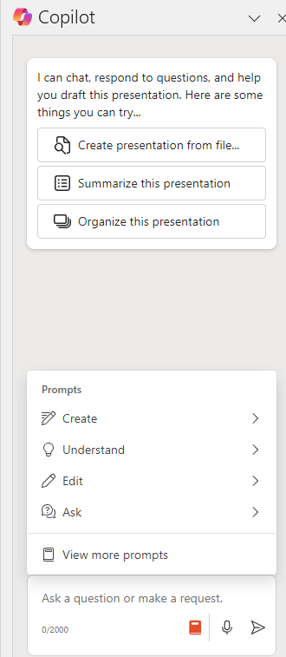
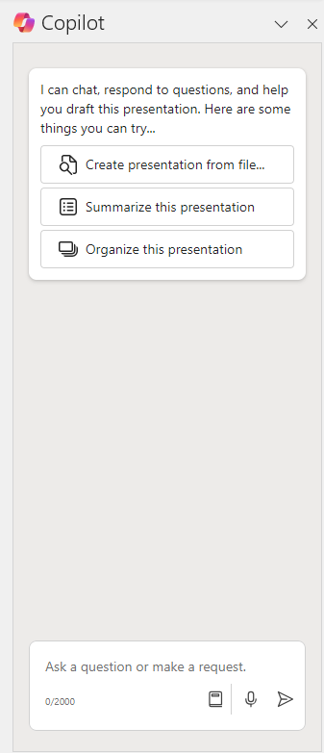
How to use: Copilot in PowerPoint Note the specific prompts shown may vary
Sample use cases
Turn an idea into a presentation
Turn a Word doc into a presentation
Improve an existing presentation
Prepare to give a presentation by summarizing key points and creating slide notes
Use the Copilot chat pane to
Create
Create a presentation from a description
Create a presentation from a Word document URL
Refine (Edit)
Add a slide about a topic
Add an image based on a description
Change the text format
Organize the presentation by adding an agenda and creating Sections
Summarize (Organize)
Create a summary
Show key slides – Provides a list of slides with important information
Discover (Understand)
Show action items and next steps
Ask questions about the presentation
Command (Ask)
Reformat text
Create a new slide
Select a predefined prompt in the Copilot sidebar. You can then add more context
Ask general knowledge questions or ask for creative ideas. You’ll need to review any content for factual mistakes
Click on the Prompt Guide icon
____ to show the prompts to edit a slide or learn about the presentation

Slide 74
Find more PowerPoint prompts to try in Copilot Lab
Add an agenda
Add images
Add a summary
Add a slide
Add an agenda slide
Add a relevant image to this slide
Add a slide that summarizes this presentation
Add a slide about [the benefits of meditation].
Get a head start
Generate ideas
Create presentations
Organize your thoughts
Create a presentation about [team icebreaker activities]
Create a presentation about how to [effectively volunteer for non-profit organizations] with a slide about impact
file
Create a new presentation based on file
Organize this presentation into sections
Rewrite this slide
Stay on track
Extract key information
Stay on track
Rewrite the slide to be more persuasive
Show action items
Summarize this presentation
What are the dates and deadlines mentioned in this presentation?

Slide 75
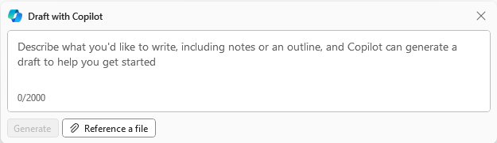
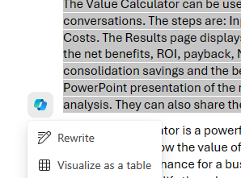
How to use: Copilot in Word in the document Note the specific prompts shown may vary
Sample use cases
Turn an outline or idea into text
Rewrite existing text for length, tone, new phrasing
Add tables based on the text
What can you do in the document
Draft with Copilot – Add content to the Word doc
Start from a blank page to create new content using Reference a file (up to 3 Word or PowerPoint files) or providing a topic for ungrounded content (ungrounded content will not necessarily be factual)
Add new content at any point using Inspire Me (to build on existing content), referencing a file for new grounded content, or providing a topic for ungrounded content (ungrounded content will not necessarily be factual)
Add suggested image (next to the title)
Put information into a table using Visualize as a table
Provide ideas or reference a file
Provide ideas, reference a file, or let Copilot write
Rewrite or add a table
Add an image

Slide 76
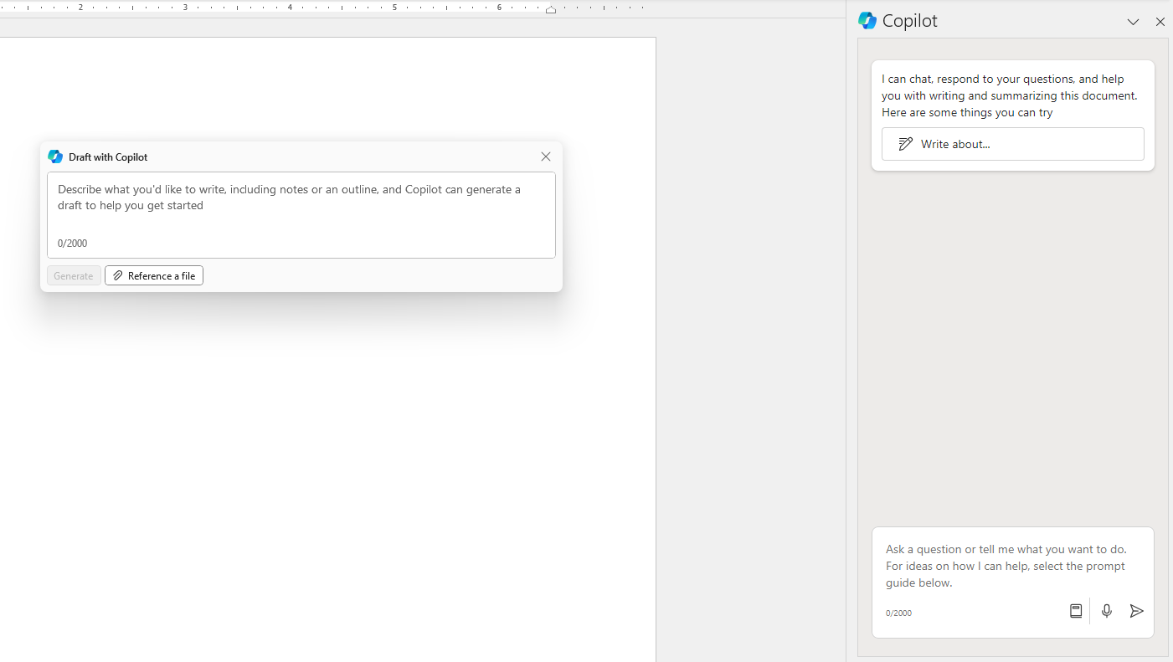
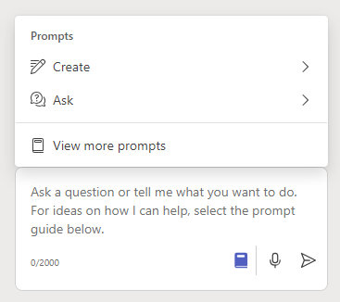
How to use: Copilot in Word in the Copilot chat pane Note the specific prompts shown may vary
Sample use cases
Rewrite existing text for length, tone, new phrasing
Summarize or answer questions about an existing document
Use the Copilot chat pane to
Create
Create a presentation from a description
Create a presentation from a Word document
Refine
Add a slide about a topic
Add an image based on a description
Change the text format
Organize the presentation by adding an agenda and creating Sections
Summarize
Create a summary
Show key slides – Provides a list of slides with important information
Show action items and next steps
Ask questions about the presentation
Command (Ask)
Ask general questions
Select a predefined prompt in the Copilot sidebar. You can then add more context.
Ask general knowledge questions or ask for creative ideas. You’ll need to review any content for factual mistakes
Click on the Prompt Guide icon
____ to show the prompts to edit a slide or learn about the presentation

Slide 77
Find more Word prompts to try in Copilot Lab
Write an introduction
Summarize this doc
List pros and cons
Add a paragraph
Write an intro paragraph for this document and make it sound [professional]
Summarize this document [in 3key points]
List the pros and cons of [the different project ideas mentioned in this document]
Add a paragraph that captures [the argument of this document]
Change the font
Create an overview
Outline a business plan
Take notes in a meeting
Change the font to [Segoe UI, 12point]
Create a high-level overview of [agile product development]
Draft a business plan outline for a [sustainable marketing company]
Draft a one-page template that I can use to take notes for a meeting. Include sections for the date and topic
Understand quickly
Brainstorm team building ideas
Improve this document
Write more confidently
Explain this document in three sentences
Give me ideas for icebreaker activities for a new team
Give me specific examples from this document on how I can improve it for [a leadership review?]
How can I more concisely describe [time management]?

Slide 78
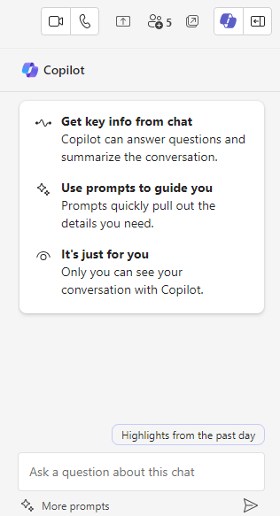
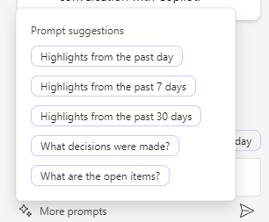
How to use: Copilot in Teams for chat Note the specific prompts shown may vary
Sample use cases
Catch up on a chat thread with a summary or by getting key points and action items
Draft a new chat entry in the thread
In the Teams chat window
Rewrite a draft and adjust for length and tone
Use the Copilot chat pane to
Ask questions about the content of the chat – does not work in Channels
Summarize over a period of time
Ask about decisions, open items, tasks
Ask what a specific person said
Ask about links
When creating a chat entry click on the Copilot icon
----to show the Rewrite and Adjust prompts when drafting a new chat
Click on the Prompt Guide icon
____ to show the prompts to edit a slide or learn about the presentation

Slide 79
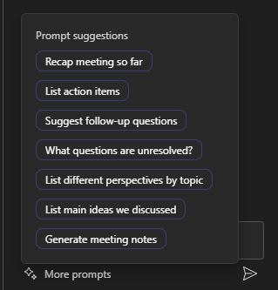
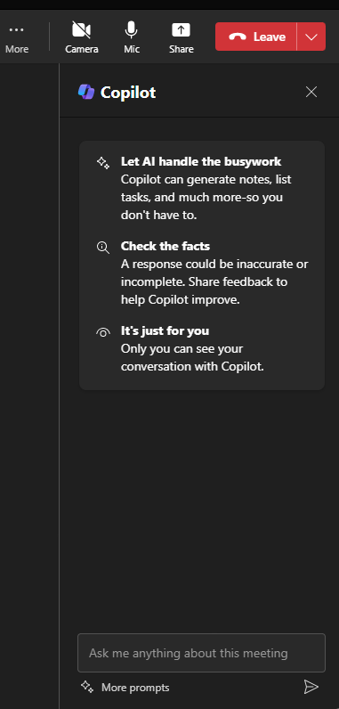
How to use: Copilot in Teams during a meeting Note the specific prompts shown may vary
Sample use cases
Get help during a meeting with a summary, key points, sentiment, or potential questions
Catch up on a meeting with a summary or by asking questions
Works during 1:1 and group calls, Meet Now, Scheduled private meetings, recurring meetings, Channel meetings
Use the Copilot chat pane to
Get a summary of the meeting so far
Key discussion points
Who said what or what people said
Where do people disagree
Suggest action items
Click on the Prompt Guide icon
__ to show the prompts to edit a slide or learn about the presentation

Slide 80
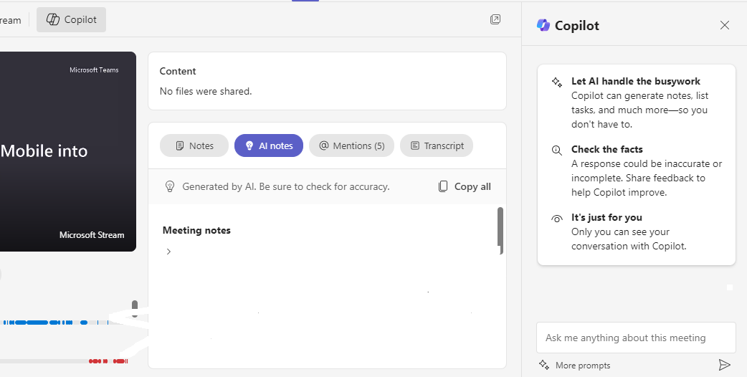
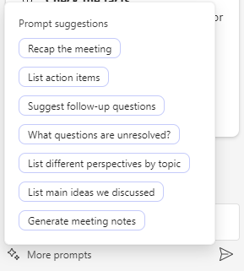
How to use: Copilot in Teams after a meeting Note the specific prompts shown may vary
Sample use cases
Catch up on a meeting with a summary or by asking questions
Works for scheduled meetings with a transcript (1:1 and group)
Use the Copilot chat pane on the Recap tab to
Recap the meeting
List action items
Follow up questions
Highlight the different perspectives on a topic
List main ideas
Click on the Prompt Guide icon
____ to show the prompts to ask questions about the meeting content

Slide 81
Find more Teams prompts to try in Copilot Lab
Find action items
Compare Ideas
What are the options?
List ideas
Are there any action items for me?
For each idea discussed, identify the pros and cons formatted as a table with 3 headers: idea, pros, cons.
Create a table of the options discussed with pros and cons
List 5 ideas discussed
Get the schedule
Get clarity
What decisions were made
Be prepared
List the key dates in a table
List the different opinions and suggest clarifying questions to ask for each
Did the team achieve consensus on a decision and what was it?
What are the goals and topics from the meeting? Format each section with a bolded heading, and bolded names
Keep meetings moving
Summarize meetings
What questions can the group ask to generate more ideas or insights? Limit each to 30-60 characters
Summarize what was discussed about

Slide 82
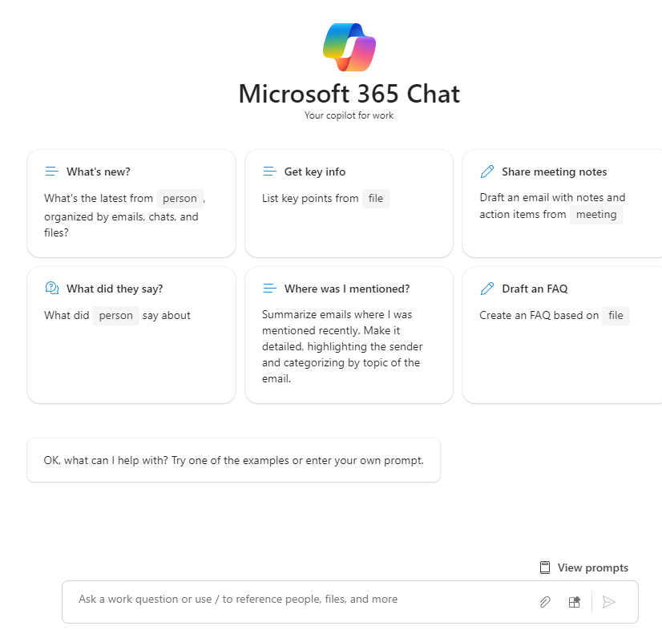
How to use: Copilot in Microsoft Copilot Note the specific prompts shown may vary
Your AI assistant for search and summarization
Search for important information from across the company
Catch up on or summarize content from a specific source or channel like a person, all Teams chat, or a meeting
Get updates on a project
Reference up to three items from files, meetings, people, and emails.
Use the Copilot chat pane to
Ask questions about Microsoft Graph content
Reference up to three items
Reference Word, PowerPoint, Excel, PDF files
Reference meetings, people, and emails
Ask general questions to Copilot
Click on the View Prompts to open Copilot LAB and see more suggestions

Slide 83
Find more Microsoft Copilot prompts in Copilot Lab
What's new?
Get key info
Catch up on meetings
Share meeting notes
person
file
meeting
What’s the latest from person , organized by emails, chats, and files?
List key points from file
Recap meeting summarizing key takeaways and actions items as separate sections including who’s responsible
Draft an email with notes and action items from meeting
meeting
What did they say
Where was I mentioned?
Draft an FAQ
Find open issues
person
file
What did person say about
Summarize emails where I was mentioned recently. Make it detailed, highlighting the sender
Create an FAQ based on file
What were the open issues from meeting ?
meeting
Write an intro
How to
List action items
Generate ideas
Propose a new introduction to file
How do I write a request for proposal?
What are the action items from meeting ?
List ideas for a fun remote team building event
file
meeting

Slide 84
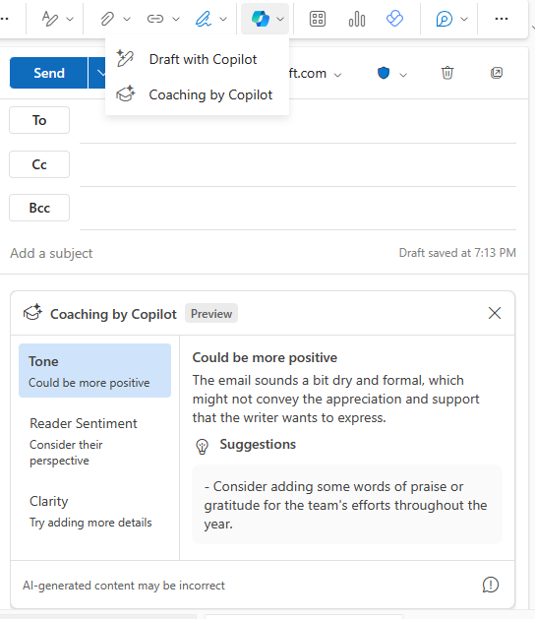
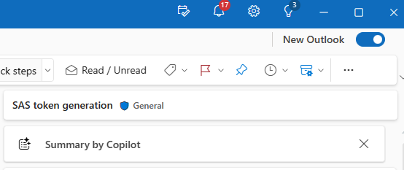
How to use: Copilot in Outlook Note the specific prompts shown may vary
Sample use cases
Catch up on an email thread with a summary or by getting key points and action items
Draft a new email or reply to a thread
Use the Copilot chat pane to
New Email
Draft with Copilot
Provide a topic or key points for a new email – Copilot can access information in the current thread
Select tone and length
Will revise an existing draft
Coaching by Copilot
Will provide suggestions on tone, sentiment, and clarity
Summary by Copilot
Get a summary of an email thread with citations
Have Copilot create a draft on a new topic or an existing thread.
Get suggestions from Copilot to improve your email.
At the top of each email. Generate a summary of the email or thread

Slide 85
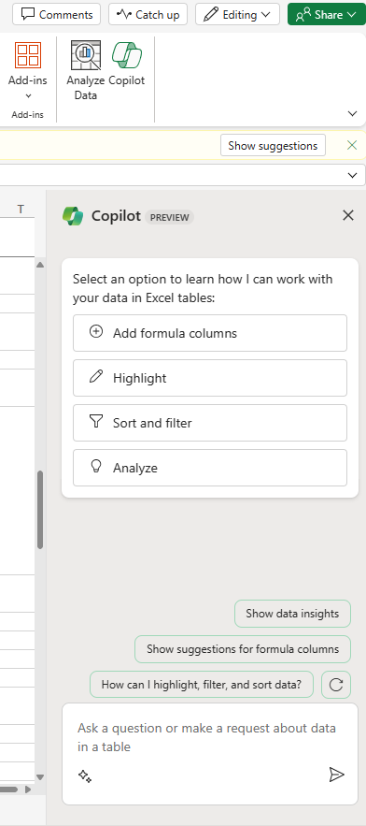
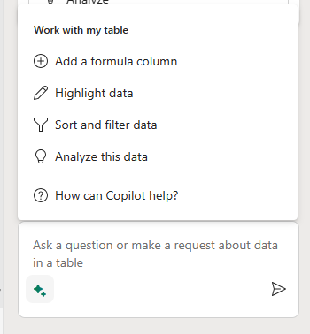
How to use: Copilot in Excel Note the specific prompts shown may vary
Sample use cases
Get help identifying trends or outliers
Create charts to highlight information
Use the Copilot chat pane to
Add formula columns – Describe what you want to do or use a suggestion
Add a row with a formula
Change text font or update cell color
Create a pivot chart
Highlight specific content
Filter and sort the data
Click on the Prompt Guide icon
____ to show the prompts to understand and manipulate data in a table

Slide 86
Thank You!

