Slide 1
Sleepless in Seattle No Longer
Joshua Reich*, Michel Goraczko,
Aman Kansal, and Jitu Padhye
Columbia University*, Microsoft Research

Slide 2
A Short Story: Sleepless in Seattle
A desktop machine
  Workdays: often used, sometimes idle
  Nights, holidays, weekends: often idle
    sometimes accessed remotely by user
    more often accessed by IT (patches, updates, scans)
But always powered on

Slide 3
A Short Story: Sleepless in Seattle
Why?
B/c its user and the IT dept want
  continuous remote availability
  seamless access (no fiddling w/ manual tools to wake machine)

Slide 4
This Story is Typical
Enterprise machines rarely sleep
  2/3^{rds} of office PCs are left on after hours*
  Or is it 95%? Power management disabled**
  600+ desktops always left on (of total 700+ )***
  Almost all desktop at MSR left on after hours
  [Your own stat or anecdote here]
  *Robertson et. al.: After-hour power status of office equipment and energy usage of plug-load devices.
  LBNL report #53729
  **Nordman, http://www.lbl.gov/today/2004/Aug/20-Fri/r8comm2.lo.pdf
  ***Agarwal et. al: Somniloquy, Augmenting network Interfaces to reduce PC energy usage (NSDI 2009)

Slide 5
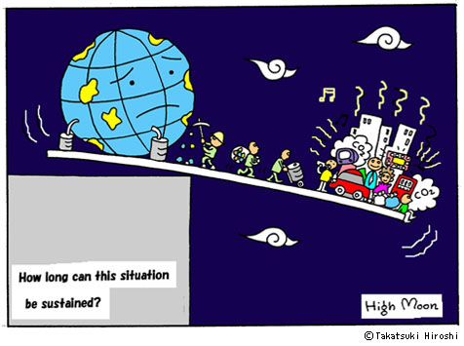
Wasteful Resource Consumption
Not a story with a happy ending
Unless we change things
This talk is about making one such change, focusing on practicality and economic feasibility

Slide 6
Outline
Problem
Sleep Proxy Architecture
Deployment & Instrumentation
Findings
Related Work and Next Steps

Slide 7
Outline
Problem
Sleep Proxy Architecture
Deployment & Instrumentation
Findings
Related Work and Next Steps

Slide 8
Back of Envelope Energy Waste
*Wolfram Alpha, 112.6 million service industry workers, let’s assume roughly 1/3rd have desktop machines for total of 40M enterprise desktops
If machine
  Draws 100W when awake
  Actually being used 50% of the time.
Then 400-500 kWh are wasted per year.
For Microsoft this is something like 40 GWh.
Over the entire US, on the order of 20 TWh!*

Slide 9
Sleep Proxies Can Help
A Sleep Proxy allows a machine to be
  network available
  while physically asleep

Slide 10
Reaction Policy
When machine sleeps, sleep proxy takes over, examines traffic, following a Reaction Policy
  Respond (e.g., ARP)
  Wake the sleep machine (e.g., remote login)
  Ignore (e.g., ICMP)
Reaction Policy choices determine
  Amount of potential sleep actually saved
  Co$t and complexity of sleep-proxying system

Slide 11



How a Network Sleep Proxy Works
WAN
Remote User
Remote Login
Work Payload
Wake Up!
Sleep notification
Send Traffic To Me
Client Machine
Send Traffic to Me
Remote Login Response
Sleep Proxy

Slide 12
Sleep Proxy Economics
The Type of Green Companie$ Really Care About
Single machine savings: only $60-$70 per year (though rising)
Now multiply by 40M enterprise desktops => $1-3 Billion* yearly savings, just in USA.
But for a single company – a couple of 100,000 to a couple of million $’s per year
*In line w/ Nordman report’s $0.8 – 2.7 Billion estimated savings.

Slide 13
The Bottom Line
Savings
  Very substantial in aggregate
  Relatively small for individual companies.
=> Sleep-proxying systems need to be cheap
  Low hardware cost
  Good consolidation ratio (#sleep proxies : #desktops)
  Low admin / setup cost

Slide 14

Sleep-Proxying Isn’t a New Idea
First suggested over a decade ago
  Christensen & Gulledge, 1998
Taken up again recently
  Allman, et al., Hotnets, 2007
  Agarwal, et al., NSDI, 2009
  Nedevschi, et al., NSDI, 2009
Two other great papers here at USENIX ATC
  LiteGreen, Das, et al. (Virtualization)
  SleepServer, Agarwal, et al., (Custom App Stubs)

Slide 15
Our Contributions
A design geared towards cheap hardware
  One dedicated machine per subnet (or less)
  Proxy can be run on a low power box
    Atom processor machine? No prob.
    Probably even wall-plug, Open/DDWRT style as well
And little work for IT
  Simple, lightweight client side install
  No client-side configuration or hardware changes
  Little admin or setup needed on proxy side

Slide 16
Our Contributions (cont.)
First operational enterprise deployment
  Likely where the biggest bang for the buck
  Home users tending to low power devices anyway
  Smaller # of desktops in academic-style networks
Provide insight on what sleep-proxied enterprise might actually look like
  Why machines are woken
  Why they stay awake
  Where our approach works well and falls short

Slide 17
Outline
Problem
Sleep Proxy Architecture
Deployment & Instrumentation
Findings
Related Work and Next Steps

Slide 18
Sleep-Proxying System Design Goals
Given normal workload, choose architecture and reaction policy
  No change to network applications
  Minimal client-side/network change, configuration
  Sleep proxies that
    Can be deployed on cheap, low power hardware (maybe even run on peers themselves)
    Can cover all clients in a subnet
    Close to zero-configuration /administration
Provide reasonable opportunity for sleep

Slide 19
Our Sleep-Proxying Design Principle
First 90% savings w/ 10% of the cost
90 / 10
*Tom Cargill, Bell Labs. Popularized by Jon Bentley in Communications of the ACM, Programming Pearls, 1985

Slide 20
Our Sleep-Proxying Design Principle
Leave final 10% savings, avoiding the other 90% of the cost
10 / 90
*Tom Cargill, Bell Labs. Popularized by Jon Bentley in Communications of the ACM, Programming Pearls, 1985

Slide 21
Our Sleep-Proxying System Design
Client side service (daemon)
  Sends sleep notifications
  Informs sleep proxy about all LISTENING ports
  Almost no resource consumption
  Uses native OS sleep policies
  User self-install from standard MSI (two clicks)
  No client-side configuration work for IT

Slide 22
Our Sleep-Proxying System Design
Sleep proxy reaction policy
  Respond: to IP address resolution traffic (e.g., ARP, Neighbor-Discovery)
  Wake: client on incoming TCP connection attempts (recognized by presence of SYN flag)
  Ignore: all other traffic

Slide 23
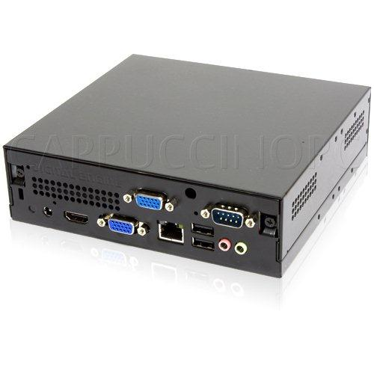
Design Benefits
No need to define policies determining for which applications clients should be woken
Great consolidation ratios
Low cost, low power, potentially peered, proxies
Practically no IT management/config req’d.
Digital Engine Mini PC

Slide 24
How Our Sleep Proxy Works
Subnet router
WAN
Remote User
TCP SYN
1.2.3.4:3389
TCP SYN
1.2.3.4:3389
WOL / Magic Packet
00:11:22:33:44:55 …
Sleep notification
00:11:22:33:44:55
1.2.3.4
Listing ports: 445, 3389
ARP Probe
00:11:22:33:44:55
1.2.3.4
Client Machine
ARP Probe
00:11:22:33:44:55
1.2.3.4
SYN-ACK
Sleep Proxy

Slide 25
Sample Wakeup Timeline
Remote User RU Client Machine CM Sleep Proxy SP
Step | Time | From → To | Packet Type | Note
1 | 0 | RU->(CM) SP | SYN
2 | 0.04 | RU->CM | Magic packet
3 | 3 | RU->(CM) SP | SYN | Retransmit
4 | 5.6 | CM->Bcast | ARP Probe | CM awake
5 | 9 | RU->CM | SYN | Retransmit
6 | 9.01 | CM->RU | SYN ACK
Save by having sleep proxy replay most recent TCP SYN
Notes:
(OPTIONAL)
Not too bad, but we can improve this

Slide 26
Outline
Problem
Sleep Proxy Architecture
Deployment & Instrumentation
Findings
Related Work and Next Steps

Slide 27
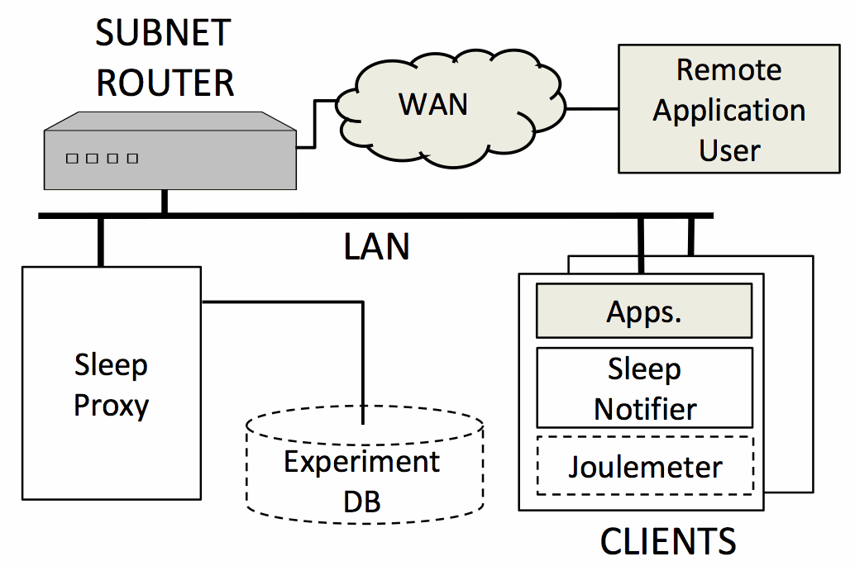
Deployment Architecture

Slide 28
Sleep-Proxying Subsystem

Slide 29
All Sleep Proxies Log Data to DB

Slide 30
Joulemeter:
Software-only power monitor Assess Source of Sleep Problems

Slide 31

Why Machines Lose Sleep
Crying baby syndrome:
  Sleeping machine (parent) woken often by remote clients (crying babies)
Identify by measuring
  How quickly machines wake after sleeping
  What traffic is waking them up and from whom
  What processes run immediately after wakeup
  Who places stay-awake requests with OS*
*POWERCFG /REQUESTS

Slide 32

Why Machines Lose Sleep
Application induced insomnia
  Machine won’t sleep b/c app requests
  e.g., media server, virus scanner
How does insomnia happen?
  WinAPI SetThreadExecutionState*
    ES_CONTINUOUS
    ES_SYSTEM_REQUIRED
  Have remote user hold file open on machine
Identify by measuring
  Who places stay-awake requests with OS
*http://msdn.microsoft.com/en-us/library/aa373208(VS.85).aspx

Slide 33
Deployment Stats
Sleep Proxies on 6 subnets in MSR Redmond
Sleep Clients running on 50+ machines
  Installed by users (two clicks)
  Most primary user workstations
  IT recommended
System in operation almost one year
~ 10 MWh saved (not bad for a research prototype)

Slide 34
Outline
Problem
Sleep Proxy Architecture
Deployment & Instrumentation
Findings
Related Work and Next Steps

Slide 35
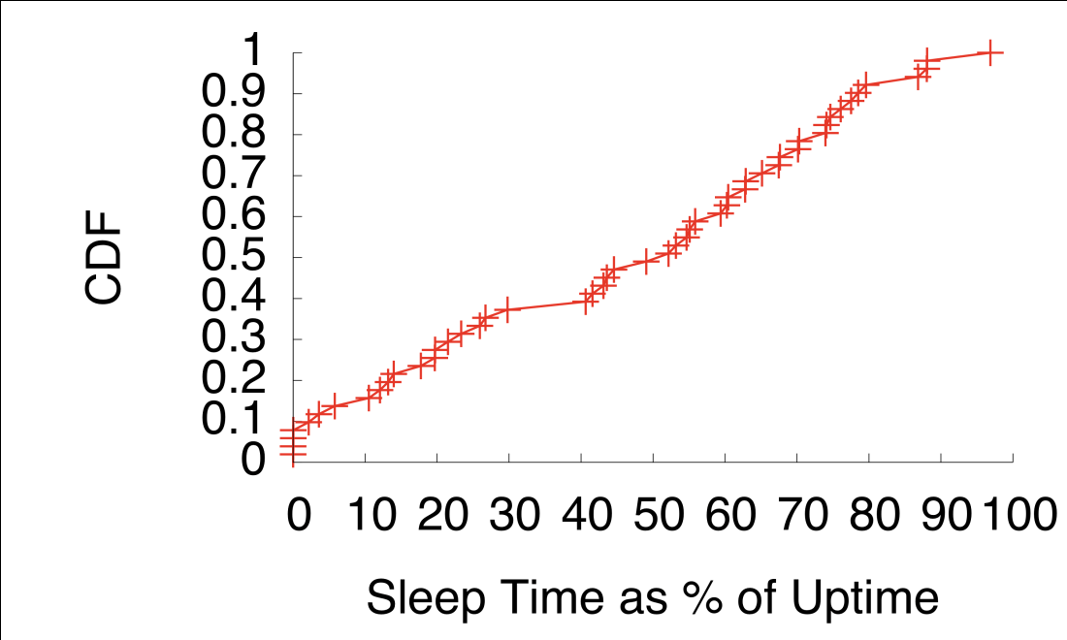
Sleep Savings
Most machines sleep most of the time
~20% machines sleep very poorly

Slide 36
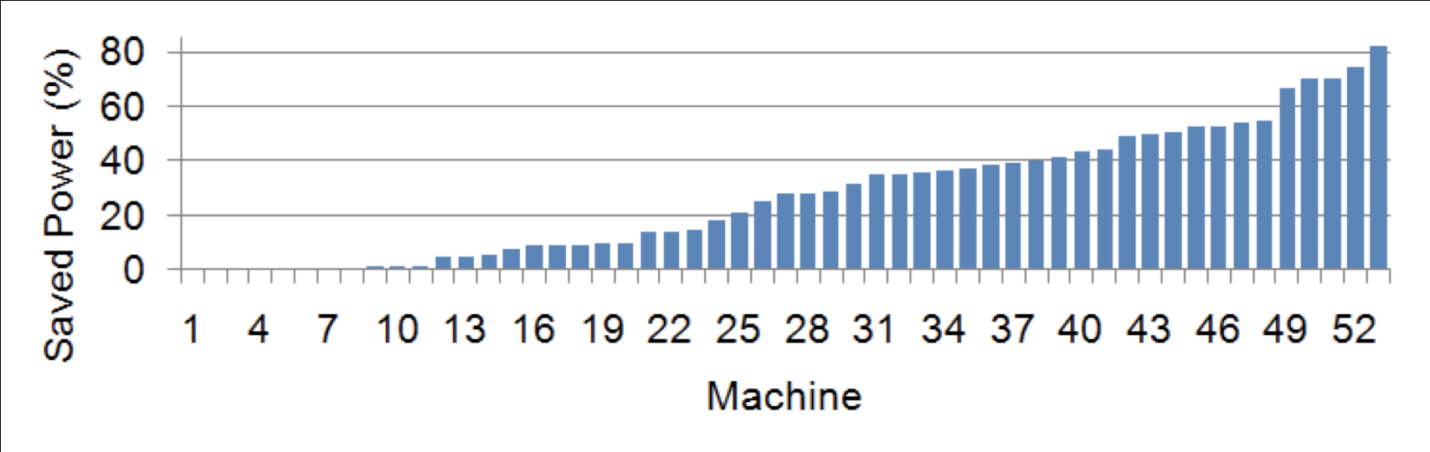
Energy Savings
Substantial power savings for many machines
Note: Saved Power is lower bound estimate.

Slide 37
Why Machines Lose Sleep
Crying baby syndrome
  Sleeping machine (parent) woken often by remote clients (crying babies)
Application induced insomnia
  Machine won’t sleep b/c app requests
  e.g., media server, virus scanner

Slide 38
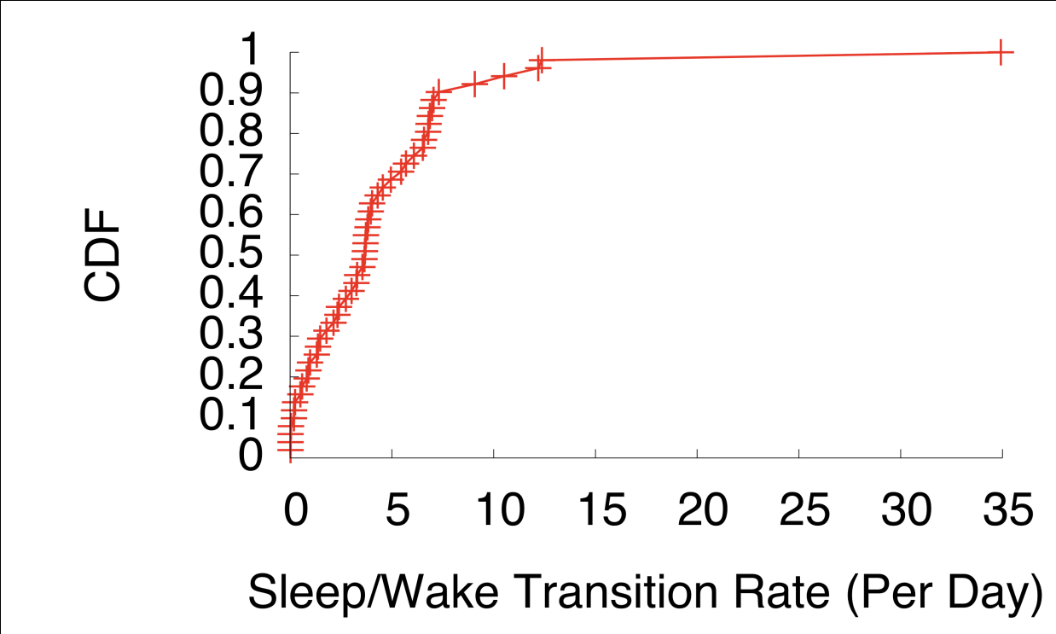
Impact of Crying Babies
~10% of lost sleep

Slide 39
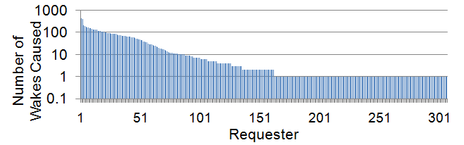
Who are the Crying Babies?
1. Small subset of remote machines (requesters) that cause lots of wake events

Slide 40
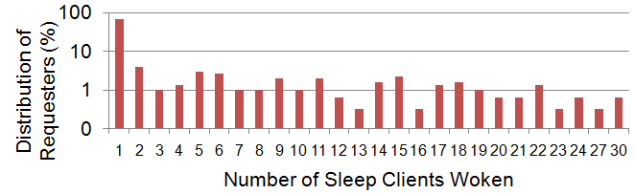
Who are the Crying Babies?
2. Small subset of remote machines (requesters) that wake lots of sleeping clients
Requestors mostly IT servers (e.g., virus scanners, patch server)

Slide 41
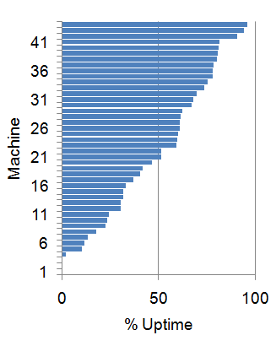
Impact of Insomnia
~90% of lost sleep

Slide 42
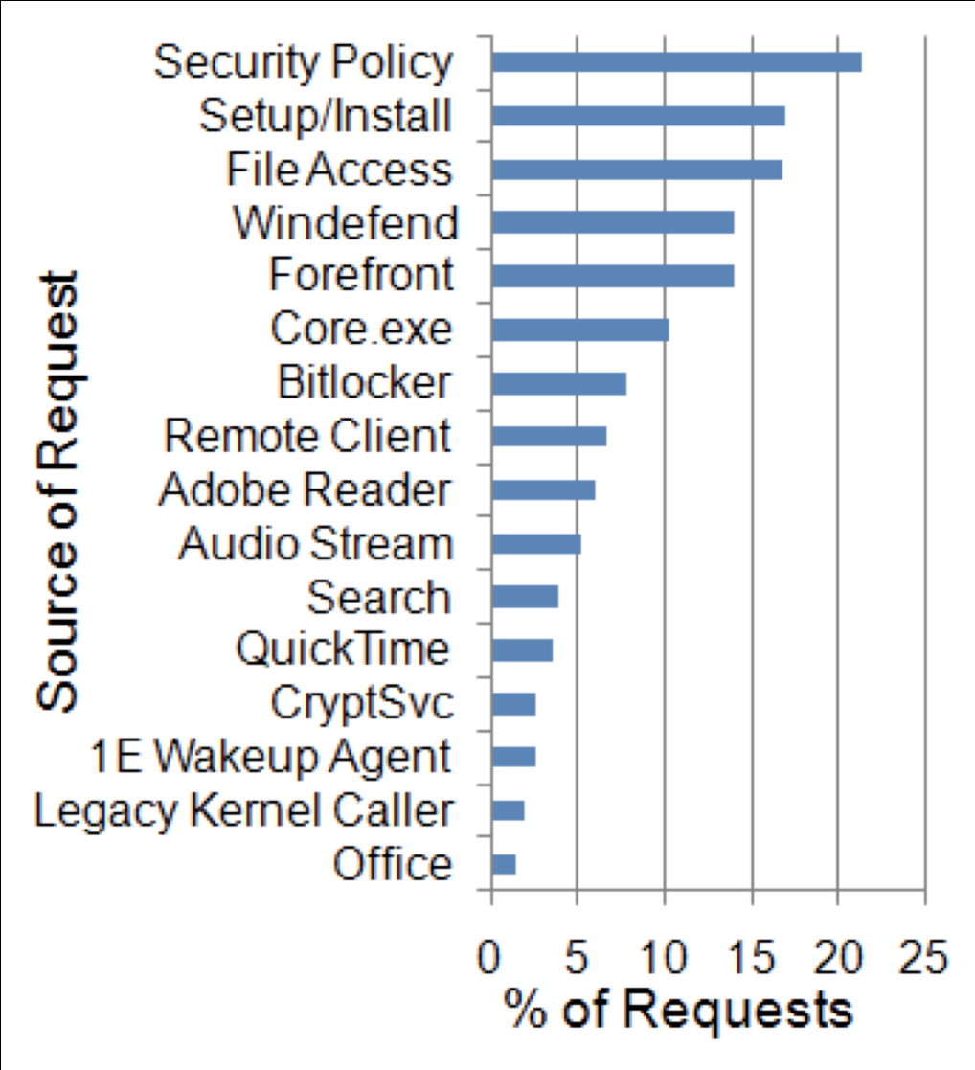
Who Causes Insomnia?
5 of top 7 are IT apps
Several caused by
  program bugs
  legacy drivers
Hard to improve via reaction policy w/o big expen$e
Many amenable to better coordination of IT tasks

Slide 43
Persistent Cloud Applications
Small minority used LiveMesh, LiveSync
We refer to these as persistent cloud apps
  Designed primarily to overcome NAT/firewall
Requires more sophisticated reaction policy
But, not used much in the enterprise
#Fail
Remote Login, Sync Operation
Persistent TCP
Cloud Server
TCP

Slide 44
Findings Summary
Relatively simple reaction policy can work well
  filter by port
  deal w/ tunneled packets, v4/v6, etc.
Insomnia foremost cause of lost sleep
IT main cause of both insomnia and crying baby
  Unclear cost effective reaction policy that can help
  But intelligent scheduling of IT tasks may help greatly
    Wake once, do everything, then sleep soundly
Greater complexity can be useful
  Persistent cloud apps (non-enterprise systems)
  BitTorrent, Skype, etc. (non-enterprise systems)
  Additional sleep opportunities (if economical)

Slide 45
Outline
Problem
Sleep Proxy Architecture
Deployment & Instrumentation
Findings
Related Work and Next Steps

Slide 46
Next Steps
P2P Sleep-Proxying (in progress)
Sleep-considerate IT app/server coordination
Lightweight support for persistent cloud apps
Change remote file access model

Slide 47
Us: Quick Overview
Reaction Policy:
  Wake on incoming TCP connections
Great consolidation ratio
  Unmodified server (1000’s)
  Low power box (100’s, maybe 1000’s)
  Peered proxy (100’s)
Almost no client change
  Daemon to send notification packets
  Client OS agnostic
Allows for lots of sleep in the enterprise

Slide 48
Comparison w/ SleepServer
Reaction Policy:
  Respond to stubbed apps
Good consolidation ratio (100’s)
  Unmodified server
Moderate client change
  Code, test, install stub-aware apps
  Transfer state / data
  Credential transfer (which can get complicated in enterprise)
Some additional sleep in enterprise, potentially more in non-enterprise settings

Slide 49
Comparison w/ LiteGreen
Reaction Policy:
  Respond to everything
  Except computational intense processes, local disk
Middling consolidation ratio (10’s)
  Powerful server + lots of RAM
Huge client-side / network changes
  Virtualize OS
  RDP even into local machine
  Move most locally stored data onto SAN/NAS
  Install Gigbit backbone (if you don’t have already)
A good deal more additional sleep opportunity (can deal w/ crying babies and even some IT apps)

Slide 50
Comparison w/ Other Work
LiteGreen
(Das, et. al)
SleepServer
(Agarwal, et. al.)
Us
(Reich, et al.)

Slide 51
Why Not Built-In NIC Capabilities?
Generality
  Old machines may not support patterns
  Complex network may require too many patterns
  Setting up pattern support may require
    Fiddling w/ BIOS, other system settings
    Non-uniform APIs
Extensibility
  Wake on swipe, GPS coordinates
Monitoring
Can discard dedicated hardware w/ P2P anyway
Notes:
(OPTIONAL)

Slide 52
Isn’t This Just Your Network?
Yes. We only have empirical evidence from our own deployment
But we believe other nets qualitatively similar
  Functionally similiar: security scans, patches, etc.
  Related work (e.g., Nedevschi 2009)
  Anecdotes from other researchers
Of course, we are in the process of verifying
  Let us know if you’d be interested in testing on your network!
Notes:
(OPTIONAL)

Slide 53
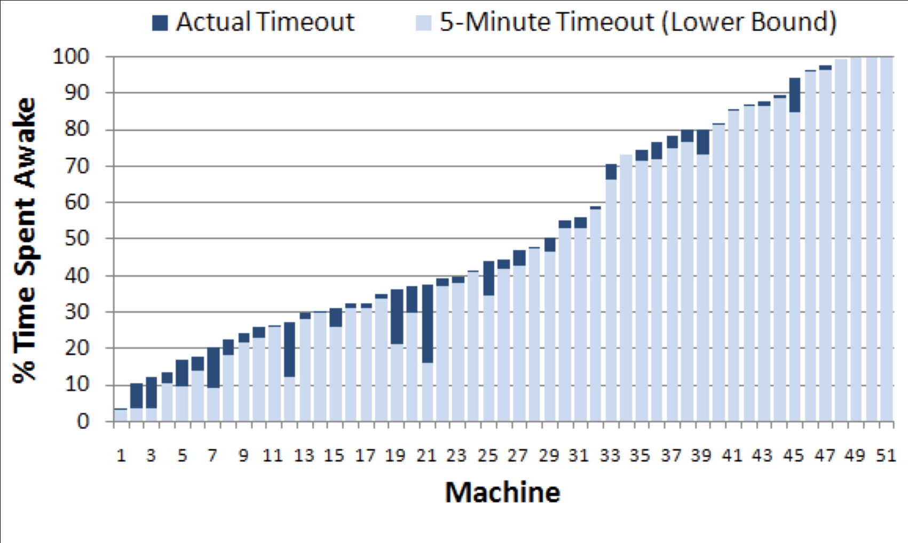
Aggressive idle Timeouts
Are of Secondary Effectiveness
Notes:
(OPTIONAL)

Slide 54
What Isn’t Novel
Suggesting a sleep proxy (1998)
Comparing reaction policies (2009)
Notes:
(OPTIONAL)

Slide 55
What is Novel
Build on previous work
  Adopt policy Nedevschi 2009 predicted best
  Improved on it to support dynamic apps
Focus on economic feasibility
Actually deploy in an operational environment
Learn lessons
  Insomnia is actually biggest problem
  Solution isn’t better reaction policies
Notes:
(OPTIONAL)

