Slide 1
ZIRIA
wireless PHY programming for hardware dummies
Gordon Stewart (Princeton), Mahanth Gowda (UIUC),
Geoff Mainland (Drexel), Cristina Luengo (UPC), Anton Ekblad (Chalmers)
Bozidar Radunovic (MSR), Dimitrios Vytiniotis (MSR)
Notes:
removeDC >>> do { ps <- detectCarrier
; channel

Slide 2
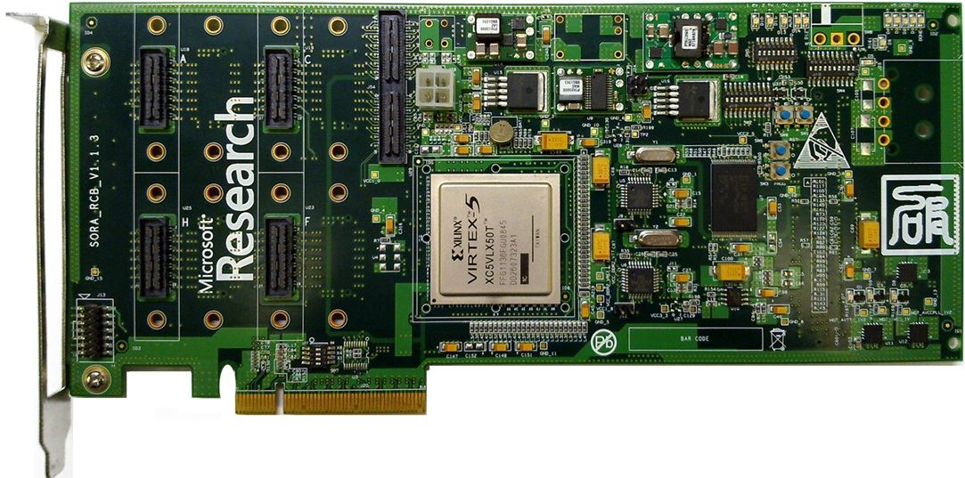
Programming software radios
Typical scenario:
RF + A/D sends samples through
PCI-express to CPU. All PHY/MAC processing done on CPU
Lots of recent innovation in PHY/MAC design
Communities: MobiCom, SIGCOMM
Software Defined Radio (SDR) platforms useful for experimentation and research
GNURadio (C/C++, Python) predominant platform
relatively easy to program, lots of libraries
slow; first real-time GNURadio WiFi RX in appeared only last year
SORA (MSR Asia): C++ library + custom hardware
lots of manual optimizations,
hard to modify SORA pipelines, shared state
A breakthrough: extremely fast code and libraries!

Slide 3
The problem
Essentially the traditional complaints against FPGAs …
Error prone designs, latency-sensitivity issues
Code semantics tied to underlying hardware or execution model
Hard to maintain the code, big barrier to entry
… become valid against software platforms too, undermining the very advantages of software!
Airblue [ANCS’10] offered a solution: a hardware synthesis platform that offers latency-insensitivity and high-level programmability
ZIRIA: similar goals for software implementations

Slide 4
SDR manual optimizations (SORA)
struct _init_lut {
void operator()(uchar (&lut)[256][128])
{ int i,j,k;
uchar x, s, o;
for ( i=0; i<256; i++) {
for ( j=0; j<128; j++) {
x = (uchar)i;
s = (uchar)j;
o = 0;
for ( k=0; k<8; k++) {
uchar o1 = (x ^ (s) ^ (s >> 3)) & 0x01;
s = (s >> 1) | (o1 << 6);
o = (o >> 1) | (o1 << 7);
x = x >> 1;
}
lut [i][j] = o; } } } }
Hand-written bit-fiddling code to create lookup tables for specific computations that must run very fast
… and more e.g. manual provision of dataflow pipeline widths

Slide 5
Another problem: dataflow abstractions
Predominant abstraction used (e.g. SORA, StreamIt, GnuRadio) is that of a “vertex” in a dataflow graph
Reasonable as abstraction of the execution model (ensures low-latency)
Unsatisfactory as programming and compilation model
Why unsatisfactory? It does not expose:
When is vertex “state” (re-) initialized?
Under which external “control” messages can the vertex change behavior?
How can vertex transmit “control” information to other vertices?
Events (messages) come in
Events (messages) come out

Slide 6
Example: dataflow abstractions in SORA
DEFINE_LOCAL_CONTEXT(TBB11aRxRateSel, CF_11RxPLCPSwitch, CF_11aRxVector );
template<TDEMUX5_ARGS>
class TBB11aRxRateSel : public TDemux<TDEMUX5_PARAMS>
{
CTX_VAR_RO (CF_11RxPLCPSwitch::PLCPState, plcp_state );
CTX_VAR_RO (ulong, data_rate_kbps ); // data rate in kbps
public:
…..
public:
REFERENCE_LOCAL_CONTEXT(TBB11aRxRateSel);
STD_DEMUX5_CONSTRUCTOR(TBB11aRxRateSel)
BIND_CONTEXT(CF_11RxPLCPSwitch::plcp_state, plcp_state)
BIND_CONTEXT(CF_11aRxVector::data_rate_kbps, data_rate_kbps)
{}
void Reset()
{
Next0()->Reset();
// No need to reset all path, just reset the path we used in this frame
switch (data_rate_kbps) {
case 6000:
case 9000:
Next1()->Reset();
break;
case 12000:
case 18000:
Next2()->Reset();
break;
case 24000:
case 36000:
Next3()->Reset();
break;
case 48000:
case 54000:
Next4()->Reset();
break;
}
}
Shared state with other components
Verbose, hinders fast prototyping
Implementation of component relies on dataflow graph!
Notes:
Fast prototyping in Blink better than in other SDR platforms

Slide 7
What is “state” and “control”: WiFi RX
Channel characteristics:
a control value
Payload modulation parameters:
A control value
Transmission detected:
a control value
Packet start
Channel info
DetectSTS
Channel Estimation
Invert Channel
Invert Channel
Packet info
Decode Header
Decode Packet
Detect if we have transmission:
Processing while updating internal state
Estimates the effects of the communication channel

Slide 8
A great opportunity to use functional programming ideas in a high-performance scenario
Better dataflow abstractions for capturing state initialization and control values
We identify an important gap: a lot of related work focuses more on efficient DSP (e.g. SORA, Spiral, Feldspar, StreamIt) and much less on control, but e.g. LTE spec is 400 pages with a handful (and mostly standardized) DSP algorithms
Better automatic optimizations

Slide 9
ZIRIA
A non-embedded DSL for bit stream and packet processing
Programming abstractions well-suited for wireless PHY implementations in software (e.g. 802.11a/g)
Optimizing compiler that generates real-time code
Developed @ MSR Cambridge, open source under Apache 2.0
www.github.com/dimitriv/Ziria
http://research.microsoft.com/projects/Ziria
Repo includes WiFi RX & TX PHY implementation for SORA hardware

Slide 10
ZIRIA: A 2-level language
Lower-level
Imperative C-like language for manipulating bits, bytes, arrays, etc.
Statically known array sizes
Aimed at EE crowd (used to C and Matlab)
Higher-level:
Monadic language for specifying and composing stream processors
Enforces clean separation between control and data flow
Intuitive semantics (in a process calculus)
Runtime implements low-level execution model
inspired by stream fusion in Haskell
provides efficient sequential and pipeline-parallel executions

Slide 11
ZIRIA programming abstractions
inStream (a)
inStream (a)
t
c
outControl (v)
outStream (b)
outStream (b)
A stream transformer t, of type:
ST T a b
A stream computer c, of type:
ST (C v) a b
* Types similar to (but a lot simpler than) Haskell Pipes

Slide 12
Control-aware streaming abstractions
inStream (a)
inStream (a)
t
c
outControl (v)
outStream (b)
outStream (b)
map :: (a -> b) -> ST T a b
repeat :: ST (C ()) a b -> ST T a b
take :: ST (C a) a b
emit :: v -> ST (C ()) a v

Slide 13
Data- and control-path composition
Drain-from-downstream semantics
(>>>) :: ST T a b -> ST T b c -> ST T a c
(>>>) :: ST (C v) a b -> ST T b c -> ST (C v) a c
(>>>) :: ST T a b -> ST (C v) b c -> ST (C v) a c
Reinventing a Swedish classic:
The “Fudgets” GUI monad
[Carlsson & Hallgren, 1996]
Composition along “control path”
(like a monad*)
Composition along “data path”
(like an arrow)
(>>=) :: ST (C v) a b -> (v -> ST x a b) -> ST x a b
return :: v -> ST (C v) a b
Like Yampa’s switch, but using different channels for control and data
Monad similar to Elliott’s Task monad [PADL’99]

Slide 14
Composing pipelines, in diagrams
Monadic ‘seq’ notation ☺
seq { x <- m1; m2 }
===
m1 >>= (\x -> m2)
C
T
c1
t2
seq { v <- (c1 >>> t1)
; t2 >>> t3
}
t1
t3

Slide 15
High-level WiFi RX skeleton
DetectSTS
Packet start
Channel Estimation
Channel info
Invert Channel
Invert Channel
Decode Header
Packet info
Decode Packet
let comp wifi_rx =
seq { pstart <- detectSTS()
; cinfo <- estimateChannel(pstart)
; pinfo <- invertChannel(cinfo) >>> decodeHeader()
; invertChannel(cinfo) >>> decodePacket(pinfo)
}

Slide 16
Plugging in low-level imperative code
let comp scrambler() =
var scrmbl_st: arr[7] bit := {'1,'1,'1,'1,'1,'1,'1};
var tmp,y: bit;
repeat {
(x:bit) <- take;
do {
tmp := (scrmbl_st[3] ^ scrmbl_st[0]);
scrmbl_st[0:5] := scrmbl_st[1:6];
scrmbl_st[6] := tmp;
y := x ^ tmp
};
emit (y)
}
Low-level imperative code
Lifted with “do”

Slide 17
CPU execution model
Every c :: ST (C v) a b compiles to 3 functions:
tick :: () → St (Result v b + NeedInput)
process :: a → St (Result v b)
init :: () → St ()
data Result v b ::= Skip | Yield b | Done v
Compilation task: compose* tick(), process(), init() compositionally from smaller blocks
* Actual implementation uses labeled blocks and gotos

Slide 18
Main loop
write b to output
tick()
Result v b
Skip
Yield(b)
Done(v)
NeedInput
read a from input
process(a)
write v to ctrl output

Slide 19
CPU scheduling: no queues
Ticking (c1 >>> c2) starts from c2, processing (c1 >>> c2) starts from c1
Reason: design decision to avoid introducing queues as result of compilation
Actually queues could be introduced explicitly by programmers,
… or as a result of vectorization (see later) but we guarantee that upon control transitions no un-processed data remains in the queues (which is on of the main reasons SORA pipelines are hard to modify!)
Ticking/processing seq { x <- c1; c2 } starts from c1; when Done, we init() c2 and start ticking/processing on c2

Slide 20
Optimizing ZIRIA code
Exploit monad laws, partial evaluation
Fuse parts of dataflow graphs
Reuse memory, avoid redundant memcopying
Compile expressions to lookup tables (LUTs)
Pipeline vectorization transformation
Pipeline parallelization
The rest
of the talk

Slide 21
Pipeline vectorization
Problem statement: given (c :: ST x a b), automatically rewrite it to
c_vect :: ST x (arr[N] a) (arr[M] b)
for suitable N,M.
Benefits of vectorization
Fatter pipelines => lower dataflow graph interpretive overhead
Array inputs vs individual elements => more data locality
Especially for bit-arrays, enhances effects of LUTs

Slide 22
Computer vectorization feasible sets
seq { x <- takes 80
; var y : arr[64] int
; do { y := f(x) }
; emit y[0]
; emit y[1]
}
Assume we have cardinality info: # of values the component takes and emits before returning (Here: ain = 80, aout = 2)
Feasible vectorization set:
{ (din,dout) | din `divides` ain,
dout `divides` aout }
e.g.
din = 8, dout =2
seq { var x : arr[80] int
; for i in 0..10 {
(xa : arr[8] int) <- take;
x[i*8,8] := xa;
}
; var y : arr[64] int
; do { y := f(x) }
; emit y[0,2] }
ST (C ()) int int
ST (C ()) (arr[8] int) (arr[2] int)

Slide 23
Impl. keeps feasible sets and not just singletons
seq { x <- c1
; c2
}
c1_v1 :: ST (C v) (arr[80] int) (arr[2] int)
c1_v2 :: ST (C v) (arr[16] int) (arr[2] int)
….
Well-typed choice:
c1_v1 and c2_v2
Hence: we must keep sets
c2_v1 ::ST (C v) (arr[24] int) (arr[2] int)
c2_v2 :: ST (C v) (arr[16] int) (arr[2] int)
….

Slide 24
Transformer vectorizations
Without loss of generality, every ZIRIA transformer can be treated as:
repeat c
where c is a computer
How to vectorize (repeat c)?

Slide 25
Transformer vectorizations in isolation
How to vectorize (repeat c)?
Why? It’s a TRANSFORMER,
it’s supposed to always have data to process
Let c have cardinality info (ain, aout)
Can vectorize to divisors of ain (aout) [as before]
Can also vectorize to multiples of ain (aout)
repeat {
(vect_xa : arr[8] int) <- take;
times i 2 {
times j 4 {
do { vect_ya[j] := f(vect_xa[i*4 + j]) }
}
emit vect_ya;
}
}
repeat { x <- take
; emit f(x)
}
ST T int int
ST T (arr[8] int) (arr[4] int)

Slide 26
Transformers-before-computers
ANSWER: No! (repeat c) may consume data destined for c2 after the switch
SOLUTION: consider (K*ain, N*K*aout), NOT arbitrary multiples˚
LET ME QUESTION THIS ASSUMPTION
(˚) caveat: assumes that
(repeat c) >>> c1 terminates when c1 and c have returned. No “unemitted” data from c
``It’s a TRANSFORMER,
it’s supposed to always have data to process’’
Assume c1 vectorizes to input (arr[4] int)
seq { x <- (repeat c) >>> c1
; c2 }
ain = 1, aout =1
QUIZ: Is vect. ST T (arr[8] int) (arr[4] int) correct?

Slide 27
Transformers-after-computers
ANSWER: No! (repeat c) may not have a full 8-element array to emit when c1 terminates!
SOLUTION: consider (N*K*ain, K*aout), NOT arbitrary multiples [symmetrically to before]
The danger of consuming more data or emitting less data when a shared variable changes is what makes SORA pipelines with manually provisioned queues harder to modify
Assume c1 vectorizes to output (arr[4] int)
seq { x <- c1 >>> (repeat c)
; c2 }
ain = 1, aout =1
QUIZ: Is vect. (ST T (arr[4] int) (arr[8] int) correct?

Slide 28
How to choose final vectorization?
In the end we may have very different vectorization candidates
Which one to choose? Intuition: prefer fat pipelines
Failed idea: maximize sum of pipeline arrays
Alas it does not give uniformly fat pipelines: 256+4+256 > 128+64+128
256
4
4
256
c1_vect
c2_vect
128
64
64
128
c1_vect’
c2_vect’
Notes:
How can this arise?
c1 is a computer that has 2 down vectorizations, (256,4) and (128,64)
And c2_vect is a transformer-after-computer that has ain = 2 and aout = 128
According to the rules in previous slide c2 can vectorize to: (1*2*2, 2*128) (c2_vect)
… or it can vectorize to: (32*1*2, 1*128)

Slide 29
How to choose final vectorization?
Solution: a classical idea from distributed optimization
Maximize sum of a convex function (e.g. log) of sizes of pipeline arrays
log 256+log 4+log 256 = 8+2+8 = 18 < 20 = 7+6+7 = log 128+log 64+log 128
Sum of log(.) gives uniformly fat pipelines and can be computed locally
256
4
4
256
c1_vect
c2_vect
128
64
64
128
c1_vect’
c2_vect’

Slide 30
Final piece of the puzzle: pruning
As we build feasible sets from the bottom up we must not discard vectorizations
But there may be multiple vectorizations with the same type, e.g:
Which one to choose? [They have same type (ST x (arr[8] bit) (arr[8] bit)]
We must prune by choosing one per type to avoid search space explosion
Answer: keep the one with maximum utility from previous slide
8
4
4
8
c1_vect
c2_vect
8
2
2
8
c1_vect’
c2_vect’

Slide 31
Vectorization and LUT synergy
let comp scrambler() =
var scrmbl_st: arr[7] bit :=
{'1,'1,'1,'1,'1,'1,'1};
var tmp,y: bit;
repeat {
(x:bit) <- take;
do {
tmp := (scrmbl_st[3] ^ scrmbl_st[0]);
scrmbl_st[0:5] := scrmbl_st[1:6];
scrmbl_st[6] := tmp;
y := x ^ tmp
};
emit (y)
}
let comp v_scrambler () =
var scrmbl_st: arr[7] bit :=
{'1,'1,'1,'1,'1,'1,'1};
var tmp,y: bit;
var vect_ya_26: arr[8] bit;
let auto_map_71(vect_xa_25: arr[8] bit) =
LUT for vect_j_28 in 0, 8 {
vect_ya_26[vect_j_28] :=
tmp := scrmbl_st[3]^scrmbl_st[0];
scrmbl_st[0:+6] := scrmbl_st[1:+6];
scrmbl_st[6] := tmp;
y := vect_xa_25[0*8+vect_j_28]^tmp;
return y
};
return vect_ya_26
in map auto_map_71
Vectorization
Automatic lookup-table-compilation
Input-vars = scrmbl_st, vect_xa_25 = 15 bits
Output-vars = vect_ya_26, scrmbl_st = 2 bytes
IDEA: precompile to LUT of 2^15 * 2 = 64K
RESULT: ~ 1Gbps scrambler

Slide 32
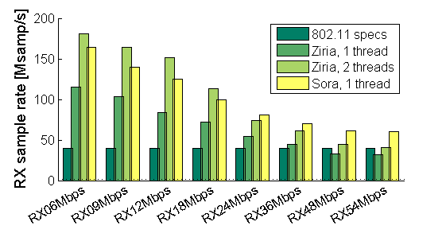
Performance numbers (RX)

Slide 33
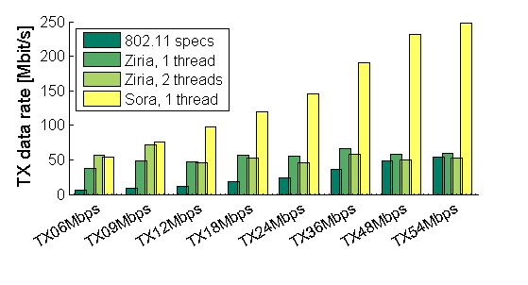
Performance numbers (TX)
More work to be done here, SORA much faster!

Slide 34
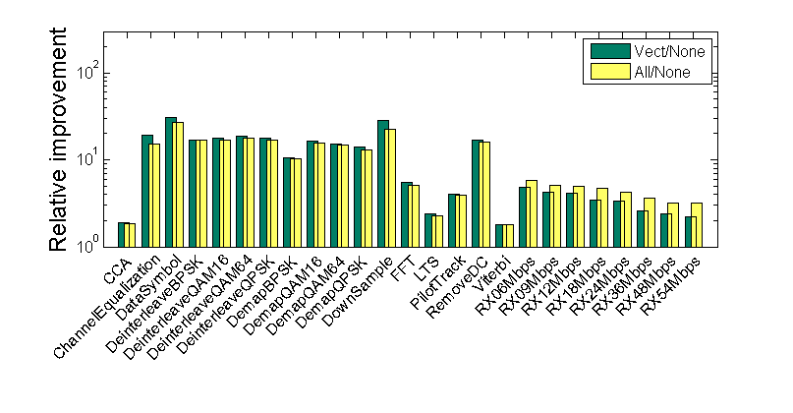
Effects of optimizations (RX)
Most benefits come from vectorization of the RX complex16 pipelines

Slide 35
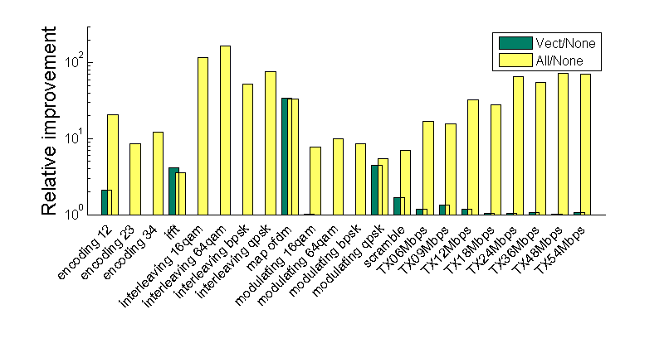
Effects of optimizations (TX)
Vectorization alone is slow (bit array addressing)
but enables LUTs!

Slide 36
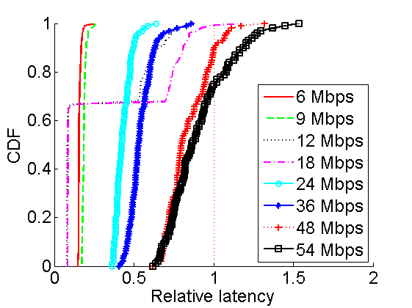
Latency (TX)
Methodology
Sample consecutive read/write operations
Normalize 1/data-rate
Result: largely satisfying latency requirements

Slide 37
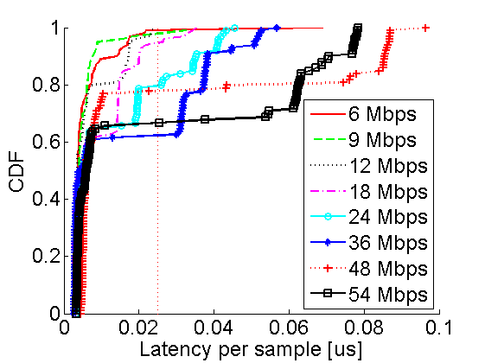
Latency (RX)
WiFi 802.11a/g requires SIFS ~ 16/10us, and 0.1 << 10
1/40Mhz = 0.024
Notes:
SIFS = short interframe space

Slide 38
Latency (conclusions)
Mostly latency requirements are satisfied
On top of this, hardware buffers amortize latency
Big/unstable latency would mean packet dropping in the RX: but we see ~ 95% packet successful reception in our experiments with SORA hardware

Slide 39
What’s next
Compilation to FPGAs and/or custom DSPs
A general story for parallelism with many low-power cores
A high-level semantics in a process calculus
Porting to other hardware platforms (e.g. USRP)
Improve array representations, take ideas from Feldspar [Chalmers], Nikola [Drexel]
Work on a Haskell embedding to take advantage of generative programming in the style of Feldspar and SPIRAL [CMU,ETH]

Slide 40
Conclusions
Although ZIRIA is not a pure functional PL:
Has design inspired by monads and arrows
Stateful components communicate only through explicit control and data channels => A lesson from taming state in pure functional languages
Strong types that capture both data and control channel improve reusability and modularity
… and they allow for optimizations that would otherwise be entirely manual (e.g. vectorization)
Putting functional programming (ideas) to work!

Slide 41
Thanks!
http://research.microsoft.com/en-us/projects/ziria/
www.github.com/dimitriv/Ziria

