Slide 1
Trust Me, I’m Partially Right
Incremental Visualization Lets Analysts Explore Large Datasets Faster
Danyel Fisher Steven Drucker
Microsoft Research
Igor Popov mc schraefel
University of Southampton

Slide 2
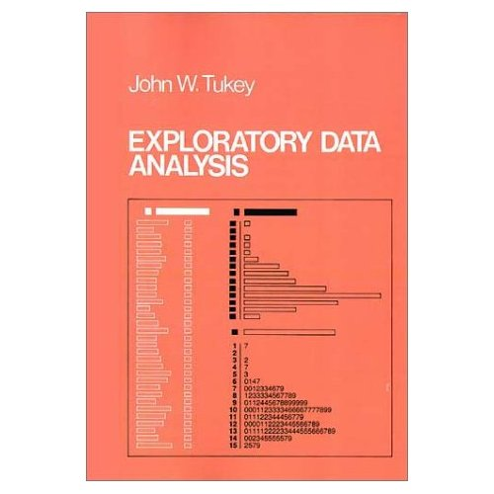
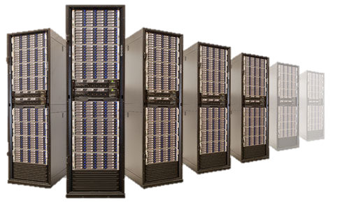
Notes:
I’m here to talk about exploratory data analysis, big data, and the places where they overlap.
In exploratory data analysis, the analyst gets to know a dataset. They may carry out multiple interactions, explore lots of different queries
They don’t necessarily know what they are asking until they ask it.

Slide 3
The Problem
Notes:
If you have a really big dataset, it takes far too long to do queries, get meaningful results, and visualize them

Slide 4
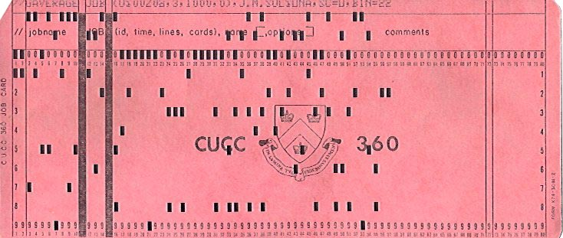
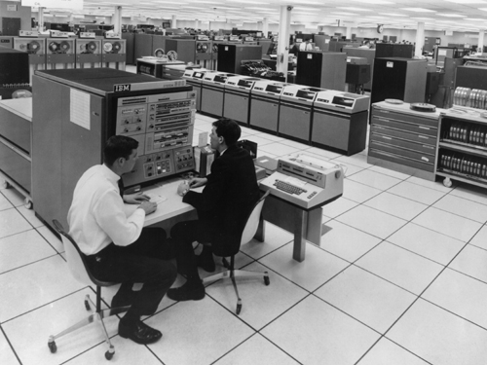
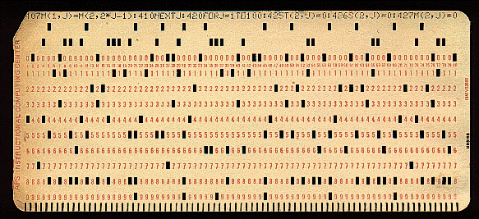
Notes:
We have a word for a room full of computers running overnight jobs
Punchcard.
And if there’s anything this conference isn’t meant to be, it’s punch-card overnight jobs

Slide 5
On Being Fast
Pre-Arrange the Data, and Be Exact
OLAP CUBE
Dremel, Sawzall, (Parallel) Column Stores
Get Approximate Answers, and Be Inexact
Adobe Insight
Infobright
Notes:
Olap cubes: spend a lot of time computing up front; visualize rapidly at the back. (If you ask a question the system isn’t ready for, you’re dead)
DREMEL: Expensive; ever-larger datasets
Adobe Insight:

Slide 6
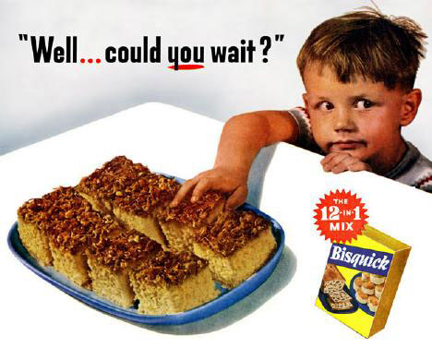
Trade accuracy for latency
100%
Online
☺
Traditional
Time
Image adapted from Hellerstein
Notes:
I don’t have to explain the virtues of interactivity to a CHI audience

Slide 7
Progressive Computation
Joe Hellerstein (Berkeley)
Chris Jermain (Rice)
Chris Olston (Stanford)
Notes:
Progressive / Incremental / Online Analysis
An open problem in the database world
CONTROL
[Hadoop Online] => [HStreams]
It’s not actually easy – but it does seem to be doable, at least for lots of interesting cases

Slide 8
This is a bad idea
I want to know the right answer
I don’t understand error bars
Why show me incomplete data?

Slide 9
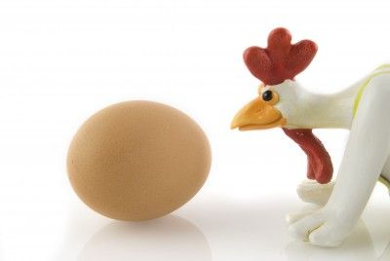
So why not?
Notes:
Chicken and egg issue here.
Database people don’t’ really see the user-side demand
Interface people don’t build interfaces for back-ends that don’t exist

Slide 10
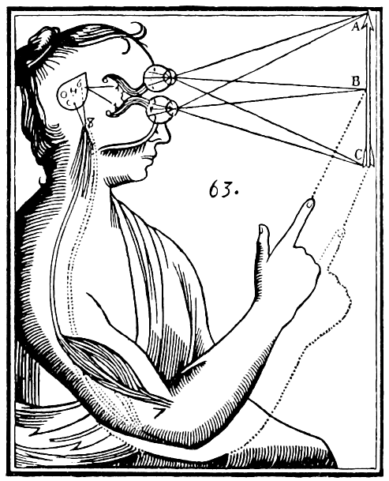
Let’s test it.
Sadly, it’s hard to build a scaled-out progressive query system.
Notes:
Let’s Test It!
Build a prototype
Put it in front of users
But wait! It’s hard to build an incremental database system.

Slide 11
Contribution
Methodology for approximating the front-end experience,
Observations of user behavior and preliminary feedback.
But not …
the idea of a bar chart with confidence bounds

Slide 12
sampleAction

Slide 13
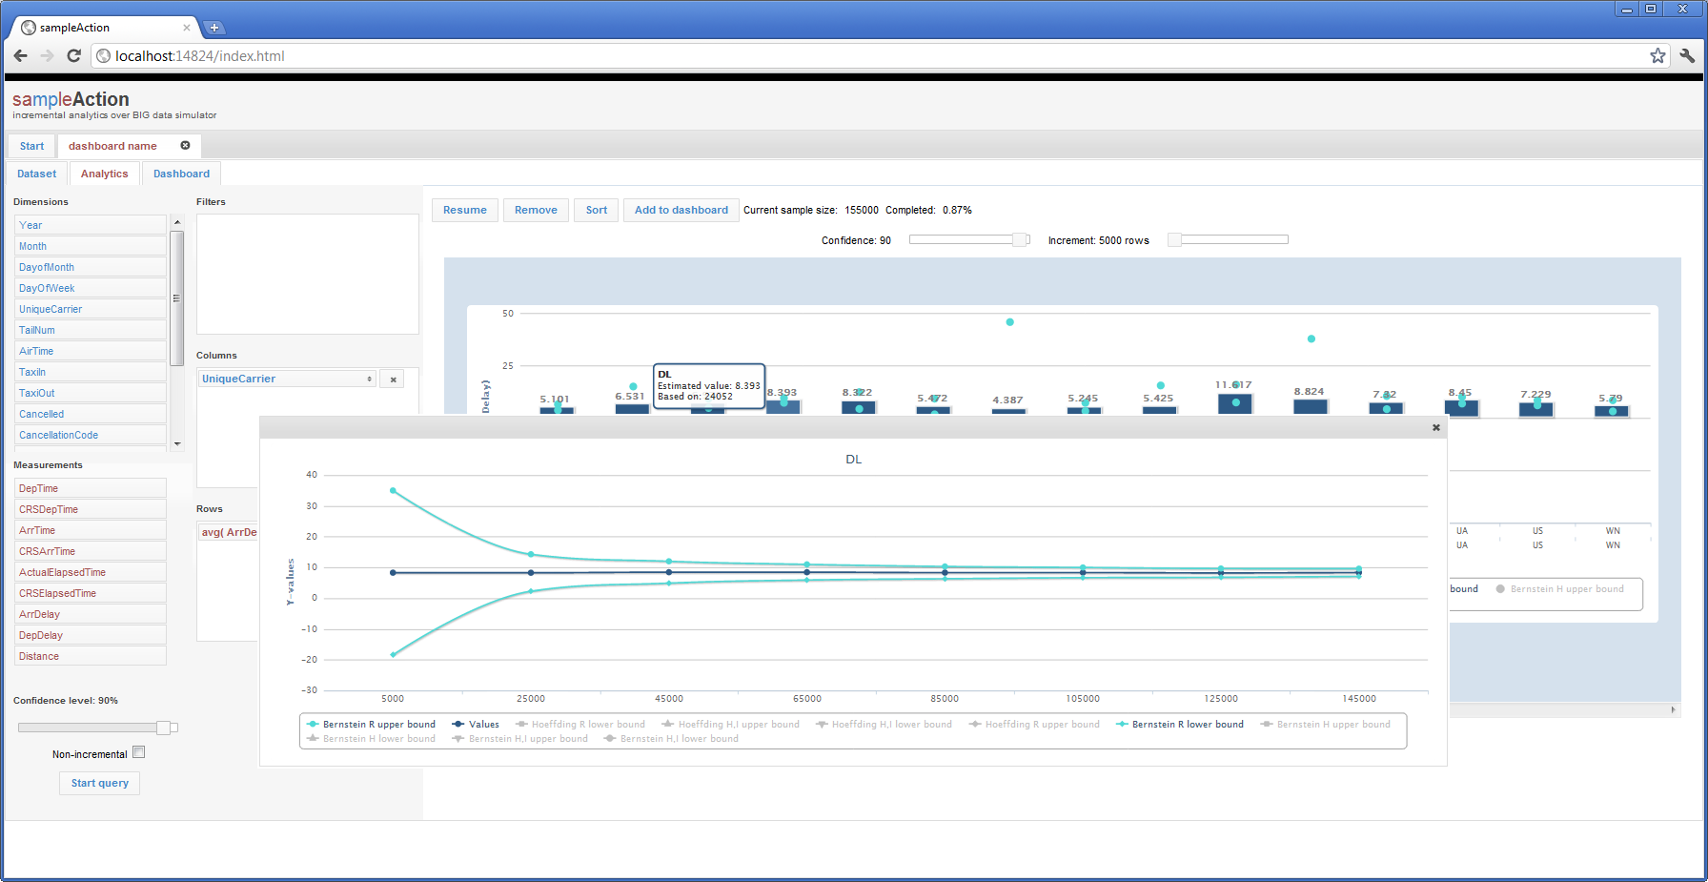

Slide 14
Animate over the top:
BACK END:
Small dataset
Take all the data rapidly
Aggregate results
FRONT END:
Present results
Schematic drawing:
BACK END:
Big Dataset
Take Samples rapidly
Aggregate results
FRONT END:
Present results
Small Database
Big Dataset Management System
Take Samples Rapidly
Aggregate Results and compute error
Present Front-End
Take Increasingly-Large Samples

Slide 15
Computing Confidence Bounds
Different methods, one core insight
$$bounds \sim \frac{variance}{\sqrt{samples}}$$

Slide 16
Good For
Bad For
Aggregate Queries
Randomized Data
Big single table
Slow datasets
Far away on a network
Slow to process an item
Sparse items
Finding Outliers
Ordered Data
Complex joins
Indexed datasets

Slide 17
CAVEATS
Pre-randomized data
Lots of different algorithms for choosing bounds
Sample size gets much smaller as soon as you have a Join
Not truly independent samples

Slide 18
User Study
Three Stories from people with big data at Microsoft
Loaded system with (a sample of) their real data
Recorded interviews with screen capture

Slide 19
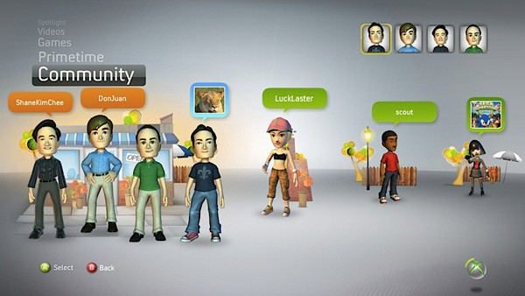
Alan

Slide 20
Games
Per-player gamer behavior on Xbox live
Game (title, developer) Nationality (region, country) Age
Duration of play Frequency
“I ran this query yesterday. Does your system show the same thing?”
Asked new questions that he hadn’t been able to before
“I know FIFA Soccer is more popular in Brazil than South Africa. But are the players older?”

Slide 21
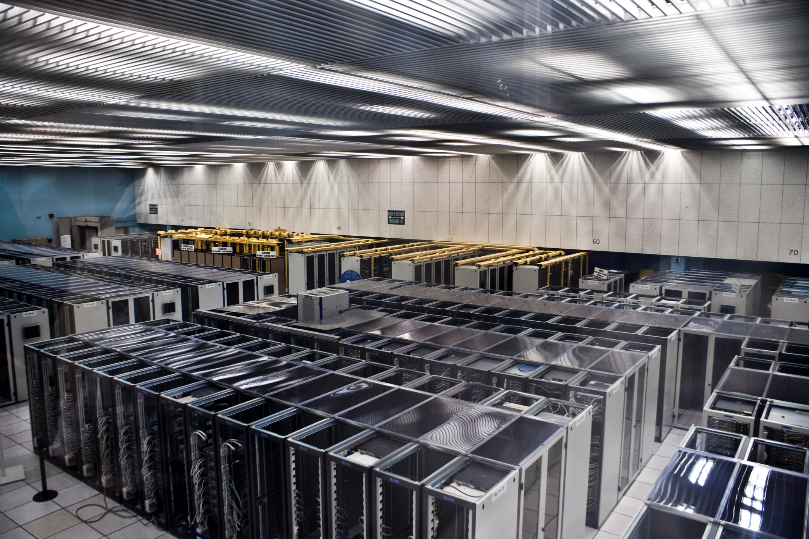
Bob

Slide 22
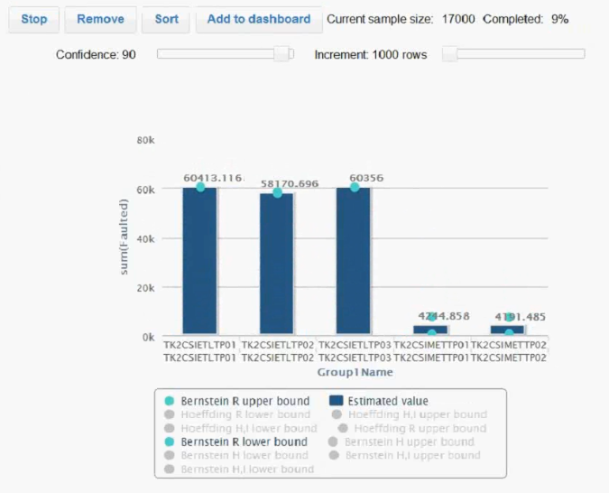
Server Farm
Server faults on back-end servers
Date Log entry # Fault type Server name
Frequency
“Ok, we’ll stop that, and we’ll change over to the right variable this time.”
Rejected failed hypotheses rapidly
“The errors are high, but consistent across machines. The pile of errors we’re seeing is a site-wide issue, not a machine issue.”

Slide 23
Sam

Slide 24
Twitter Emotions
Emotional terms found in a Twitter feed (preprocessed)
Date Word appear in “Negative” list? Word appear in “Positive” list?
Frequency
What keyword filters will have a good distribution of emotions?
“The statistician in me is saying, I want to let this run a little longer before I make a total judgment call on these two sets.”
“I didn’t actually know before that ‘hate’ was so dominant.”
Traded time for accuracy

Slide 25
What We Learned
Users made lots of mistakes
Users carried out lots of queries
…and cut them off early
Users were fearless about exploration

Slide 26
What Exploration Looks Like
Queries become low cost
Do not check
Try, watch it fail, fix, and try again
Compare multiple queries
Most numbers are rough

Slide 27
Were Error Bars a Bad Idea?
Confidence intervals narrow with two different things:
Variance of samples
Frequency of samples
Not obvious to all users at first that it would converge

Slide 28
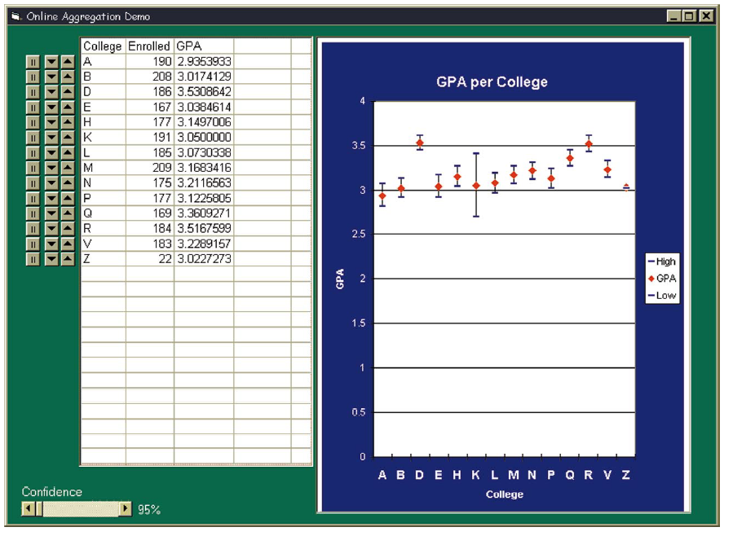
How big are confidence intervals?
max-min = 50
max-min = 5000
Notes:
Some approximate ranges can be ORDERS OF MAGNITUDE bigger than others! Scaling & visualization are really important

Slide 29
Next Steps
Other representations of uncertainty could yield different behavior
Add comparison
More analytics

Slide 30
What if we’re wrong?
Uncertainty swamps data
Convergence is incorrect
Potential study: Manipulate failures in order to test user behavior
(Thanks, reviewers!)

Slide 31
Call To Action
With interactive feedback, users can
Ask more questions
Explore more data
Come to novel results
Users are willing to trade accuracy for time
Database people: Build it!
HCI people: Give it a UX!

Slide 32
Thanks & Questions
SQL Power View team, who posed the question initially
Mary Czerwinski (VIBE)
Christian Konig (eXtreme Computing Group)
Anonymous Reviewers
By the way:
A group at MSR is looking for a specialist in human-interfaces for machine learning.

