Slide 1
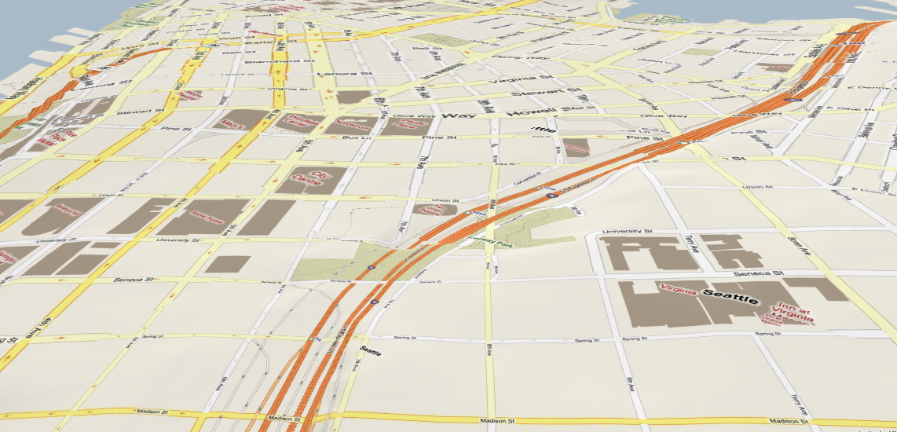
Driving with Knowledge from the Physical World
Jing Yuan, Yu Zheng
Microsoft Research Asia

Slide 2
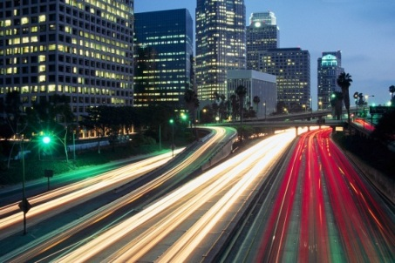

What We Do
Finding the customized and practically fastest driving route for a particular user using
  (Historical and real-time) Traffic conditions
  Driver behavior (of taxi drivers and end users)
Physical Routes
Traffic flows
Drivers

Slide 3

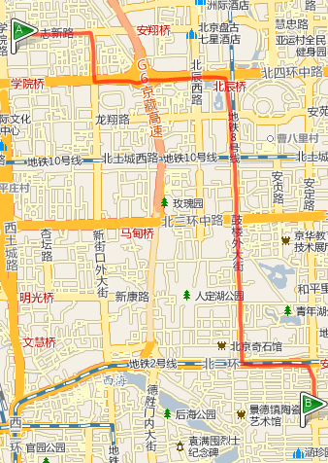
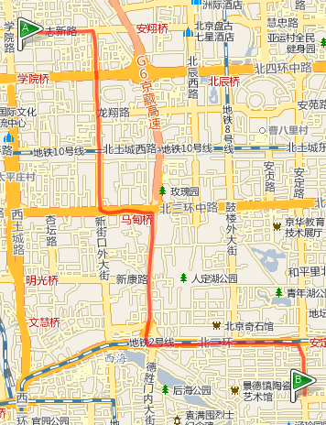
Application Scenarios
Driver A
Driver A
Driver B
8:30
13:20
13:20

Slide 4
Application Scenarios
Driver B
Driver B
13:20
13:20
Log user B’s driving routes for 1 month

Slide 5
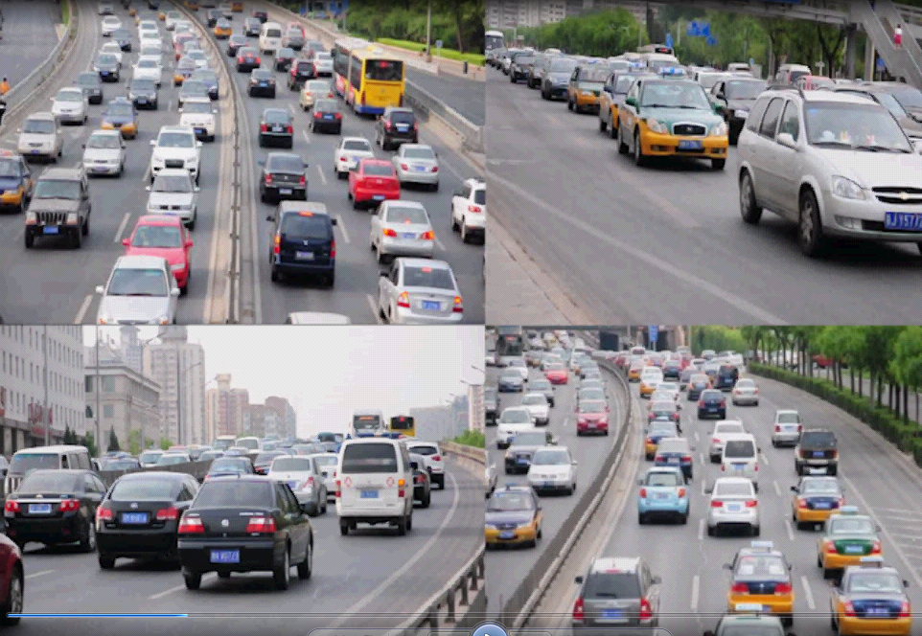
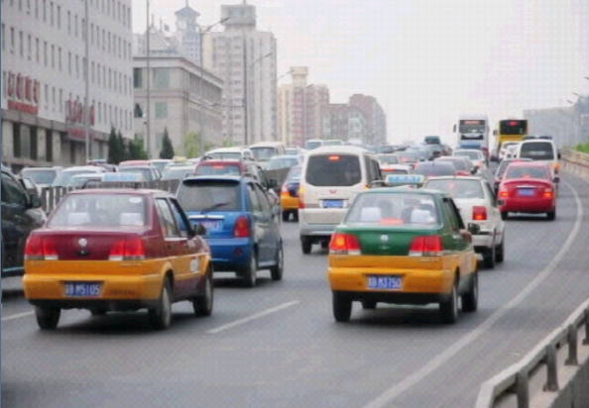

Slide 6







Motivation
Taxi drivers are experienced drivers
GPS-equipped taxis are mobile sensors
Human Intelligence
Traffic patterns

Slide 7
Rank | Cities | Country/Region | Taxicabs
1 | The Mexico city | Mexico | 103,000+
2 | Bangkok | Thailand | 80,000+
3 | Seoul | South Korea | 73,000+
4 | Beijing | China | 67,000
5 | Tokyo | Japan | 60,000
6 | Shanghai | China | 50,000+
7 | New York City | USA | 48,300
8 | buenos aires | Argentina | 45,000
9 | Moscow | Russia | 40,000 (1000,000)
10 | St.Paul | Brazil | 37,000
11 | Tianjin | China | 35,000
12 | Taipei | Taiwan | 31,000+
13 | New Taipei City | Taiwan | 23,500
14 | Singapore | Singapore | 23,000
15 | Osaka | Japan | 20,000
16 | Hong Kong | China | 18,000+
17 | Wuhan | China | 18,000
18 | London | England | 17,000
19 | Harbin | China | 17,000
20 | Guangzhou | China | 16,000+
21 | Shenyang | China | 15,000+
22 | Paris | France | 15,000

Slide 8
What We Do
A time-dependent, user-specific, and self-adaptive driving directions service using
  GPS trajectories of a large number of taxicabs
  GPS log of an end user
Physical Routes
Traffic flows
Drivers

Slide 9
System Overview
0

Slide 10
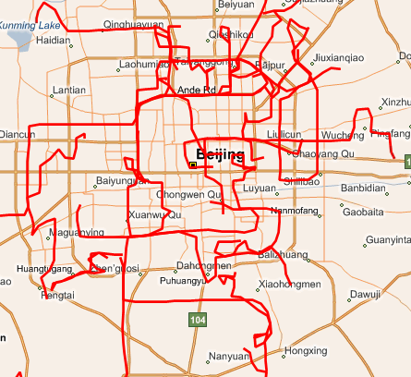
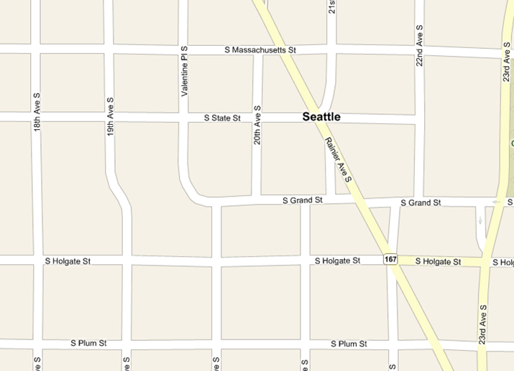




Offline Mining
Building landmark graphs
Mining taxi drivers’ knowledge
Challenges
  Intelligence modeling
  Data sparseness
  Low-sampling-rate

Slide 11
Offline Mining
Building landmark graphs

Slide 12
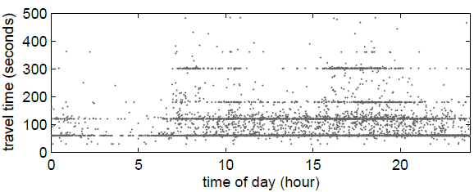
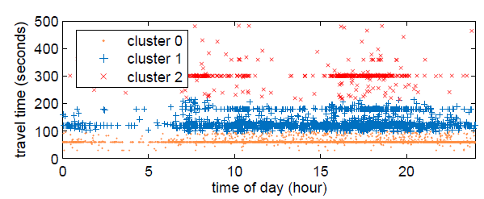
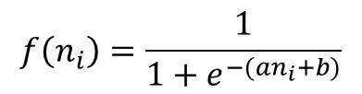
Mining Taxi Drivers’ Knowledge
Learning travel time distributions for each landmark edge
  Traffic patterns vary in time on an edge
  Different land edges have different distributions
Differentiate taxi drivers’ experiences in different regions
Sigmoid learning curve
$$f\left(n_{i}\right)=\frac{1}{1+e^{−(an_{i}+b)}}$$

Slide 13
System Overview

Slide 14
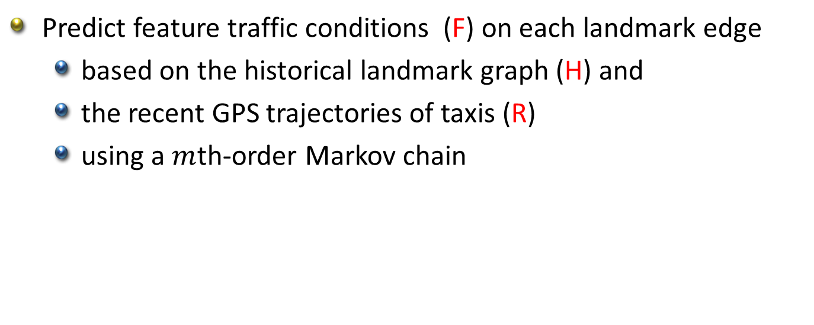
Online Inference
Predict feature traffic conditions (F) on each landmark edge
  based on the historical landmark graph (H) and
  the recent GPS trajectories of taxis (R)
  using a $m$th-order Markov chain
Notes:
Overview the online inference
Brief the figure
Motivation of using mth-order Markov Chain.

Slide 15
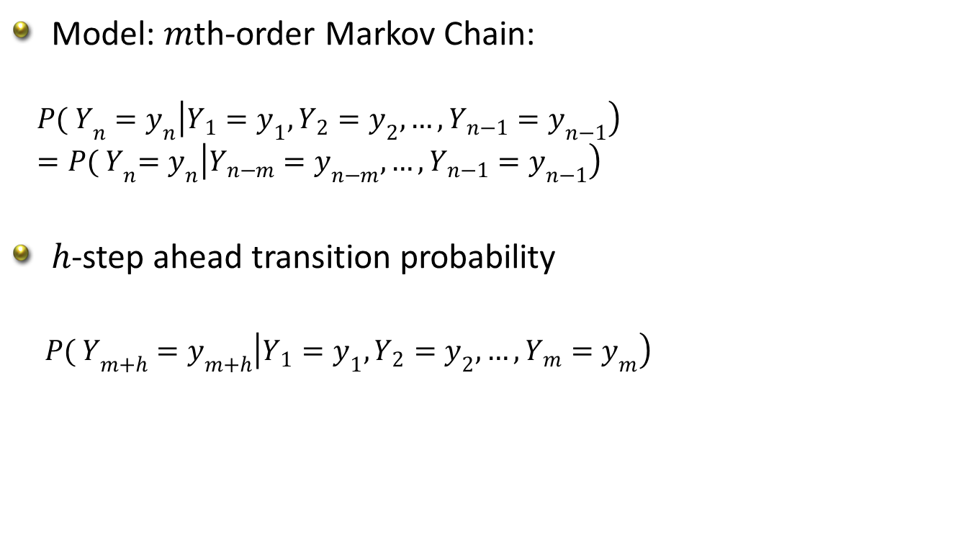
Online Inference
Model: $m$th-order Markov Chain:
$${P( Y}_{n}=y_{n}\left|Y_{1}=y_{1},Y_{2}=y_{2},…,Y_{n−1}=y_{n−1}\right)$$
$${ =P( Y}_{n}=y_{n}\left|Y_{n−m}=y_{n−m},…,Y_{n−1}=y_{n−1}\right)$$
$h$-step ahead transition probability
${P( Y}_{m+h}=y_{m+h}\left|Y_{1}=y_{1},Y_{2}=y_{2},…,Y_{m}=y_{m}\right)$
Notes:
Time consuming

Slide 16

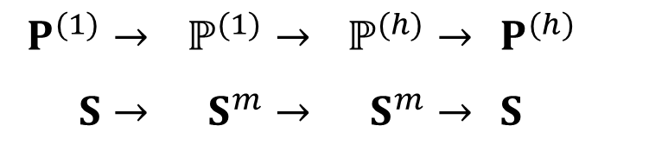
Online Inference
High dimensional embedding
Advantage: $ℙ^{(h)}$ and $Ρ^{(h)}$ can be calculated online ($h>$1)
$$Ρ^{(1)}→$$ | $$ℙ^{(1)}→$$ | $$ℙ^{(h)}→$$ | $$Ρ^{(h)}$$
$$S→$$ | $$S^{m}→$$ | $$S^{m}→$$ | $$S$$

Slide 17
System Overview
0

Slide 18
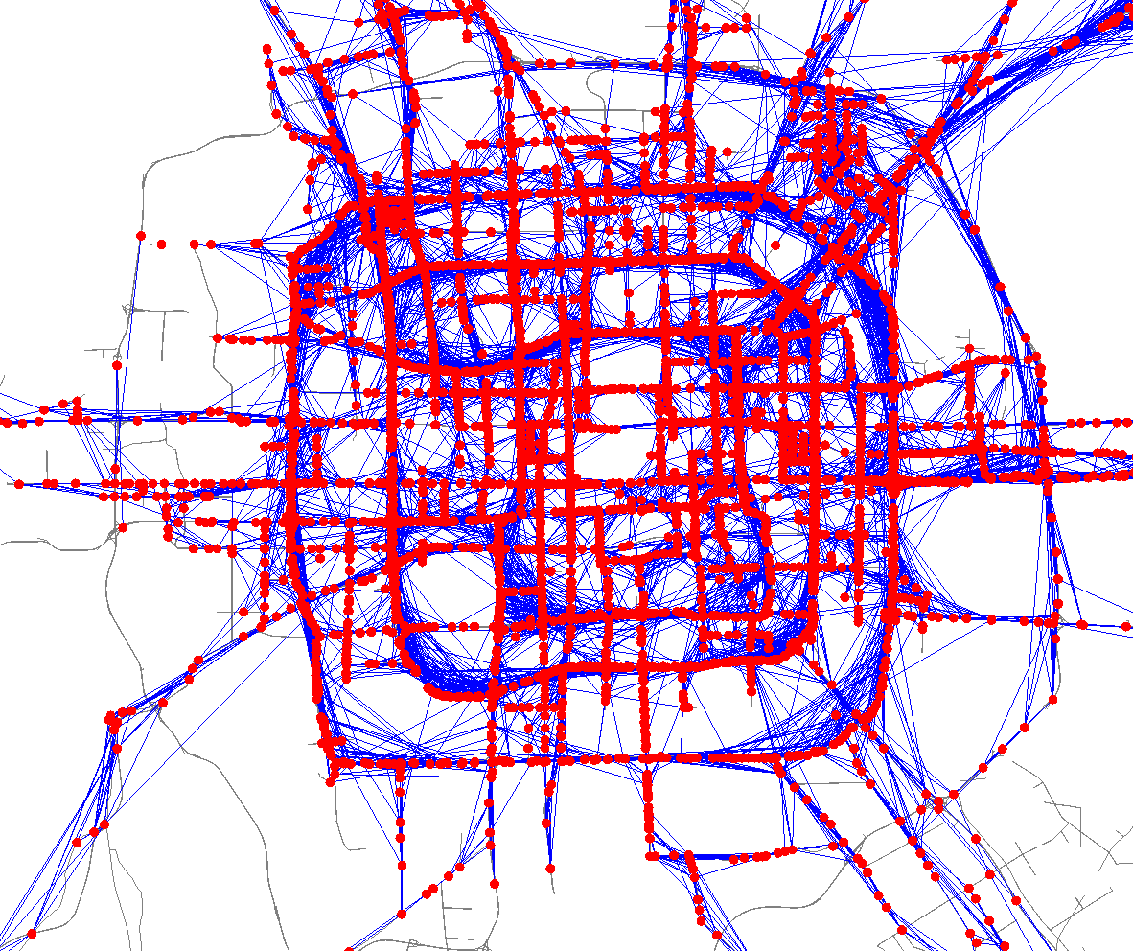

Route Computing
Rough routing
  Given a user query ($q_{s}, q_{d}$, t, $α$)
  Search a landmark graph for a rough route: a sequence of landmarks
  Using a time-dependent routing algorithm
  A landmark graph

Slide 19
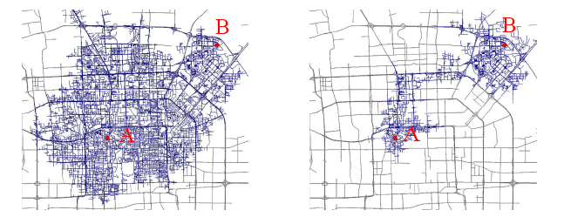
Route Computing
Refined routing
  Find out the fastest path connecting the consecutive landmarks
  Can use speed constraints
  Dynamic programming
Very efficient
  Smaller search spaces
  Computed in parallel

Slide 20
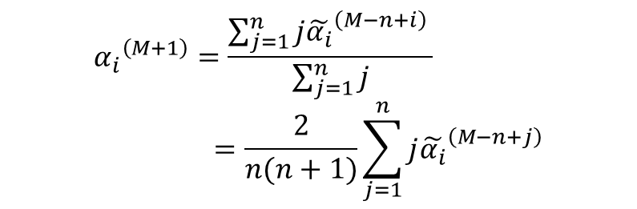

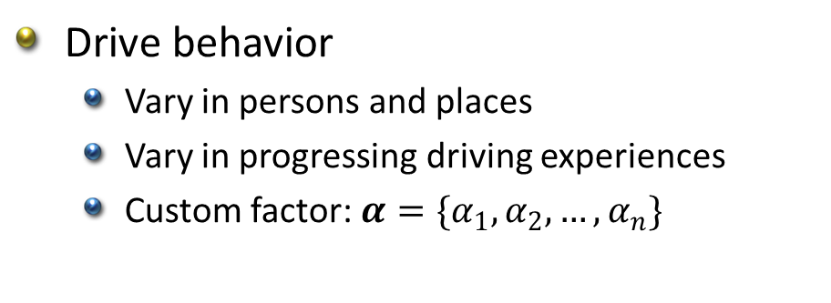
Learning an end user’s drive behavior
Drive behavior
  Vary in persons and places
  Vary in progressing driving experiences
  Custom factor: $α=\{α_{1}, α_{2},…,α_{n}\}$
${\tilde{α_{i}}}^{\left(M\right)}={CDF}_{i}\left({T_{i}}^{(M)}\right)$
Weighted Moving Average:
$${α_{i}}^{\left(M+1\right)}=\frac{\sum_{j=1}^{n}{j{\tilde{α_{i}}}^{\left(M−n+i\right)} }}{\sum_{j=1}^{n}{j}}=\frac{2}{n(n+1)}\sum_{j=1}^{n}{j{\tilde{α_{i}}}^{\left(M−n+j\right)}}$$

Slide 21
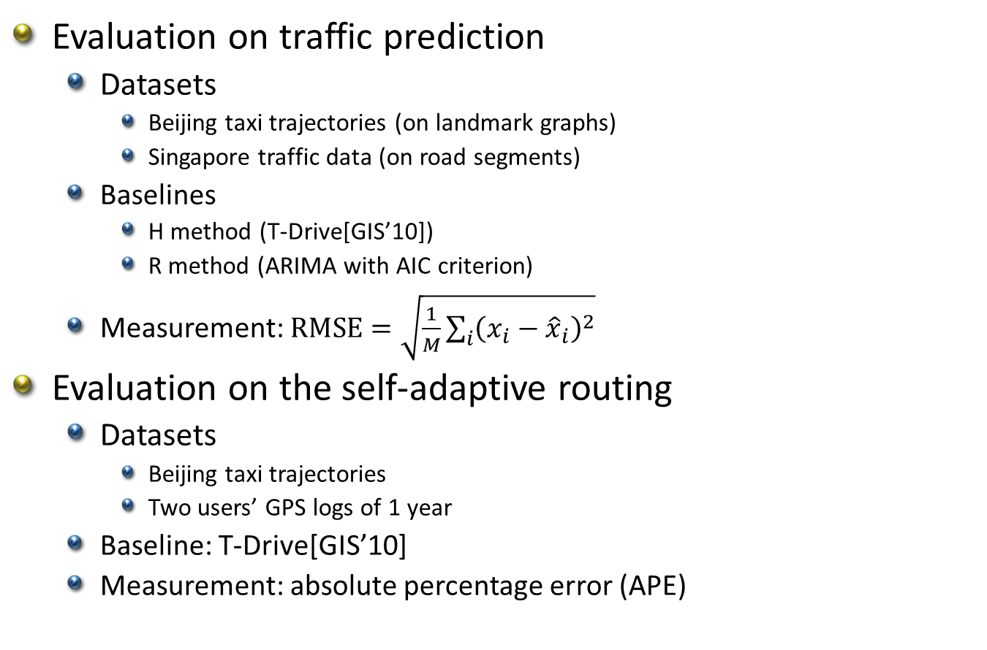
Evaluations
Evaluation on traffic prediction
  Datasets
    Beijing taxi trajectories (on landmark graphs)
    Singapore traffic data (on road segments)
  Baselines
    H method (T-Drive[GIS’10])
    R method (ARIMA with AIC criterion)
  Measurement: $RMSE=\sqrt{\frac{1}{M}\sum_{i}{{\left(x_{i}−{\hat{x}}_{i}\right)}^{2}}}$
Evaluation on the self-adaptive routing
  Datasets
    Beijing taxi trajectories
    Two users’ GPS logs of 1 year
  Baseline: T-Drive[GIS’10]
  Measurement: absolute percentage error (APE)

Slide 22
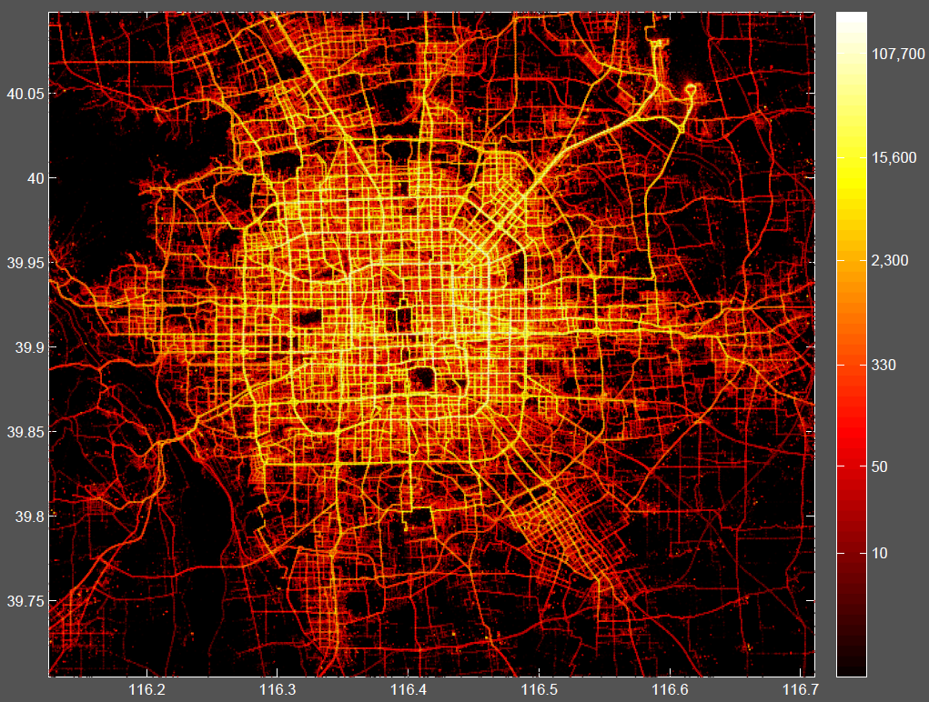
Evaluation – Beijing Datasets
Beijing Taxi Trajectories
  33,000 taxis in 3 months
  Total distance: 400 million km
  Total number of points: 790M
  Average sampling interval:
  3.1 minutes, 600 meters
Beijing Road Network
  106,579 road nodes
  141,380 road segments
Driving history of users
  GPS trajectories from GeoLife project (Data released)

Slide 23
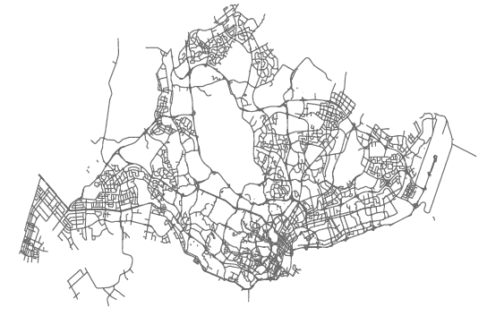
Evaluations – Singapore Dataset
For evaluating traffic prediction on road segments
  We select 50 road segments with a 43-day history of traffic conditions
  Each road segment is associated with an aggregated speed
  Average update interval: 26 minutes

Slide 24
Evaluation on Traffic Prediction
Beijing Taxi Trajectories
    Two months for offline, 12 days for online (6 weekdays, 6 weekends)

Slide 25
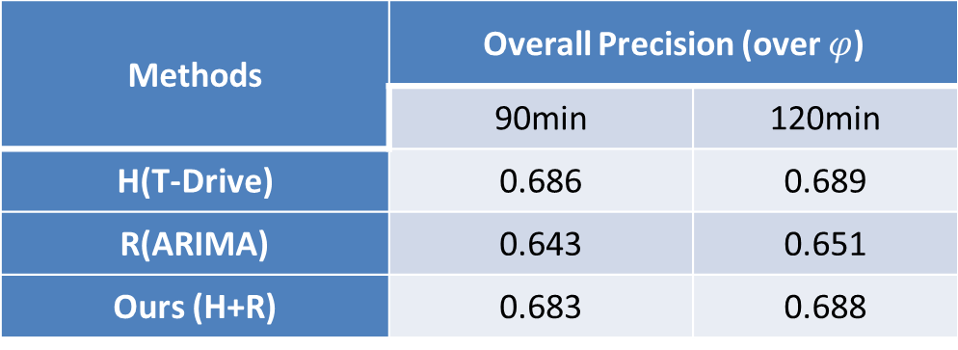
Evaluation on Traffic Prediction
The Singapore Dataset
Methods | Overall Precision (over $φ$)
 | 90min | 120min
H(T-Drive) | 0.686 | 0.689
R(ARIMA) | 0.643 | 0.651
Ours (H+R) | 0.683 | 0.688
?

Slide 26
Evaluation on Traffic Prediction
The Singapore Dataset
Datasets | On all segments | On good segments
Beijing | 3.1 | 8.7
Singapore | 1.9 | 2.5

Slide 27
Evaluation on Routing
User A on different routes
Two users on the same route
Route A
Route B
User A
User B

Slide 28
Conclusion
Model traffic patterns and taxi drivers’ intelligence with landmark graphs
Historical + Real time → Future (m-th order Markov model)
Two stage routing algorithm
Self-adaptive to a user’s drive behavior
The practically fastest path is
  Time-dependent
  User-specific (for a particular user)
  Self-adaptive

Slide 29
Thanks!
Released Datasets:
T-Drive: taxi trajectories
GeoLife: user-generated GPS trajectories
Yu Zheng
yuzheng@microsoft.com

