Slide 1
Urban Computing
-Providing a better life in cities and a better city for lives
Yu Zheng
Web Search & Mining Group
Notes:
I am Yu Zheng from web search and mining group.
I am here presenting our recent project titled urban computing, which aims to sense and understand city dynamics so as to provide people with a better life in cities and a better city for life.

Slide 2


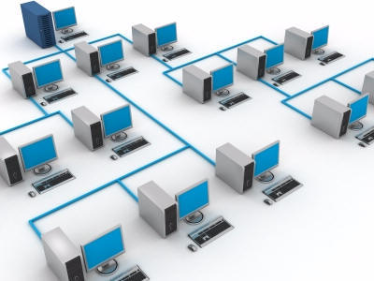
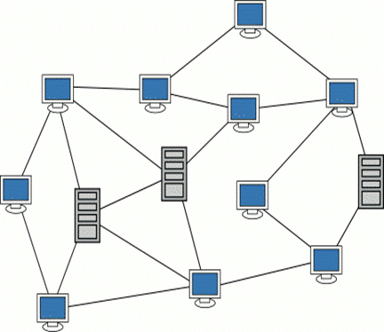

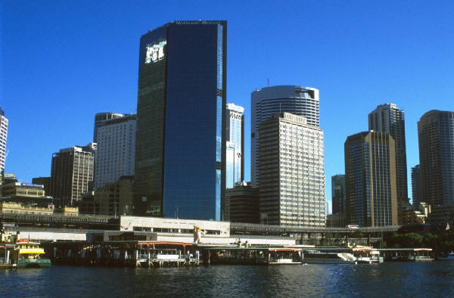

Virtual World
Physical World
Rural Spaces
Urban Spaces
Indoor Spaces
Notes:
To date, people are relying on two worlds. One is the digital world or called virtual world, which has been well organized by the Internet we are using. The other is the physical world which contains rich knowledge while still stays less-connected and ineffectively managed.
Further, the physical world can be partitioned into three kinds of places.
Urban areas are more complex and interesting spaces than the other two in terms of what and who would participate in an application or system.

Slide 3
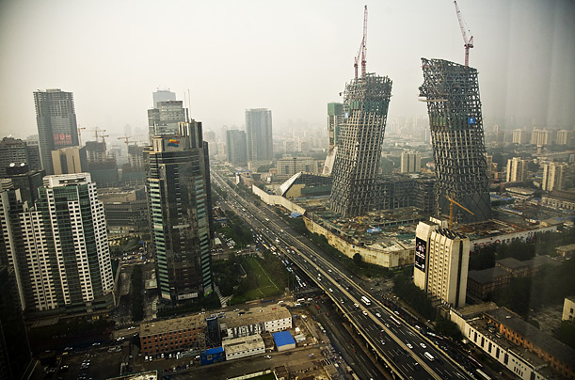
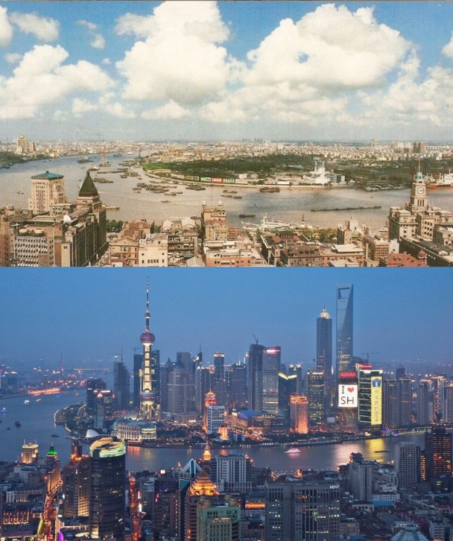
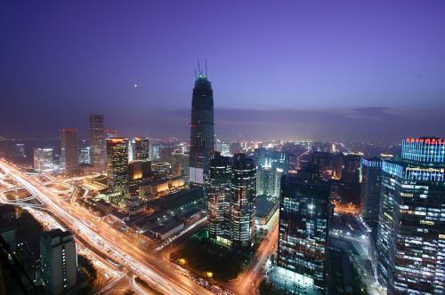

Why Urban Computing
50% of people live in urban areas (just 0.4% of earth surface)
The greatest wave of urbanization is coming
Years ago
2010
Beijing
Shanghai
Notes:
So far,… increase to 70% by 2050.
There is no doubt that we are facing the greatest challenges caused by increasing population, traffic jams, and pollutions.
From these two figures you can see how fast the cites are evolving.
So, on the one hand, it is a great opportunity for improving people’s lives in cities. On the other hand, it would be a potential economic and environmental disaster if we fail in handling it.

Slide 4
What’s Urban Computing
Sensing
Urban Computing
Improving
Mining
Urban computing is emerging as a concept where every sensor, device, person, vehicle, building, and street in the urban areas can be used as a component to enable a city-wide computing for serving people and cities.
Understanding
Notes:
Under such kind of circumstance, we come up with the concept of urban computing. There are three key features here.1. everything 2. city-wide computing instead of on one road or in a building.3. the purpose of this computing is to serve people and the city. urban computing enables a ecosystem by sensing, mining and understanding city dynamics so as to improve the urban environment. In short, better life, better city; better understanding, better improvement.

Slide 5
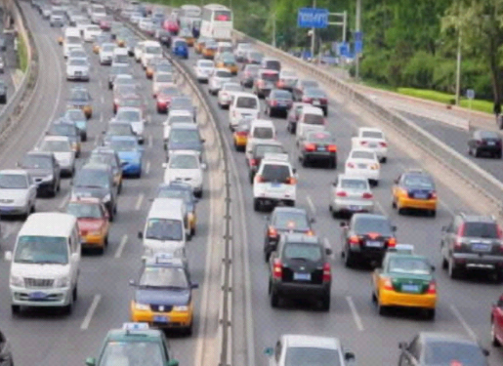
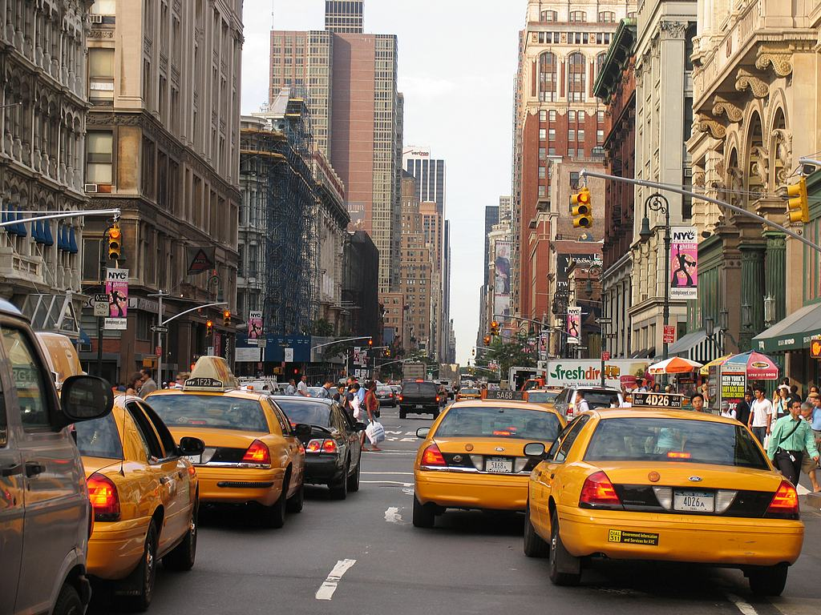
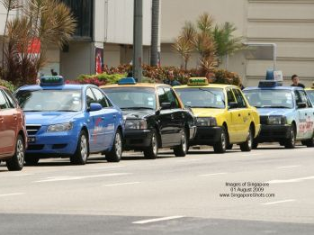
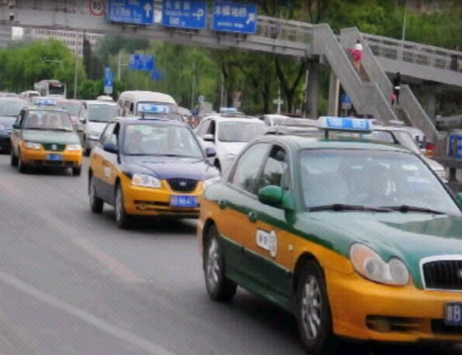
GPS-equipped taxis are mobile sensors
Notes:
Big cities faced with the challenges caused by urbanization usually have a large number of taxicabs traversing in urban areas. For example, Beijing has.
GPS-equipped taxicabs can be viewed as ubiquitous mobile sensors constantly probing a city’s rhythm and pulse, such as traffic flows on road surfaces and city-wide travel patterns of people.

Slide 6
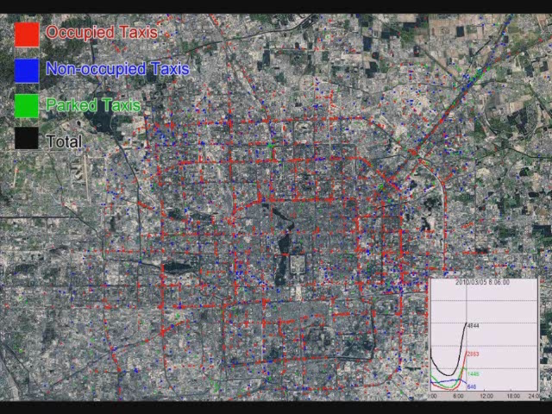

Slide 7
Rank | Cities | Countries/Regions | Taxicabs
1 | The Mexico city | Mexico | 103,000
2 | Bangkok | Thailand | 80,000
3 | Seoul | South Korea | 73,000
4 | Beijing | China | 67,000
5 | Tokyo | Japan | 60,000
6 | Shanghai | China | 50,000
7 | New York City | USA | 48,300
8 | Buenos Aires | Argentina | 45,000
9 | Moscow | Russia | 40,000
10 | St.Paul | Brazil | 37,000
11 | Tianjin | China | 35,000
12 | Taipei | Taiwan | 31,000
13 | New Taipei City | Taiwan | 23,500
14 | Singapore | Singapore | 23,000
15 | Osaka | Japan | 20,000
16 | Hong Kong | China | 18,000
17 | Wuhan | China | 18,000
18 | London | England | 17,000
19 | Harbin | China | 17,000
20 | Guangzhou | China | 16,000
21 | Shenyang | China | 15,000
22 | Paris | France | 15,000

Slide 8
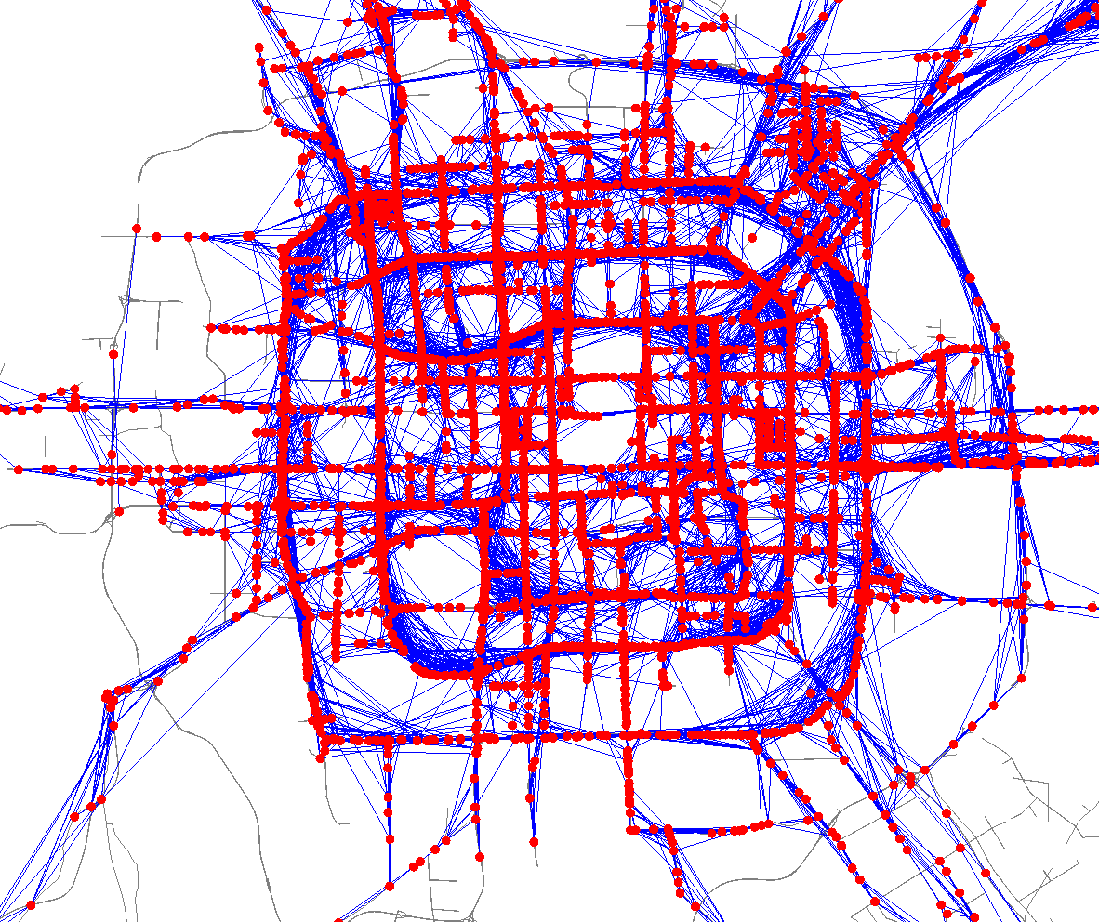
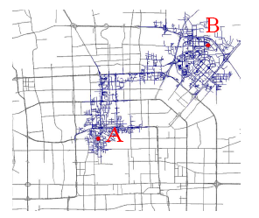
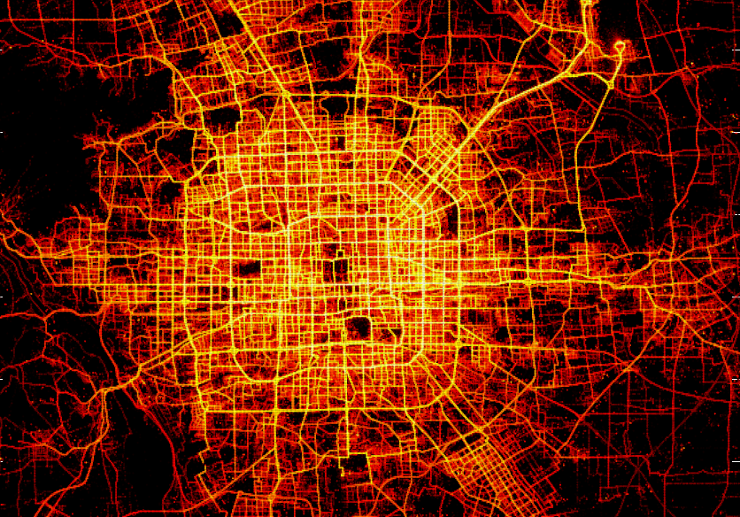
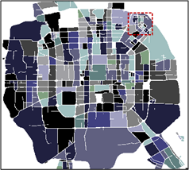
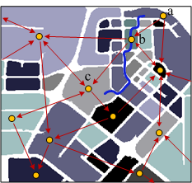
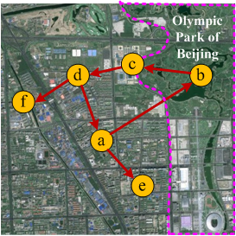
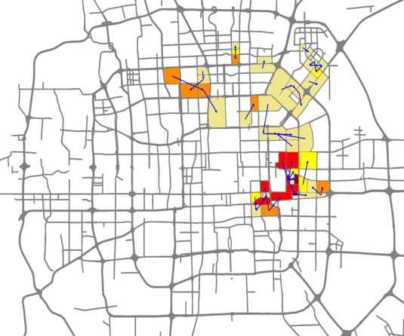
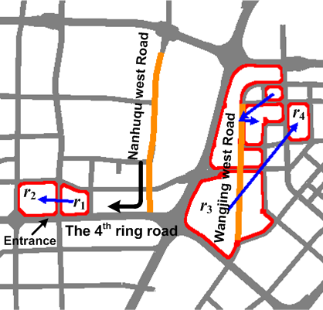
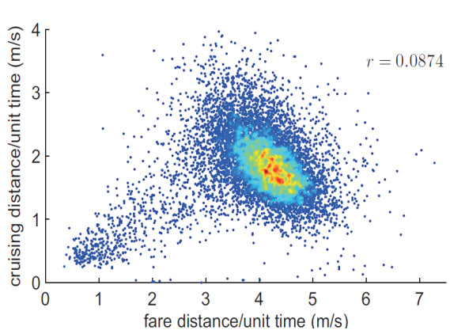
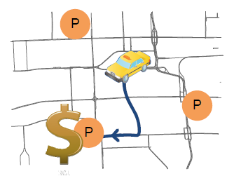
Urban Computing with Taxicabs
ACM SIGSPAITAL GIS’10 best paper runner-up, KDD’11
Finding Smart Driving Directions
33,000+ taxicabs
Anomalous Events Detection
KDD’11
Ubicomp’11 Best paper nominee
Ubicomp’11
Urban Computing for Urban Planning
Passengers-Cabbie Recommender system
Notes:
The upper-left figure plots the trajectory data generated by over 33,000 taxicabs in a period of three months in Beijing.
By mining such data, we first enable a smart driving direction service for end uses. This system provides a user with time-dependent and practically fast driving routes to a destination. The insight lies in two aspects. One is taxi drivers are experienced drivers who can find the fastest driving path to a destination based on their knowledge. The other is GPS-equipped cabs are mobile sensors probing the traffic flow on road surfaces. So, the taxi trajectories imply both human intelligence and traffic patterns. As a result, this service saves 5 minutes in a 30-minute trip on average. The first publication reporting this work won the best paper runner-up award in ACM GIS 2010, and featured by MIT technology review.
Later, we predict traffic conditions by combing historical and real-time taxi trajectories, and model the drive behavior of a particular end user. The improvement leads to a personalized and self-adaptive driving direction service for a particular user. That is a fast driving path just for you. This work contributes to saving time of a driver and dispersing traffic flows to some extent (as different people could take different fast paths). Due to its novelty, this was published on KDD this year and got a follow-up report by MIT TR. Due to the time constraints, I cannot go into details.
In the second example, we detect anomalies in a city according to the taxi trajectories. The anomaly could be caused by sudden accidents, such as traffic control, protests, concerts, parades, celebrations, and large-scale sale promotion. In many cases, the anomaly occurs before the corresponding accident actually happens. For example, in Germany, in a celebration a lot of people moved to a plaza which cannot hold them. As a result, many people get killed in a stampede. If detecting the unusual mobility pattern of people in this region in advance, we can solve the problem early and avoid the happening of the tragedy.
In the third example, we built an passenger-cabbie recommender system by mining cabs’ behavior in picking up and dropping of taxis. First, it offers taxi drivers some locations towards which they can quickly find a passenger and maximize the profit of the next trip. Second, it provides passengers with some places within a walking distance where they can easily take a vacant taxicab. Actually, the work is not easy, especially for the taxi driver recommendations, as you have to build a sophisticated probabilistic model to online calculate the cost and gain of taxi to different places according to its present location. This work was presented on Ubicomp 2011.
In the last example, we perform urban computing for urban planning, which is the way to fundamentally solve the traffic problem in a city. Specifically, this work identify less-effective city configurations by analyzing people’s urban mobility learned from the taxi trajectories over a certain period. Therefore, this technology can evaluate city configurations, and suggest potential improvement to city planners.

Slide 9
Urban Computing for Urban Planning
Goals
  City-wide traffic modeling
  Evaluate city configurations
  Suggest potential improvement to city planners
  Identify root causes of the problem
Datasets
  Taxi trajectories: March to May, 2009 and 2010
  Beijing maps and POIs
Best paper nominee in UbiComp 2011
Notes:
The challenge of this research lies in two aspects.
The first is city-wide traffic modeling. Here, it should be the city-wide mobility patterns of people instead of traffic conditions on a single road.
Second, we need to identify the root causes of the problem, instead of finding some observations. We are not detecting traffic jams which are only observations.
We carried out this work using the data generated in the same period of the consecutive two years, and evaluate them with Beijing maps and some real city planning of Beijing.

Slide 10
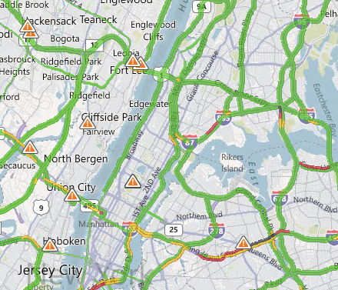
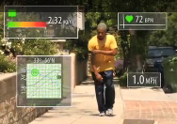
Related Work
Traffic Condition Estimation
  Mobile Millennium – U.C. Berkeley
  CarTel – MIT
  ClearFlow – MSR Redmond
  …
City Sensing
  Sensible City - MIT
  Urban Sensing – UCLA
  Metro Sensing- Dartmouth
  …
Notes:
Before entering into details, I’d like to mentions some related work you could be imagining.
There is a brunch of work detecting traffic conditions on roads. The difference between us is very clear. Specifically, we do not care traffic conditions on a single road segment. Instead, we aim to model people’s mobility between geographical regions, trying to identify the root causes of the problem.
There are some projects proposed the concept of city sensing `which expects to provide people with a better sharing and social experience in urban area by participatory sensing. We share some similar vision. But, we are using taxicabs to sensing the city, and focus on improving urban planning, which I have never see before.
Now, let me elaborate on the methodology of this work.

Slide 11
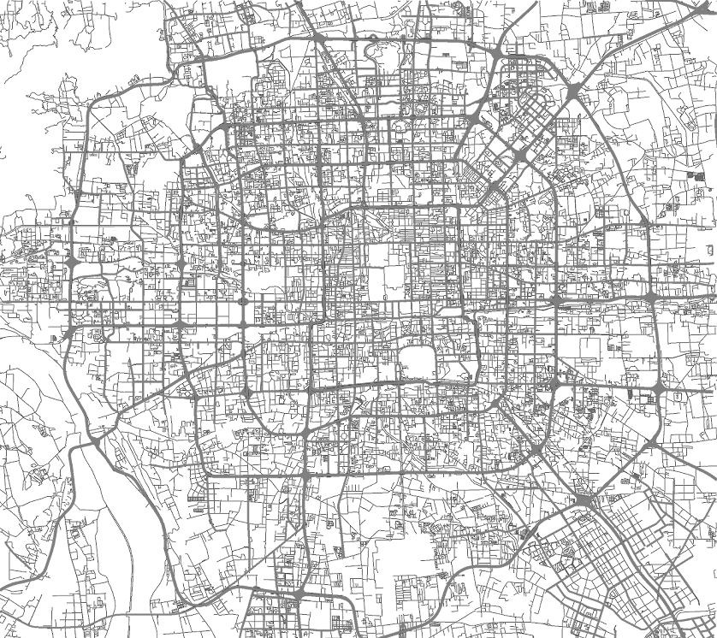
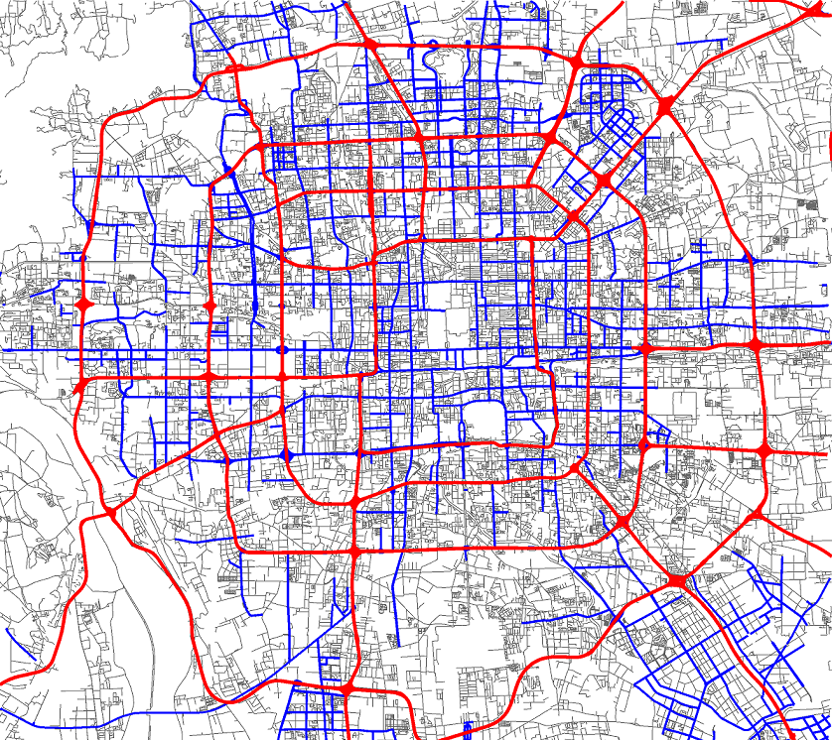

City-Wide Traffic Modeling
Partition a city into regions with major roads
Regions are root causes of the problem
Notes:
Partition a city into regions using major roads, such as high-way and ring roads.
Here, each region stands for a community including some neighborhoods and low-level road segments
Traffic problems appearing on roads are just observations while regions are the root causes of the problem, because People live in regions and travel between regions.
Actually, partition a city into regions using road network is a NP hard problem in computational geometry. But, we fulfill this challenging task very effectively and efficiently using an image segmentation method, which has been regarded as great contribution to the society by the reviewers.

Slide 12
City-Wide Traffic Modeling
Partition the dataset by time slots (a data-driven method)
Workday
Non-workday
Time | Work day | Non-Workday
Slot 1 | 7:00am-10:30am | 9:00am-12:30pm
Slot 2 | 10:30am-4:00pm | 12:30pm-7:30pm
Slot 3 | 4:00pm-7:30pm | 7:30pm-9:00am
Slot 4 | 7:30pm-7:00am
Notes:
Further, we partition the taxi trajectories into some portion according to traffic conditions using a data-driven method. For example, in Beijing, work day has been into 4 time slots corresponding to morning rush hours and evening rush hours, etc. it is not redefined.

Slide 13
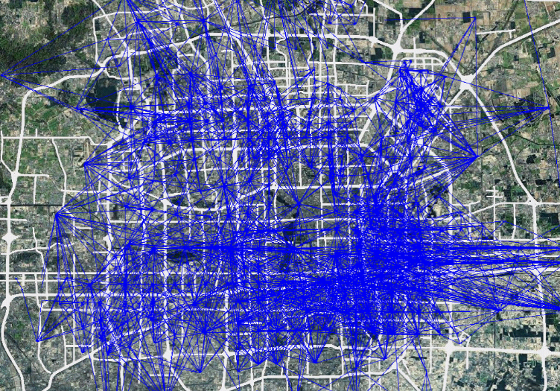
City-Wide Traffic Modeling
Project taxi trajectories onto these regions
Building a region graph for each time slot

Slide 14



Finding Problematic Edges
Extracting features from each edge
  |S|: Number of taxis
  E(v): Expectation of speed
  $θ={E\left(D\right)}/{CenDist(r_{1},{ r}_{3})}$
$CenDist(r_{1},{ r}_{3}$)
$$a_{ij}=<\left|S\right|, E\left(V\right), θ>$$
Notes:
We identify three features representing the connectivity between any two regions.
The first one is the number of taxis traveling between the two regions.
The other is the expectation of the speeds of these taxis.
The third one is a ratio between the average of actual travel distances and the Euclidian distance between the centers of the two regions.

Slide 15

Finding Problematic Edges
Select edges with |S| above average
Detect Skyline edges according to < $E\left(V\right), θ$>
  Select edges with big $θ$ and small $E\left(V\right)$
Notes:
We first select the edges with the traffic volume above the average, and then detect the skyline edges according to the other two features. Here, we aim to find out the region pairs with a very poor connectivity, that is the edges with a big theta, ……. In fact they are the points from this blue curve.

Slide 16

Making Sense of Individual Problematic Edges
Formulate skyline graphs for each day
Mining frequent sub-graph patterns across days
  To avoid false alert
  Deep understanding
Find correlation among patterns
${(r}_{3}→{ r}_{6})⇒{(r}_{4}→{ r}_{5})$
Notes:
For each time slot we can obtain some skyline edges. Now, we formulate some skyline graph by associating these skyline edges. For example, spatially overlapping and temporally adjacent.

Slide 17
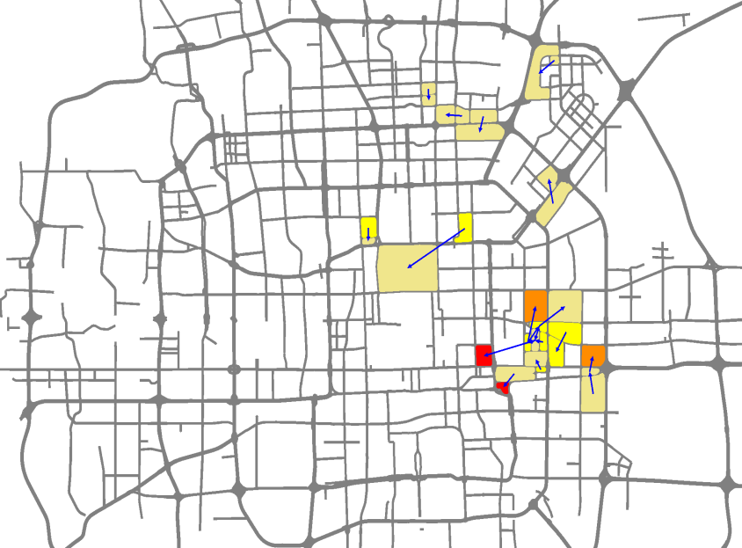
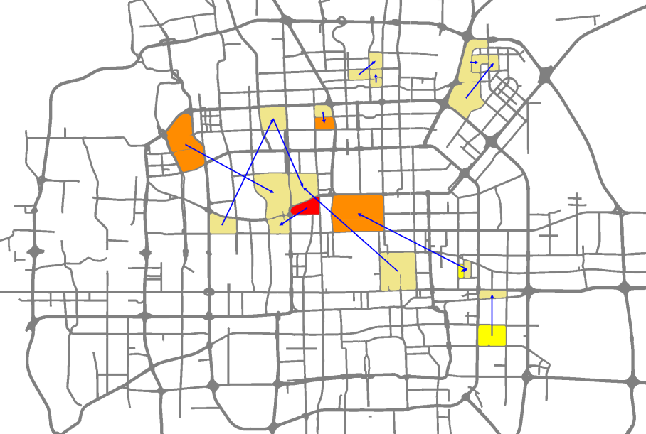

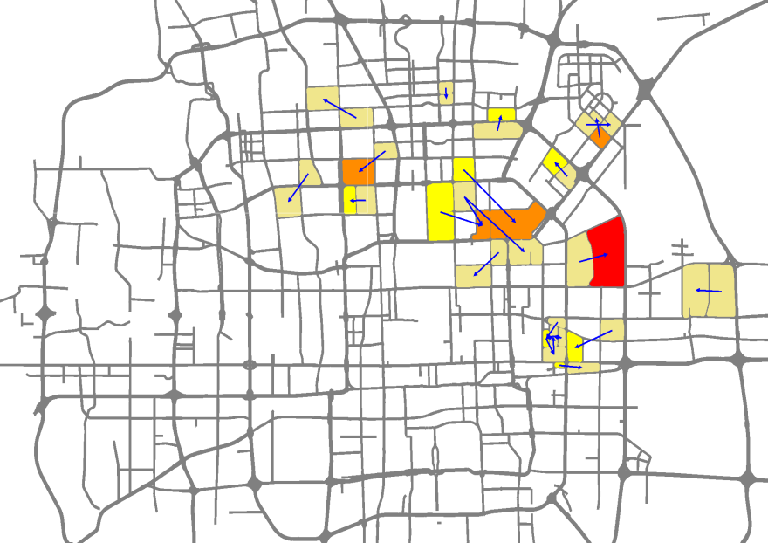
2009
Workday
Non-work day
2010
Notes:
This slide shows the results we detected from the data of the past two years. The depth of the color represents the frequency of the problem occurred. We have compared these results with the heat map of Beijing.
On the one hand, some problematic region pairs occurred in 2009 while disappeared in 2010. On the other hand, the number of the flawed region pairs increased, which indicates that the traffic conditions in Beijing becomes worse. By comparing the results of the two years, we can evaluate the urban planning carried out in 2009.

Slide 18
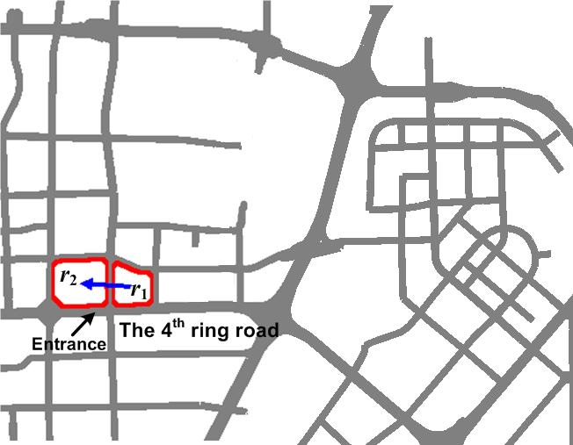
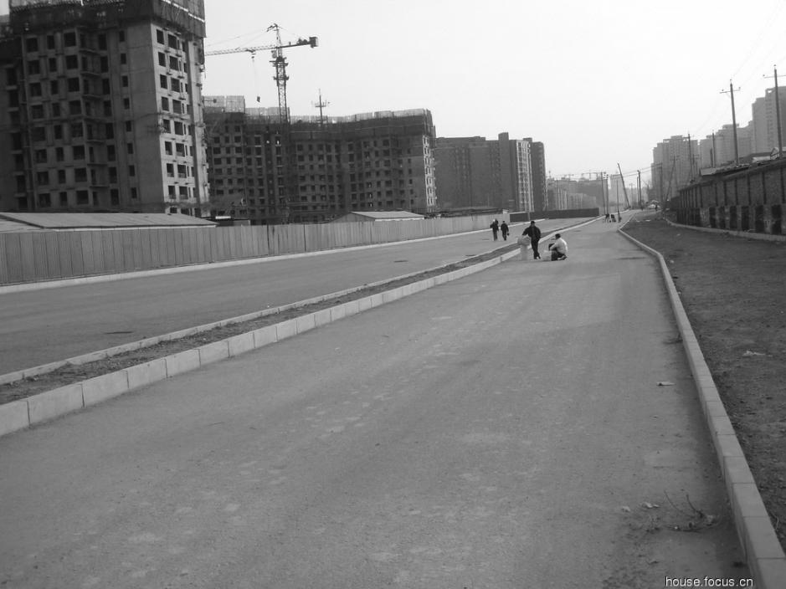
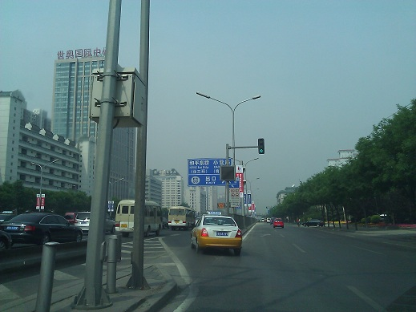
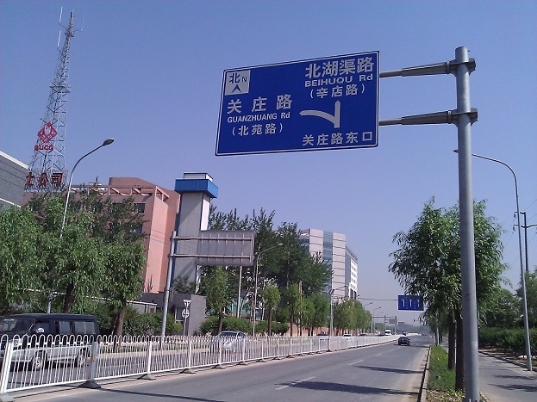
A new road launched in August 2009
An additional entrance
2009
2010

Slide 19

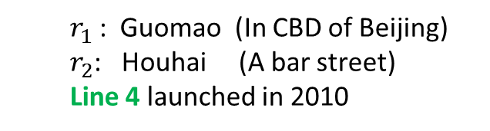
  Example 2
  Example 3
  $r_{1}$: Guomao (In CBD of Beijing)
  $r_{2}$: Houhai (A bar street)
  Line 4 launched in 2010
  Finding correlation
${(r}_{1}→{ r}_{2})⇒[{(r}_{2}→{ r}_{4})$,${(r}_{1}→{ r}_{3})$]

Slide 20


Future Work
Analyzing the purpose of trips
  Why and when
  POIs
Human demands | POI sub-categories
Home | Apartment building
Work | Government & Office building
Education | School, Training center
Food | Restaurant
Entertainment | Museum, Movie theater, Club
Outdoor | Park, Sports field, Interests
Shopping | Shop, Store, Mall, Outlet
Transportation | Airport, Railway & Bus station
Health care | Hospital, Medical center, Pharmacy
Car service | Car sale, Car repair, gas stations
$$P=\{a_{1},a_{2},…,a_{i},…,a_{10}\}$$
$$∆P=dist∙(P_{d}−P_{o}).$$
Notes:
To understand the detected flaws, we further explore the purpose the each trip generated between these two regions. Specifically, we analyze the POI distribution around the source and destination of each trip.
Meanwhile, we use trip distance as trip weight when computing trip purpose. A longer distance infers that people have more urgent demand for taking this trip.

Slide 21
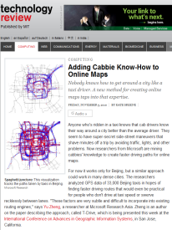
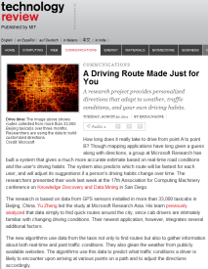
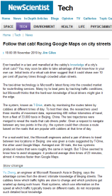
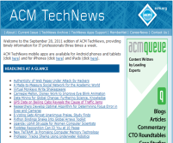
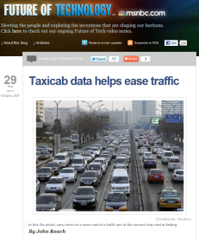
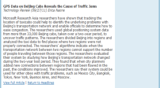
Impact
High-quality and influential publications
  Best paper runner-up award in ACM SIGSPATIAL GIS 2011
  Best paper nominee in UbiComp 2011
  KDD’11(2), UbiComp’11(2), TKDE(1)
Media reports on top-tier presses
  MIT Technology Review (3 times, featured twice)
  MSNBC news (1)
  NewScientist (1)
  Many Chinese news…
Potential real-world deployment
  Governments: Singapore LTA
  MS product team: SQL Server
Notes:
We also identified some opportunities for potential real-world deployment.
First, Singapore also has a variety of sensors installed in urban area, and they are eager to getting new technologies for urban planning. The land use authority of Singapore has offered us the API to access their traffic data, based on which we have carried out some real experiments.
Second, we are working with the STB team in shanghai and third parties, trying to test our technology on streaming insight platform in shanghai and hangzhou cities. Urban computing can be a killer application built on MS cloud computing platform, demonstration our ability of innovation and operation to government.

Slide 22
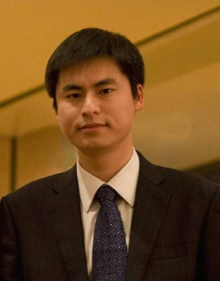
Thanks!
Yu Zheng
yuzheng@microsoft.com
Homepage

