Slide 1



Nikolaj Bjørner
Senior Researcher
Microsoft Research
Redmond
Modern Satisfiability Modulo Theories Solvers in Program Analysis

Slide 2
Lectures
Wednesday 10:45–12:15
An Introduction to Z3 with Applications
Thursday August 30th 15:45–17:15
Introduction to SAT and SMT
Friday 10:30–10:45
Theories and Solving Algorithms
Friday 15:45–17:15
Advanced: Quantifiers, Arrays, Fixed-points

Slide 3
Takeaways:
Engineering of an Incremental Decision Procedure for Arithmetic
Engineering User Theories with Z3
Combination methods for Decision Procedures
  There are very many papers on the subject
  Focus: Paper by de Moura and Bjørner, SMT 2007 on
  Model-based theory combination.

Slide 4
Plan
  Decision procedures for Arithmetic [Dutertre & de Moura CAV 2006]
  Engineering Theories with Z3
  Combining Decision Procedures

Slide 5
Case Analysis
Many verification/analysis problems require: case-analysis
x ≥ 0, y = x + 1, (y > 2 ∨ y < 1)

Slide 6
Case Analysis
Many verification/analysis problems require: case-analysis
x ≥ 0, y = x + 1, (y > 2 ∨ y < 1)
Naïve Solution: Convert to DNF
(x ≥ 0, y = x + 1, y > 2) ∨ (x ≥ 0, y = x + 1, y < 1)

Slide 7
Case Analysis
Many verification/analysis problems require: case-analysis
x ≥ 0, y = x + 1, (y > 2 ∨ y < 1)
Naïve Solution: Convert to DNF
(x ≥ 0, y = x + 1, y > 2) ∨ (x ≥ 0, y = x + 1, y < 1)
Too Inefficient!
(exponential blowup)

Slide 8

SMT : Basic Architecture
SAT
Theory
Solvers
SMT
Equality + UF
Arithmetic
Bit-vectors
…
Case Analysis

Slide 9
SAT + Theory solvers
Basic Idea
x ≥ 0, y = x + 1, (y > 2 ∨ y < 1)
Abstract (aka “naming” atoms)
p₁, p₂, (p₃ ∨ p₄)
p₁ ≡ (x ≥ 0), p₂ ≡ (y = x + 1),
p₃ ≡ (y > 2), p₄ ≡ (y < 1)

Slide 10
SAT + Theory solvers
Basic Idea
x ≥ 0, y = x + 1, (y > 2 ∨ y < 1)
Abstract (aka “naming” atoms)
p₁, p₂, (p₃ ∨ p₄)
p₁ ≡ (x ≥ 0), p₂ ≡ (y = x + 1),
p₃ ≡ (y > 2), p₄ ≡ (y < 1)
SAT
Solver

Slide 11
SAT + Theory solvers
Basic Idea
x ≥ 0, y = x + 1, (y > 2 ∨ y < 1)
Abstract (aka “naming” atoms)
p₁, p₂, (p₃ ∨ p₄)
p₁ ≡ (x ≥ 0), p₂ ≡ (y = x + 1),
p₃ ≡ (y > 2), p₄ ≡ (y < 1)
SAT
Solver
Assignment
p₁, p₂, ¬p₃, p₄

Slide 12
SAT + Theory solvers
Basic Idea
x ≥ 0, y = x + 1, (y > 2 ∨ y < 1)
Abstract (aka “naming” atoms)
p₁, p₂, (p₃ ∨ p₄)
p₁ ≡ (x ≥ 0), p₂ ≡ (y = x + 1),
p₃ ≡ (y > 2), p₄ ≡ (y < 1)
SAT
Solver
Assignment
p₁, p₂, ¬p₃, p₄
x ≥ 0, y = x + 1,
¬(y > 2), y < 1

Slide 13
SAT + Theory solvers
Basic Idea
x ≥ 0, y = x + 1, (y > 2 ∨ y < 1)
Abstract (aka “naming” atoms)
p₁, p₂, (p₃ ∨ p₄)
p₁ ≡ (x ≥ 0), p₂ ≡ (y = x + 1),
p₃ ≡ (y > 2), p₄ ≡ (y < 1)
SAT
Solver
Assignment
p₁, p₂, ¬p₃, p₄
x ≥ 0, y = x + 1,
¬(y > 2), y < 1
Unsatisfiable
x ≥ 0, y = x + 1, y < 1
Theory
Solver

Slide 14
SAT + Theory solvers
Basic Idea
x ≥ 0, y = x + 1, (y > 2 ∨ y < 1)
Abstract (aka “naming” atoms)
p₁, p₂, (p₃ ∨ p₄)
p₁ ≡ (x ≥ 0), p₂ ≡ (y = x + 1),
p₃ ≡ (y > 2), p₄ ≡ (y < 1)
SAT
Solver
Assignment
p₁, p₂, ¬p₃, p₄
x ≥ 0, y = x + 1,
¬(y > 2), y < 1
New Lemma
¬p₁∨¬p₂∨¬p₄
Unsatisfiable
x ≥ 0, y = x + 1, y < 1
Theory
Solver

Slide 15
SAT + Theory solvers
New Lemma
¬p₁∨¬p₂∨¬p₄
Unsatisfiable
x ≥ 0, y = x + 1, y < 1
Theory
Solver
AKA
Theory conflict

Slide 16
SAT + Theory solvers: Main loop
procedure SmtSolver(F)
(F_{p}, M) := Abstract(F)
loop
(R, A) := SAT_solver(F_{p})
if R = UNSAT then return UNSAT
S := Concretize(A, M)
(R, S’) := Theory_solver(S)
if R = SAT then return SAT
L := New_Lemma(S’, M)
Add L to F_{p}

Slide 17
SAT + Theory solvers
Basic Idea
F: x ≥ 0, y = x + 1, (y > 2 ∨ y < 1)
Abstract (aka “naming” atoms)
F_{p} : p₁, p₂, (p₃ ∨ p₄)
M: p₁ ≡ (x ≥ 0), p₂ ≡ (y = x + 1),
p₃ ≡ (y > 2), p₄ ≡ (y < 1)
SAT
Solver
A: Assignment
p₁, p₂, ¬p₃, p₄
S: x ≥ 0, y = x + 1,
¬(y > 2), y < 1
L: New Lemma
¬p₁∨¬p₂∨¬p₄
S’: Unsatisfiable
x ≥ 0, y = x + 1, y < 1
Theory
Solver

Slide 18
SAT + Theory solvers
F: x ≥ 0, y = x + 1, (y > 2 ∨ y < 1)
Abstract (aka “naming” atoms)
F_{p} : p₁, p₂, (p₃ ∨ p₄)
M: p₁ ≡ (x ≥ 0), p₂ ≡ (y = x + 1),
p₃ ≡ (y > 2), p₄ ≡ (y < 1)
SAT
Solver
A: Assignment
p₁, p₂, ¬p₃, p₄
S: x ≥ 0, y = x + 1,
¬(y > 2), y < 1
L: New Lemma
¬p₁∨¬p₂∨¬p₄
S’: Unsatisfiable
x ≥ 0, y = x + 1, y < 1
Theory
Solver
procedure SMT_Solver(F)
(F_{p}, M) := Abstract(F)
loop
(R, A) := SAT_solver(F_{p})
if R = UNSAT then return UNSAT
S = Concretize(A, M)
(R, S’) := Theory_solver(S)
if R = SAT then return SAT
L := New_Lemma(S, M)
Add L to F_{p}
“Lazy translation” to
DNF

Slide 19
SAT + Theory solvers
State-of-the-art SMT solvers implement
many improvements.

Slide 20
SAT + Theory solvers
Incrementality
Send the literals to the Theory solver as they are assigned by the SAT solver
p₁ ≡ (x ≥ 0), p₂ ≡ (y = x + 1),
p₃ ≡ (y > 2), p₄ ≡ (y < 1), p₅ ≡ (x < 2),
p₁, p₂, p₄ | p₁, p₂, (p₃ ∨ p₄), (p₅ ∨ ¬p₄)
Partial assignment is already
Theory inconsistent.

Slide 21
SAT + Theory solvers
Efficient Backtracking
We don’t want to restart from scratch after each backtracking operation.

Slide 22
SAT + Theory solvers
Efficient Lemma Generation (computing a small S’)
Avoid lemmas containing redundant literals.
p₁ ≡ (x ≥ 0), p₂ ≡ (y = x + 1),
p₃ ≡ (y > 2), p₄ ≡ (y < 1), p₅ ≡ (x < 2),
p₁, p₂, p₃, p₄ | p₁, p₂, (p₃ ∨ p₄), (p₅ ∨ ¬p₄)
¬p₁∨¬p₂ ∨¬p₃ ∨¬p₄
Imprecise Lemma

Slide 23
SAT + Theory solvers
Theory Propagation
It is the SMT equivalent of unit propagation.
p₁ ≡ (x ≥ 0), p₂ ≡ (y = x + 1),
p₃ ≡ (y > 2), p₄ ≡ (y < 1), p₅ ≡ (x < 2),
p₁, p₂ | p₁, p₂, (p₃ ∨ p₄), (p₅ ∨ ¬p₄)
p₁, p₂ imply ¬p₄ by theory propagation
p₁, p₂ , ¬p₄ | p₁, p₂, (p₃ ∨ p₄), (p₅ ∨ ¬p₄)

Slide 24
SAT + Theory solvers
Theory Propagation
It is the SMT equivalent of unit propagation.
p₁ ≡ (x ≥ 0), p₂ ≡ (y = x + 1),
p₃ ≡ (y > 2), p₄ ≡ (y < 1), p₅ ≡ (x < 2),
p₁, p₂ | p₁, p₂, (p₃ ∨ p₄), (p₅ ∨ ¬p₄)
p₁, p₂ imply ¬p₄ by theory propagation
p₁, p₂ , ¬p₄ | p₁, p₂, (p₃ ∨ p₄), (p₅ ∨ ¬p₄)
Tradeoff between precision × performance.

Slide 25
An Architecture: the core
Core
Arithmetic
Bit-Vectors
Scalar Values
Equality
Uninterpreted Functions
SAT Solver

Slide 26
An Architecture: the core
Core
Arithmetic
Bit-Vectors
Scalar Values
Equality
Uninterpreted Functions
Case Analysis
SAT Solver

Slide 27
An Architecture: the core
Core
Arithmetic
Bit-Vectors
Scalar Values
Equality
Uninterpreted Functions
Blackboard:
equalities, disequalities,
predicates
SAT Solver

Slide 28
Linear Arithmetic
Many approaches
  Graph-based for difference logic: a – b ≤ 3
  Fourier-Motzkin elimination:
  Standard Simplex
  General Form Simplex

Slide 29
Difference Logic: a – b ≤ 5
Very useful in practice!
Most arithmetical constraints in software verification/analysis are in this fragment.
x := x + 1
x₁ = x₀ + 1
x₁ - x₀ ≤ 1, x₀ - x₁ ≤ -1

Slide 30
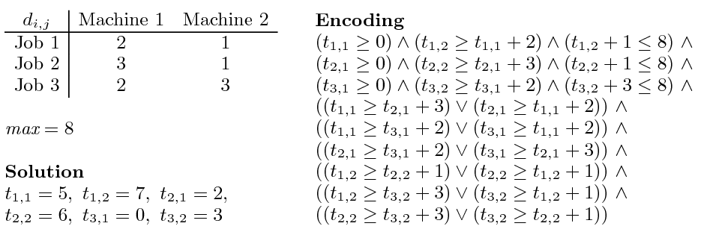
Job shop scheduling

Slide 31
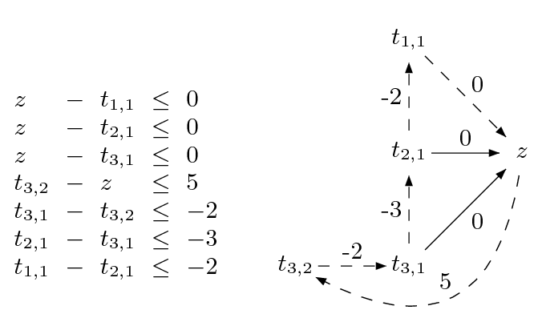
Difference Logic
Chasing negative cycles!
Algorithms based on Bellman-Ford (O(mn)).

Slide 32
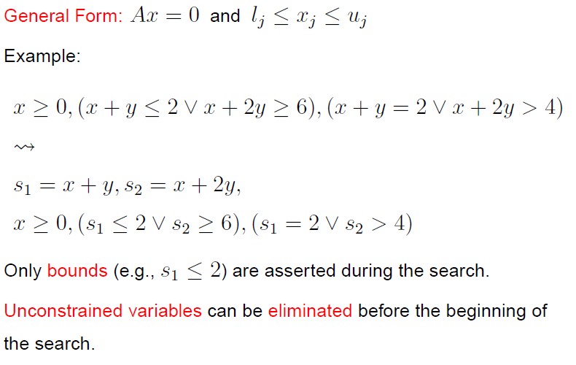
General Form

Slide 33
From Definitions to a Tableau
s₁ ≡ x + y, s₂ ≡ x + 2y

Slide 34
From Definitions to a Tableau
s₁ ≡ x + y, s₂ ≡ x + 2y
s₁ = x + y,
s₂ = x + 2y

Slide 35
From Definitions to a Tableau
s₁ ≡ x + y, s₂ ≡ x + 2y
s₁ = x + y,
s₂ = x + 2y
s₁ - x - y = 0
s₂ - x - 2y = 0

Slide 36
From Definitions to a Tableau
s₁ ≡ x + y, s₂ ≡ x + 2y
s₁ = x + y,
s₂ = x + 2y
s₁ - x - y = 0
s₂ - x - 2y = 0
s₁, s₂ are basic (dependent)
x,y are non-basic

Slide 37
Pivoting
A way to swap a basic with a non-basic variable!
It is just equational reasoning.
Key invariant: a basic variable occurs in only one equation.
Example: swap s₁ and y
s₁ - x - y = 0
s₂ - x - 2y = 0

Slide 38
Pivoting
A way to swap a basic with a non-basic variable!
It is just equational reasoning.
Key invariant: a basic variable occurs in only one equation.
Example: swap s₁ and y
s₁ - x - y = 0
s₂ - x - 2y = 0
-s₁ + x + y = 0
s₂ - x - 2y = 0

Slide 39
Pivoting
A way to swap a basic with a non-basic variable!
It is just equational reasoning.
Key invariant: a basic variable occurs in only one equation.
Example: swap s₁ and y
s₁ - x - y = 0
s₂ - x - 2y = 0
-s₁ + x + y = 0
s₂ - x - 2y = 0
-s₁ + x + y = 0
s₂ - 2s₁ + x = 0

Slide 40
Pivoting
A way to swap a basic with a non-basic variable!
It is just equational reasoning.
Key invariant: a basic variable occurs in only one equation.
Example: swap s₁ and y
It is just substituting equals by equals.
s₁ - x - y = 0
s₂ - x - 2y = 0
-s₁ + x + y = 0
s₂ - x - 2y = 0
-s₁ + x + y = 0
s₂ - 2s₁ + x = 0

Slide 41
Pivoting
Definition:
An assignment (model) is a mapping from variables to values
A way to swap a basic with a non-basic variable!
It is just equational reasoning.
Key invariant: a basic variable occurs in only one equation.
Example: swap s₁ and y
It is just substituting equals by equals.
s₁ - x - y = 0
s₂ - x - 2y = 0
-s₁ + x + y = 0
s₂ - x - 2y = 0
Key Property:
If an assignment satisfies the equations before a pivoting step, then it will also satisfy them after!
-s₁ + x + y = 0
s₂ - 2s₁ + x = 0

Slide 42
Pivoting
Definition:
An assignment (model) is a mapping from variables to values
A way to swap a basic with a non-basic variable!
It is just equational reasoning.
Key invariant: a basic variable occurs in only one equation.
Example: swap s₂ and y
It is just substituting equals by equals.
s₁ - x - y = 0
s₂ - x - 2y = 0
Example:
M(x) = 1
M(y) = 1
M(s₁) = 2
M(s₂) = 3
-s₁ + x + y = 0
s₂ - x - 2y = 0
Key Property:
If an assignment satisfies the equations before a pivoting step, then it will also satisfy them after!
-s₁ + x + y = 0
s₂ - 2s₁ + x = 0

Slide 43
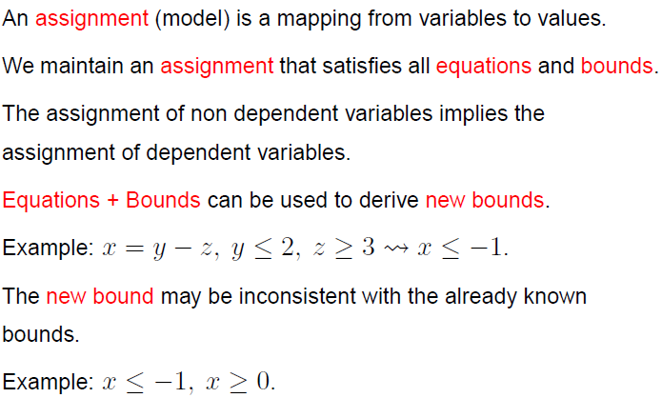
Equations + Bounds + Assignment

Slide 44
“Repairing Models”
If the assignment of a non-basic variable does not satisfy a bound, then fix it and propagate the change to all dependent variables.
a = c – d
b = c + d
M(a) = 0
M(b) = 0
M(c) = 0
M(d) = 0
1 ≤ c
a = c – d
b = c + d
M(a) = 1
M(b) = 1
M(c) = 1
M(d) = 0
1 ≤ c

Slide 45
“Repairing Models”
If the assignment of a non-basic variable does not satisfy a bound, then fix it and propagate the change to all dependent variables. Of course, we may introduce new “problems”.
a = c – d
b = c + d
M(a) = 0
M(b) = 0
M(c) = 0
M(d) = 0
1 ≤ c
a ≤ 0
a = c – d
b = c + d
M(a) = 1
M(b) = 1
M(c) = 1
M(d) = 0
1 ≤ c
a ≤ 0

Slide 46
“Repairing Models”
If the assignment of a basic variable does not satisfy a bound, then pivot it, fix it, and propagate the change to its new dependent variables.
a = c – d
b = c + d
M(a) = 0
M(b) = 0
M(c) = 0
M(d) = 0
1 ≤ a
c = a + d
b = a + 2d
M(a) = 0
M(b) = 0
M(c) = 0
M(d) = 0
1 ≤ a
c = a + d
b = a + 2d
M(a) = 1
M(b) = 1
M(c) = 1
M(d) = 0
1 ≤ a

Slide 47
“Repairing Models”
Sometimes, a model cannot be repaired. It is pointless to pivot.
a = b – c
a ≤ 0, 1 ≤ b, c ≤ 0
M(a) = 1
M(b) = 1
M(c) = 0
The value of M(a) is too big. We can reduce it by:
reducing M(b)
  not possible b is at lower bound
increasing M(c)
  not possible c is at upper bound

Slide 48
“Repairing Models”
Extracting proof from failed repair attempts is easy.
s₁ ≡ a + d, s₂ ≡ c + d
a = s₁ – s₂ + c
a ≤ 0, 1 ≤ s₁, s₂ ≤ 0, 0 ≤ c
M(a) = 1
M(s₁) = 1
M(s₂) = 0
M(c) = 0

Slide 49
“Repairing Models”
Extracting proof from failed repair attempts is easy.
s₁ ≡ a + d, s₂ ≡ c + d
a = s₁ – s₂ + c
a ≤ 0, 1 ≤ s₁, s₂ ≤ 0, 0 ≤ c
M(a) = 1
M(s₁) = 1
M(s₂) = 0
M(c) = 0
{ a ≤ 0, 1 ≤ s₁, s₂ ≤ 0, 0 ≤ c } is inconsistent

Slide 50
“Repairing Models”
Extracting proof from failed repair attempts is easy.
s₁ ≡ a + d, s₂ ≡ c + d
a = s₁ – s₂ + c
a ≤ 0, 1 ≤ s₁, s₂ ≤ 0, 0 ≤ c
M(a) = 1
M(s₁) = 1
M(s₂) = 0
M(c) = 0
{ a ≤ 0, 1 ≤ s₁, s₂ ≤ 0, 0 ≤ c } is inconsistent
{ a ≤ 0, 1 ≤ a + d, c + d ≤ 0, 0 ≤ c } is inconsistent

Slide 51
Plan
  Decision procedures for Arithmetic
  Engineering Theories with Z3 [B. APLAS/CPP 2011]
  Combining Decision Procedures

Slide 52

Why Engineering Theories?
Support
Rich Theories (and logics) with
Efficient Decision Procedures
Auth
MSOL
Sequences
XDucers
Queues
ASP
DL
homomorphisms
Optimization
Orders
Objects
HOL
MultiSets
BAPA
Strings
Reg. Exprs.
NRA
NIA
Floats
f*
*
SAT
EUF
LRA
LIA
Arrays
Bit-Vectors
Alg. DT

Slide 53
We review three methods:
Theory Solver: Optimization,
Partial Orders
Reduction: Object Types
Saturation: HOL

Slide 54

Goal: Tools to make users happy & productive

Slide 55
Overview of methods
Reduction
(eager reduction)
New Theory
Theory Solver
(1st class solver)
Compile
Saturation
(lazy reduction)
Constraints
Model
New
Theory
New
Theory
Equalities
Partial
Compile
Search

Slide 56
Optimization
Reduction
New Theory
Theory
Solver
Compile
Constraints
Model
Saturation
New
Theory
New
Theory
Eqs
Partial
Compile
Search
Get More Satisfaction with SMT
Intro
Lazy
Reduction
SMT?
Eager Reduction
Z3?
Theory Solver
Oliveras, Nieuenhuis, SAT 2006

Slide 57
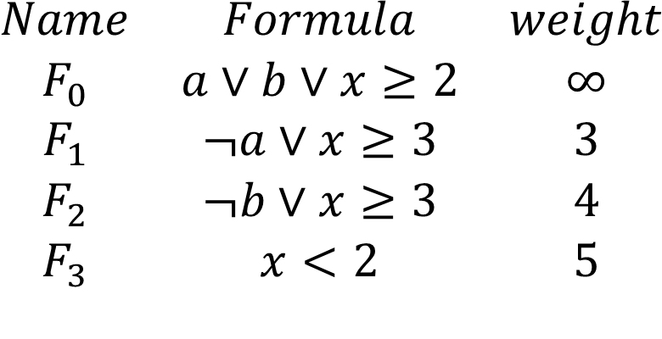
Weighted MaxSMT
$$\begin{matrix}Name & Formula & weight \\ F_{0} & a∨b∨x≥2 & ∞ \\ F_{1} & ¬a∨x≥3 & 3 \\ F_{2} & ¬b∨x≥3 & 4 \\ F_{3} & x<2 & 5\end{matrix}$$
Unsat

Slide 58


Weighted MaxSMT
$$\begin{matrix}Name & Formula & weight \\ F_{0} & a∨b∨x≥2 & ∞ \\ F_{1} & ¬a∨x≥3 & 3 \\ F_{2} & ¬b∨x≥3 & 4 \\ F_{3} & x<2 & 5\end{matrix}$$
Penalty: $∞$
Sat $¬a∧¬b∧x<2$

Slide 59

Weighted MaxSMT
$$\begin{matrix}Name & Formula & weight \\ F_{0} & a∨b∨x≥2 & ∞ \\ F_{1} & ¬a∨x≥3 & 3 \\ F_{2} & ¬b∨x≥3 & 4 \\ F_{3} & x<2 & 5\end{matrix}$$
Sat $¬a∧b∧x=2$
Penalty: 9 = 4 + 5

Slide 60

Weighted MaxSMT
$$\begin{matrix}Name & Formula & weight \\ F_{0} & a∨b∨x≥2 & ∞ \\ F_{1} & ¬a∨x≥3 & 3 \\ F_{2} & ¬b∨x≥3 & 4 \\ F_{3} & x<2 & 5\end{matrix}$$
Sat $¬a∧¬b∧x≥2$
Penalty: 5

Slide 61

Weighted MaxSMT
$$\begin{matrix}Name & Formula & weight \\ F_{0} & a∨b∨x≥2 & ∞ \\ F_{1} & ¬a∨x≥3 & 3 \\ F_{2} & ¬b∨x≥3 & 4 \\ F_{3} & x<2 & 5\end{matrix}$$
Penalty: 3
Sat $a∧¬b∧x<2$

Slide 62
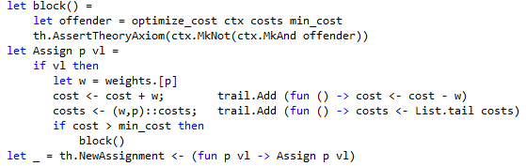
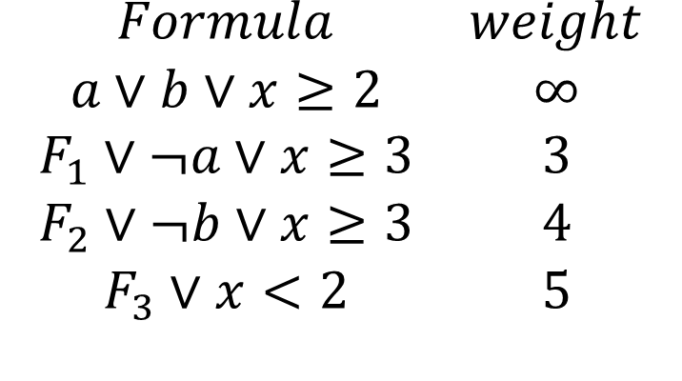
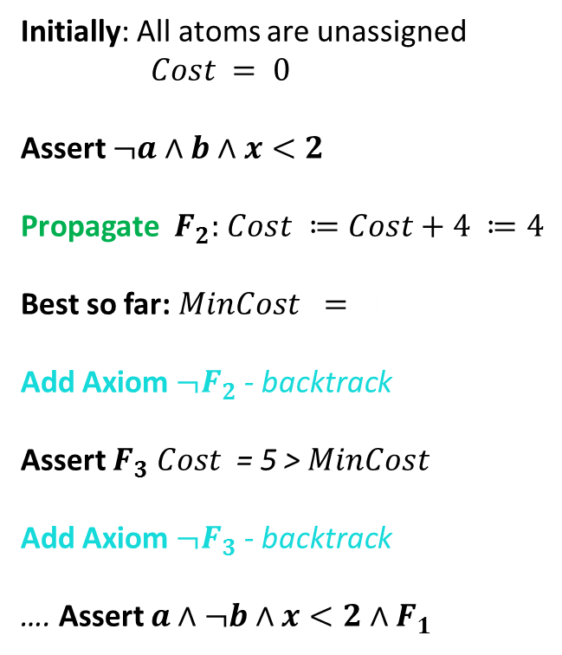
Weighted MaxSMT
$$\begin{matrix}Formula & weight \\ a∨b∨x≥2 & ∞ \\ F_{1}∨¬a∨x≥3 & 3 \\ F_{2}∨¬b∨x≥3 & 4 \\ F_{3}∨x<2 & 5\end{matrix}$$
Initially: All atoms are unassigned
$Cost = 0$
Assert $¬a∧b∧x<2$
Propagate: $F_{2}:$ $Cost ≔Cost+4 ≔4$
Best so far: $MinCost = 4$
Add Axiom ${¬F}_{2}$ - backtrack
Assert $F_{3}$ $Cost$ = 5 > $MinCost$
Add Axiom ${¬F}_{3}$ - backtrack
…. Assert $a∧¬b∧x<2∧F_{1}$
What does it take to
encode this in Z3?

Slide 63
Principles of Modern SMT solvers in two slides

Slide 64
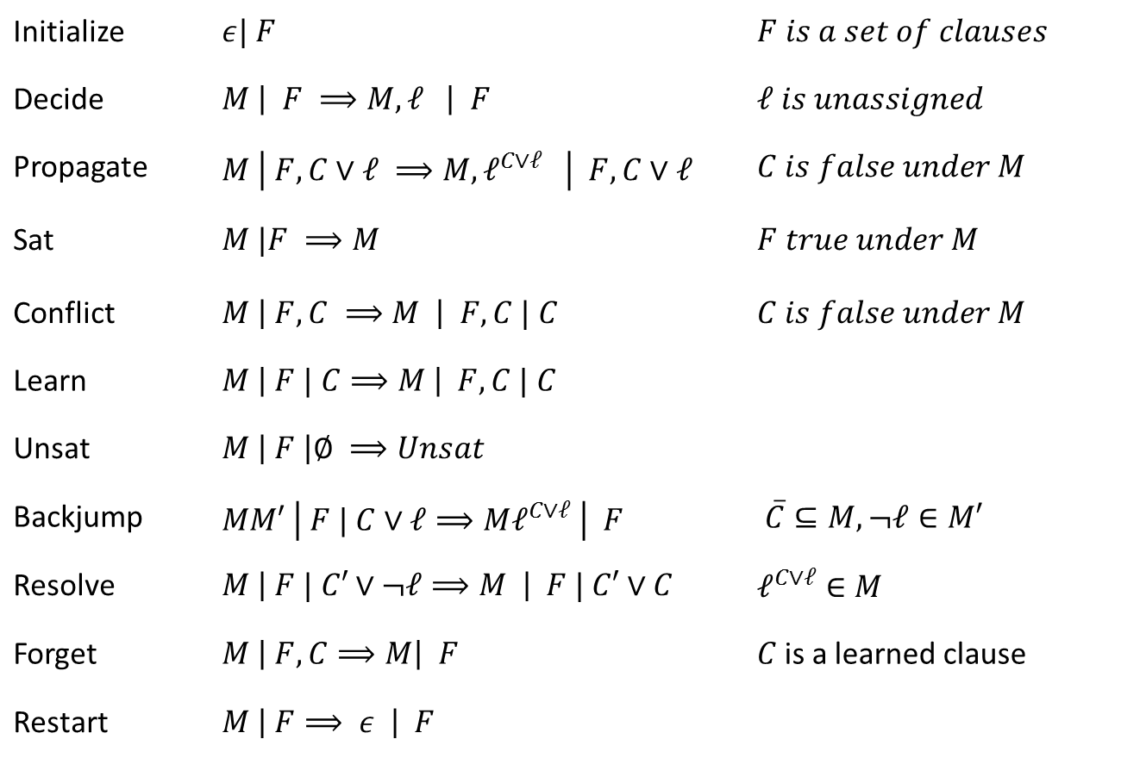
Core Engine in Z3:
Modern DPLL/CDCL
Initialize | $ε| F$ | $F is a set of clauses$
Decide | $M \left| F ⟹M, ℓ \right| F$ | $ℓ is unassigned$
Propagate | $M \left| F, C∨ℓ ⟹M, ℓ^{C∨ℓ} \right| F,C∨ℓ$ | $C is false under M$
Sat | $M |F ⟹M$ | $F true under M$
Conflict | $M \left| F, C ⟹M \right| F,C | C$ | $C is false under M$
Learn | $M \left| F | C⟹M \right| F, C | C$
Unsat | $M \left| F \right|∅ ⟹Unsat$
Backjump | $MM′ \left| F | C∨ℓ⟹Mℓ^{C∨ℓ} \right| F$ | $\overline{C}⊆M, ¬ℓ∈M′$
Resolve | $M \left| F | C′∨¬ℓ⟹M \right| F | C′∨C$ | $ℓ^{C∨ℓ}∈M$
Forget | $M \left| F, C⟹M\right| F$ | $C$is a learned clause
Restart | $M \left| F⟹ ε \right| F$
Model
Proof
Conflict
Resolution
[Nieuwenhuis, Oliveras, Tinelli J.ACM 06] customized

Slide 65
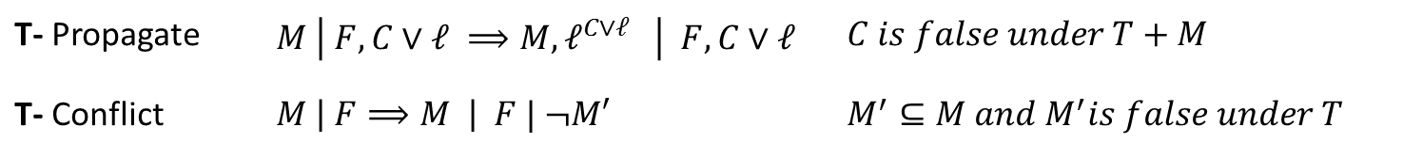
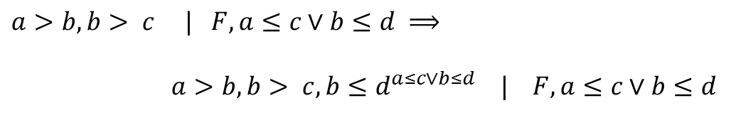

DPLL(T) solver interaction
T- Propagate | $M \left| F, C∨ℓ ⟹M, ℓ^{C∨ℓ} \right| F,C∨ℓ$ | $C is false under T+M$
T- Conflict | $M \left| F⟹M \right| F | ¬M′$ | $M^{′}⊆M and M^{′}is false under T$
T- Propagate
$a>b, b> c | F, a≤c∨b≤d ⟹$
$a>b, b> c, b≤d^{a≤c∨b≤d} | F, a≤c∨b≤d$
T- Conflict
$M | F⟹$ $M | F, a≤b∨b≤c∨c<a$
$$where a>b, b> c, a≤c⊆M$$

Slide 66
How does Z3 enable T solvers?

Slide 67
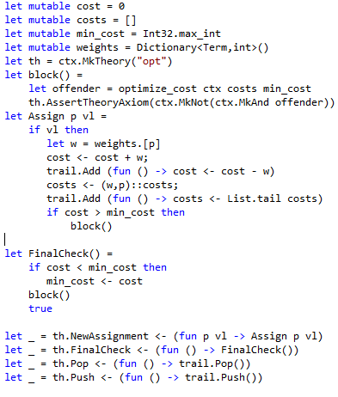
DPLL(T) Solver Interaction
Calls into DPLL engine
T-Propagate
T-Conflict
Callbacks from DPLL engine
Callbacks from DPLL engine
with new assignment
T-Propagate
T-Conflict
Calls into DPLL engine

Slide 68
Partial Orders &
Object Hierarcies
Reduction
New Theory
Theory
Solver
Compile
Constraints
Model
Saturation
New
Theory
New
Theory
Eqs
Partial
Compile
Search
Intro
Lazy
Reduction
SMT?
Eager Reduction
Acyclic graphs and SMT
Z3?
Theory Solver

Slide 69







Partial Orders as Acyclic Graphs
$∀x. x≼x$
$∀x,y. x≼y∧y≼x→x=y$
$∀x, y, z . x≼y∧y≼z→x≼z$
Elements are equal
in strongly connected
components
= =
$$≼$$
$$≼$$
$$≼$$
$$≽$$
$$≼$$
$$≼$$

Slide 70



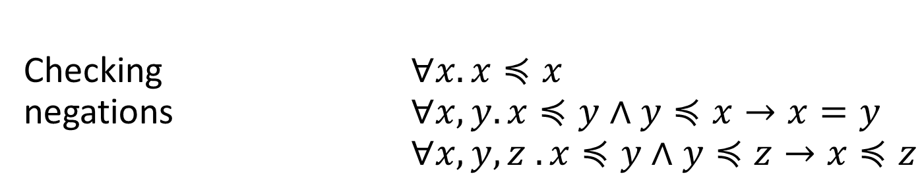




Partial Orders as Acyclic Graphs
Checking $∀x. x≼x$
negations $∀x,y. x≼y∧y≼x→x=y$
$∀x, y, z . x≼y∧y≼z→x≼z$
$$≼$$
$$≼$$
$$≼$$
$$≼$$
$$≼$$
$$≼$$
$$¬≼$$
$$¬≼$$
$$≼$$
$$≼$$
$$≼$$
$$≼$$
OK
Not OK

Slide 71
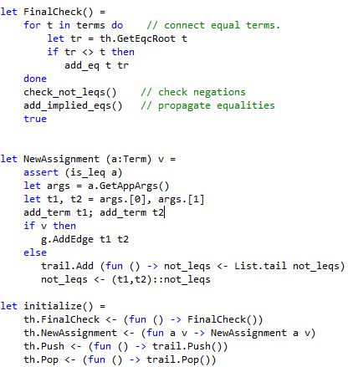













Partial Orders as Acyclic Graphs
Checking Consistency of $¬\left(x≼y\right)$:
Is there is a $≼$path from to $?$
Extracting Equalities from $≼$using strongly connected components:
$$≼$$
$$≼$$
$$≼$$
$$¬≼$$
$$≼$$
$$≼$$
$$≼$$
$$≼$$
$$≼$$
$$≽$$
$$≼$$
$$≼$$

Slide 72
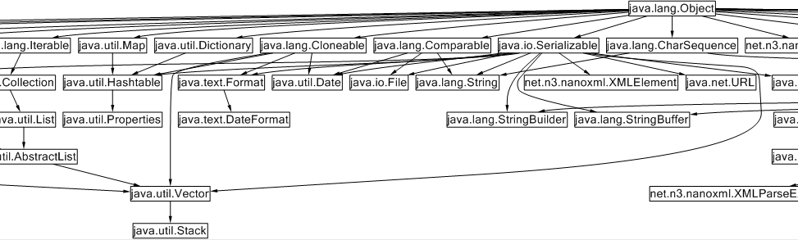



Inheritance as table-lookup
$$x≼java.lang.Comparable$$
Efficient propagators using
Type Slicing algorithm
Leverages ordering of children
J. Gil and Y. Zibin.[TOPLAS 2007]
Available as F#/Z3 sample
$$x≼java.lang.Clonable$$
$$x=java.util.Date$$
Sherman, Garvin, Dwyer. IJCAR 2010

Slide 73

Object Graphs
Reduction
New Theory
Theory
Solver
Compile
Constraints
Model
Saturation
New
Theory
New
Theory
Eqs
Partial
Compile
Search
Intro
Lazy
Reduction
To Cycle and not to Cycle
SMT?
Eager Reduction
Z3?
Theory Solver
from Pex

Slide 74
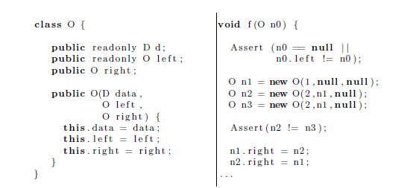
A Theory of Objects
Objects are
non-extensional
Read-only fields
Heap can be updated

Slide 75
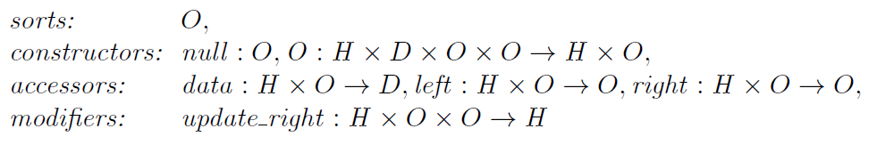
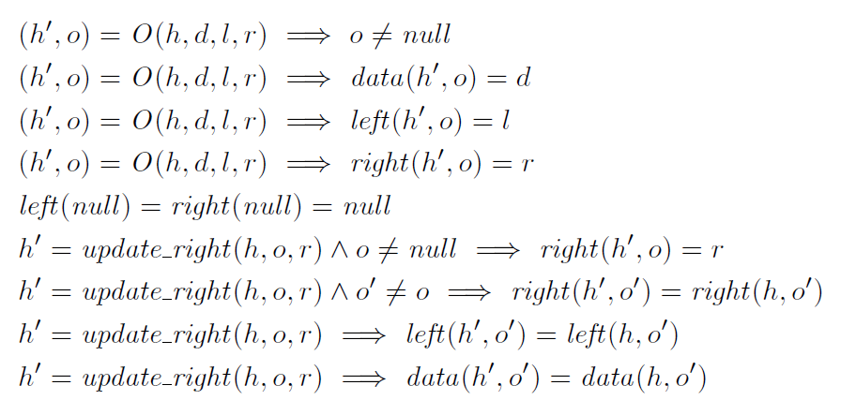
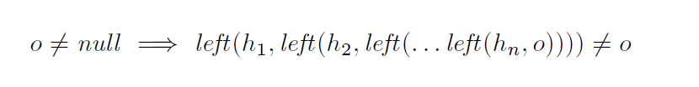
A Theory of Objects
So far so good, but what about read-only fields?

Slide 76
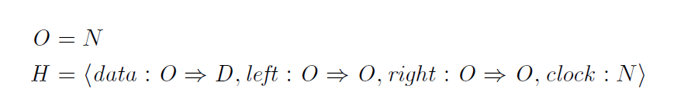
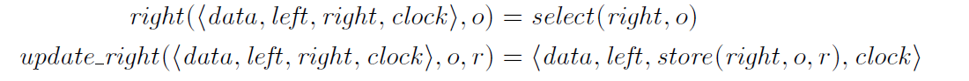
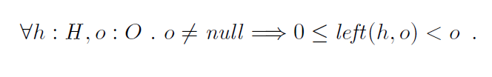
Encoding: Heaps as Arrays
Domains: objects are Natural numbers, left child is a smaller number
Most axioms follow by function definitions.
…
Only Axiom: Instantiate for every occurrence of left(h,o)

Slide 77
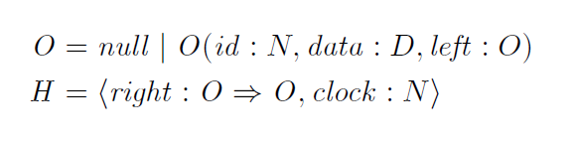
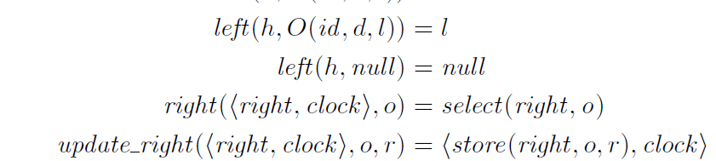

Encoding: Heaps as Arrays+Data-Types
Domains: read-only fields use algebraic data-types
Most axioms follow by function definitions.
No Extra Axiom: Data-type theory enforces acyclicity over left
$⇒$ More efficient search

Slide 78
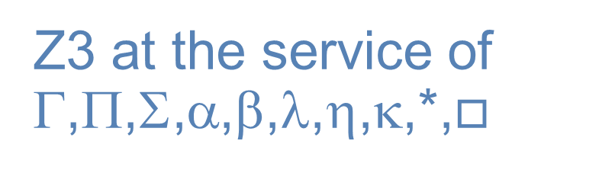
HOL
Reduction
New Theory
Theory
Solver
Compile
Constraints
Model
Saturation
New
Theory
New
Theory
Eqs
Partial
Compile
Search
Z3 at the service of
Γ,Π,Σ,α,β,λ,η,κ,*,$□$
Intro
Lazy
Reduction
SMT?
Eager Reduction
Z3?
Theory Solver
SMT version of Satalax, Brown, CADE 2011

Slide 79

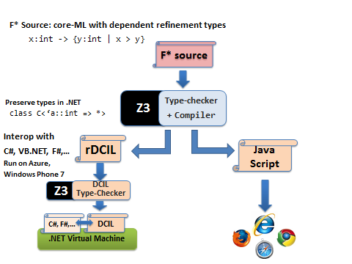

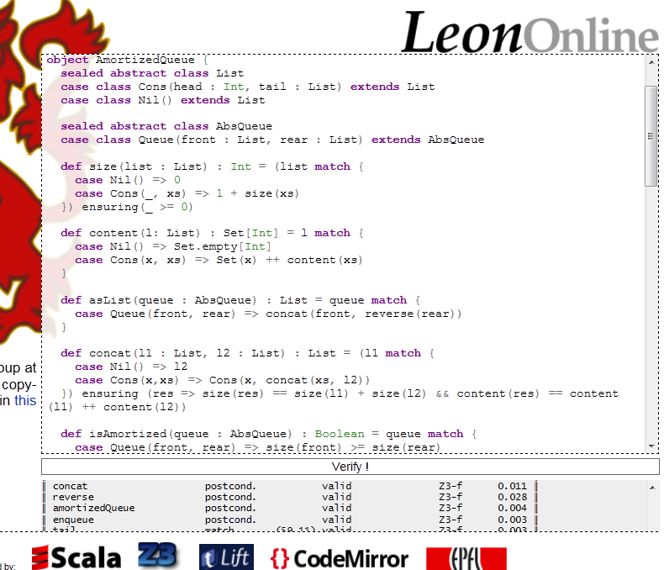

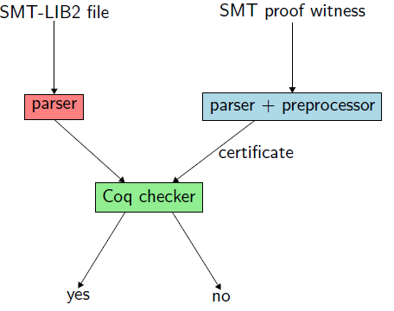
Types and Z3 do mingle
Sledge Hammer
Armand, Grégoire, Keller, Théry, Werner

Slide 80
But
Used for First-Order Theorems

Slide 81
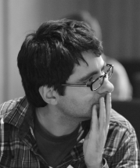

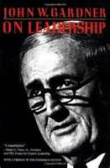

Sure, often
HOL (problem)
is just
FO (solution)
in disguise
“We are all faced with a series of great opportunities brilliantly disguised as unsolvable problems.”
“For every problem there is a solution which is simple, clean and wrong.”
John W. Gardner
Henry Louis Mencken

Slide 82
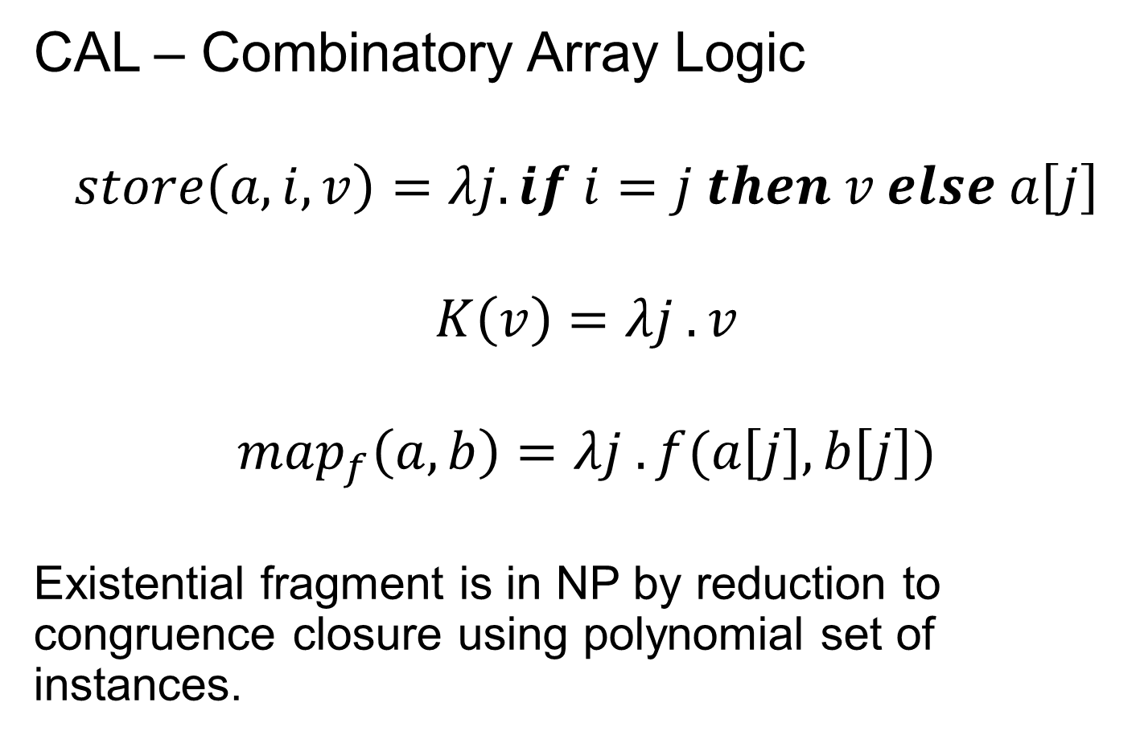
Digression: CAL
CAL – Combinatory Array Logic
$$store\left(a,i,v\right)=λj. if i=j then v else a\left[j\right]$$
$$K\left(v\right)=λj . v$$
$$map_{f}\left(a,b\right)=λj . f(a\left[j\right],b\left[j\right])$$
Existential fragment is in NP by reduction to congruence closure using polynomial set of instances.

Slide 83
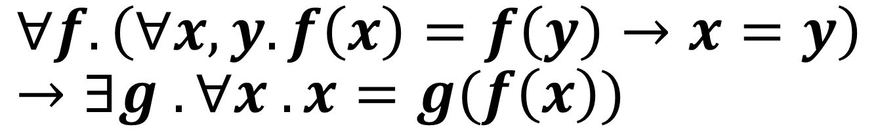
but can we do something
more HOLish?
e.g.,
$$∀f. \left(∀x,y. f\left(x\right)=f\left(y\right)→x=y\right)→∃g . ∀x . x=g(f\left(x\right))$$

Slide 84
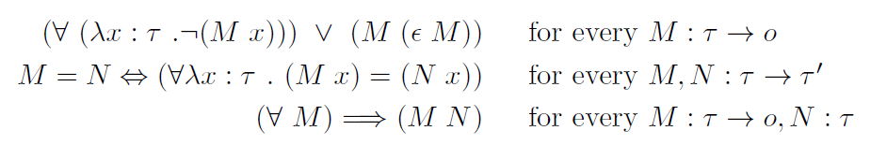

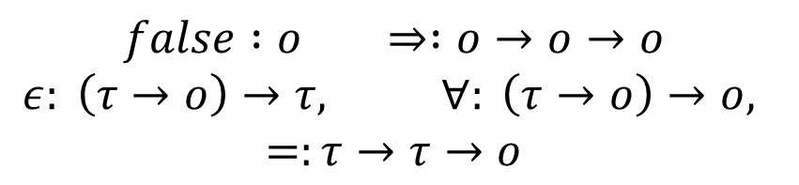

Idea: Saturate for Henkin Models
$$σ∷=i \left| o τ∷=σ \right| τ→τ$$
Types
Terms
Constants
Axioms
$$M, N ∷=λx:τ. M \left| \left(M N\right) \right| x$$
$$false :o ⇒ :o→o→o$$
$$ε: \left(τ→o\right)→τ, ∀: \left(τ→o\right)→o,$$
$$=:τ→τ→o$$

Slide 85
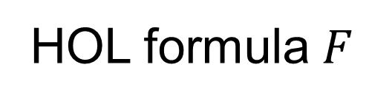
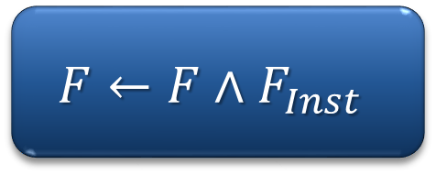

Lazy Saturation loop
HOL formula $F$
Assert $⟦F⟧$
$$F←F∧F_{Inst}$$
Check SAT
Instantiate
Unsat
Model

Slide 86
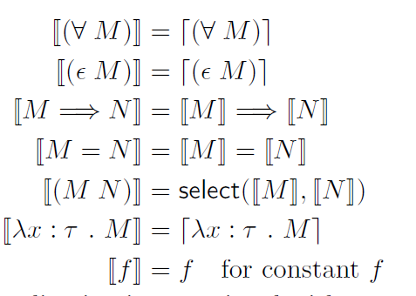
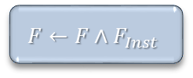



HOL $⇒$SMT
HOL formula $F$
Assert $⟦F⟧$
$$F←F∧F_{Inst}$$
Check SAT
Instantiate
Unsat
Model
$$⟦_⟧:HOL →SMT$$
Propositional
reasoning
SAT
Equalities
Congruence
Closure
SMT
Extensional
arrays

Slide 87
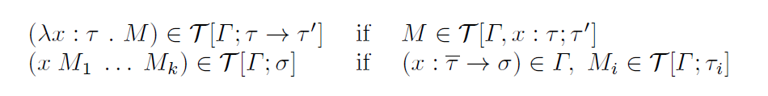
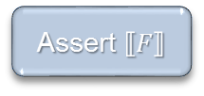


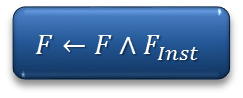
$βη$ long NF
HOL formula $F$
Assert $⟦F⟧$
$$F←F∧F_{Inst}$$
Check SAT
Instantiate
Unsat
Model
Set of $βη$ long NF terms with free variables from $Γ$ of type $τ$
Enumerate $T[Γ;τ]$ by depth:
Many more algorithms (matching, unification)/optimizations required for anything viable…
… but main task of Boolean search, equalities, functions is delegated

Slide 88
Conclusions
  We surveyed three methods for adding new theories (logics) to Z3:
  As 1st class Theory Solver
  Eager reduction: embed theory in Z3
  Lazy reduction: add facts on demand
  Choose one that fits your theory!

Slide 89
[Zvonimir Rakamaric, Roberto Bruttomesso, Alan J. Hu, Alessandro Cimatti: Verifying Heap-Manipulating Programs in an SMT Framework. ATVA 2007: 237-252]
[Stan Rosenberg, Anindya Banerjee and David Naumann. Decision Procedures for Region Logic. VMCAI 2012]

Slide 90
Plan
  Decision procedures for Arithmetic
  Engineering Theories with Z3
  Combining Decision Procedures [de Moura & B. SMT 2007]

Slide 91
Theories vs. Problem Classes
Applications often generate problems with particular characteristics (many ground clauses/bit-vectors + predicates/arithmetic + transendentals/..)
New Z3 feature by de Moura & Passmore:
  Compose strategies using tactical interface.

Slide 92
Combining Theories
In practice, we need a combination of theories.
b + 2 = c and f(read(write(a,b,3), c-2)) ≠ f(c-b+1)
A theory is a set (potentially infinite) of first-order sentences.
Main questions:
Is the union of two theories T1 ∪ T2 consistent?
Given a solvers for T1 and T2, how can we build a solver for
T1 ∪ T2?

Slide 93
A Combination History
Foundations
Efficiency using rewriting
1979 Nelson, Oppen - Framework
1996 Tinelli & Harindi. N.O. Fix
2000 Barrett et.al N.O + Rewriting
2002 Zarba & Manna. Nice Theories
1984 Shostak. Theory solvers
1996 Cyrluk et.al Shostak Fix #1
1998 B. Shostak with Constraints
2001 Rueß & Shankar Shostak Fix #2
2004 Ranise et.al. N.O + Superposition
2001: Efficient DPLL made guessing cheap
2006 Bruttomesso et.al. Delayed Theory Combination
2007 de Moura & B. Model-based Theory Combination

Slide 94
Disjoint Theories
Two theories are disjoint if they do not share function/constant and predicate symbols.
= is the only exception.
Example:
The theories of arithmetic and arrays are disjoint.
Arithmetic symbols: {0, -1, 1, -2, 2, …, +, -, *, >, <, ≥, ≤}
Array symbols: { read, write }

Slide 95
Purification
It is a different name for our “naming” subterms procedure.
b + 2 = c, f(read(write(a,b,3), c-2)) ≠ f(c-b+1)
b + 2 = c, v₆ ≠ v₇
v₁ ≡ 3, v₂ ≡ write(a, b, v₁), v₃ ≡ c-2, v₄ ≡ read(v₂, v₃),
v₅ ≡ c-b+1, v₆ ≡ f(v₄), v₇ ≡ f(v₅)

Slide 96
Purification
It is a different name for our “naming” subterms procedure.
b + 2 = c, f(read(write(a,b,3), c-2)) ≠ f(c-b+1)
b + 2 = c, v₆ ≠ v₇
v₁ ≡ 3, v₂ ≡ write(a, b, v₁), v₃ ≡ c-2, v₄ ≡ read(v₂, v₃),
v₅ ≡ c-b+1, v₆ ≡ f(v₄), v₇ ≡ f(v₅)
b + 2 = c, v₁ ≡ 3, v₃ ≡ c-2, v₅ ≡ c-b+1,
v₂ ≡ write(a, b, v₁), v₄ ≡ read(v₂, v₃),
v₆ ≡ f(v₄), v₇ ≡ f(v₅), v₆ ≠ v₇

Slide 97
Stably Infinite Theories
A theory is stably infinite if every satisfiable QFF is satisfiable in an infinite model.
EUF and arithmetic are stably infinite.
Bit-vectors are not.

Slide 98
Important Result
The union of two consistent, disjoint, stably infinite theories is consistent.

Slide 99
Convexity
A theory T is convex iff
for all finite sets S of literals and
for all a₁ = b₁∨ … ∨ a_{n} = b_{n}
S implies a₁ = b₁∨ … ∨ a_{n} = b_{n}
iff
S implies a_{i} = b_{i} for some 1 ≤ i ≤ n

Slide 100
Convexity: Results
Every convex theory with non trivial models is stably infinite.
All Horn equational theories are convex.
formulas of the form s₁ ≠ r₁∨ … ∨ s_{n} ≠ r_{n} ∨ t = t’
Linear rational arithmetic is convex.

Slide 101
Convexity: Negative Results
Linear integer arithmetic is not convex
1 ≤ a ≤ 2, b = 1, c = 2 implies a = b ∨ a = c
Nonlinear arithmetic
a² = 1, b = 1, c = -1 implies a = b ∨ a = c
Theory of bit-vectors
Theory of arrays
c₁ = read(write(a, i, c₂), j), c₃ = read(a, j)
implies c₁ = c₂ ∨ c₁ = c₃

Slide 102
Combination of non-convex theories
EUF is convex (O(n log n))
IDL is non-convex (O(nm))
EUF ∪ IDL is NP-Complete
Reduce 3CNF to EUF ∪ IDL
For each boolean variable p_{i} add 0 ≤ a_{i} ≤ 1
For each clause p₁ ∨ ¬p₂ ∨ p₃ add
f(a₁, a₂, a₃) ≠ f(0, 1, 0)

Slide 103
Combination of non-convex theories
EUF is convex (O(n log n))
IDL is non-convex (O(nm))
EUF ∪ IDL is NP-Complete
Reduce 3CNF to EUF ∪ IDL
For each boolean variable p_{i} add 0 ≤ a_{i} ≤ 1
For each clause p₁ ∨ ¬p₂ ∨ p₃ add
f(a₁, a₂, a₃) ≠ f(0, 1, 0)
implies
a₁ ≠ 0 ∨ a₂ ≠ 1 ∨ a₃ ≠ 0

Slide 104
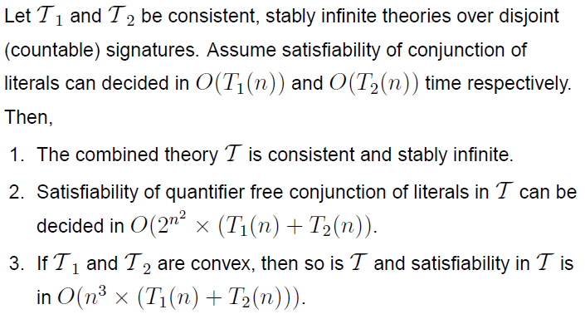
Nelson-Oppen Combination

Slide 105
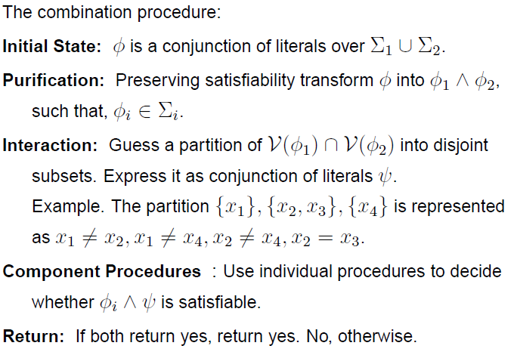
Nelson-Oppen Combination

Slide 106
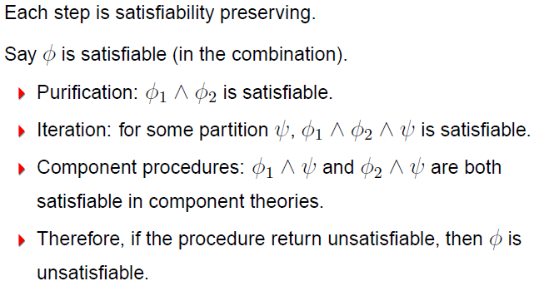
Soundness

Slide 107
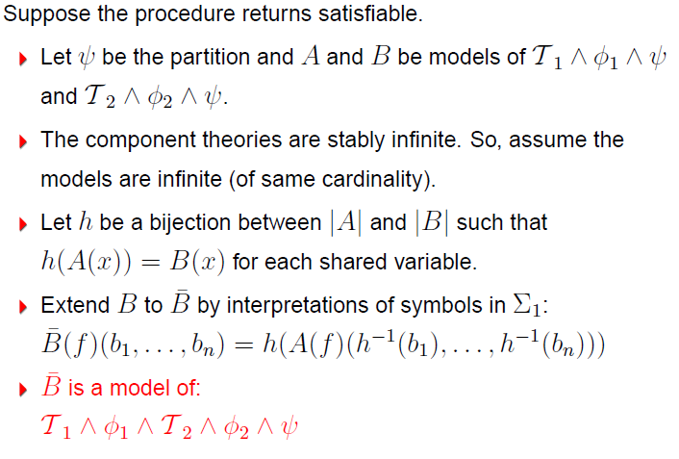
Completeness

Slide 108
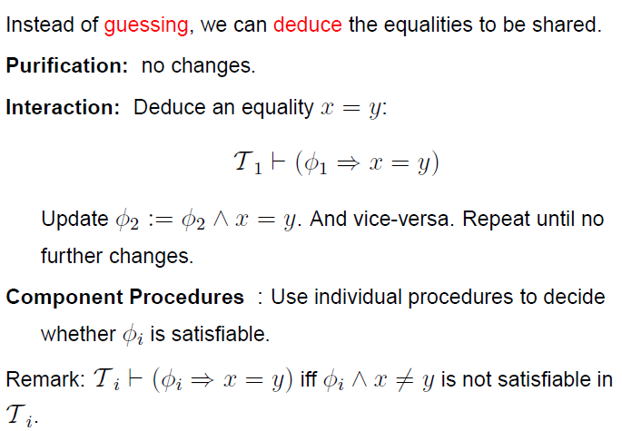
NO deterministic procedure
(for convex theories)

Slide 109
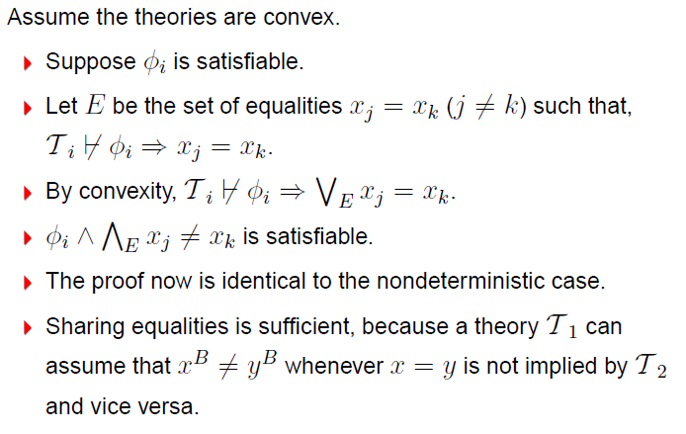
NO deterministic procedure
Completeness

Slide 110
NO procedure: Example
b + 2 = c, f(read(write(a,b,3), c-2)) ≠ f(c-b+1)
Arithmetic
b + 2 = c,
v₁ ≡ 3,
v₃ ≡ c-2,
v₅ ≡ c-b+1
Arrays
v₂ ≡ write(a, b, v₁), v₄ ≡ read(v₂, v₃)
EUF
v₆ ≡ f(v₄),
v₇ ≡ f(v₅),
v₆ ≠ v₇

Slide 111
NO procedure: Example
b + 2 = c, f(read(write(a,b,3), c-2)) ≠ f(c-b+1)
Arithmetic
b + 2 = c,
v₁ ≡ 3,
v₃ ≡ c-2,
v₅ ≡ c-b+1
Arrays
v₂ ≡ write(a, b, v₁), v₄ ≡ read(v₂, v₃)
EUF
v₆ ≡ f(v₄),
v₇ ≡ f(v₅),
v₆ ≠ v₇
Substituting c

Slide 112
NO procedure: Example
b + 2 = c, f(read(write(a,b,3), c-2)) ≠ f(c-b+1)
Arithmetic
b + 2 = c,
v₁ ≡ 3,
v₃ ≡ b,
v₅ ≡ 3
Arrays
v₂ ≡ write(a, b, v₁), v₄ ≡ read(v₂, v₃),
EUF
v₆ ≡ f(v₄),
v₇ ≡ f(v₅),
v₆ ≠ v₇
Propagating v₃ = b

Slide 113
NO procedure: Example
b + 2 = c, f(read(write(a,b,3), c-2)) ≠ f(c-b+1)
Arithmetic
b + 2 = c,
v₁ ≡ 3,
v₃ ≡ b,
v₅ ≡ 3
Arrays
v₂ ≡ write(a, b, v₁), v₄ ≡ read(v₂, v₃),
v₃ = b
EUF
v₆ ≡ f(v₄),
v₇ ≡ f(v₅),
v₆ ≠ v₇,
v₃ = b
Deducing v₄ = v₁

Slide 114
NO procedure: Example
b + 2 = c, f(read(write(a,b,3), c-2)) ≠ f(c-b+1)
Arithmetic
b + 2 = c,
v₁ ≡ 3,
v₃ ≡ b,
v₅ ≡ 3
Arrays
v₂ ≡ write(a, b, v₁), v₄ ≡ read(v₂, v₃),
v₃ = b,
v₄ = v₁
EUF
v₆ ≡ f(v₄),
v₇ ≡ f(v₅),
v₆ ≠ v₇,
v₃ = b
Propagating v₄ = v₁

Slide 115
NO procedure: Example
b + 2 = c, f(read(write(a,b,3), c-2)) ≠ f(c-b+1)
Arithmetic
b + 2 = c,
v₁ ≡ 3,
v₃ ≡ b,
v₅ ≡ 3,
v₄ = v₁
Arrays
v₂ ≡ write(a, b, v₁), v₄ ≡ read(v₂, v₃),
v₃ = b,
v₄ = v₁
EUF
v₆ ≡ f(v₄),
v₇ ≡ f(v₅),
v₆ ≠ v₇,
v₃ = b,
v₄ = v₁
Propagating v₅ = v₁

Slide 116
NO procedure: Example
b + 2 = c, f(read(write(a,b,3), c-2)) ≠ f(c-b+1)
Arithmetic
b + 2 = c,
v₁ ≡ 3,
v₃ ≡ b,
v₅ ≡ 3,
v₄ = v₁
Arrays
v₂ ≡ write(a, b, v₁), v₄ ≡ read(v₂, v₃),
v₃ = b,
v₄ = v₁
EUF
v₆ ≡ f(v₄),
v₇ ≡ f(v₅),
v₆ ≠ v₇,
v₃ = b,
v₄ = v₁,
v₅ = v₁
Congruence: v₆ = v₇

Slide 117
NO procedure: Example
b + 2 = c, f(read(write(a,b,3), c-2)) ≠ f(c-b+1)
Arithmetic
b + 2 = c,
v₁ ≡ 3,
v₃ ≡ b,
v₅ ≡ 3,
v₄ = v₁
Arrays
v₂ ≡ write(a, b, v₁), v₄ ≡ read(v₂, v₃),
v₃ = b,
v₄ = v₁
EUF
v₆ ≡ f(v₄),
v₇ ≡ f(v₅),
v₆ ≠ v₇,
v₃ = b,
v₄ = v₁,
v₅ = v₁ ,
v₆ = v₇
Unsatisfiable

Slide 118
NO deterministic procedure
Deterministic procedure may fail for non-convex theories.
0 ≤ a ≤ 1, 0 ≤ b ≤ 1, 0 ≤ c ≤ 1,
f(a) ≠ f(b),
f(a) ≠ f(c),
f(b) ≠ f(c)

Slide 119
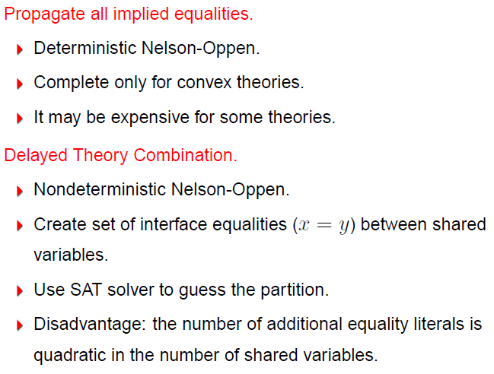
Combining Procedures in Practice

Slide 120

Combining Procedures in Practice

Slide 121

Example

Slide 122

Example

Slide 123

Example

Slide 124

Example

Slide 125

Example

Slide 126

Example

Slide 127

Example

Slide 128

Example

Slide 129

Example

Slide 130

Non-stably infinite theories in practice

