Slide 1



Delayed-Dynamic-Selective (DDS) Prediction for Reducing Extreme Tail Latency in Web Search
Saehoon Kim§, Yuxiong He*, Seung-won Hwang§, Sameh Elnikety*, Seungjin Choi§
§
*

Slide 2






Web Search Engine Requirement
Queries
High quality + Low latency
This talk focuses on how to achieve low latency without compromising the quality

Slide 3
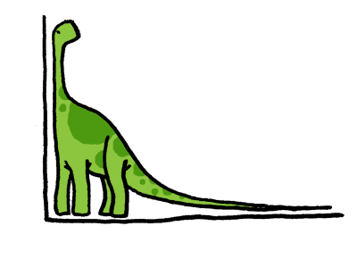
Low Latency for All Users
Reduce tail latency (high-percentile response time)
Reducing average latency is not sufficient
Latency
Commercial search engine reduces 99th-percentile latency

Slide 4

Reducing End-to-End Latency
The 99th–percentile
response time < 120ms
Aggregator
40 Index Server Nodes (ISNs)
ISN
ISN
ISN
ISN
The 99.99th–percentile
response time < 120ms
Long(-running )query

Slide 5
Reducing Tail Latency by Parallelization
Resource | Latency
Network | 4.26 ms
Queueing | 0.15 ms
I/O | 4.70 ms
CPU | 194.95 ms
Opportunity of Parallelization
  Available idle cores
  CPU-intensive workloads

Slide 6
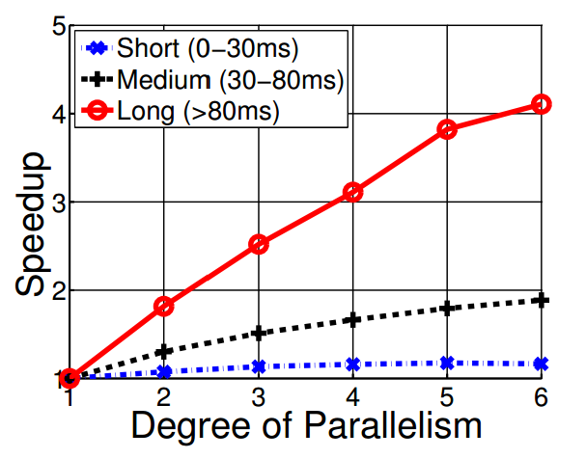
Challenges of Exploiting Parallelism
Parallelizing all queries
  Inefficient under medium to high load
Parallelizing short queries
  No speed up
Parallelizing long queries
  Good speed up
Parallelize only long(-running) queries

Slide 7

Prior Work - PREDictive Parallelization
Predict the query execution time
Parallelize the predicted long queries only
Execute the predicted short queries sequentially
“WSDM”
Feature
Extraction
Regression
function
Long
Prediction model
Short
Predictive Parallelization: Taming Tail Latencies in Web Search, [M. Jeon, SIGIR’14]

Slide 8
Requirements
99th tail latency at aggregator <= 120ms
Reduce 99.99th tail latency at each ISN <= 120ms
 | Recall | Precision
Requirements | >= 98.9% | Should be high
Reason | To optimize 99.99th tail latency | Less queries to be parallelized
PRED | 98.9% | 1.1%
PRED cannot effectively reduce
99.99th tail latency

Slide 9
Contributions
Key Contributions:
  Proposes DDS (Delayed-Dynamic-Selective) prediction to achieve very high recall and good precision
  Use DDS prediction to effectively reduce extreme tail latency

Slide 10
Overview of DDS
Delayed prediction
Selective prediction
Predictor for confidence level
Not
confident
Queries
> 10ms
Query
Long
Dynamic prediction
Predictor for execution time
Queries
< 10ms
Finished
Short

Slide 11
Delayed Prediction
Complete many short queries sequentially
Collect dynamic features

Slide 12
Dynamic Features
What are dynamic features?
  Features that can only be collected at runtime
Two categories
  NumEstMatchDocs: to estimate the total # matched docs
  DynScores: to predict early termination

Slide 13
Primary Factors for Execution Time
1. # total matched documents
Highest
Docs sorted by static scores
Lowest
Doc 1
Doc 2
Doc 3
…….
Doc N-2
Doc N-1
Doc N
Web documents
…….
…….
Inverted index for “WSDM”
Inverted index for “2015”
Processing

Slide 14
Primary Factors for Execution Time
1. # total matched documents
Highest
Docs sorted by static scores
Lowest
Doc 1
Doc 2
Doc 3
…….
Doc N-2
Doc N-1
Doc N
Web documents
…….
…….
Inverted index for “WSDM”
Inverted index for “2015”
Processing
Not evaluated
2. Early termination

Slide 15
Early Termination
Highest
Docs sorted by static scores
Lowest
Doc 1
Doc 2
Doc 3
…….
Doc N-2
Doc N-1
Doc N
Web documents
…….
…….
Inverted index for “WSDM”
Processing
Not evaluated
To predict early termination,
Consider a dynamic score distribution
Doc ID | Dynamic Score
Doc 1 | -4.11
Doc ID | Dynamic Score
Doc 3 | -4.01
Doc 1 | -4.11
Doc ID | Dynamic Score
Doc 3 | -4.01
Doc 1 | -4.11
Doc 5 | -4.23
Doc ID | Dynamic Score
Doc 3 | -4.01
Doc 8 | -4.10
Doc 1 | -4.11
Top-3 Results
If min. Dynamic score > threshold, then stop.

Slide 16
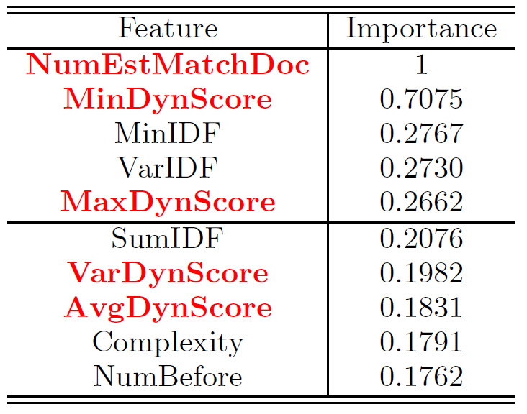
Importance of Dynamic Features
Top-10 feature importance by boosted regression tree
NumEstMachDoc helps to predict # total matched docs
DynScore helps to predict early termination

Slide 17
Selective Prediction
Find out almost all long queries with good precision
Identify the outliers (long query predicted as short)
Predicted execution time

Slide 18
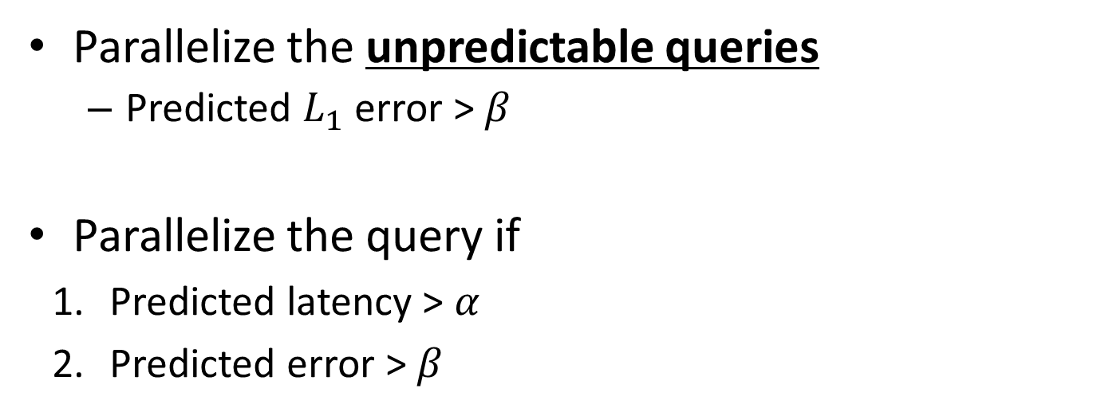
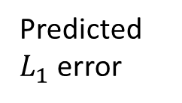
Selective Prediction
Long queries
Predicted
$L_{1}$ error
Short queries
Predicted execution time

Slide 19
Overview of DDS
Delayed prediction
Selective prediction
Predictor for confidence level
Not
confident
Queries
> 10ms
Query
Long
Dynamic prediction
Predictor for execution time
Queries
< 10ms
Finished
Short

Slide 20
Evaluations of Predictor Accuracy (1/3)
Baseline (PRED)
  Static features with no delayed prediction
  IDF, Static score (e.x. PageRank), etc.
Proposed method (DDS)
  Dynamic (+static) features with Delayed and Selective prediction

Slide 21
Evaluations of Predictor Accuracy (2/3)
69,010 Bing queries at production workload
  14,565 queries >= 10ms
  635 queries >= 100ms
Boosted regression tree with 10-fold cross validation
  For PRED, we use 69,010 queries
  For DDS, we use 14,565 queries

Slide 22
Evaluations of Predictor Accuracy (3/3)
957% Improvement over PRED

Slide 23
Evaluations of Predictor Accuracy (3/3)
957% Improvement over PRED
Delayed

Slide 24
Evaluations of Predictor Accuracy (3/3)
957% Improvement over PRED
Selective features
Dynamic features
Delayed
Notes:
You may want to add an additional animation label to show “Delay”, “Dynamic”, “Selective”

Slide 25
Simulation Results on Tail Latency Reduction
Baseline (PRED)
  Predict query execution time before running it
  Parallelize the long query with 4-way parallelism
Proposed method (DDS)
  Run a query for 10ms sequentially
  Parallelizes the long or unpredictable queries with 4-way parallelism

Slide 26
ISN Response Time

Slide 27
ISN Response Time

Slide 28
ISN Response Time
70% throughput increase

Slide 29
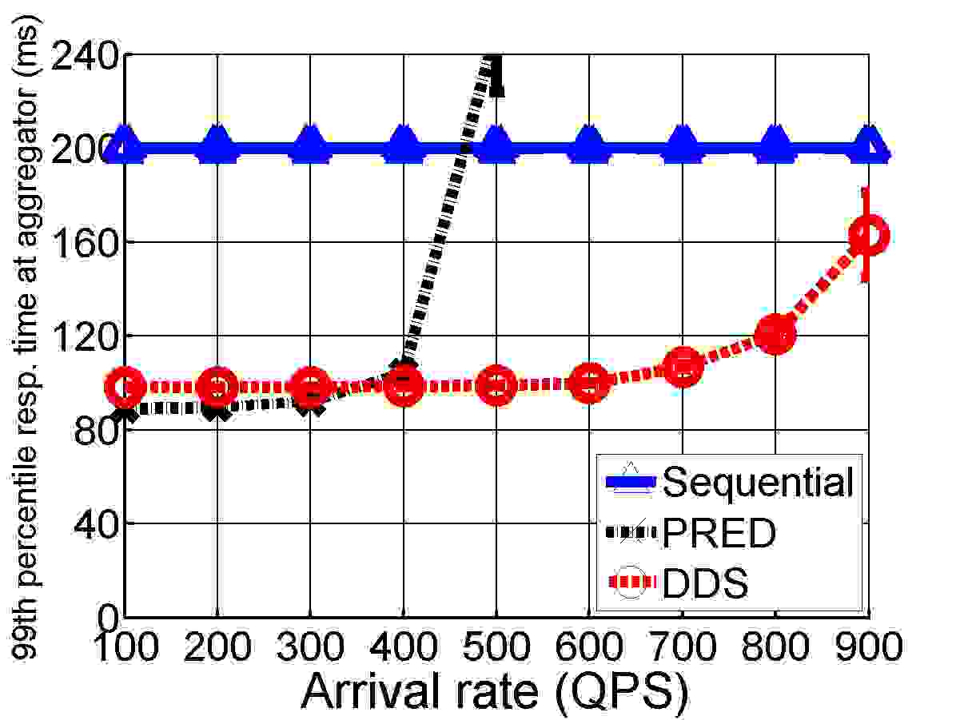
Aggregator Response Time
DDS can optimize 99th-percentile tail latency at aggregator under high QPS

Slide 30
Conclusion
Proposes a novel prediction framework
  Delayed prediction/Dynamic features/Selective prediction
  Achieves a high precision and recall compared to PRED
Reduces 99th-percentile aggregator response time <= 120ms under high load!

Slide 31


