Slide 1
Reliable wireless connectivity on the go
Ratul Mahajan
Networking Research Group, MSR
Jitu Padhye, Sharad Agarwal, Brian Zill (MSR)
Aruna Balasubramanian, Brian Levine, Arun Venkataramani (UMass)
John Zahorjan (U of Washington)

Slide 2

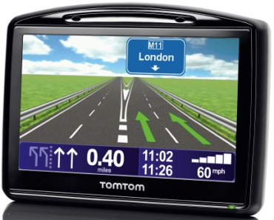
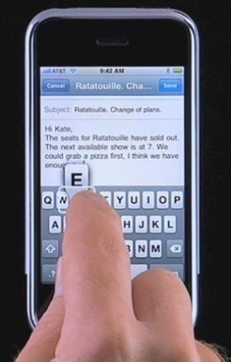
Increasing demand for connectivity from moving vehicles
Commuter Internet access
  E.g., MS Connector
Navigation units
  E.g., for current traffic conditions
Seamless access between driving
and being stationary
Many novel vehicular applications

Slide 3
How to best enable such connectivity?
Two possibilities with distinct characteristics
  WWAN links (e.g., 3G, WiMax)
    Expensive, almost ubiquitous coverage
  WLAN links (e.g., WiFi)
    Inexpensive, short range, poor coverage

Slide 4
This talk
Considers each possibility and identifies key challenges
  Packet loss, path delay, consistency of connection quality
Proposes solutions
  PluriBus for WWAN links
  ViFi for WLAN links

Slide 5
VanLAN: Our vehicular testbed
Uses campus shuttles as vehicular clients
  Equipped with EVDO (Sprint), WiMax (Clearwire), and WiFi radios, and a GPS unit
  Currently, 2 shuttles; expanding to Connectors
  Zero driving overhead but limited control
A mesh of basestations for WiFi experiments
  Currently, 11 BSes across 5 MS buildings

Slide 6
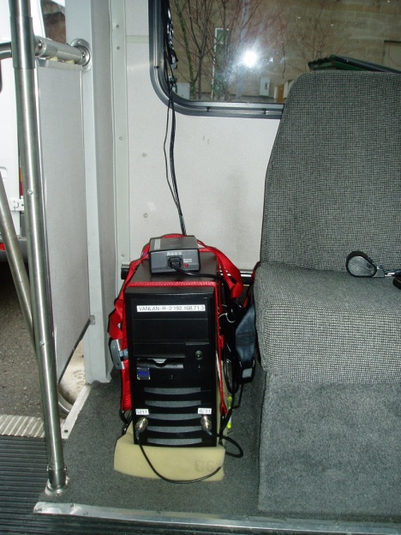
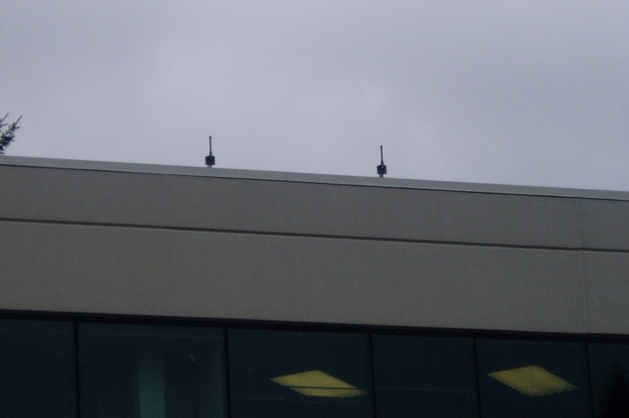
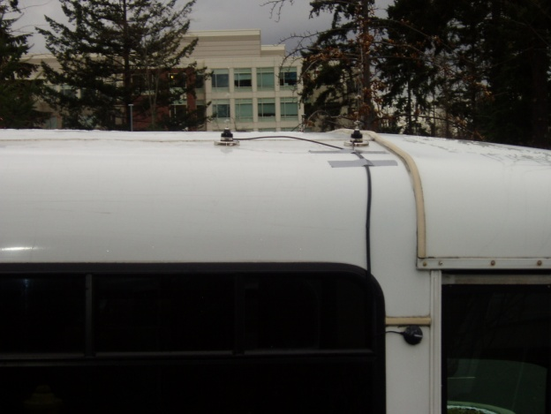
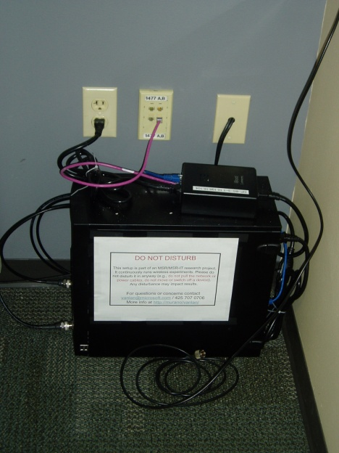
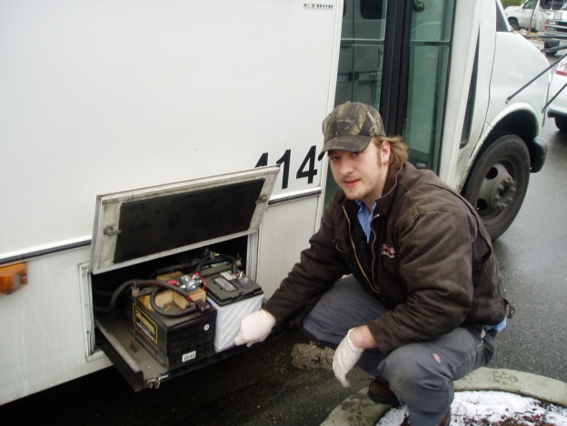

Deployment of VanLAN

Slide 7
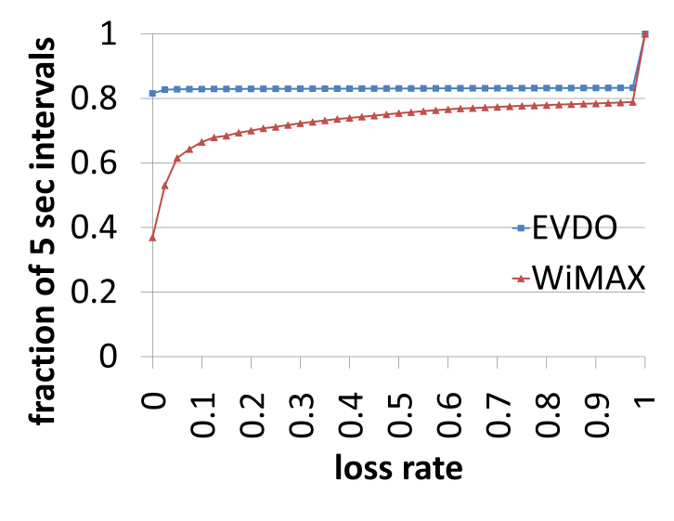
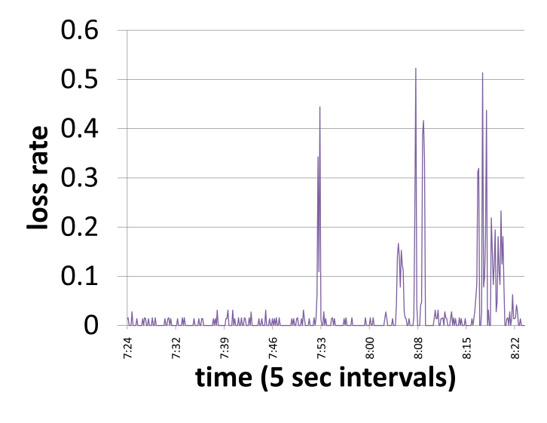
The WWAN environment: Packet loss
EVDO
WiMax
WiMax
Paths can have high loss rates

Slide 8
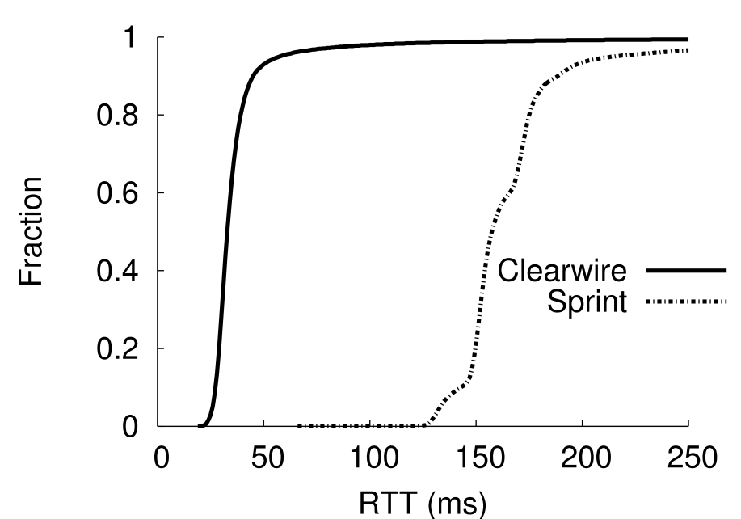
The WWAN environment: Path delay
WiMax
EVDO
Paths have high delay
  Most delay is inside carrier networks

Slide 9
Application performance
Advice from folks behind MS Connector:
  “there can be lapses in the backhaul coverage or system congestion”
  “cancel a failed download and re-try in approximately 5 minutes”

Slide 10
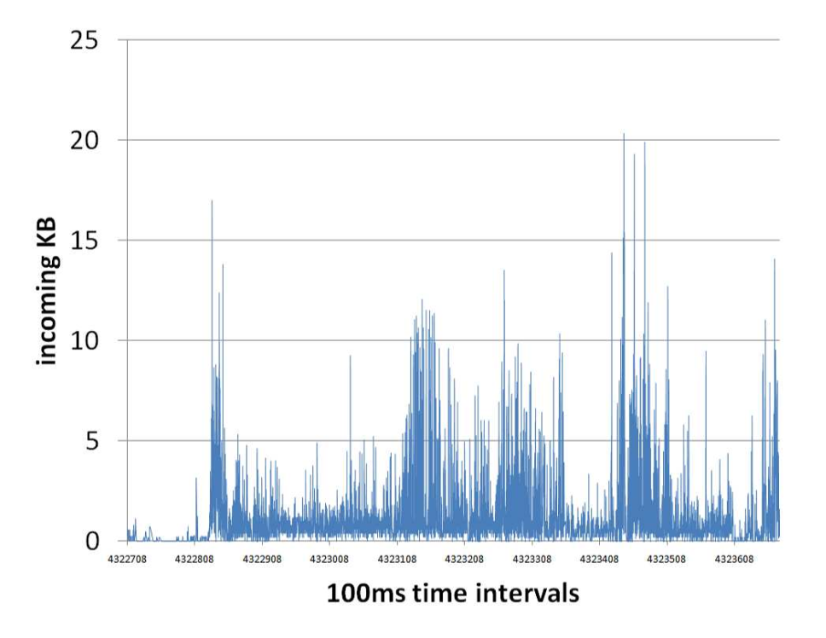
Workload characteristics as measured on MS Connector
Demand is highly bursty
  Leftover capacity between bursts

Slide 11
Overview of PluriBus
Seamlessly combines multiple WWAN links into a single, high-performance path
Employs two main techniques:
  Opportunistic erasure coding masks losses from end hosts using spare path capacity
  Delay-based path selection reduces average packet delay
The two techniques are independent

Slide 12
Masking losses
Erasure coding >> retransmitting lost packets
  Retransmissions have high delay
Two desirable properties
Both are absent in current erasure coding systems
The code should not rely on the reception of a threshold number of packets
Coded packets should interfere minimally with data packets

Slide 13
Opportunistic erasure coding
Send coded packets when and only when there is instantaneous spare capacity in the system
Coded packets should interfere minimally with data packets
→
The code should not rely on the reception of a threshold number of packets
Evolution codes greedily maximize the amount of data recovered by each coded packet
→

Slide 14
Judging availability of spare capacity
Estimate bottleneck (WWAN link) queue length
  Queue ← Max(0, Queue – TimeSinceLastUpdate) +
  PacketSize/PathCapacity
  Estimate capacity using known techniques
    The task is simplified by the MAC of these links
    Leverage normal packets instead of special probes
Send coded packets whenever the queue is zero
  Logically, uses up all spare capacity

Slide 15
Evolution codes: Overview
Encode over a window of packets sent in the last round trip time
  Aim for greedy, partial recovery of packets
Let W = window of packets; and
r = fraction of packets at the receiver
  Assume all packets have the same probability
  Use the XOR operator for encoding packets

Slide 16
Evolution codes: Detail
What should be the degree of a coded packet?
  If the degree is x, expected yield is Y(x) = x ∙ (1 – r) ∙ r^{x-1}
  The yield is maximized for x = -1 / log(r)
  Higher r => higher degree
Updating W and r
  When a data packet is sent, increment W by one and update r based on path loss rate
  When a coded packet is sent, W is unchanged and update r based on path loss rate and expected yield

Slide 17
Delay-based path selection
Path delay
=
Queue
length
+
Transmission time
+
Propagation
delay
Send each data packet along the path likely to deliver it first
  Uses the fastest path until queuing increase its delay to the next fastest path

Slide 18
PluriBus summary
When a data packet arrives, send it right away along the currently fastest path
Send a coded packet along a path whenever the estimated queue length along it is zero
Code packets using Evolution codes

Slide 19
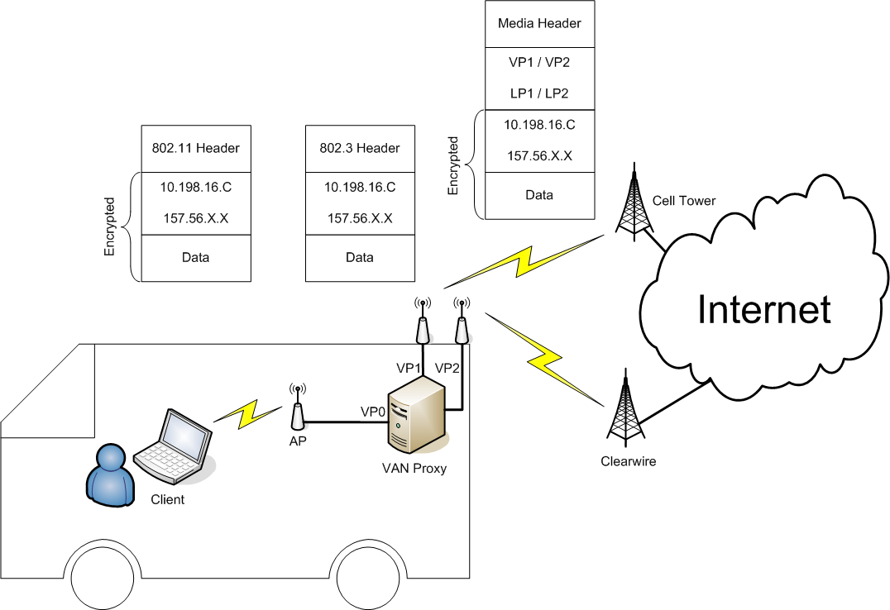
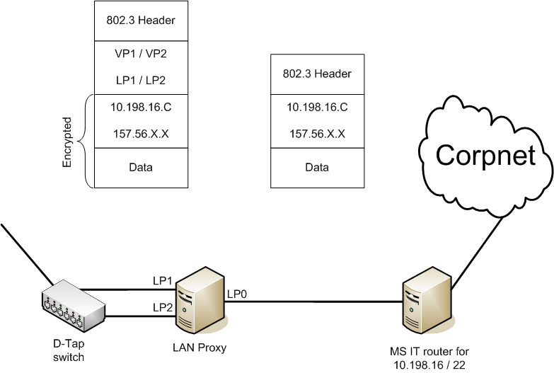
Implementation of PluriBus
Context: providing network access to employees on-board campus shuttles and MS Connector
  As if you are connected to MSFTWLAN (no RAS!)

Slide 20
Experimental evaluation
Compare PluriBus with an alternative method
  MinConnPath: stripes data at the level of connections; no loss protections
Use workload similar to that on the Connector
  Dominated by short TCP flows
Measure performance using flow completion time

Slide 21
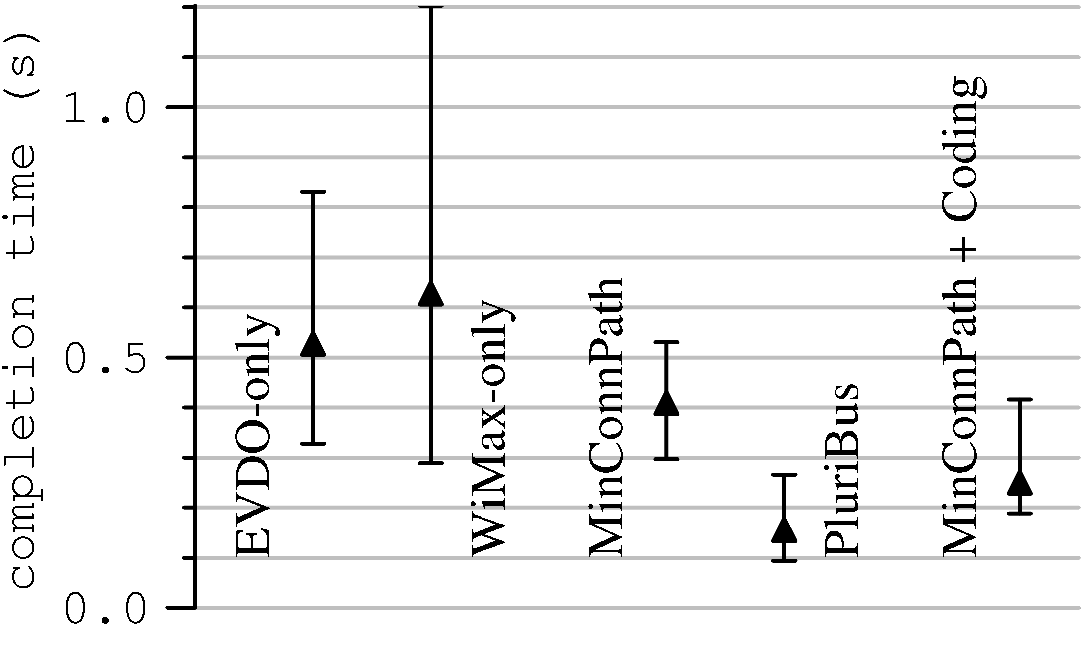
Performance of PluriBus
PluriBus reduces the median flow completion time by a factor of 2.5 compared to MinConnPath

Slide 22
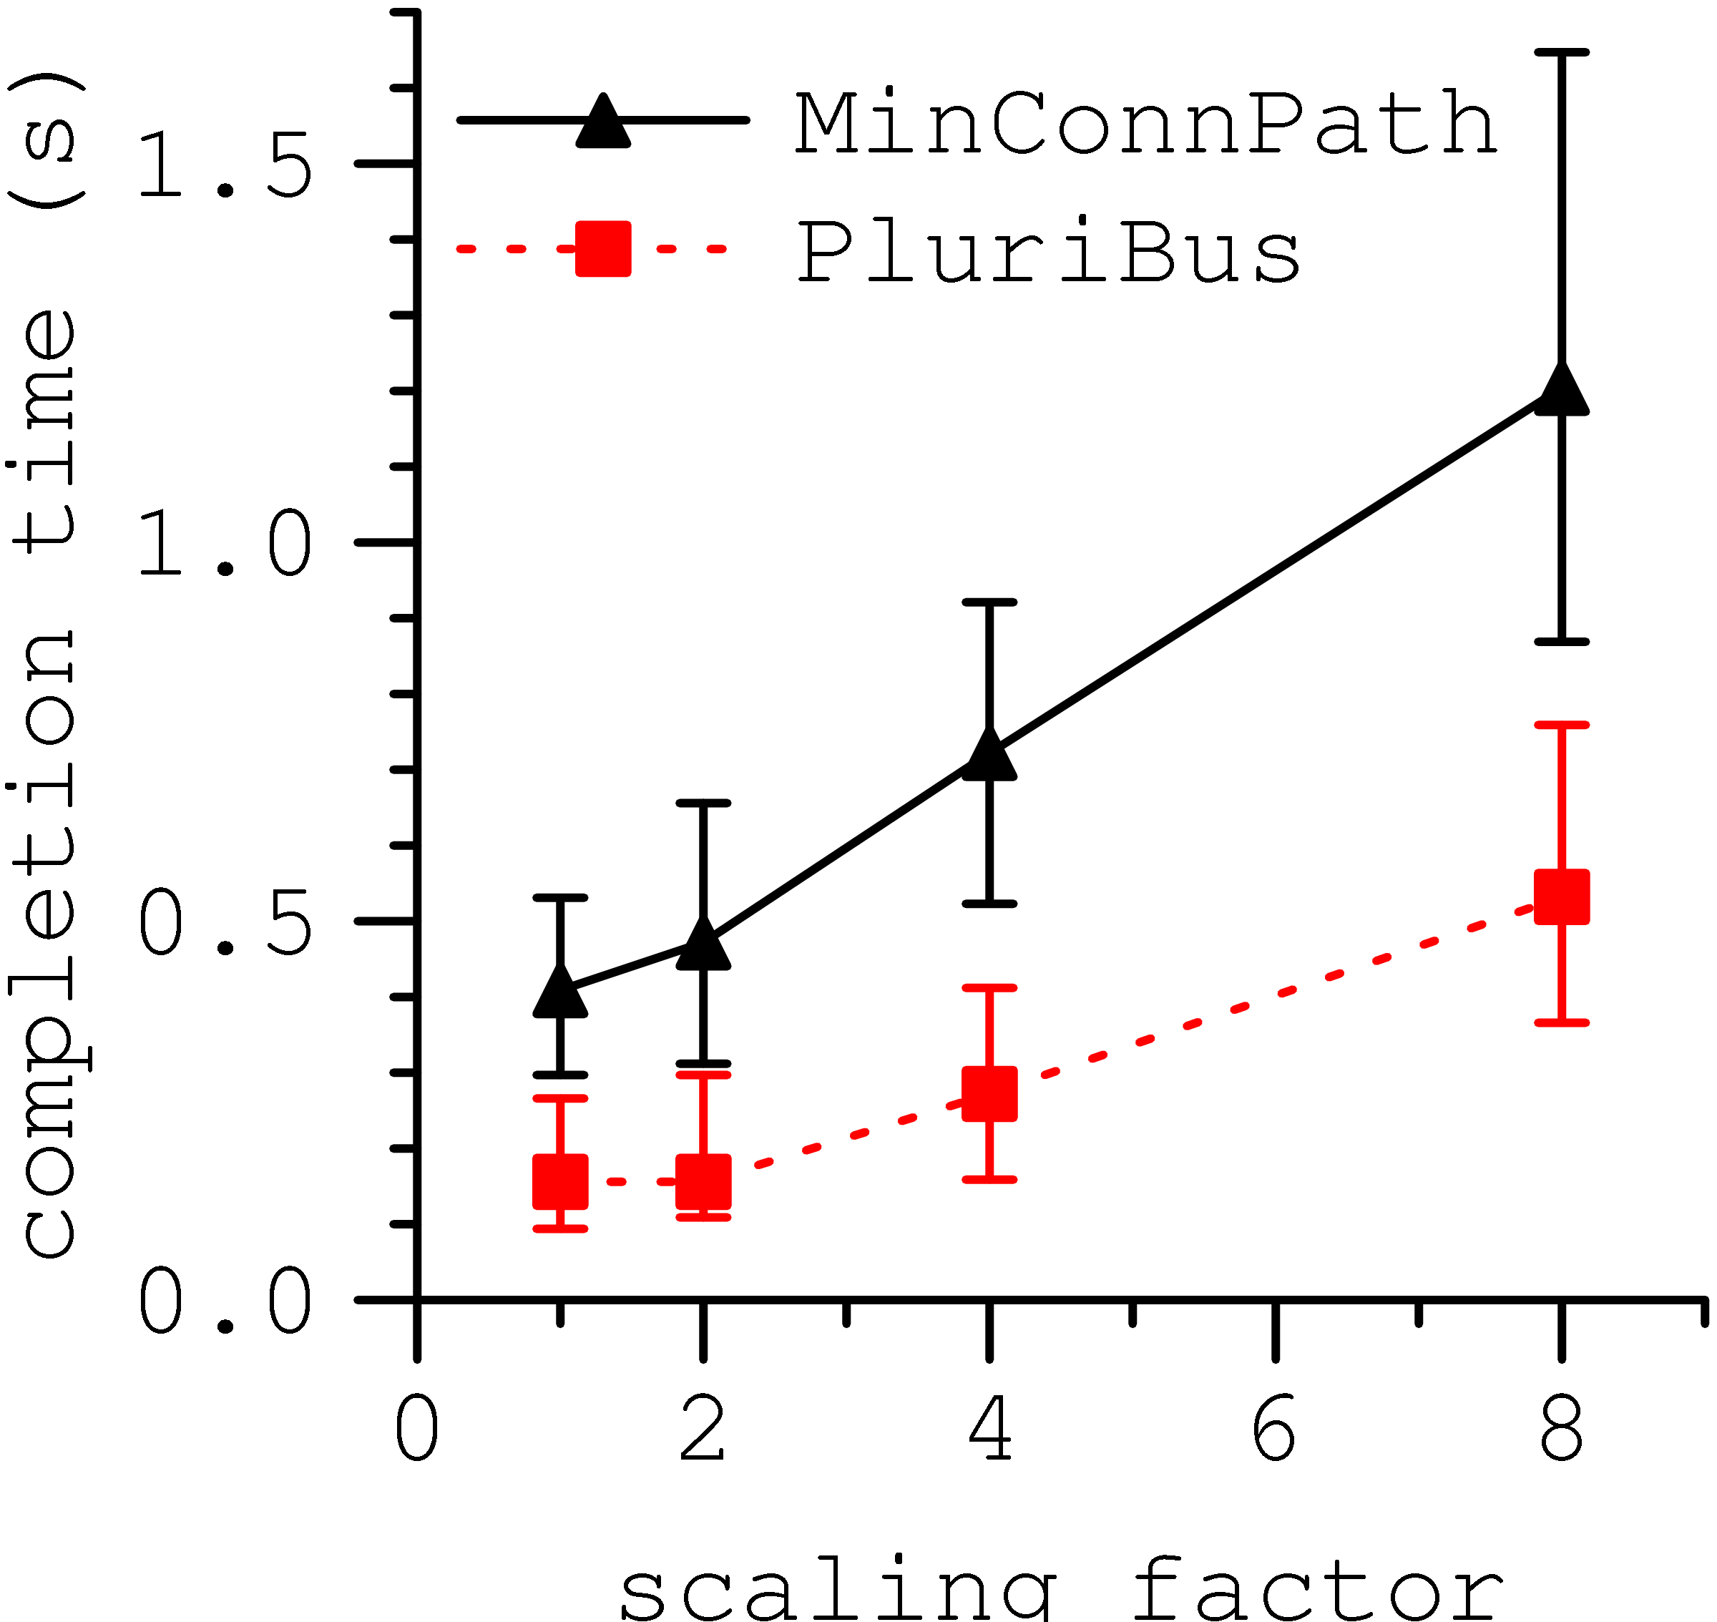
Performance as a function of load

Slide 23
WiFi and moving vehicles
Motivation behind using WiFi:
  Inexpensiveness and higher peak throughput
  Increasing ubiquity can make it a reality (at least partially)
    City-wide meshes, enterprise campuses, hotspots and open APs
Key question: Can popular applications (e.g., VoIP, Web browsing) be supported using vehicular WiFi today?
  Traditional handoff protocols cause frequent disruptions
Our answer: Yes, using ViFi

Slide 24


Wireless handoff background
Hard handoff
  Clients talk to
  exactly one BS
  Current 802.11
Soft handoff
  Clients talk to multiple BSes

Slide 25
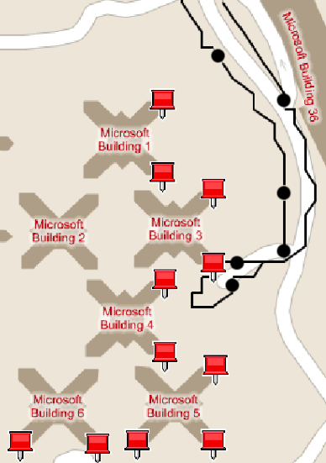
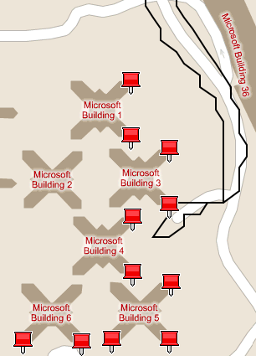
Trace-driven comparison of handoff policies
Disruption
Hard handoff
Soft handoff (ideal)

Slide 26
Designing a practical soft handoff policy
How to pick multiple BSes?
  A generalization of picking one
  Usually, two or three BSes suffice
What to do when multiple BSes hear a packet from the mobile?
  The BS backplane may be bandwidth-limited
How do multiple BSes send packet to the mobile?
  Simultaneous transmissions may collide

Slide 27
ViFi overview
C
Vehicle chooses anchor BS
  Anchor responsible for vehicle’s packets
Vehicle chooses a set of BSes in range to be auxiliaries
  E.g., B, C and D can be chosen as auxiliaries
  Leverage packets overheard by auxiliaries
A
B
D
Internet

Slide 28
ViFi protocol
C
Downstream: To vehicle
Source
Source transmits a packet
If destination receives, it transmits an ack
If auxiliary overhears packet but not ack, it probabilistically relays to destination
If destination received relay, it transmits an ack
If no ack within retransmission interval, source retransmits
A
B
Dest
D
C
Upstream: From vehicle
Dest
A
B
Source
D

Slide 29
Why is relaying effective?
Losses are bursty
Losses are independent
    Different senders → receiver
    Sender → different receivers
C
C
A
B
A
B
D
D
Downstream: To vehicle
Upstream: From vehicle

Slide 30
Guidelines for probability computation
Make a collective relaying decision and limit the total number of relays
Give preference to auxiliary with good connectivity with destination
Avoid per-packet coordination

Slide 31
Determining the relaying probability
    Goal: Compute relaying probability R_{B} of auxiliary B
    1: The probability that auxiliary B is considering relaying
      C_{B} = P(B heard the packet) ∙ P(B did not hear ack)
    2: Expected number of relays by B is E(B) = C_{B} ∙ R_{B}
      3: Set total number of expected relays to one, i.e., ∑ E(x) = 1
      4: To solve uniquely, set R_{B} α P(destination hears B)
      4: B estimates P(auxiliary considering relaying) and
      P(destination heard auxiliary) for each auxiliary

Slide 32
ViFi implementation and evaluation
Implementation requires only software changes
  Built on top of ad hoc mode
  Uses broadcast mode transmissions
Evaluation based on deployment on VanLAN
  Workload: VoIP and short TCP transfers
  Performance measure: reduction in disruptions

Slide 33
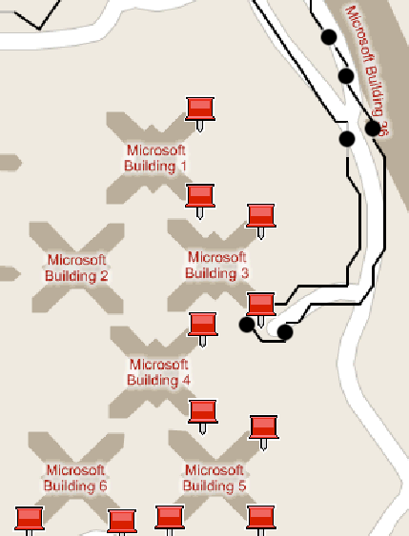
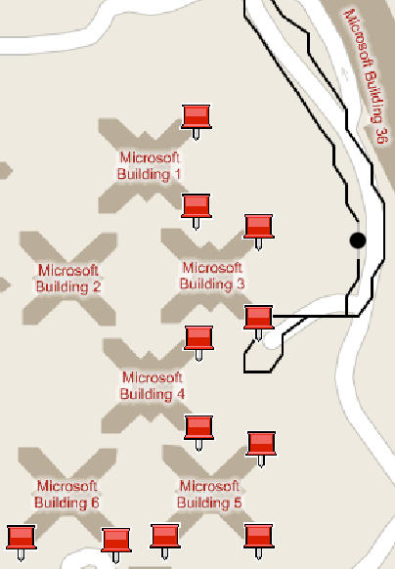
ViFi reduces disruptions
WiFi
ViFi

Slide 34
ViFi improves VoIP performance
> 100%
Length of voice call before
disruption (seconds)
ViFi
WiFi
Traffic generated per G.729 codec
Disruption: when MoS < 2

Slide 35
ViFi improves Web browsing performance
> 50%
> 100%
ViFi
WiFi
ViFi
WiFi
Number of transfers
before a stalled download
Median transfer time
(seconds)
Workload: Repeated downloads of a 10 KB file

Slide 36
Conclusions
Providing high performance wireless connectivity for moving vehicles is particularly challenging
WWAN case: PluriBus reduces packet loss and delay using opportunistic erasure coding and delay-based path selection
WLAN case: ViFi reduces disruptions using soft handoff
Both systems deployed and tested on a real vehicular testbed
More details at http://research.microsoft.com/vanlan/

Slide 37
Backup slides

Slide 38
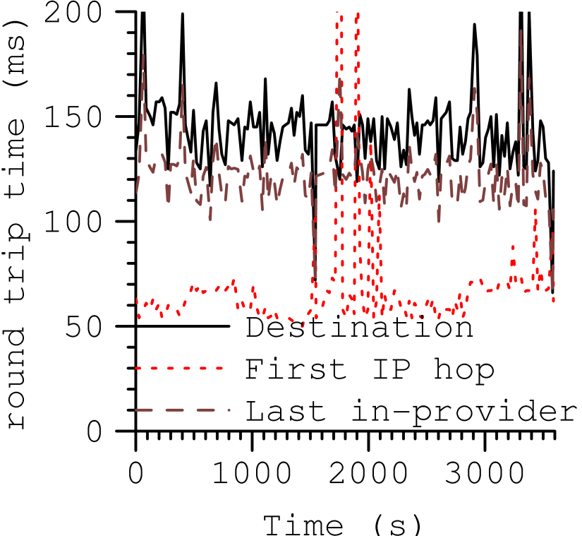
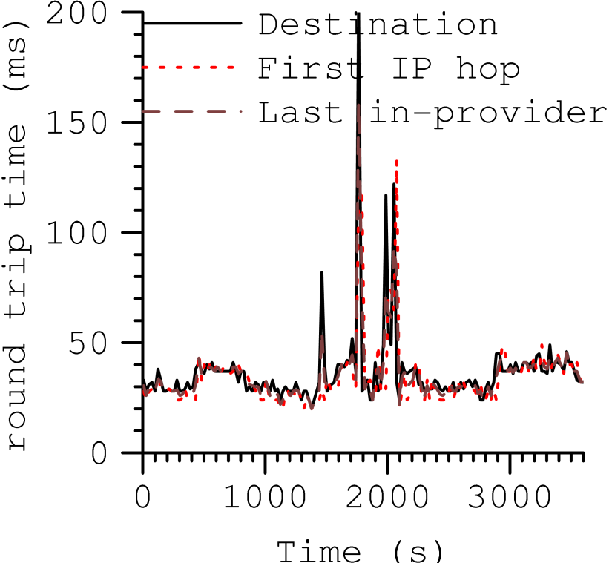
Dissecting WWAN path delay
EVDO
WiMax
Most of the delay is inside the carrier network

Slide 39
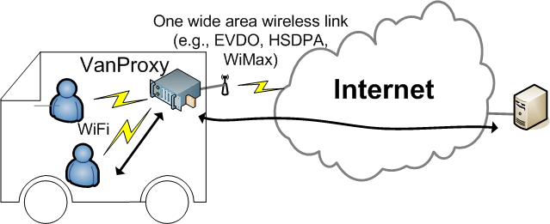
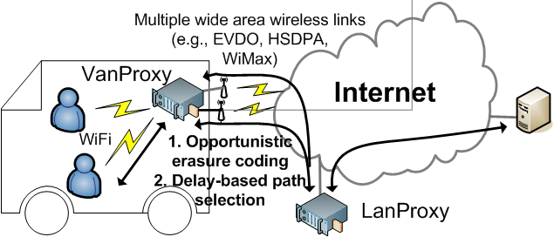
PluriBus in a commuter setting
Today
PluriBus

Slide 40
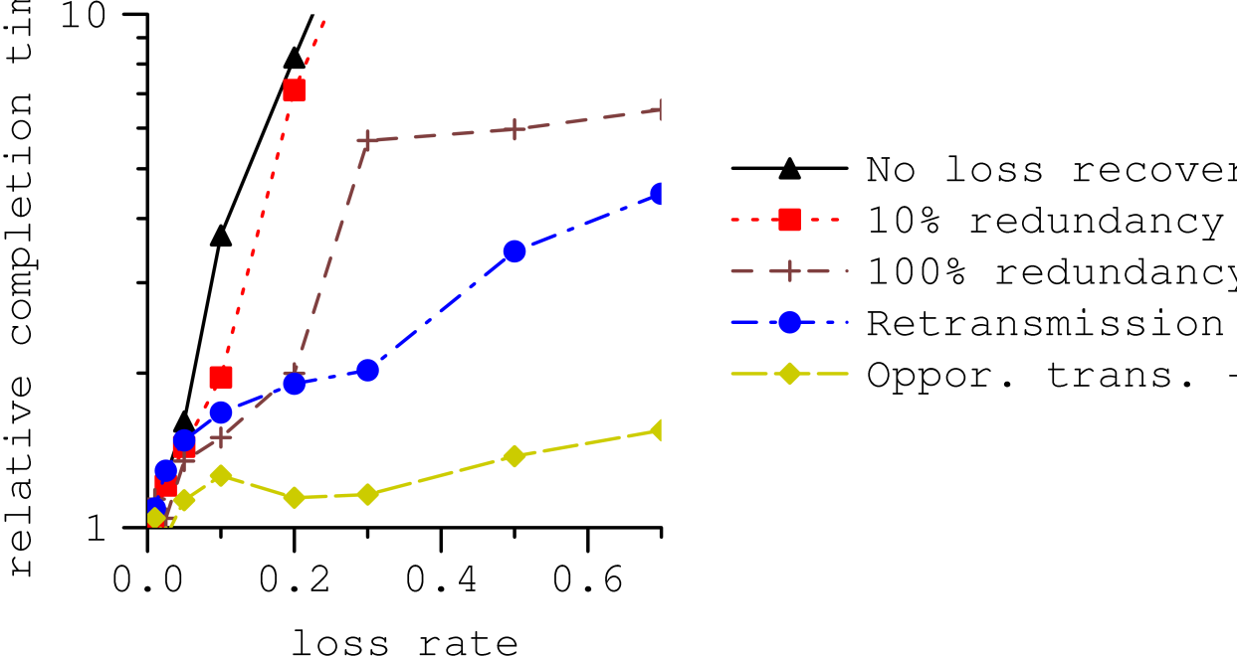
Benefit of opportunistic erasure coding
No loss recovery
10% redundancy
100% redundancy
Retransmissions
LT codes + oppor. transmissions
Emulation experiment
One lossy path
Relative completion time
Loss rate
Opportunistic erasure coding significantly outperforms other methods

Slide 41
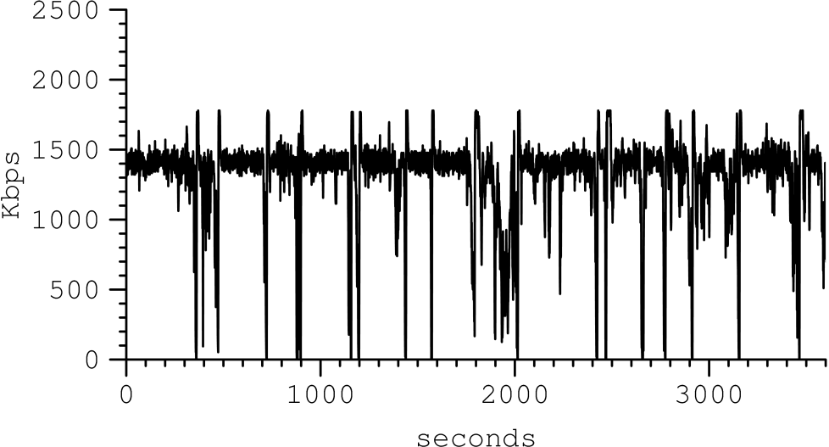
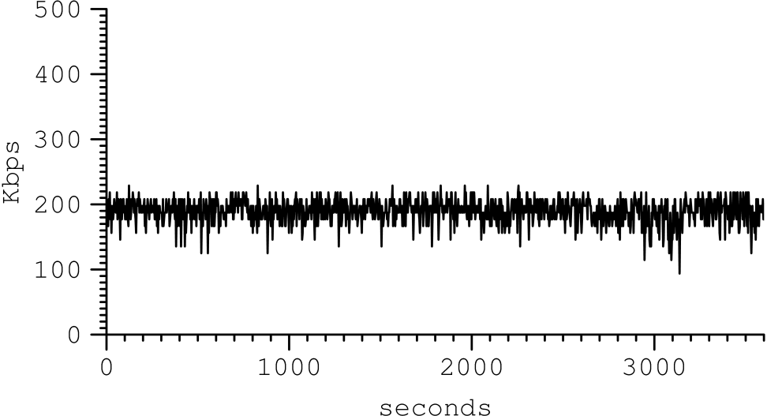
Capacity of WiMax links
Downlink
Uplink

Slide 42
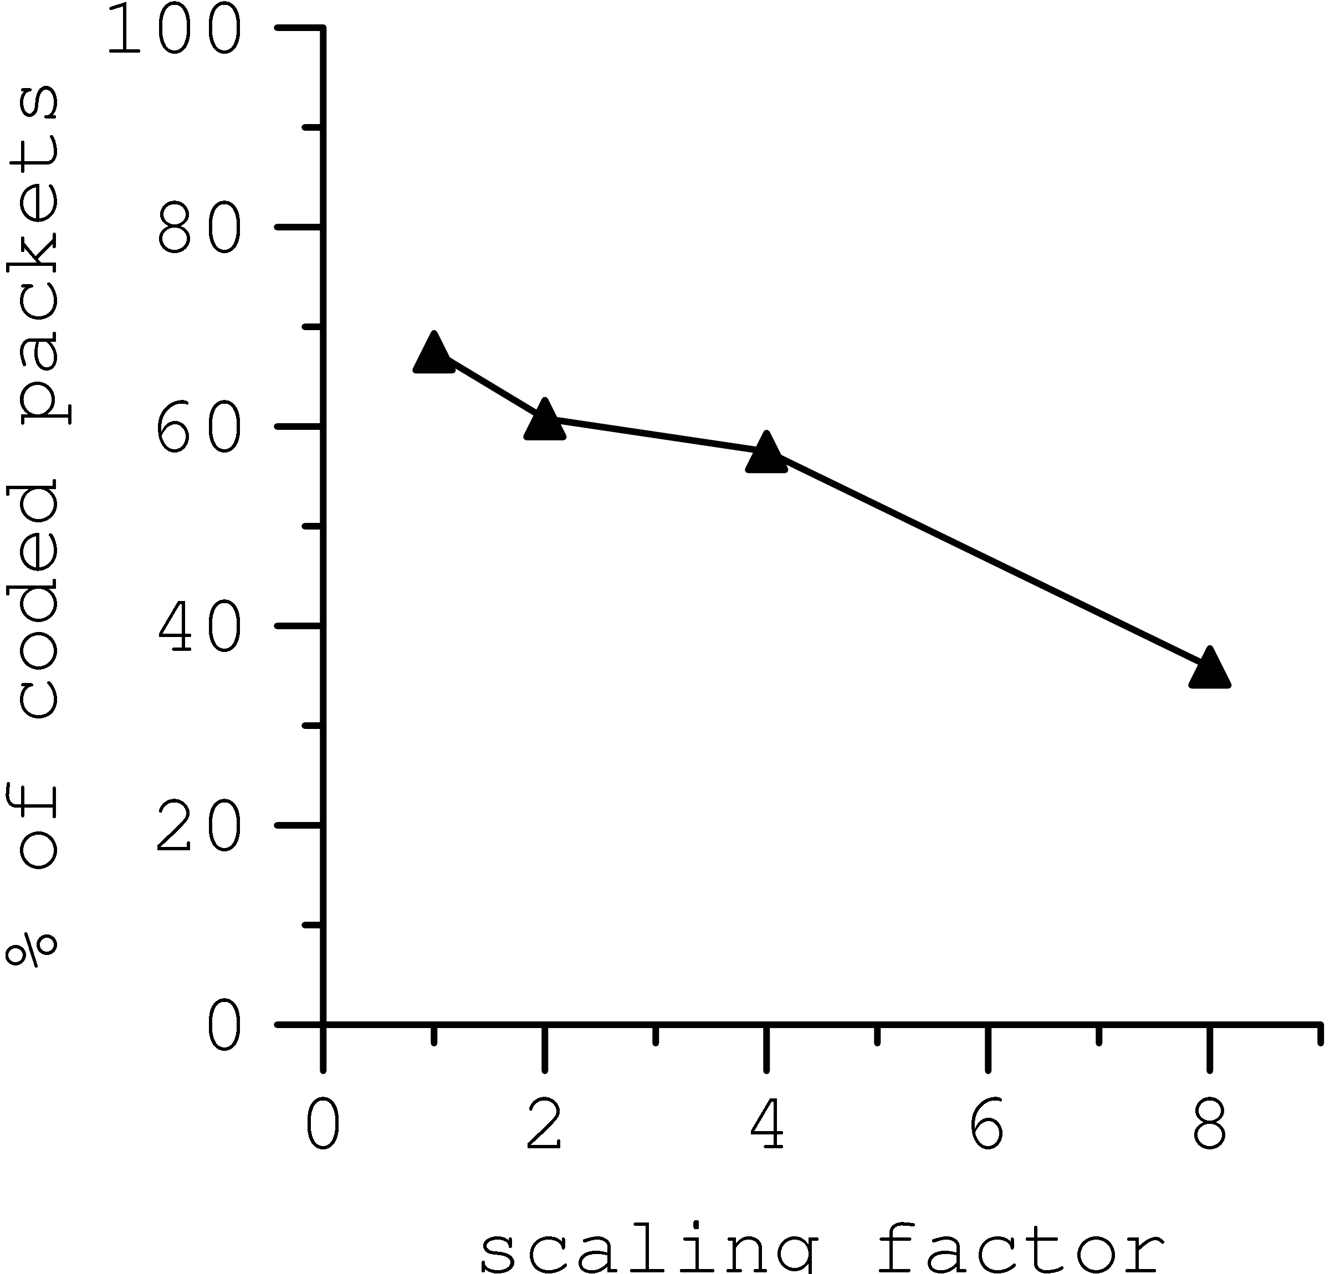
Fraction of coded packets

Slide 43
ViFi uses medium as efficiently as WiFi
Efficiency
(packets delivered / sent)
ViFi
WiFi

