Slide 1
Interactive WiFi Connectivity from Moving Vehicles
Aruna Balasubramanian, Ratul Mahajan
Arun Venkataramani, Brian N Levine, John Zahorjan
University of Massachusetts Amherst
Microsoft Research
University of Washington

Slide 2

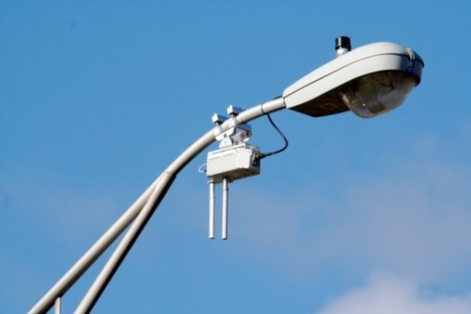
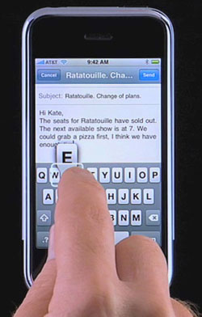
Motivation
Increasing demand for network access from vehicles
  E.g., VoIP, Web, email
  Cellular access expensive
Ubiquity of WiFi
  Cheaper, higher peak throughput compared to cellular

Slide 3


Our work
  Given enough coverage, can WiFi technology be used to access mainstream applications from vehicles?
  Existing work shows
    the feasibility of WiFi access at vehicular speeds
    focus on non-interactive applications. e.g., road monitoring
Internet

Slide 4
Talk outline
Can popular applications be supported using vehicular WiFi today?
  Performance is poor due to frequent disruptions
How can we improve application performance?
  ViFi, a new handoff protocol that significantly reduces disruptions
Does ViFi really improve application performance?
  VoIP, short TCP transfers

Slide 5
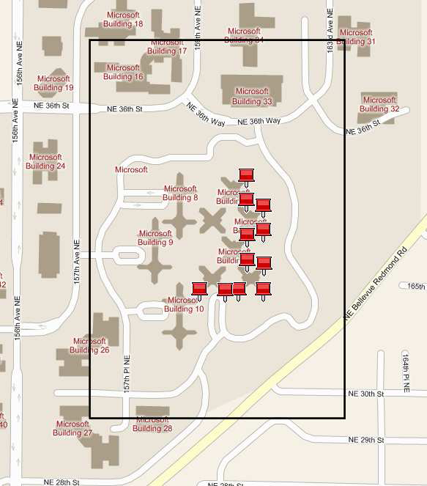
VanLAN: Our Vehicular Testbed
Uses MS campus vans
Base stations(BSes) are deployed on roadside buildings
Currently 2 vans, 11 BSes

Slide 6
Measurement study
Study application performance in vehicular WiFi setting
  Focus on basic connectivity
Study performance of different handoff policies
Trace-driven analysis
  Nodes send periodic packets and log receptions

Slide 7
Handoff policies studied
Practical hard handoff
  Associate with one BS
  Current 802.11
Ideal hard handoff
  Use future knowledge
  Impractical

Slide 8
Handoff policies studied
Practical hard handoff
  Associate with one BS
  Current 802.11
Ideal hard handoff
  Use future knowledge
  Impractical
Ideal soft handoff
  Use all BSes in range
  Performance upper bound

Slide 9
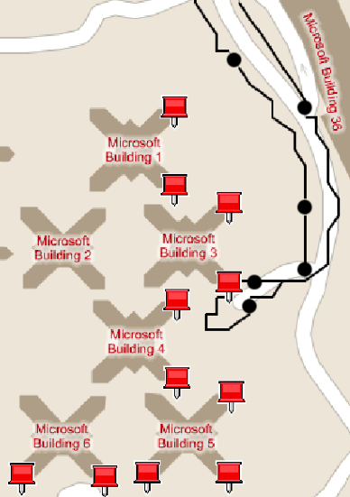
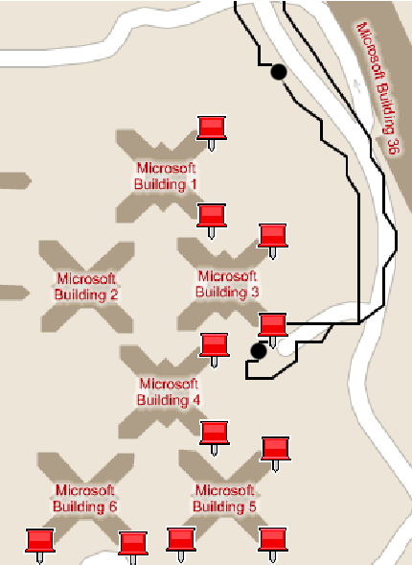
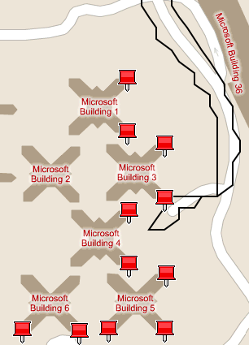
Comparison of handoff policies
Disruption
Summary
Performance of interactive applications poor when using existing handoff policies
Soft handoff policy can decrease disruptions and improve performance of interactive applications
Practical hard handoff
Ideal hard handoff
Ideal soft handoff

Slide 10
Talk outline
Can popular applications be accessed using vehicular WiFi?
How can we improve application performance?
  ViFi, a practical diversity-based handoff protocol
Does ViFi really improve application performance?
  VoIP, short TCP transfers

Slide 11
Designing a practical soft handoff policy
Goal: Leverage multiple BSes in range
  Not straightforward
  Constraints in Vehicular WiFi
  1. Inter-BS backplane often bandwidth-constrained
  2. Interactive applications require timely delivery
  3. Fine-grained scheduling of packets difficult
Internet

Slide 12
Why are existing solutions inadequate?
Opportunistic protocols for WiFi mesh (ExOR, MORE)
  Uses batching: Not suitable for interactive applications
Path diversity protocols for enterprise WLANs (Divert)
  Assumes BSes are connected through a high speed back plane
Soft handoff protocols for cellular (CDMA-based)
  Packet scheduling at fine time scales
  Signals can be combined

Slide 13
ViFi protocol set up
Vehicle chooses anchor BS
  Anchor responsible for vehicle’s packets
Vehicle chooses a set of BSes in range to be auxiliaries
  e.g., B, C and D can be chosen as auxiliaries
  ViFi leverages packets overheard by the auxiliary
C
A
B
D
Internet

Slide 14
ViFi protocol
C
Source transmits a packet
If destination receives, it transmits an ack
If auxiliary overhears packet but not ack, it probabilistically relays to destination
If destination received relay, it transmits an ack
If no ack within retransmission interval, source retransmits
Source
A
B
Dest
D
Downstream: Anchor to vehicle
C
Dest
A
B
Source
D
Upstream: Vehicle to anchor

Slide 15
Why relaying is effective?
Losses are bursty
Independence
    Losses from different senders independent
    Losses at different receivers independent
C
C
A
B
A
B
D
D
Downstream
Upstream

Slide 16
Guidelines for probability computation
    1. Make a collective relaying decision and limit the total number of relays
    2. Give preference to auxiliary with good connectivity with destination
  How to make a collective decision without per-packet coordination overhead?

Slide 17
Determine the relaying probability
    Goal: Compute relaying probability R_{B} of auxiliary B
    Step 1: The probability that auxiliary B is considering relaying
      C_{B} = P(B heard the packet) . P(B did not hear ack)
    Step 2: The expected number of relays by B is
      E(B) = C_{B} ¢ R_{B}
      Step 3: Formulate ViFi probability equation, ∑ E(x) = 1, x 2 auxiliary
        to solve uniquely, set R_{B} proportional to P(destination hears B)
      Step 4: B estimates P(auxiliary considering relaying) and P(destination heard auxiliary) for each auxiliary
  ViFi: Practical soft handoff protocol uses probabilistic relaying for coordination without per-packet coordination cost

Slide 18
ViFi Implementation
Implemented ViFi in windows operating system
  Use broadcast transmission at the MAC layer
  No rate adaptation
Deployed ViFi on VanLAN BSes and vehicles

Slide 19
Talk outline
Can popular applications be accessed using vehicular WiFi?
  Due to frequent disruptions, performance is poor
How can we improve application performance?
  ViFi, a practical diversity-based soft handoff protocol
Does ViFi really improve application performance?

Slide 20
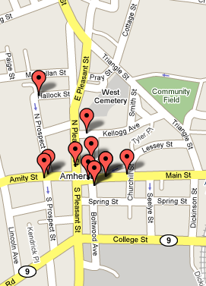
Evaluation
Evaluation based on VanLAN deployment
  ViFi reduces disruptions
  ViFi improves application performance
  ViFi’s probabilistic relaying is efficient
Also in the paper: Trace-driven evaluation on DieselNet testbed at UMass, Amherst
  Results qualitatively consistent
Notes:
Mention the voip and tcp were deployed

Slide 21
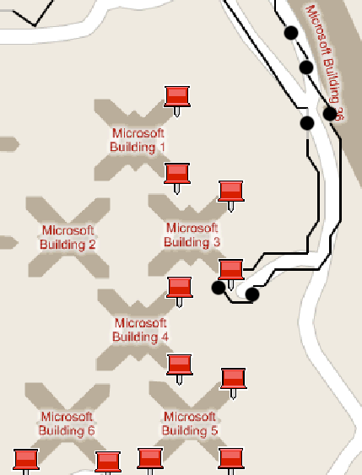
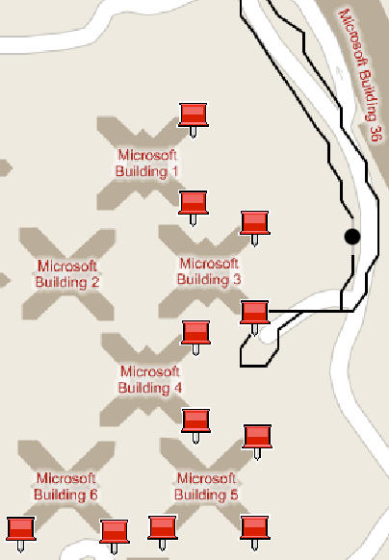
ViFi reduces disruptions in our deployment
Practical hard handoff
ViFi

Slide 22
ViFi improves VoIP performance
Use G.729 codec
> 100%
ViFi
seconds
Practical hard
handoff
Length of voice call before disruption
Disruption = When mean opinion score (mos) is lower than a threshold

Slide 23
ViFi improves performance of short TCP transfers
Workload: repeatedly download/upload 10KB files
> 50%
> 100%
ViFi
Practical
hard
handoff
Number of transfers before disruption
Median transfer time (sec)
Disruption = lack of progress for 10 seconds

Slide 24
ViFi uses medium efficiently
Efficiency:
Number of unique packets delivered/ Number of packets sent
efficiency
ViFi
Practical hard
handoff

Slide 25
Conclusions
Our work improves performance of interactive applications for vehicular WiFi networks
  Interactive applications perform poorly in vehicular settings due to frequent disruptions
  ViFi, a diversity-based handoff protocol significantly reduces disruptions
  Experiments on VanLAN shows that ViFi significantly improves performance of VoIP and short TCP transfers
  http://research.microsoft.com/netres/Projects/vanLAN/

Slide 26
Practical soft handoff
AllBS itself is not a practical protocol
How does diversity even work in the downstream?
Internet

Slide 27
Distributed computation
B needs to compute for each auxiliary
(1) contending probabilities (2) P(V will hear from the auxiliary)
Can be computed using loss rates between the auxiliary and its neighbors
Compute loss rates using beacon receptions
Embeds its loss rates in beacons
Learns loss rates of auxiliaries from their beacons
Estimates relaying probability of B, C and D
C
V
A
B
D

Slide 28
Distributed probability computation
Compute consistent
relaying probabilities
B need to know for C and D
Probability that C and D are making a relaying decision
Probability that vehicle will hear from C and D
Both can be estimated using loss probabilities between C and D
and their neighbors
Nodes exchange 2-hop loss rates using beacons
B computes relaying probabilities for B, C and D
C
V
A
B
D
Compute consistent
relaying probabilities

