Slide 1


A Machine Learning Framework for Programming by Example
by
Aditya Menon, UCSD/NICTA
Santosh Vempala, Georgia Tech
Omer Tamuz, Weizmann
Sumit Gulwani, MSR
Butler Lampson, MSR
Adam Tauman Kalai, MSR
in Australia$→$
Notes:
11:42

Slide 2




Lawrence Carin (5)
John D. Lafferty (4)
Michael I. Jordan (4)
Zoubin Ghahramani (4)
Huan Xu (3)
Ivor W. Tsang (3)
Ambuj Tewari (3)
Csaba Szepesvári (3)
Masashi Sugiyama (3)
Nathan Srebro (3)
Bernhard Schölkopf (3)
Mark D. Reid (3)
Shie Mannor (3)
Rong Jin (3)
Ali Jalali (3)
Hal Daumé III (3)
Steven C. H. Hoi (3)
Geoffrey E. Hinton (3)
Arthur Gretton (3)
David B. Dunson (3)
David M. Blei (3)
Yoshua Bengio (3)
Peilin Zhao (2)
Yaoliang Yu (2)
Tianbao Yang (2)
Zhixiang Eddie Xu (2)
Min Xu (2)
Eric P. Xing (2)
Jialei Wang (2)
Pascal Vincent (2)
Yichuan Tang (2)
Peng Sun (2)
Amos J. Storkey (2)
Karthik Sridharan (2)
Ohad Shamir (2)
Shai Shalev-Shwartz (2)
Fei Sha (2)
Jeff Schneider (2)
Bruno Scherrer (2)
The computer learns $f$ from a few examples!

Slide 3
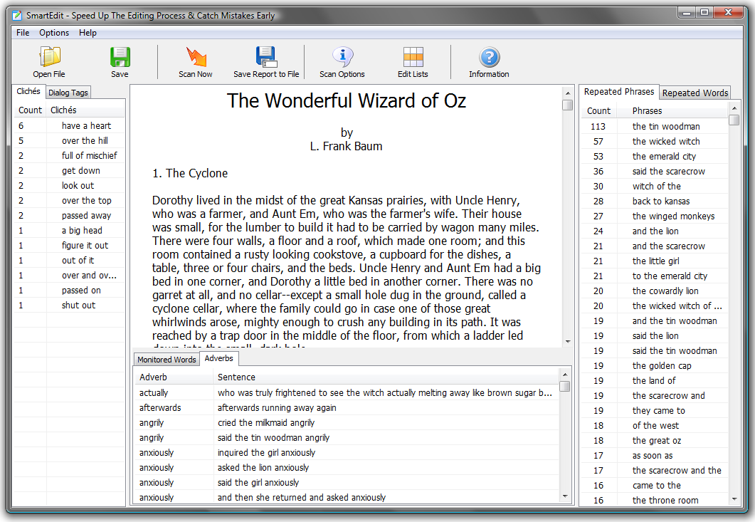

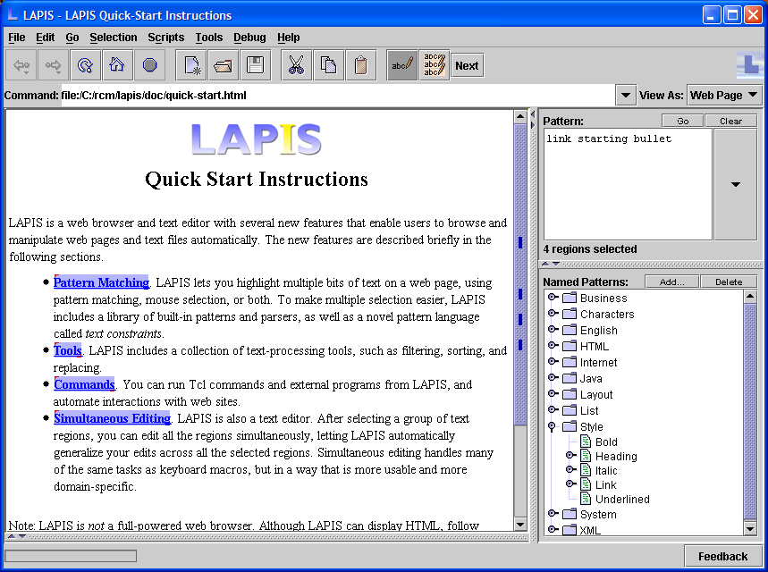
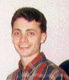

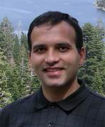
Prior work
EBE [Nix85]
Tourmaline [Mye93]
TELS [WM93]
Eager [Cyp93]
Cima [Mau94]
DEED [Fuj98]
SmartEDIT [LWDW01]
LAPIS [Miller02]
FlashFill [Gulwani2011]
[Liang-Jordan-Klein10]
Sidestep the NP-hard search problem

Slide 4
Sequential Transformations by Example Programming System
Sequential Transformations by Example Programming System

Slide 5

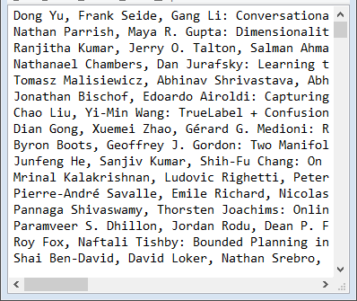
STEPS: Each step defined by example input$→$output
Dong Yu, Frank Seide, Gang Li: Conversationa
Nathan Parrish, Maya R. Gupta: Dimensionalit
Dong Yu, Frank Seide, Gang Li
Nathan Parrish, Maya R. Gupta
(Step 1)

Slide 6
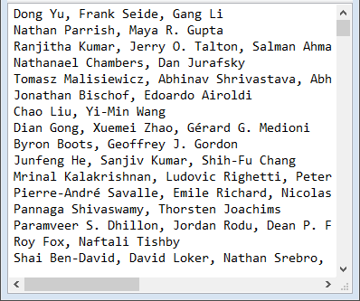

STEPS: Each step defined by example input$→$output
Dong Yu, Frank Seide, Gang Li: Conversationa
Nathan Parrish, Maya R. Gupta: Dimensionalit
Dong Yu
Frank Seide
Gang Li
Nathan Parrish
Maya R. Gupta
Dong Yu, Frank Seide, Gang Li
Nathan Parrish, Maya R. Gupta
(Step 2)
(Step 1)
x.Replace(/:.*$/gm,$""$)

Slide 7
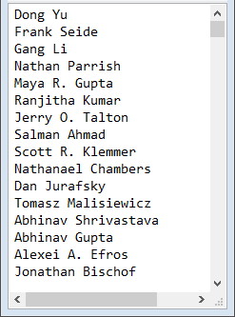


STEPS: Each step defined by example input$→$output
Dong Yu, Frank Seide, Gang Li
Nathan Parrish, Maya R. Gupta
Dong Yu
Frank Seide
Gang Li
Nathan Parrish
Maya R. Gupta
(Step 1)
(Step 2)
x.Replace(/:.*$/gm,$""$)
x.Replace(/, /gm,$"\backslash n"$)

Slide 8

STEPS: Each step defined by example input$→$output
Count or append “ (1)”? .
Dong Yu, Frank Seide, Gang Li
Nathan Parrish, Maya R. Gupta
Dong Yu
Frank Seide
Gang Li
Nathan Parrish
Maya R. Gupta
Dong Yu (1)
Frank Seide (1)
Gang Li (1)
Nathan Parrish (1)
Maya R. Gupta (1)
(Step 1)
(Step 2)
(Step 3)
x.Replace(/, /gm,$"\backslash n"$)

Slide 9
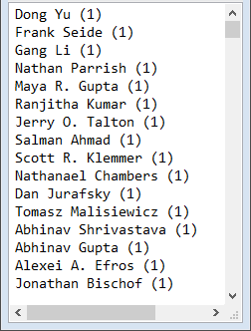
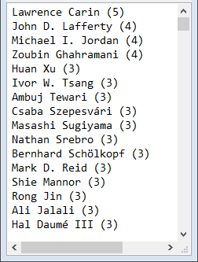

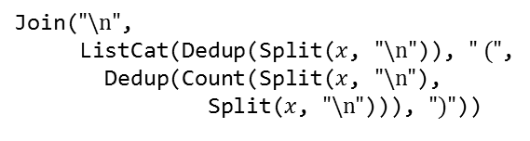
STEPS: Each step defined by example input$→$output
Mock example
Dong Yu, Frank Seide, Gang Li
Nathan Parrish, Maya R. Gupta
Dong Yu
Frank Seide
Gang Li
Nathan Parrish
Maya R. Gupta
adam
adam
john
nina
nina
adam
adam (3)
john (1)
nina (2)
adam (3)
nina (2)
john (1)
(Step 1)
(Step 2)
(Step 3)
(Step 4)
Join($"\backslash n"$,
ListCat(Dedup(Split($x$, $"\backslash n"$)), $" ("$,
Dedup(Count(Split($x$, $"\backslash n"$),
Split($x$, $"\backslash n"$))), $")"$))
x.Replace(/, /gm,$"\backslash n"$)

Slide 10

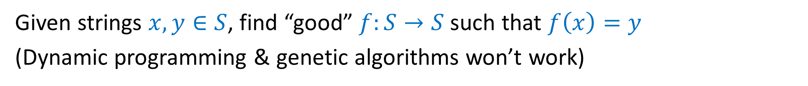



Learning to Search for Programming by example
Given strings $x,y∈S$, find “good” $f:S→S$ such that $f\left(x\right)=y$
(Dynamic programming & genetic algorithms won’t work)
$$x$$
$$y$$
P .
.12
.06
.01
.01
.20
.10
.22
.12
.08
.04
√
√
√
√
√√
CFG
$S$ $→$ $x$
$S$ $→$ Join($Delim$, $SList$)
$S →$ “Peaches”
$S →$ “Bananas”
...
$SList$ $→$ Sort($SList$, $Comp$)
$SList$ $→$ Reverse($SList$)
$SList$ $→$ Split($S$, $Delim$)
...
$Delim$ $→$ “\n”
$Delim$ $→$ “ ”
$Delim$ $→$ $S$
...
Join
Peaches
Bananas
Pears
Apples
Apples
Pears
Bananas
Peaches
“\n”
Reverse
Split
$$x$$
“\n”

Slide 11

Learning to Search for Programming by example
Given strings $x,y∈S$, find “good” $f:S→S$ such that $f\left(x\right)=y$
Enumerate PCFG programs in order of likelihood.
$$x$$
$$y$$
P .
.12
.06
.01
.01
.20
.10
.22
.12
.08
.04
√
√
√
√
√√
CFG
$S$ $→$ $x$
$S$ $→$ Join($Delim$, $SList$)
$S →$ “Peaches”
$S →$ “Bananas”
...
$SList$ $→$ Sort($SList$, $Comp$)
$SList$ $→$ Reverse($SList$)
$SList$ $→$ Split($S$, $Delim$)
...
$Delim$ $→$ “\n”
$Delim$ $→$ “ ”
$Delim$ $→$ $S$
...
Join
Peaches
Bananas
Pears
Apples
Apples
Pears
Bananas
Peaches
“\n”
Reverse
Split
$$x$$
“\n”
Trained on corpus of
tasks from help forums

Slide 12

The abstract MLE problem:
Given dist. $μ$ over $(x,y,data,f)$, find $\underset{f}{argmax}\underset{μ}{Pr}\left[f|x,y,data\right]$

Slide 13
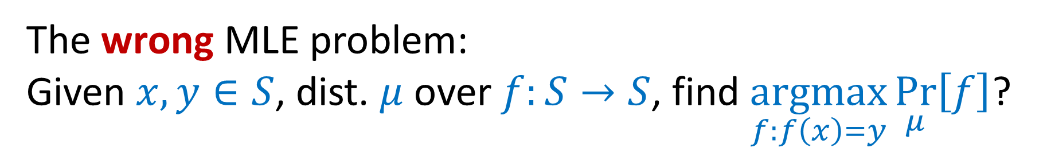
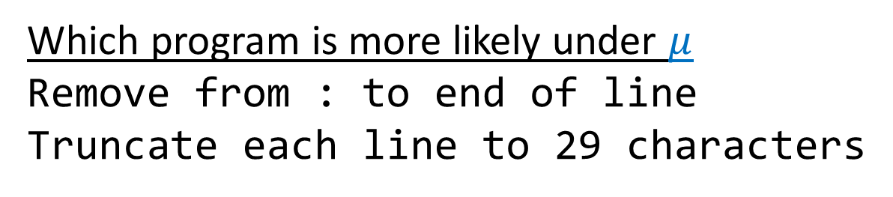
The wrong MLE problem:
Given $x,y∈S$, dist. $μ$ over $f:S→S$, find $\underset{f:f\left(x\right)=y}{argmax}\underset{μ}{Pr}\left[f\right]$?
Which program is more likely under $μ$
Remove from : to end of line
Truncate each line to 29 characters
√
Dong Yu, Frank Seide, Gang Li: Conversationa
Nathan Parrish, Maya R. Gupta: Dimensionalit
Dong Yu, Frank Seide, Gang Li
Nathan Parrish, Maya R. Gupta

Slide 14
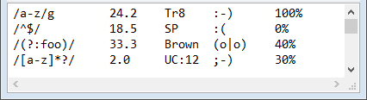
The wrong MLE problem:
Given $x,y∈S$, dist. $μ$ over $f:S→S$, find $\underset{f:f\left(x\right)=y}{argmax}\underset{μ}{Pr}\left[f\right]$?
Which program is more likely under $μ$
Remove from : to end of line
Truncate each line to 29 characters
√
/a-z/g 24.2 Tr8 :-) 100%
/^$/ 18.5 SP :( 0%
/a-z/g 24.2 Tr8
/^$/ 18.5 SP

Slide 15

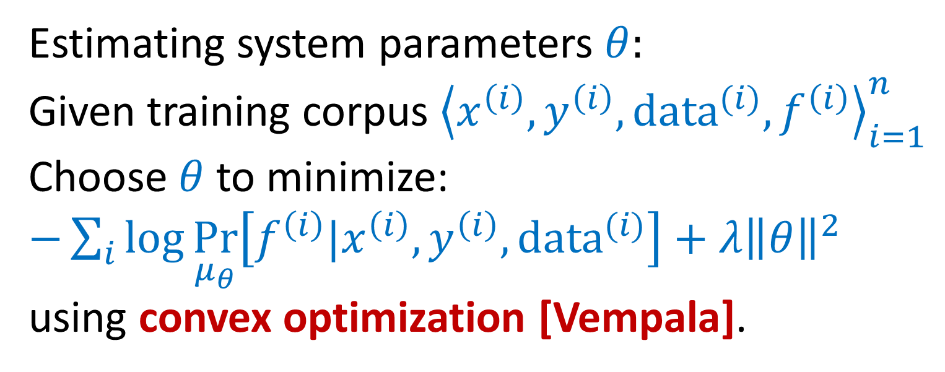
The abstract MLE problem:
Given dist. $μ_{θ}$ over $(x,y,data,f)$, find $\underset{f}{argmax}\underset{μ_{θ}}{Pr}\left[f|x,y,data\right]$
Estimating system parameters $θ:$
Given training corpus ${\left\langle x^{\left(i\right)},y^{\left(i\right)},{data^{(i)},f}^{\left(i\right)}\right\rangle }_{i=1}^{n}$
Choose $θ$ to minimize:
$−\sum_{i}{\log{\underset{μ_{θ}}{Pr}\left[f^{\left(i\right)}|x^{\left(i\right)},y^{\left(i\right)},data^{(i)}\right]+λ{\left\|θ\right\|}^{2}}}$
using convex optimization [Vempala].

Slide 16
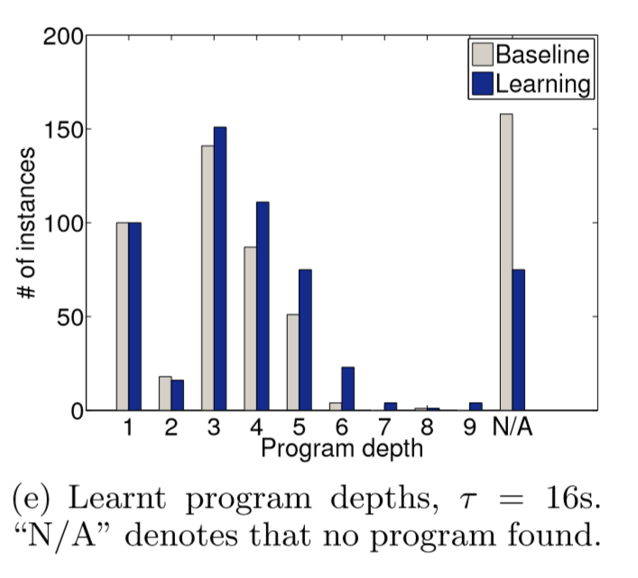
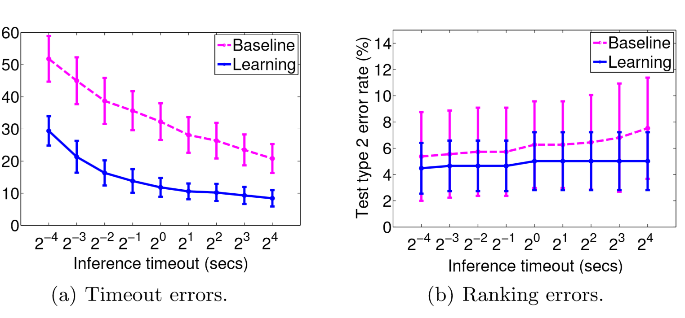
Experimental results
*Everything is in Javascript
Baseline = equal weights (MDL)

Slide 17
Conclusions
Programming by Example involves hard search problem
Search space generated by clues (features->CFG rules)
Learn weights on heuristic clues
Future work
Learned shared structure (like [Liang-Jordan-Klein10])
Generate more clues on-the-fly

Slide 19
F

