Slide 1
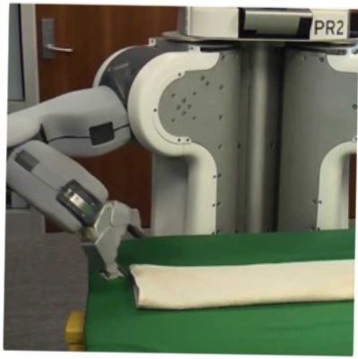
Programming by Examples
Sumit Gulwani
Marktoberdorf Lectures
August 2015

Slide 2
Lecture 1
Demos of Programming-by-Examples Tools
Dealing with Ambiguity in Example-based specification

Slide 3
Programming by Examples
Program synthesis: Generate a program in an underlying language from user specification using a search algorithm.
Programming by Examples is a subfield of Program Synthesis
Specification: Examples
Underlying Languages: Lecture 2
Search Methodology: Lecture 3
An end-to-end story involves aspects from ML, HCI (Lec. 1)
Lecture 4: Soon-to-be-released SDK with academic license
(given by student attendee Alex Polozov)
Lecture 5: Other specs/methodologies/applications + …

Slide 4
The New Opportunity
2 orders of magnitude more end users
99% of computer users don’t know programming.
Struggle with simple repetitive tasks
Traditional customer for PL technology
End Users
(non-programmers with access to computers)
Software developer

Slide 5
Excel help forums

Slide 6
Typical help-forum interaction
300_w30_aniSh_c1_b → w30
300_w5_aniSh_c1_b → w5
=MID(B1,5,2)
=MID(B1,5,2)
=MID(B1,FIND(“_”,$B:$B)+1, FIND(“_”,REPLACE($B:$B,1,FIND(“_”,$B:$B),””))-1)

Slide 7
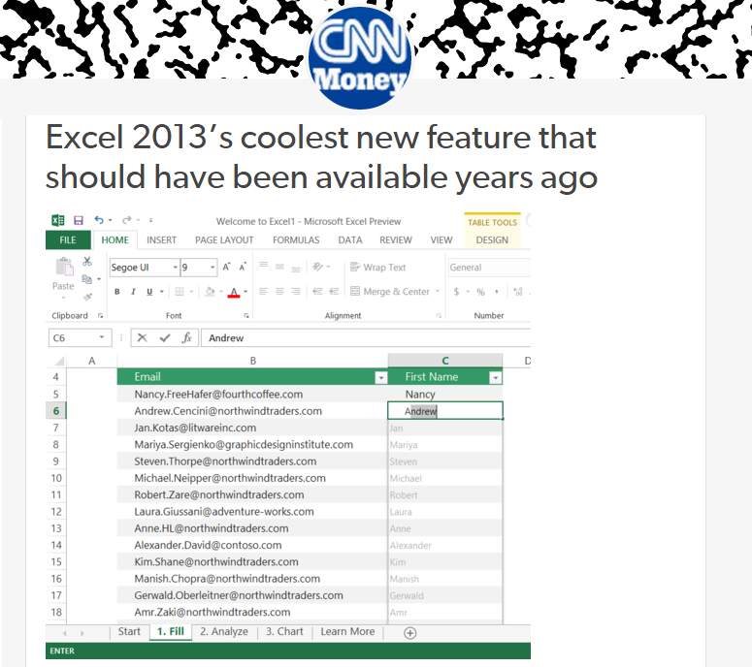
Flash Fill (Excel 2013 feature) demo
“Automating string processing in spreadsheets using input-output examples”; POPL 2011; Sumit Gulwani

Slide 8
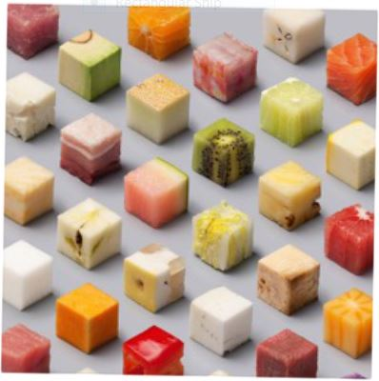
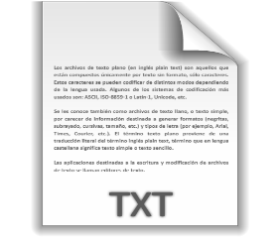
Data Wrangling
Data locked up in silos in various formats
Flexible organization for viewing but challenging to manipulate.
Wrangling workflow: Extraction, Transformation, Formatting
Data scientists spend 80% of their time wrangling data.
PBE can enable easier & faster data wrangling experience.

Slide 9
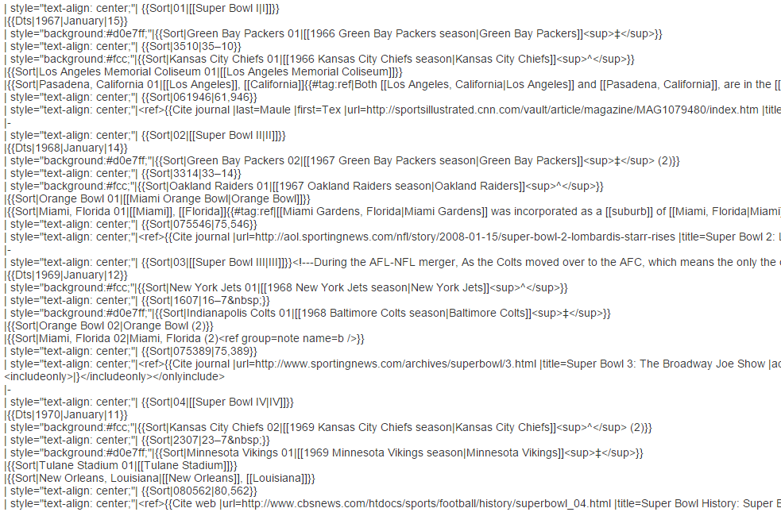
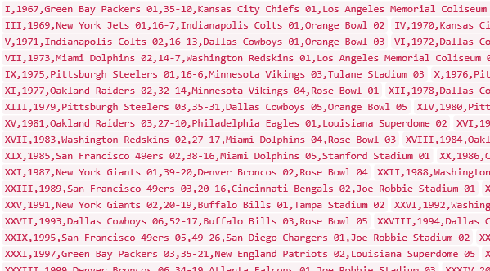
Data Science Class Assignment
To get Started!

Slide 10
FlashExtract Demo
“FlashExtract: A Framework for data extraction by examples”;
PLDI 2014; Vu Le, Sumit Gulwani

Slide 11
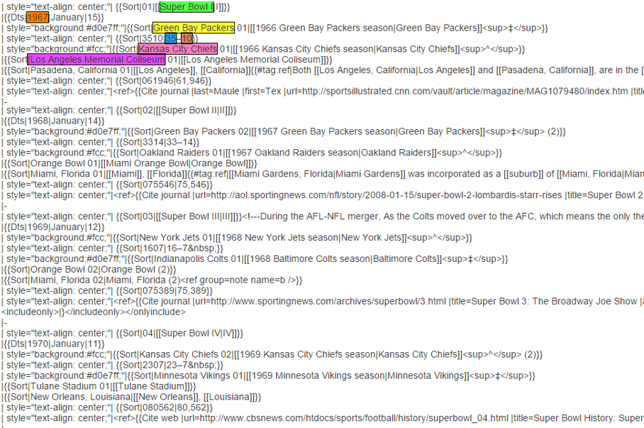
FlashExtract

Slide 12
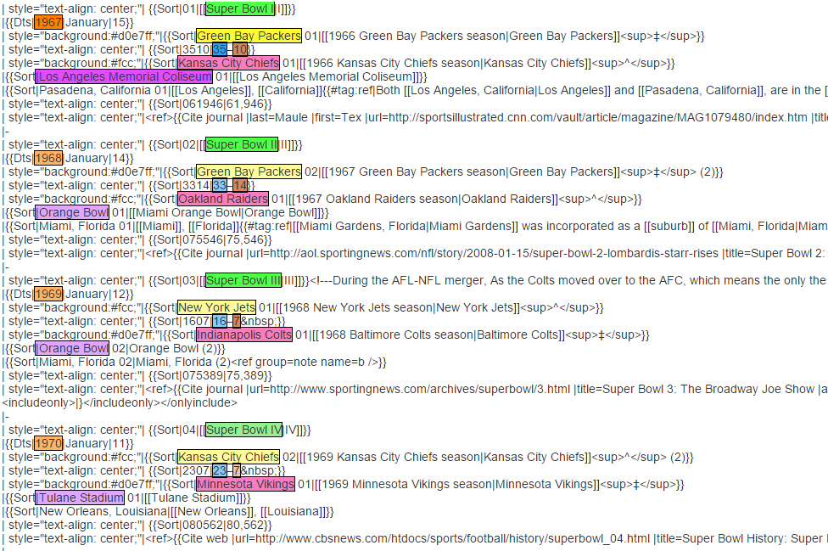
FlashExtract

Slide 13
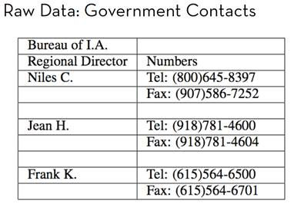
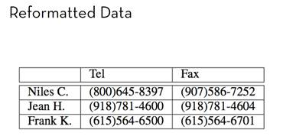
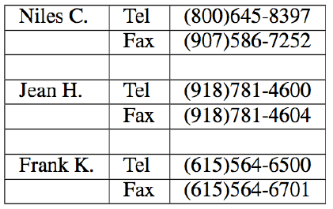
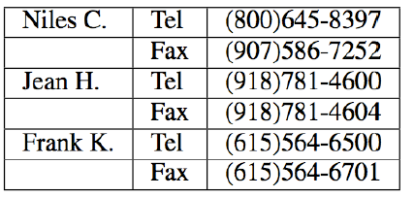
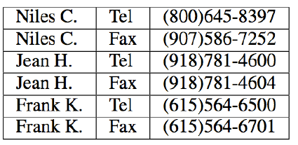
Trifacta: small, guided steps
Table Re-formatting
Start with:
End goal:
FlashRelate
4. Pivot Number on Type
Trifacta provides a series of small transformations:
1. Split on “:” Delimiter
2. Delete Empty Rows
3. Fill Values Down
From: Skills of the Agile Data Wrangler (tutorial by Hellerstein and Heer)

Slide 14
FlashRelate Demo
“FlashRelate: Extracting Relational Data from Semi-Structured Spreadsheets Using Examples”;
PLDI 2015; Barowy, Gulwani, Hart, Zorn

Slide 15
PBE tools for Data Manipulation
Extraction
FlashExtract: Extract data from text files, web pages [PLDI 2014; Powershell convertFrom-string cmdlet
Transformation
Flash Fill: Excel feature for Syntactic String Transformations [POPL 2011, CAV 2015]
Semantic String Transformations [VLDB 2012]
Number Transformations [CAV 2013]
FlashNormalize: Text normalization [IJCAI 2015]
Formatting
FlashRelate: Extract data from spreadsheets [PLDI 2015, PLDI 2011]
FlashFormat: a Powerpoint add-in [AAAI 2014]

Slide 16
PBE Architecture
Example-based specification
Program
Search Algorithm
Challenge 1: Ambiguous/under-specified intent may result in unintended programs.

Slide 17
Dealing with Ambiguity
Ranking
Synthesize multiple programs and rank them.

Slide 18
Basic ranking scheme
Prefer programs with simpler Kolmogorov complexity
Prefer fewer constants.
Prefer smaller constants.
Input | Output
Alex Polozov | Alex
Helmut Seidl | Helmut
1st Word
If (input = “Alex Polozov”) then “Alex” else “Helmut”
“Alex”

Slide 19
Challenges with Basic ranking scheme
Prefer programs with simpler Kolmogorov complexity
Prefer fewer constants.
Prefer smaller constants.
Input | Output
Alex Polozov | Polozov, Alex
Helmut Seidl | Seidl, Helmut
2nd Word + “, ‘’ + 1st Word
“Polozov, Alex”
How to select between
Fewer larger constants vs. More smaller constants?
Idea: Associate numeric weights with constants.

Slide 20
Challenges with Basic ranking scheme
Prefer programs with simpler Kolmogorov complexity
Prefer fewer constants.
Prefer smaller constants.
Input | Output
Missing page numbers, 1993 | 1993
64-67, 1995 | 1995
1st Number from the beginning
1st Number from the end
How to select between
Same number of same-sized constants?
Idea: Examine data features (in addition to program features)

Slide 21
Machine learning based ranking scheme
Rank score of a program is a:
weighted combination of various features
Features are over both program and user data
Training data for weight computation:
Let T be a task, specified as a set of input-output pairs for all inputs that the user cares about.
Let (I,O) be any single input-output pair from task T.
Let P be the set of all programs consistent with (I,O).
Let Q $⊂$P be the set of all programs consistent with task T.
Weights should be such that at least one program in Q is ranked higher than all programs in P-Q.

Slide 22
Machine learning based ranking scheme
Rank score of a program is a:
weighted combination of various features
Features are over both program and user data
Features over user data:
Similarity of generated output (or even intermediate values) over various user inputs
IsYear
Numeric Deviation
Number of characters
IsPersonName

Slide 23
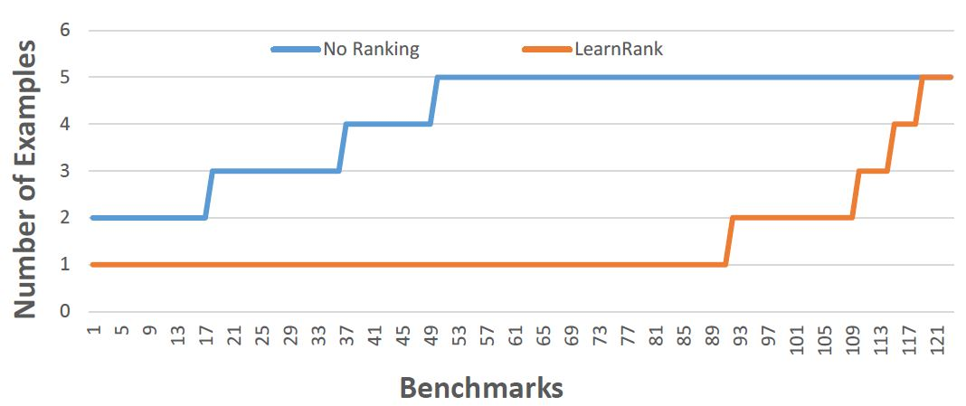
Comparison of Ranking Strategies over FlashFill Benchmarks
Basic
Learning
Strategy | Average # of examples required
Basic | 4.17
Learning | 1.48
“Predicting a correct program in Programming by Example”; CAV 2015
Rishabh Singh, Sumit Gulwani

Slide 24
FlashFill Ranking Demo

Slide 25
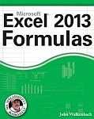
Need for a fall-back mechanism
“It's a great concept, but it can also lead to lots of bad data. I think many users will look at a few "flash filled" cells, and just assume that it worked. … Be very careful.”
“most of the extracted data will be fine. But there might be exceptions that you don't notice unless you examine the results very carefully.”

Slide 26
Dealing with Ambiguity
Ranking
Synthesize multiple programs and rank them.
User Interaction Models
Communicate actionable information to the user.

Slide 27
User Interaction Models for Ambiguity Resolution
Make it easy to inspect output correctness
User can accordingly provide more examples
Show programs
in any desired programming language; in English
Enable effective navigation between programs
Computer initiated interactivity (Active learning)
Highlight less confident entries in the output.
Ask directed questions based on distinguishing inputs.
“User Interaction Models for Disambiguation in Programming by Example”,
[UIST 2015] Mayer, Soares, Grechkin, Le, Marron, Polozov, Singh, Zorn, Gulwani

Slide 28
FlashExtract Demo
(User Interaction Models)

