Slide 1
Big Data Analytics with Parallel Jobs
Ganesh Ananthanarayanan
University of California at Berkeley
http://www.cs.berkeley.edu/~ganesha/

Slide 2
Rising philosophy of data-ism
Diagnostics and decisions backed by extensive data analytics
"In God we trust. Everybody else bring data to the table.“
Competitive and Social Benefits
Dichotomy: Ever-increasing data size and ever-decreasing latency target
Notes:
Slide to crystallize competing challenges

Slide 3
Parallelization
Massive parallelization on large clusters
Data growing faster than Moore’s law
Computation Frameworks
Dryad

Slide 4
Computation Frameworks
Job → DAG of tasks
Outputs of upstream tasks are passed downstream
Job’s input (file) is divided among tasks
Every task reads a block of data
Computation and storage are co-located
Tasks scheduled for locality
Notes:
Animate

Slide 5
Computation Frameworks
Task₁
Task₃
Task₂
Block
Slot
Notes:
Animate

Slide 6
Promise of Big Data Analytics
Goal: Efficient execution of jobs
Completion time and utilization
Challenge: Scale
Data size and parallelism
Performance variations → stragglers
Efficient and fault-tolerant execution of parallel jobs on large clusters

Slide 7
IO intensive → Memory
Tasks are IO intensive
Task completes faster if its input is read off memory instead of disk
Memory local task
Falling memory prices
64GB/machine at FB in Aug 2011, 256GB/machine not uncommon now

Slide 8
Can we move all data to memory?
Proposals for making “RAM as the new disk” (e.g., RAMCloud)
Huge discrepancy between storage and memory capacities
200x more data on disks than available memory
Use memory as cache
Notes:
600? 200-400x

Slide 9
Will the inputs fit in cache?
Production traces
Dryad and Hadoop clusters
Thousands of machines
Over 1 million jobs in all, span of 6 months (2011-12)
Notes:
Have a figure for 92%

Slide 10
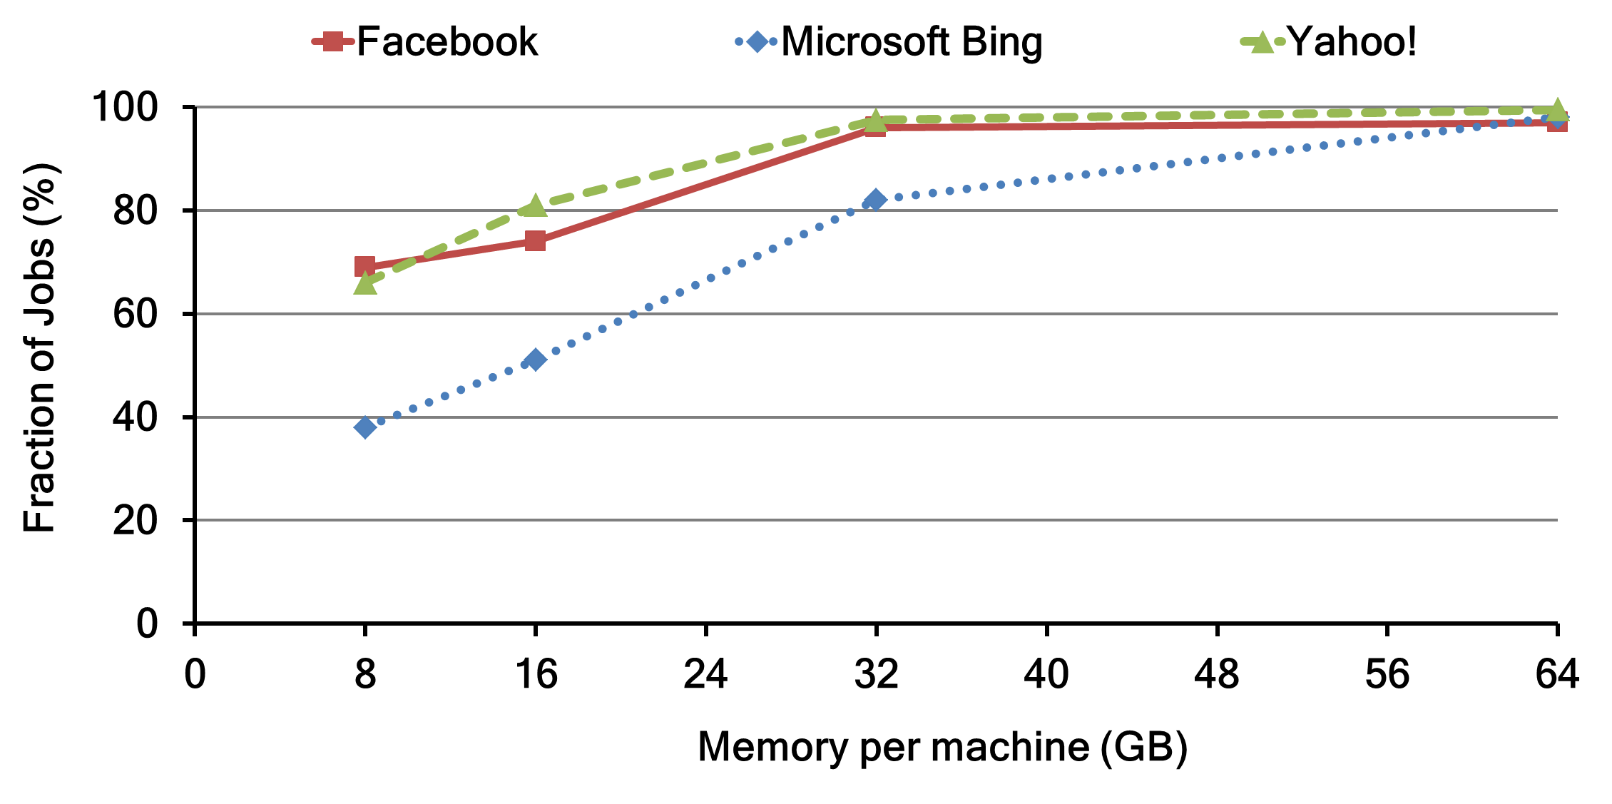
Will the inputs fit in cache?
Heavy-tailed distribution of jobs sizes → 92% of jobs can fit their inputs in memory
Notes:
Have a figure for 92%

Slide 11
We built a memory cache…
Simple in-memory distributed cache
Cache input data of jobs
Schedule tasks for memory locality
Simple cache replacement policies
Least Recently Used (LRU) and Least Frequently Used (LFU)

Slide 12
We built a memory cache…
Replayed the Facebook trace of Hadoop jobs
Jobs sped up by 10% with LFU; hit-ratio of 67%
Belady’s MIN (optimal)
13% improvement with hit-ratio of 74%
How do we make caching really speedup parallel jobs?
Notes:
LFU first, then MIN
Give hit-ratio number
Out of focus

Slide 13
Parallel jobs require a new class of cache replacement algorithms

Slide 14
Parallel Jobs
Tasks of small jobs run simultaneously in a wave
Task duration
(uncached input)
Task duration
(cached input)
slot₁
slot₁
slot₁
slot₂
slot₂
slot₂
time
time
time
completion
time
completion
time
completion
time
All-or-Nothing: Unless all inputs are cached, there is no benefit

Slide 15
All-or-Nothing for multi-waved jobs
Large jobs run tasks in multiple waves
Number of tasks is larger than number of slots
Wave-width: Number of parallel tasks of a job
slot₁
slot₂
slot₃
slot₄
slot₅
time
completion time
Notes:
Explain multi-waved with animation

Slide 16
All-or-Nothing for multi-waved jobs
Large jobs run tasks in multiple waves
Number of tasks is larger than number of slots
Wave-width: Number of parallel tasks of a job
slot₁
slot₂
slot₃
slot₄
slot₅
time
completion time
Notes:
Explain multi-waved with animation

Slide 17
All-or-Nothing for multi-waved jobs
Large jobs run tasks in multiple waves
Number of tasks is larger than number of slots
Wave-width: Number of parallel tasks of a job
slot₁
slot₂
slot₃
slot₄
slot₅
time
completion time
Notes:
Animate waves and wave-widths

Slide 18
All-or-Nothing for multi-waved jobs
Large jobs run tasks in multiple waves
Number of tasks is larger than number of slots
Wave-width: Number of parallel tasks of a job
slot₁
Cache at the wave-width granularity
slot₂
slot₃
slot₄
slot₅
completion time
time

Slide 19
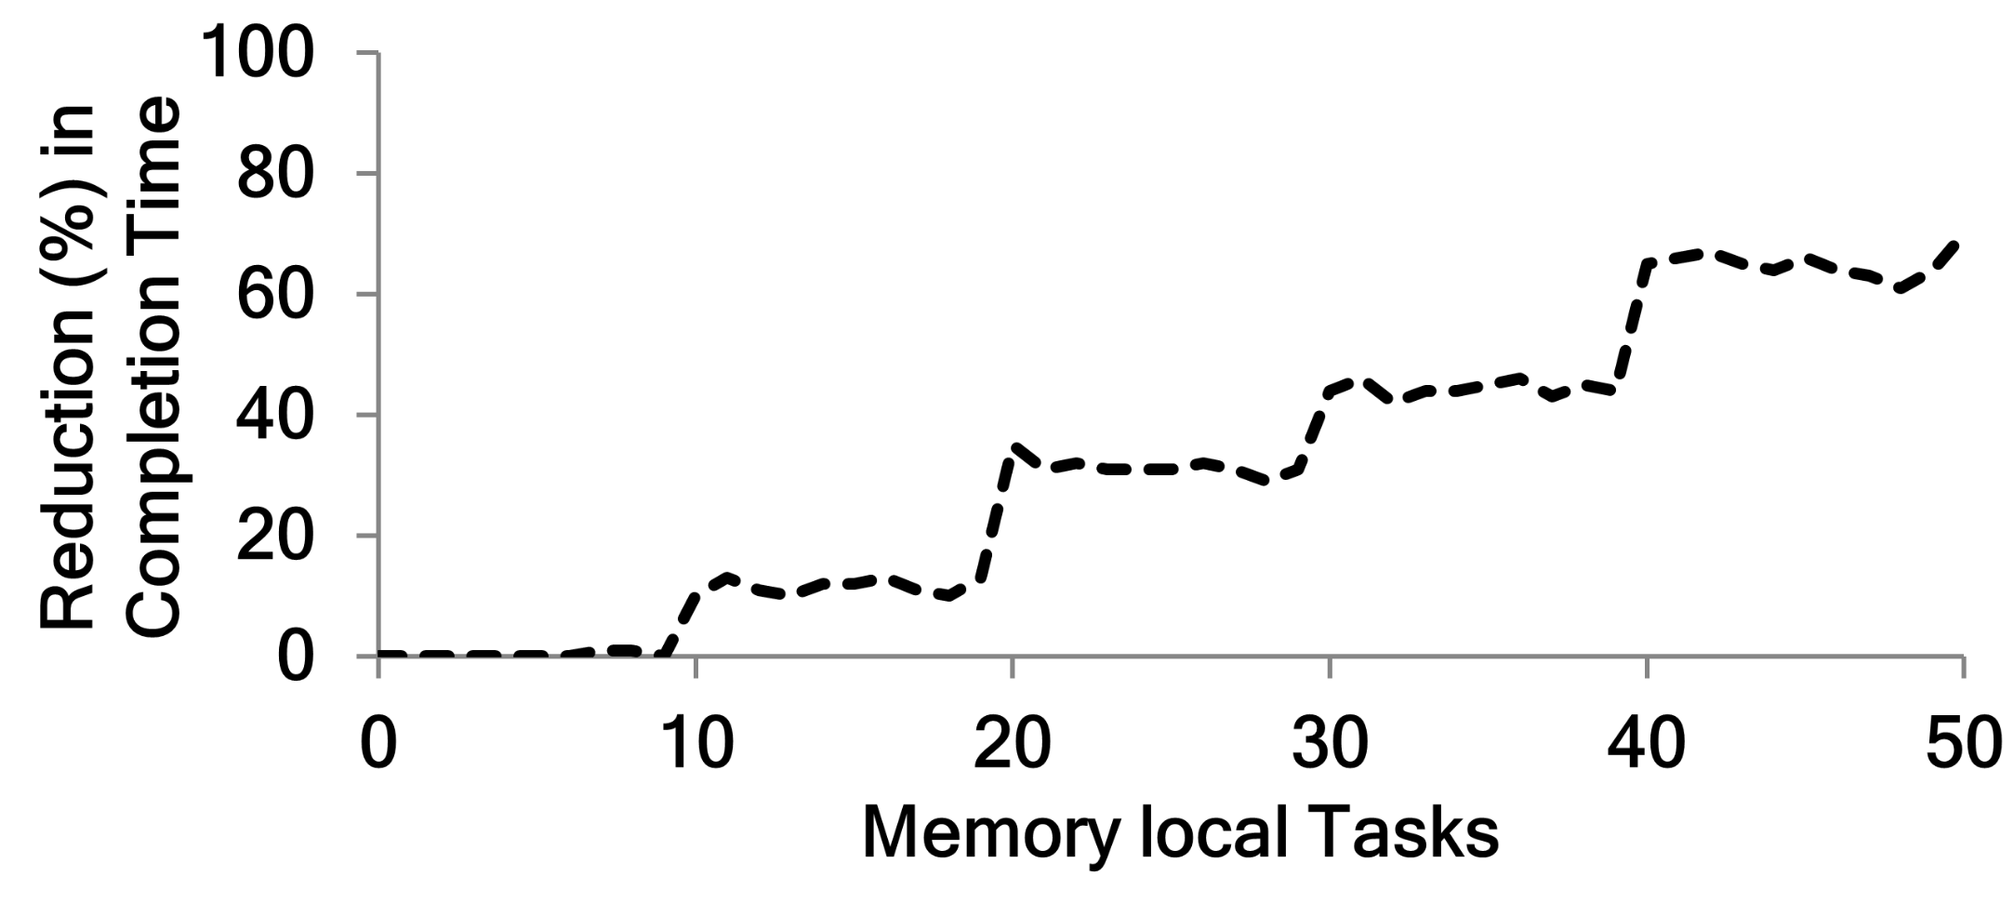
Cache at the wave-width granularity
Job with 50 tasks, wave-width of 10
All-or-nothing

Slide 20
How to evict from cache?
View at the granularity of a job’s input (file)
Evict from incompletely cached waves– Sticky Policy
Task duration
(uncached input)
Task duration
(cached input)
slot₁
slot₂
slot₃
slot₄
slot₅
slot₆
a
slot₇
slot₈
slot₁
slot₂
slot₃
slot₄
slot₅
slot₆
slot₇
slot₈
Without Sticky Policy
Job 1
Job 1
With Sticky Policy
Job 2
Job 2
completion
completion
Hit-ratio: 50%
No speed-up of jobs
Hit-ratio: 50%
Job 1 speeds up
Notes:
Use hit-ratio of 50% - focus benefits to one job

Slide 21
Which file should be evicted?
Depends on metric to optimize:
User centric metric
Completion time of jobs
Operator centric metric
Utilization of the cluster
What are the eviction policies for these metrics?

Slide 22
Reduction in Completion Time
D
Idealized model for job:
Wave-width for job: W
Frequency predicts future access: F
Task duration is proportional to data read: D
Speedup factor for cached tasks: µ
W
Cost of caching: W D
Benefit of caching:
Benefit/cost: µF/W
time
µD
F
Completion Time of Job: frequency/wave-width

Slide 23
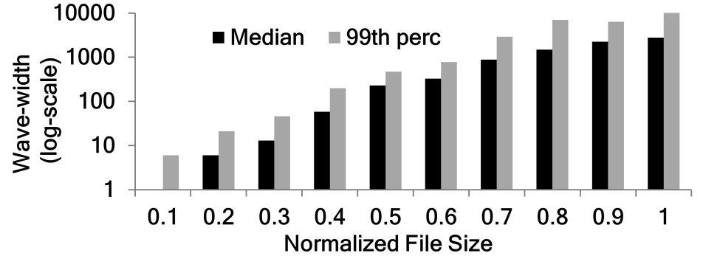
How to estimate W for a job?
Wave-width (slots)
Job size
Use the size of a file as a proxy for wave-width
Relative ordering remains unchanged
Notes:
“conservative upper bound”
Scatter plot for relative ordering

Slide 24
Improvement in Utilization
D
Idealized model for job:
Wave-width for job: W
Frequency predicts future access: F
Task duration is proportional to data read: D
Speedup factor for cached tasks: µ
W
Cost of caching: W D
Benefit of caching: µD F
Benefit/cost: µF
time
W
Utilization of job: frequency

Slide 25
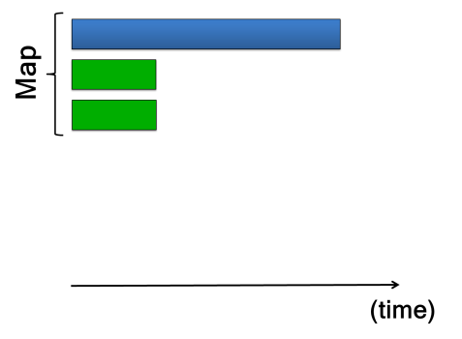
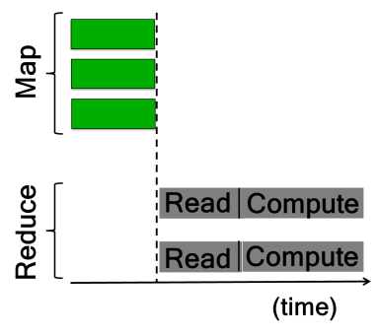
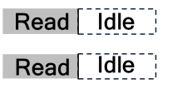
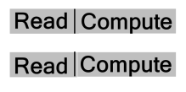
Isn’t this just Least Frequently Used?
All-or-Nothing property matters for utilization
Inter-dependent tasks overlap
Reduce tasks start before all map tasks finish (to overlap communication)
All-or-Nothing →
No wastage!

Slide 26
Cache Eviction Policies
Completion time:
LIFE (Largest Incomplete File to Evict)
Evict from file with lowest (frequency/wave-width)
Sticky: fully evict a file before next (all-or-nothing)
Utilization policy:
LFU-F (Least Frequently Used – File granularity)
Evict from file with the lowest frequency
Sticky: fully evict a file before next (all-or-nothing)
Notes:
Expand LIFE and LFU-F

Slide 27
How do we achieve the sticky policy?
Caches are distributed
Blocks of files are stored across machines
How do we know which files are incomplete?
Coordination
Global view of all the caches
…which blocks to evict (sticky policy)
…where to schedule tasks (memory locality)
Notes:
Emphasize challenge due to distribution

Slide 28
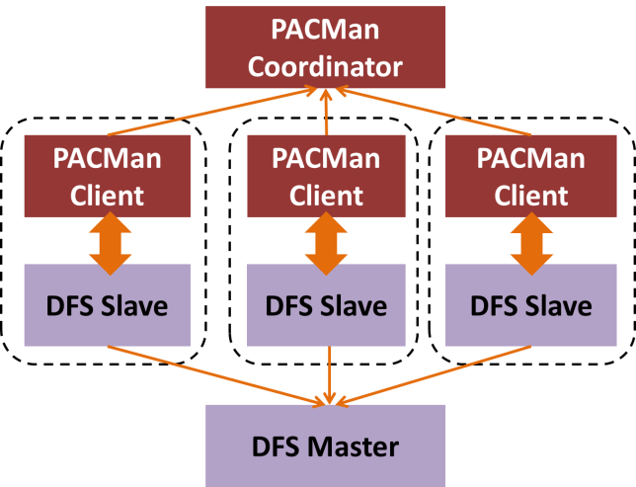
PA Man: Centralized Coordination
Global view
DFS: Distributed File System
Notes:
DFS = Distributed File System

Slide 29
Evaluation Setup
Workload derived from Facebook & Bing traces
Prototype in conjunction with HDFS
Experiments on 100-node EC2 cluster
Cache of 20GB per machine

Slide 30
Reduction in Completion Time
Replacement Policy | Reduction in average completion time (%) | Hit-Ratio (%)
MIN | 13% | 59%
LRU | 9% | 33%
LFU | 10% | 48%
LIFE | 53% | 45%
Sticky Policy
Notes:
Keep reminding that MIN is idealized

Slide 31
Improvement in Utilization
Replacement Policy | Improvement in utilization (%)
LRU | 13%
LFU | 46%
MIN | 51%
LFU-F | 54%
Sticky Policy

Slide 32
PA Man: Scalability
PACMan Coordinator
Near-uniform latency of ≤ 1.2ms with up to 11,000 clients/s
PACMan Client
Can scale up to 20 simultaneous tasks on the machine
Coordination infrastructure is sufficiently scalable

Slide 33
How far is LIFE from the optimal for speeding up parallel jobs?

Slide 34
Caches for parallel jobs are complex!
Maximize # of “job hits” (a la Belady’s MIN)
Job hit = 1 if all inputs are cached; = 0 otherwise
Cache space: Aggregated vs. Distributed
vs.

Slide 35
Caches for parallel jobs are complex!
Maximize # of “job hits” (a la Belady’s MIN)
Job hit = 1 if all inputs are cached; = 0 otherwise
Cache space: Aggregated vs. Distributed
Partial overlap of input blocks between jobs
Job 1
Job 2

Slide 36
Caches for parallel jobs are complex!
Maximize # of “job hits” (a la Belady’s MIN)
Job hit = 1 if all inputs are cached; = 0 otherwise
Cache space: Aggregated vs. Distributed
Partial overlap of input blocks between jobs
Inputs: Equal-sized vs. varying wave-width
Blocks
Jobs

Slide 37
Simplifying Assumptions
Cache space: Aggregated vs. Distributed
At ~100% locality, aggregated ~ distributed
Assume: Aggregated cache space
Partial overlap of input blocks between jobs
98% of jobs have no partial overlap
Assume: No partial overlap
Inputs: Equal-sized vs. varying wave-width
Notes:
List the assumptions of “aggregated” and “no overlap” explicitly.
Same color here

Slide 38
Notation
Jobs indexed by 1, 2, …, n
Job i has wave-width w_{i} and frequency f_{i}
Total cache space = C
Single-waved jobs
Notes:
Do you need the figure? Be consistent with earlier figures

Slide 39
Problem Definition
Job i has wave-width w_{i} and frequency f_{i}
Total cache space = C
x_{i} : if input of job i is in cache
Maximize # “job hits”
Maximize Σ_{i} f_{i} x_{i}
Subject to Σ_{i} w_{i} x_{i} ≤ C
x_{i} = 0, 1
Solution to 0-1 knapsack is optimal cache configuration

Slide 40
Theorem:
Favoring (Frequency/wave-width) is (1-1/K) optimal, where K = C/(max_{i} w_{i}).
Comparing “job hits” (Σ_{i} f_{i} x_{i})
Linear Relaxation
Truncation Discard fractional item from linear relaxation
0-1 Knapsack
≥
≥
0 ≤ x_{i} ≤ 1
x_{i} = 0, 1
* (frequency/wave-width) is optimal solution
*Discarded input is one with largest wave-width
Notes:
Animate when the two parts of the proof arrive – (Freq/wave-width) and max w

Slide 41
LIFE + Optional Eviction
Theorem:
LIFE + Optional Eviction is (1-1/K) optimal, where K = C/(max_{i} w_{i}).
Optional eviction = can evict input of incoming job
(unlike traditional caches)

Slide 42
LIFE + Optional Eviction
Replacement Policy | Reduction in average completion time (%)
LIFE | 53%
LIFE + Optional Eviction | 61%
Optimal | 63%
Most jobs are small (heavy-tailed distribution)
K → ∞ and (1-1/K) → 1;
LIFE + Optional Eviction → Optimal
Optional Eviction: Practical improvement to LIFE
Notes:
Bring out the fact that “optional eviction” actually is an improvement of a practical scheme
Optional eviction is against classical etc.

Slide 43
PA Man Highlights
All-or-nothing property for parallel jobs
Cache at granularity of wave-widths
PACMan: Coordinated in-memory caching system
Cache replacement policies for completion time (LIFE) and utilization (LFU-F); not hit-ratio
Optimality analysis; close approximation
Notes:
Bring out the fact that “optional eviction” actually is an improvement of a practical scheme

Slide 44
Straggler Mitigation
Stragglers: slow tasks that delay job completion
All-or-Nothing → job as slow as the slowest task
Mantri (for large production jobs)
First work to present insights from the wild
Cause-aware solution; in deployment at Bing
Dolly (for small interactive jobs)
Clone jobs upfront; pick first to finish
Heavy-tailed job sizes → mitigate nearly all stragglers with just 3% extra resources

Slide 45
Promise of Big Data Analytics
Efficient and fault-tolerant execution of parallel jobs
“PACMan: Coordinated Memory Caching for Parallel Jobs”, NSDI’12
“Scarlett: Coping with Skewed Popularity Content in MapReduce Clusters”, EuroSys’11
“True Elasticity in Multi-Tenant Data-Intensive Compute Clusters”, SoCC’12
“Disk-Locality in Datacenter Computing Considered Irrelevant”, HotOS’11
“Reining in Outliers in MapReduce Clusters using Mantri”, OSDI’10
“Effective Straggler Mitigation: Attack of the Clones”, NSDI’13
“Why let resources idle? Aggressive Cloning of Jobs with Dolly”, HotCloud’12
Caching & Locality
Straggler Mitigation

Slide 46
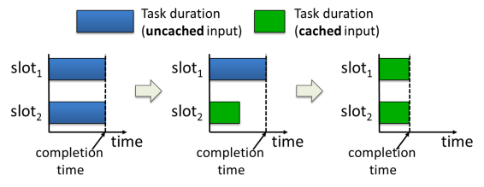
onclusion
All-or-Nothing property of parallel jobs
PA Man: Coordinated Cache Management
Provably optimal cache replacement
Straggler mitigation
Cause-based solution for large jobs, cloning for small jobs

