Slide 1
Improving Optimistic Concurrency Control Through Transaction Batching and Operation Reordering
Bailu Ding¹, Lucja Kot², Johannes Gehrke³
¹Microsoft Research, ²Gramma Tech, Inc, ³Microsoft Corporation
Notes:
Hi everyone,
Thanks for staying for the last talk in the last session on the last day.
I am Bailu Ding, from Microsoft Research.
I am going to talk about how to improve optimistic concurrency control through transaction batching and operation reordering
This is a joint work with Lucja Kot and Johannes Gehrke.

Slide 2
Optimistic Concurrency Control (OCC)
Read phase
Validation phase
Write phase
Client
Transaction Processing
Transaction Coordinators
Read / write request queue
Validation request queue
Storage
Validation
Notes:
Let’s start with an overview of how optimistic concurrency control works.
At a high level, a transaction first executes, optimistically assuming there are no conflicting concurrent transactions, and then it gets validated for conflicts before it commits and makes updates to the database.
There are three phases in the life of a transaction.
In the read phase, the transaction reads from the database and executes its operations. It keeps all the updates in a local workspace.
In the validation phase, the system checks if there is any conflict with this transaction.
If there is no conflict, the transaction enters the write phase and install its updates to the database.

Slide 3
Conflicts in OCC
T1
Read (X) -> 10
Read (Y) -> 20
Serialize T1
Before T2
T1
T2
Write (X) -> 30
X
10
30
Stale read
Commit
T2
Y
20
20
Read (X) -> 10
Abort
Z
50
50
Read (Z) -> 50
Critic of OCC: transaction restarts (time after time) with conflicts and waste resources!
Write (Z) -> 40
Read Phase
Notes:
What will a conflict look like in optimistic concurrency control?
Here we have two concurrent transactions, T1 and T2. In the read phase, T1 reads X and Y, and T2 reads X and Z. Now T1 tries to update X and T2 tries to update Z. At this stage, the updates on X and Z are local to T1 and T2.
Now T1 enters the validation phase. Since there is no conflict, T1 commits and updates X. Then T2 also enters the validation phase. Because T2 reads X as 10 while now X has been updated to 30 by T1, T2 has a stale read. So T2 has a conflict and needs to abort.
Think about that. You have done all the hard work to read from the storage, processing the data, and generate the updates. And when you go to the system for validation, it says: Oops, there is a conflict. Now what? You abort. All the hard work has been wasted and you need to start over again. And again. And again. Until you finally get through the system.
Now think about the impact of such aborts and restarts when the rate of conflicts is high. Lots of resources have been spent on executing the transactions, but no real work has been done. In fact, this is one major critic of optimistic concurrency control, because the performance of the system will take a hit when the data contention is high.
The question is: Does T2 have to abort?

Slide 4
Is T2 Destined to Abort, Really?
T1
Serialize T1
Before T2
T1
T2
Read (X) -> 10
X
10
30
Stale read
Commit
Read (Y) -> 20
Y
20
20
Abort
Write (X) -> 30
Z
50
50
T2
Serialize T2
Before T1
T2
T1
Read (X) -> 10
X
10
Commit
10
Commit
30
Read (Z) -> 50
Y
20
20
20
Write (Z) -> 40
Z
50
40
40
Conflicting transactions can all commit with an alternative serialization order!
Notes:
Let’s go back to the example. In this case, T2 has a stale read essentially because it is serialized after T1.
What if we switch the serialization order of T1 and T2, there will be no stale read and no conflict. Both transactions commit.
But can we really reorder the transactions?

Slide 5
Transaction Reordering in OCC
Observation: OCC finalizes the serialization order after transaction execution
Insight: Reorder transaction operations to reduce conflicts
Proposal: Batch transaction operations explicitly to allow reordering throughout the life of transaction execution
Notes:
Here is the observation: in optimistic concurrency control, the serialization order is only decided at the validation phase, which is after the transaction execution.
So before the serialization point, there is no restriction on how the transaction operations are processed or how to interpret the order of transaction operations
At the validation phase, by default, the transactions are serialized in a first come first serve order. As we have seen in the previous example, we can reorder these transactions into a different serialization order with less conflicts.
Such reordering, however, requires looking at more than one transaction. In other words, we need to look at a batch of transactions. Fortunately, batching doesn’t sound foreign in system design. In practice, database systems have already implemented many queues to buffer transactions and operations. So reordering just brings the concept of batching explicitly into transaction processing.
Not only that, we can further extend the idea of reordering throughput the life of a transaction.

Slide 6
A Life of a (Batched and Reordered) Transaction
Client
Transaction Processing
Transaction Coordinators
Read / write request queue
Validation request queue
Batch and reorder R/W operations
Batch and reorder transactions
Storage
Validation
Notes:
Here is the life of a transaction with batching and reordering.
As the transaction enters the system and sends read and write requests to the storage. We can batch and reorder the read and write requests to reduce stale reads.
Similarly, as the transactions enter the validation phase, we can reorder the transaction validation requests to reduce conflicts.

Slide 7
Transaction and Operation Reordering
Reordering transactions at clients
Prior work on static transaction scheduling
Reordering operations at storage
Reorder reads and writes to reduce stale reads
Reordering transactions at validation
Reorder transaction validation requests to reduce conflicts
Notes:
In fact, we can even reorder the transactions at the client side to avoid scheduling concurrent transactions that can conflict with each other.

Slide 8
Transaction and Operation Reordering
Reordering transactions at clients
Prior work on static transaction scheduling
Reordering operations at storage
Reorder reads and writes to reduce stale reads
Reordering transactions at validation
Reorder transaction validation requests to reduce conflicts
Notes:
Next I will dive into how we reorder validation requests.

Slide 9
Transaction Reordering at Validation
Goal: Find a serialization order with the least number of aborts
Given a batch of transactions $B$, construct subset $B^{′}⊆B$, such that $B^{′}$ is serializable and $|B^{′}|$ is maximal among all $B^{′}⊆B$
The number of aborts is minimized within the batch if $|B^{′}|$ is maximal
How to decide if $B′$ is serializable and how to construct a serialization order for transactions in $B′$?
Notes:
Essentially, the question we ask is how to find a serialization order that has the least number of aborts?
Now bear with me with some symbols. Formally, given a batch of transactions B, we want to construct a subset B’, where B’ is serializable and |B’| is maximal among all B’.
Before going into how to select B’, let’s first figure out when B’ is serializable, and if it is serializable, how can we construct a serialization order for transactions in B’?

Slide 10
Constructing a serialization order
Dependency graph: the conflicts of transactions
Example: If T2 updates an item T1 reads, T1 cannot be serialized after a transaction T2. We have T2 -> T1.
$B′$ is serializable if and only if its dependency graph is acyclic
T1
T1
T1
T1
T2
T3
T2
T3
T3
T2
T3
Serialization order: T2 -> T3 -> T1
Cyclic graph
Notes:
Here we introduce the concept of a dependency graph.
At a high level, a dependency graph describes the conflicts of transactions. For example, If a transaction T1 reads an item that is updated by transaction T2, T1 cannot serialize after T2. In this case, we create a dependency from T2 to T1.
So if a transaction has no dependency, it can commit without causing any other transaction to abort.
For example, we have three transactions T1, T2, and T3. Since T2 has no dependency, we can first commit T2. After removing T2 from the graph, now T3 has no dependency and can commit. So in this example, we can serialize the transactions in the order of T2, T3, and T1.
In another example, where there is a cycle of dependencies for T1, T2, and T3. There is no way to commit a transaction without causing some transaction to abort. So this dependency graph is not serializable.
This example is not a coincident. In fact, we can prove that, for a subset of transactions B’, it is serializable if and only if its dependency graph is acyclic.

Slide 11
Constructing the Maximal $B′$
Given $B$ and a dependency graph $G(B)$, find the maximal $B^{′}⊆B$ such that $G(B^{′})$ is acyclic
Find the minimal $V⊆B$ such that $G(B∖V)$ is acyclic
$B^{′}=B∖V$
Feedback vertex set!
But it is NP hard …
Notes:
Now we have more clarify on when a set of transactions are serializable.
Given a batch of transactions and a dependency graph, we want to find the maximal subset of transactions such that the dependency graph of the subset is acyclic.
This is equivalent to find the smallest number of transactions, such that by removing these transactions from the set, the resulting subset is serializable.
Now, the good news is that this problem is so classic, and it actually deserves a name: feedback vertex set problem.
The bad news is that, as with many other classic problems, this one is of course NP hard.

Slide 12
Greedy Algorithms
Strongly connected component (SCC) based
A directed graph where there is a path between every pair of nodes
Any cycle must reside in a SCC
Recursively remove nodes from SCCs to make the graph acyclic
Sort based
Recursively remove nodes based on a measure of degrees
Less accurate but much more efficient
Notes:
Apparently, we have figured out how to make NP equals to P yet. So we proposed some greedy algorithms.
The first greedy algorithm leverages the concept of strongly connected components. The intuition is that, all the nodes in a cycle can reach each other, a cycle must be contained in a strong connected component. The algorithm recursively removes nodes from strongly connected components until the graph becomes acyclic.
Given that the reordering is on the critical path of the transaction processing, we also propose another greedy algorithm based on sorting of the node degrees, that is slightly less accurate but much more efficient.

Slide 13
Policies for Alternative Performance Goals
Minimize $V$: minimize the number of aborts
Alternative performance goals
Minimize tail latency
Minimize the number of restarts
Maximize monetary value
Weighted feedback vertex set
Weighted SCC and sort based greedy algorithms
Notes:
So far we have talked about how to minimize the number of aborts with transaction batching and reordering.
Sometimes, there are other more important performance goals. For example, you want to optimize for the tail latency as a service provider for your SLAs. Or you want to minimize the number of restarts because each restart consumes resources. Or if transactions carry monetary values, and you want to make sure those million-dollar transactions get through the system as soon as possible.
We can design different policies to assign weight to transactions based on the performance goal. The reordering problem can be then modeled as the weighted version of the feedback vertex set, and can be effectively solved with the weighted version of our greedy algorithms.

Slide 14
Evaluation
Workload
Write intensive YCSB with Zipfian distribution
Hardware
Two Intel Xeon E5-2690 v4 CPU 2.20GHz w/ 28 physical cores
256GB RAM
More evaluation in the paper
Implementation on more architectures
More workloads and baselines
Parallel validation
Comparison of reordering algorithms
Parameter sensitivity
More policies: number of conflicts, tail latency, number of restarts
Notes:
We evaluate our proposed solution extensively on different systems and workloads for various aspects of our system, such as the comparison of the greedy algorithms, the sensitivity of the batch sizes, the degree of parallelism for validation, also policies for different optimization goals.
Here we show the performance with batching and reordering using a multi-key transactional YCSB benchmark.

Slide 15
Write-Intensive Skewed YCSB
Up to 2.2x improvement in throughput
Notes:
We compare against other high performance OLTP kernels with our reordering strategy that minimizes the number of aborts under a write-intensive and skewed workload.
The X axis shows the number of transactions per second in millions. The Y axis shows the number of client threads.
As the number of threads increases, the data contention becomes higher. With reordering, the throughput is up to twice as much compared with the best baseline.

Slide 16
Write-Intensive Skewed YCSB
Up to 4x reduction in percentile latency
Notes:
We also measure the tail latencies of these systems.
The X axis shows the latency in milliseconds, the Y axis shows the 90, 95, 99 percentile latency.
With reordering, the percentile latencies reduce by up to 4 times compared with the best baseline.

Slide 17
Optimize for Tail Latency
Up to 6.3x reduction in tail latency
Notes:
Finally, we show one example of optimizing for alternative performance metric, the tail latency.
We design a policy that weigh the transactions taking its start time into account. The y axis shows the latency in milliseconds. The x axis shows the 29s, 39s, 49s, and 100 percentile tail latency.
Comparing with the original policy that minimize the number of aborts, this policy reduces the very tail latency by up to 6.3 times with similar throughput.

Slide 18
Conclusion
Reordering transaction operations can reduce conflicts in optimistic concurrency control
Batching and reordering improves throughput and reduces tail latency
Reorder policies can optimize for more performance goals, such as tail latency and monetary value
Ding, Bailu, Lucja Kot, and Johannes Gehrke. "Improving optimistic concurrency control through transaction batching and operation reordering." Proceedings of the VLDB Endowment 12.2 (2018): 169-182.
Notes:
To conclude, reordering transaction operations can reduce conflicts in optimistic concurrency control.
And such batching and reordering both improves throughput and reduces tail latency.
Finally, we can design different reordering policies to optimize for more performance goals, such as throughput, tail latency, and monetary value.

Slide 19
Backup Slides

Slide 20
SCC-based Greedy Algorithm
Strongly connected component: a directed graph where there is a path between all pairs of vertices
Intuition: any cycle should be contained in a SCC
Idea: recursively remove a vertex from each SCC until the graph becomes acyclic

Slide 21
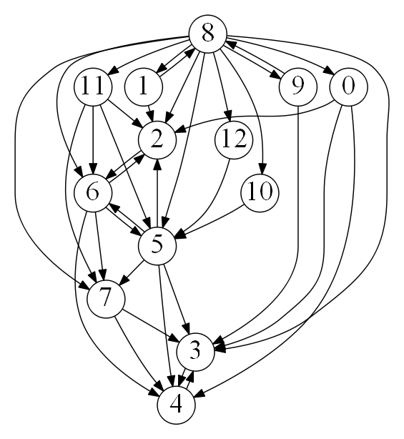
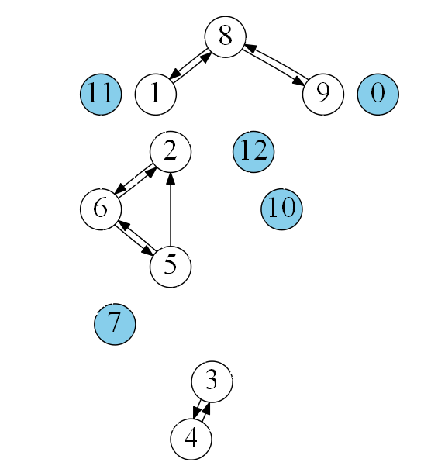
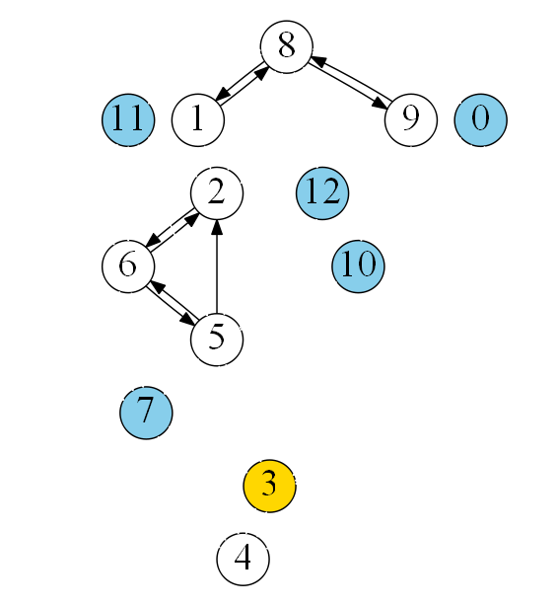
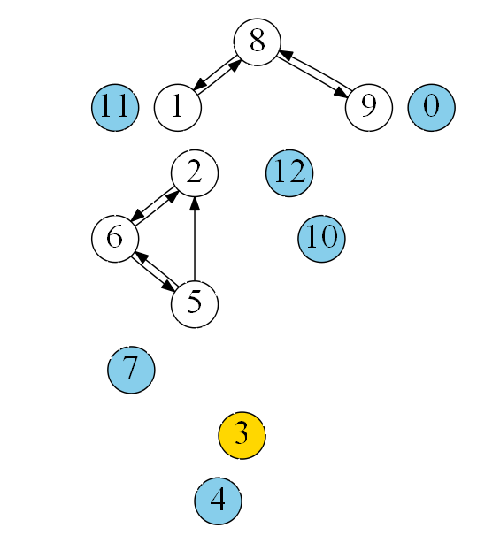
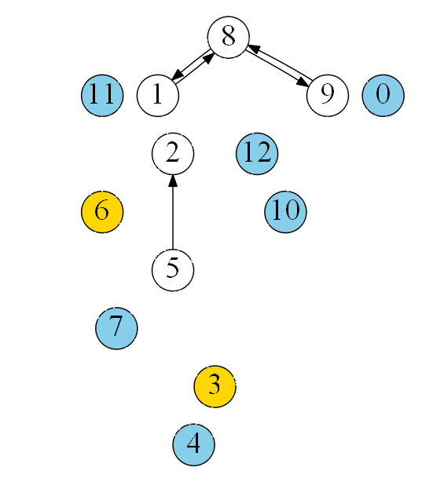
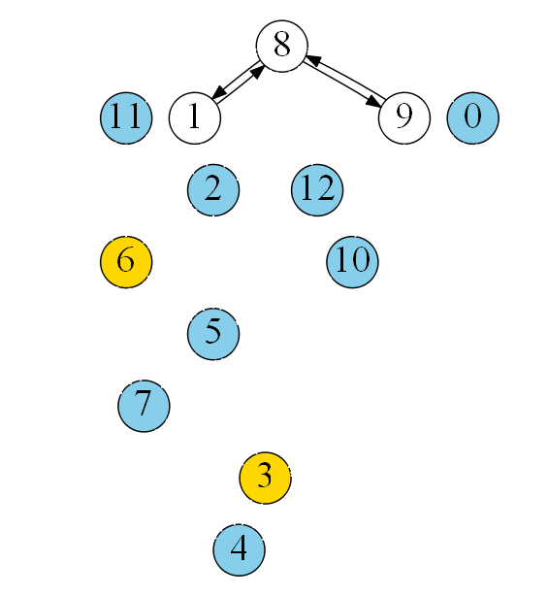
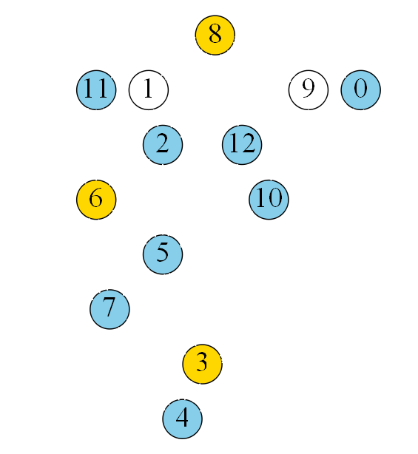
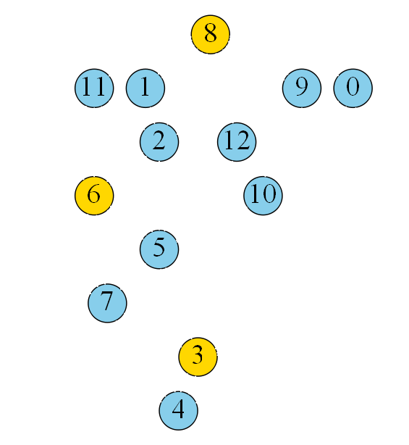
Example: SCC-based Greedy Algorithm

