Slide 1
Data-induced Predicates (sideways-information passing in the QO)
Srikanth Kandula
Laurel Orr
Surajit Chaudhuri
Notes:
Hi. Thanks for listening in. I am Srikanth Kandula from Microsoft; I will tell you about what we call data-induced predicates which bring sideways-information passing into the query optimizer. This is joint work with Laurel Orr and Surajit Chaudhuri.

Slide 2
Partition elimination is a widely used technique ^{[1]}
Aggregate statistics
(e.g., per column, min and max value)
SELECT *
FROM dates
WHERE year=2000
…
Only read partitions that can satisfy the predicate
Partitions (e.g.,
100MBs of rows in HDFS,
1M rows in SQL columnstore)
[1]: SQL Server, Oracle, Exadata, SCOPE, Vertica, ORC, Parquet, Synapse, Databricks Z-order
Notes:
Right, so partition elimination is a widely used technique in databases, datawarehouses and big-data systems.
Suppose you have a query that searches for the year 2000 in the dates table. The table is laid out in disjoint partitions which could be 100MBs of rows in HDFS or 1M rows in SQL server column segment. Associated with each partition, these systems also maintain aggregate statistics such as per column max and minimum value. Now, you can apply this predicate on these statistics and only read partitions that can satisfy the predicate. You skip the others which is what we call partition elimination.

Slide 3
But predicates cannot eliminate partitions of joining tables
Problem:
SELECT *
FROM dates
WHERE d_year=2000
JOIN storesales ON ss_sold_date_sk = d_date_sk
Many prior works: while query executes,
build bitvectors of join column values on one join input and
process only matching rows from the other input
Our goal:
without seeing any rows, at QO time, eliminate partitions.

Slide 4
Convert any predicate on a table to a new predicate over just the join column
$$$$
$$$$
$$$$
$$$$
$$$$
$$≡$$
$$≡$$
$$$$
C
$$d_{c}$$
$$σ$$
$$d_{c}$$
$$σ$$
$$σ$$
R
T
R
T
R
T
Correct iff $σ  d_{C}$
Use $d_{C}$ to eliminate partitions on R
Notes:
Can go either ways; or to other tables; so on

Slide 5
How to construct these new predicates?
data –induced predicates
“zone map” statistic
Apply pred. on partition stats
On partitions that satisfy the pred, merge the join column’s statistic
$$$$
Column | Part. #1 | Part. #2 | Part. #3
_date_sk | [3000, 5000] | [4500, 6000] | [7000, 9000]
d_year | [1995, 2000] | [1999, 2002] | [2005, 2010]
$$$$
_date_sk
$$σ_{d_year}$$
d_year=2000
3000 ≤_date_sk ≤ 6000
Note:
New predicates are induced by how the data is laid out
Can use any statistic that supports pred sat., merging, pred extract.
Can support complex pred. and other join conditions

Slide 6
diPs how much partition elimination in joining tables?
$$$$
TPC-H Query #17 (simplified)
$$$$
$$d$$
SELECT SUM(l_extendedprice)
FROM lineitem, part
WHERE p_partkey = l_partkey AND
p_brand = ‘%1’ AND p_container = ‘%2’
_{PARTKEY}
_{PARTKEY}
$$σ$$
lineitem
part
#Partitions to be read…
Initially
After predicate
diP: part → lineitem
lineitem | part
1000 | 26
1000 | 2
50 | 2
TPC-H, sf=100, skew: zipf 2
Layout:
Part sorted by _partkey
Lineitem distributed by _orderkey and then sorted by _orderdate
Notes:
Gains depend on layout and statistics and … but large gains are possible

Slide 7
Why are the diPs succinct?
Recall, to build diPs:
Apply predicate on partition stats
On partitions that satisfy the pred, merge the join column’s statistic
False positives likely in both steps

Slide 8
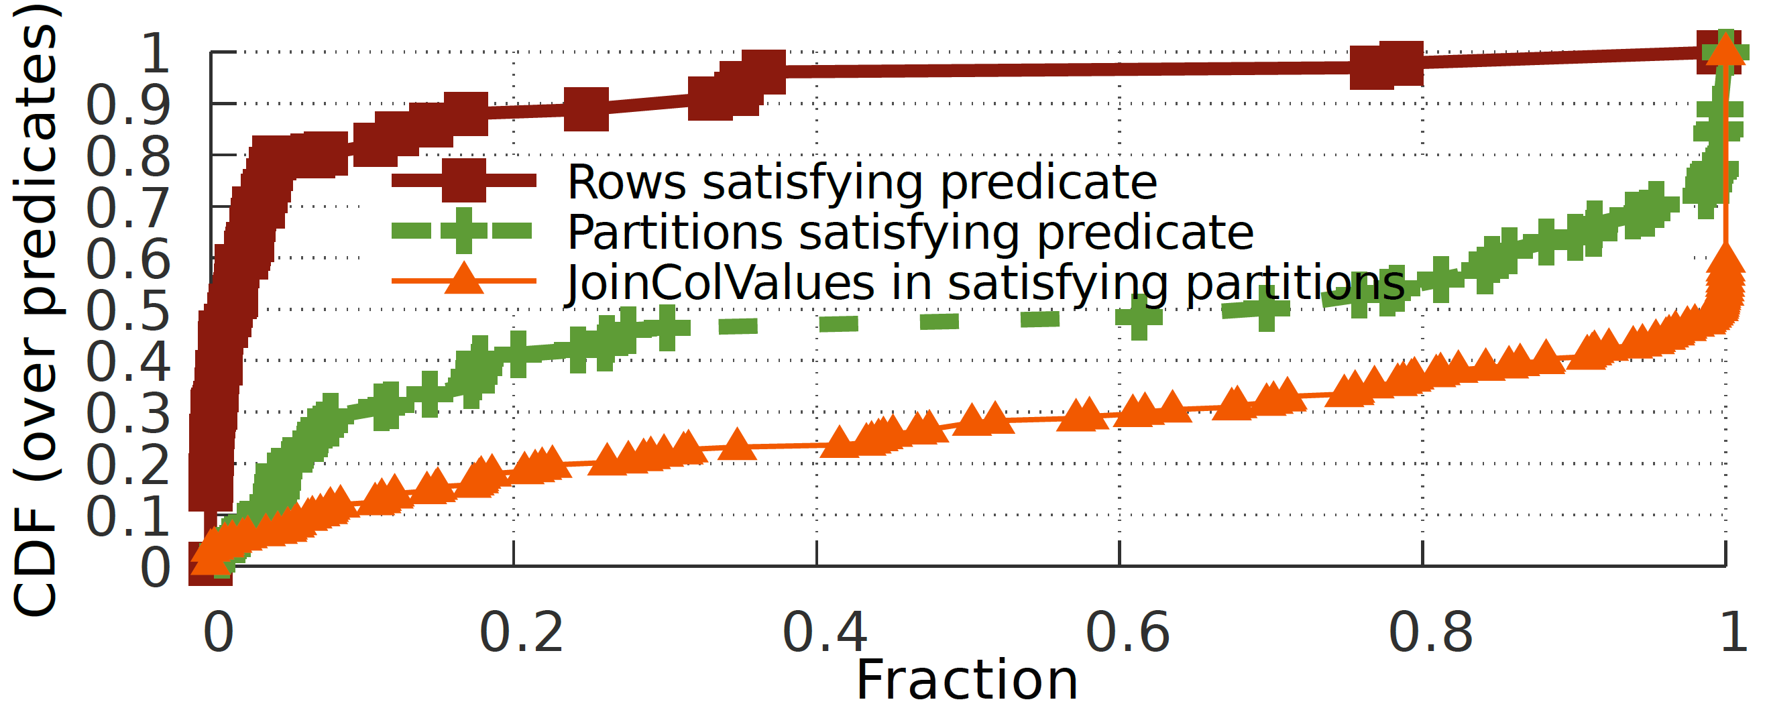
diPs are succinct, in practice
Preds / layouts from prod. SCOPE clusters:
80% of preds. pick <5% of rows
20% of preds. yield diP with <20% range
Reasons:
Tables are co-partitioned on join columns
Batch appended logs are loosely clustered on time and server name
Skew (pruning a very frequent joincol value can prune many parts.)
Notes:
Because due to a variety of reasons, the partitions that contain rows which satisfy a predicate have only a subset of join column values
SCOPE prod

Slide 9
diPs help the QO to find better query plans
No reduction in initial I/O!
TPC-H Query #17
SELECT SUM(l_extendedprice)
FROM lineitem, part
WHERE p_partkey = l_partkey AND
p_brand = ‘%1’ AND p_container = ‘%2’ AND
l_quantity < (SELECT 0.2 * AVG(l_quantity)
FROM lineitem
WHERE l_partkey = p_partkey)
$$σ$$
$$$$
$$$$
$$$$
$$$$
$$d$$
_{PARTKEY}
_{PARTKEY}
_{PARTKEY}
$$σ$$
GbAgg_{PARTKEY}
lineitem
part

Slide 10
diPs help the QO to find better query plans
Use commutativity to move diPs
TPC-H Query #17
SELECT SUM(l_extendedprice)
FROM lineitem, part
WHERE p_partkey = l_partkey AND
p_brand = ‘%1’ AND p_container = ‘%2’ AND
l_quantity < (SELECT 0.2 * AVG(l_quantity)
FROM lineitem
WHERE l_partkey = p_partkey)
$$σ$$
$$$$
$$$$
$$$$
$$$$
$$d$$
_{PARTKEY}
_{PARTKEY}
_{PARTKEY}
$$σ$$
GbAgg_{PARTKEY}
lineitem
part

Slide 11
diPs offer sideways information passing to the QO
Our approach:
Input
Output
We only use coarse summary statistics
Plan
Plan
$$…$$
$$…$$
Tables: $R, T, …$
Partition subsets: $R^{′}, T^{′}, …$
Exchange diPs on maximal SJ portions
Move diPs using commutativity
Repeat 1, 2 till fixed point

Slide 12
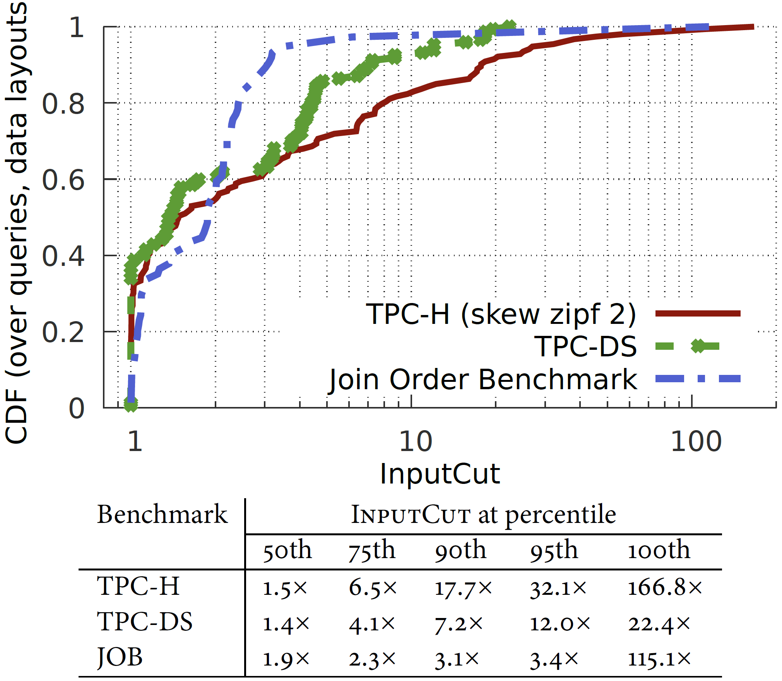
Notes:
Tuned/ typical

Slide 13
Other key questions (answered in the paper)
How do gains from diPs compare with technique X?
Can diPs converge quickly?
Does statistic choice matter?
How to update statistics when data changes?

Slide 14
diPs offer sideways information passing in the QO
Summary
Input
Output
Operate exclusively during query planning
Rely only on coarse summary statistics
Support arbitrary queries
Query
Query
Fast derivation of diPs for SJ expressions
Use QO rules to move diPs past other ops.
A new stat, range-set, that leads to more cut
(Approximate) updates to stats are trivially easy
Experiments vs strong prod. baselines show
sizable gains with a
small stat size and a
small increase in query optimization time
Tables: $R, T, …$
Partition subsets: $R^{′}, T^{′}, …$
Key ideas
S. Kandula, L. Orr and S. Chaudhuri. Pushing data-induced predicates through joins in big-data clusters. In VLDB 2020.

Slide 15
Additional Slides

Slide 16
Convergence of diPs is non-trivial
$$$$
$$$$
partkey
$$$$
$$$$
orderkey
$$σ$$
$$σ$$
$$σ$$
lineitem
orders
part

Slide 17
Convergence of diPs is non-trivial
$$$$
$$$$
Must construct diPs per {table, join}
If an incoming diP eliminates partitions, must recompute outgoing diPs
Worst-case:
n-way join requires O(n³) diPs
In practice:
Takes too long or leaves gains unrealized
partkey
$$$$
$$$$
orderkey
$d_{orderkey}^{l}$,
$$d_{partkey}^{p}$$
$$d_{orderkey}^{o}$$
$$σ$$
$$d_{partkey}^{l}$$
$$σ$$
$$σ$$
lineitem
orders
part

Slide 18
Careful schedule for fast convergence of diPs
1
$$t_{3}$$
$$t_{3}$$
1
5
$$t$$
$$r$$
1
2
1
$$t_{1}$$
$$t_{2}$$
2
3
Exchange diPs
$$t_{1}$$
1
$$t_{2}$$
2
4
Update part. subset
2
1
$$t_{4}$$
$$t_{4}$$
2
6
1
4
One join
2 diPs
1 round
Tree-like join graphs
2(n-1) diPs
Tree-depth rounds (at most n/2, log(n) typically)
Cyclic join graphs
Approximate algo in general (≈ loopy belief prop.)
Optimal; star and snowflake schemas lead to tree-like join graphs

Slide 19
Commutativity rules to move diPs: resemble transformations for selects with some impt. exceptions
$d\left(σ\right)≡σ(d)$ diPs commute with any select
$d_{c}\left(π_{e}\right)≡π_{e}({d′}_{c})$ iff $c≠e$ or $π$ is linear and invertible
$d_{c}\left({GbAgg}_{e}\right)≡{GbAgg}_{e}(d_{c})$ iff $c⊆e$
$d_{1}\left(R_{1}\right)∩d_{2}\left(R_{2}\right)≡(d_{1}∧d_{2})(R_{1}∩R_{2})≡(d_{1}∧d_{2})R_{1}∩(d_{1}∧d_{2})R_{2}$
$d_{1}\left(R_{1}\right)∪d_{2}\left(R_{2}\right)≡(d_{1}∨d_{2})(d_{1}\left(R_{1}\right)∪d_{2}\left(R_{2}\right))$
$d\left(R_{1}\right)−R_{2}≡d\left(R_{1}−R_{2}\right)≡d\left(R_{1}\right)−d\left(R_{2}\right)$
$d_{c}\left(R_{1}\right)⋈_{c=e}R_{2}≡d_{c}\left(R_{1}⋈_{c=e}R_{2}\right)$
$d_{c}(R_{1}⋈R_{2})≡d_{c}(d_{c}(R_{1})⋈R_{2})$ iff $c ∈R_{1}$

Slide 20
Another example (TPC-DS q35)
$$$$
$$$$
$$$$
$$$$
_{_customer_sk}
1
_{_customer_sk}
2
$$$$
$$∩$$
$$∩$$
$$$$
$$$$
$$$$
$$∪$$
$$∪$$
$$$$
$$$$
$$$$
$$$$
$$$$
$$$$
$$$$
$$$$
$$$$
$$$$
$$$$
$$$$
$$$$
$$$$
$$$$
$$$$
ca
_{_date_sk}
_{_date_sk}
_{_date_sk}
ca
_{_date_sk}
_{_date_sk}
_{_date_sk}
cd
c
$$q$$
cd
c
$$q$$
$$q$$
ss
cs
ws
ss
cs
$$σ$$
ws
$$σ$$
ss
cs
ws
$$q$$
d
d
d
$$$$
$$$$
$$$$
$$$$
4
_{_customer_sk}
3
_{_customer_sk}
$$$$
$$$$
$$∩$$
$$$$
$$∩$$
$$$$
$$$$
$$∪$$
$$∪$$
$$$$
$$$$
$$$$
$$$$
$$$$
$$$$
$$$$
$$$$
$$$$
$$$$
$$$$
$$$$
$$$$
$$$$
$$q$$
ca
$$$$
ca
_{_date_sk}
_{_date_sk}
_{_date_sk}
_{_date_sk}
_{_date_sk}
_{_date_sk}
$$q$$
$$q$$
ca
$$q$$
cd
c
$$q$$
$$q$$
$$q$$
cd
c
$$q$$
$$q$$
$$q$$
cd
c
ss
cs
$$σ$$
ws
c
ss
cs
$$σ$$
ws
ss
cs
ws
ss
cs
ws
$$q$$
$$q$$
d
d
d
d

Slide 22
Choice of statistics matters
Recall: any stat that supports pred eval and is mergeable can be used to build diPs
Tradeoff: stat size vs. quality of diPs vs. execution cost
Zone Maps (max and min)
Histograms (equi-depth with gaps)
Bloom filters
Range-sets
…
Input multi-set $D=\left\{x\right\}$
Range-set $R= \left\{\left[l_{i}, u_{i}\right]\right\}$
s.t.
$$\left|R\right|=n,$$
$$∀ x_{j}∈D, ∃ i, l_{i}≤x_{j}≤u_{i}$$
Zone-map
Equi-depth histogram
Frequency
Range-set
Value

Slide 23
Workflow
partition stats $≪$ input
Data
Read only partition subsets
offline
online
QO + data skipping
Plan
Query

Slide 24
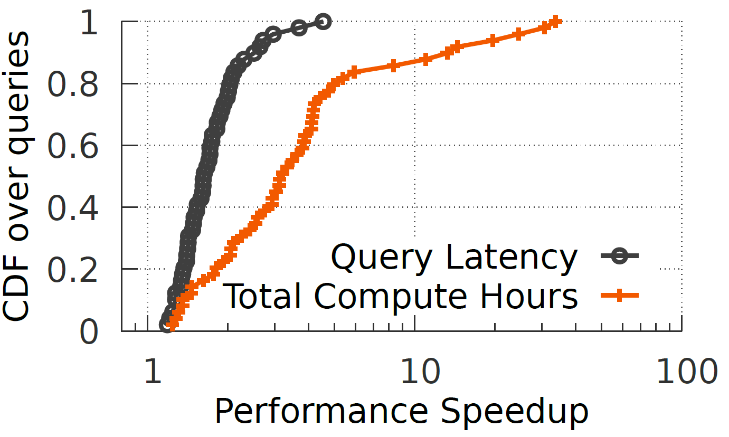
TPC-DS queries in SCOPE clusters
Method:
50 TPC-DS queries
1 TB dataset
Tables in tuned layout
X axes is relative to production baseline
diPs use range-sets

Slide 25
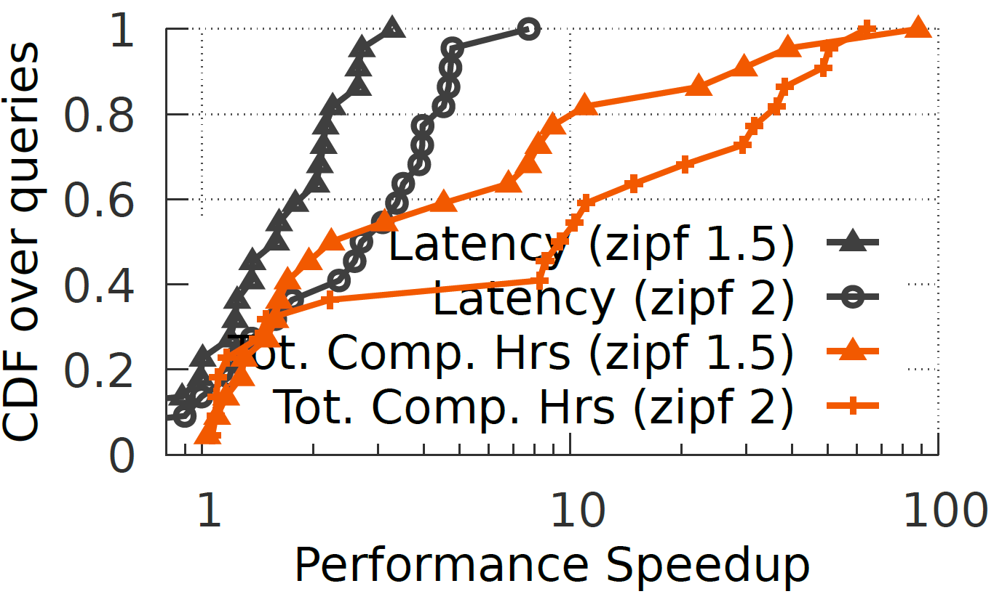
TPC-H queries in SCOPE clusters
Method:
22 TPC-H queries
100 GB dataset
Skewed datagen
Tables in tuned layout
X axes is relative to production baseline
diPs use range-sets

Slide 26
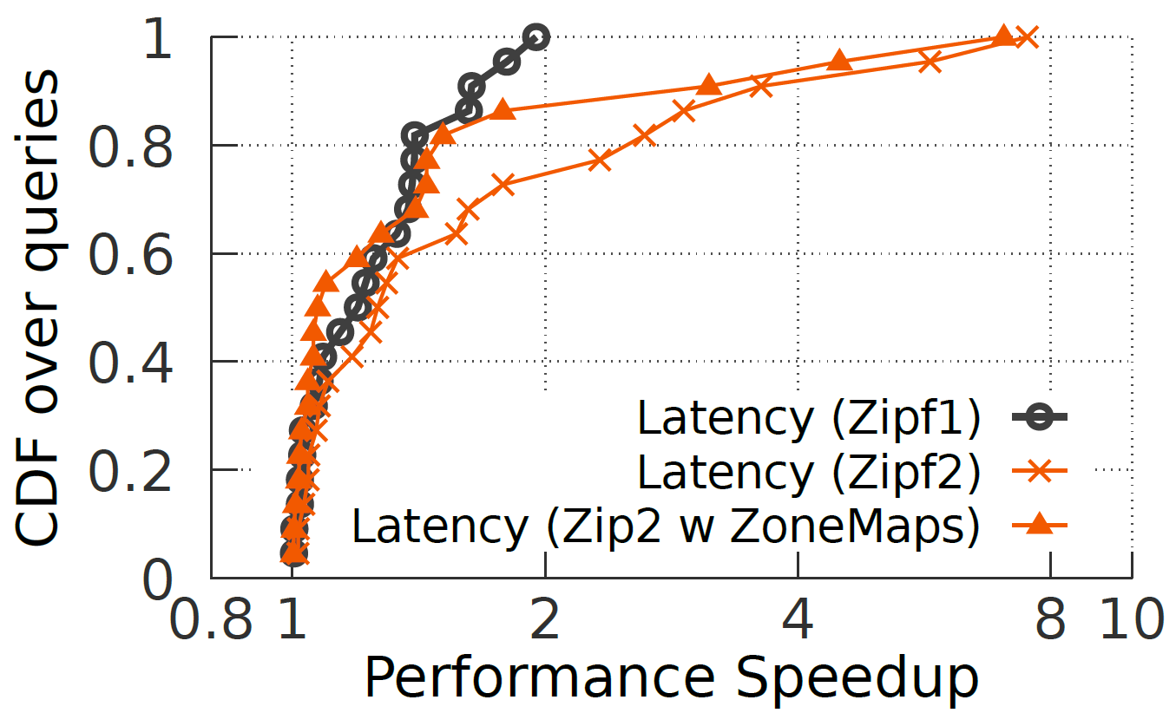
TPC-H queries on SQL server
Method:
As previous, except on SQL server 2016
Column store
“simple loading”
Queries repeat 5x
Flushes b/w execs
[using partitions or rowstores was slower]

Slide 27
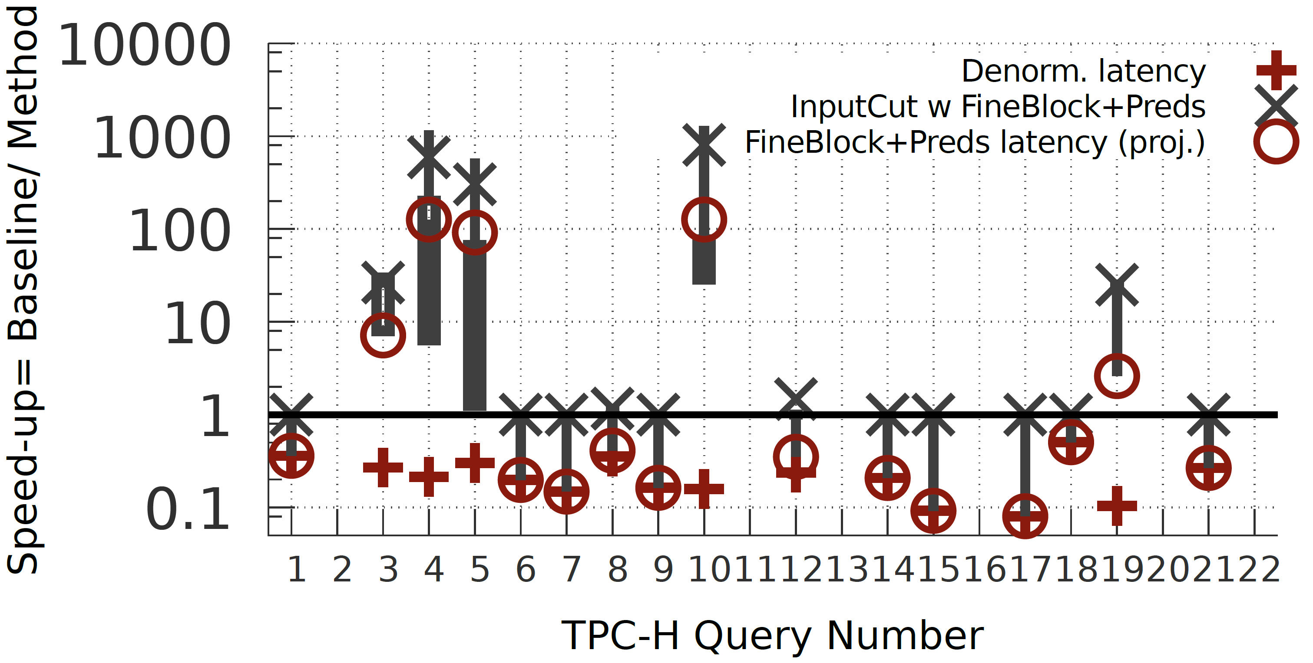
vs. Denorm View and adaptive layout
Method:
Denorm is a single table colstore
Zipf 1

Slide 28
When using different statistics; also, per-query breakdown

Slide 29
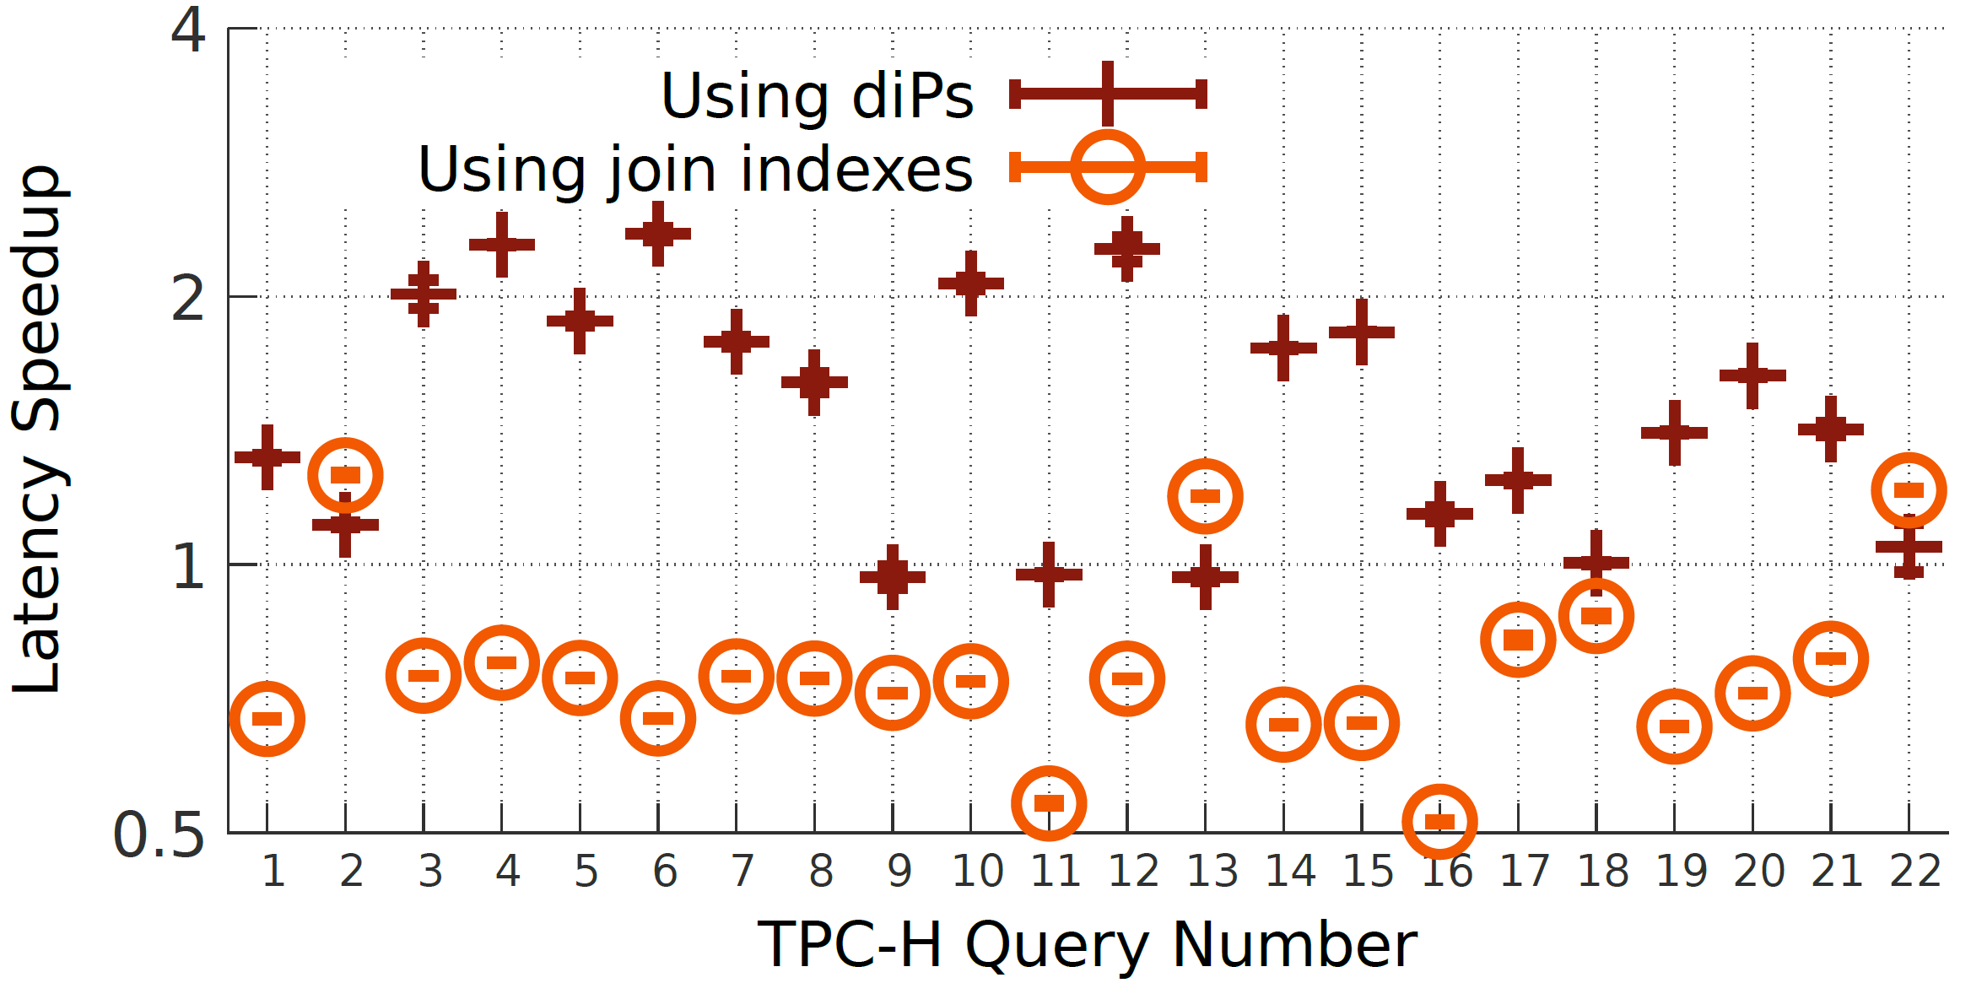
diPs vs. join indexes; on SQL server
Method:
Row store
Index on key; l on l_ok and ps on ps_sk
Baseline = rowstore with no indexes

Slide 30
Costs
Latency of plan computation
Stat sizes

Slide 31
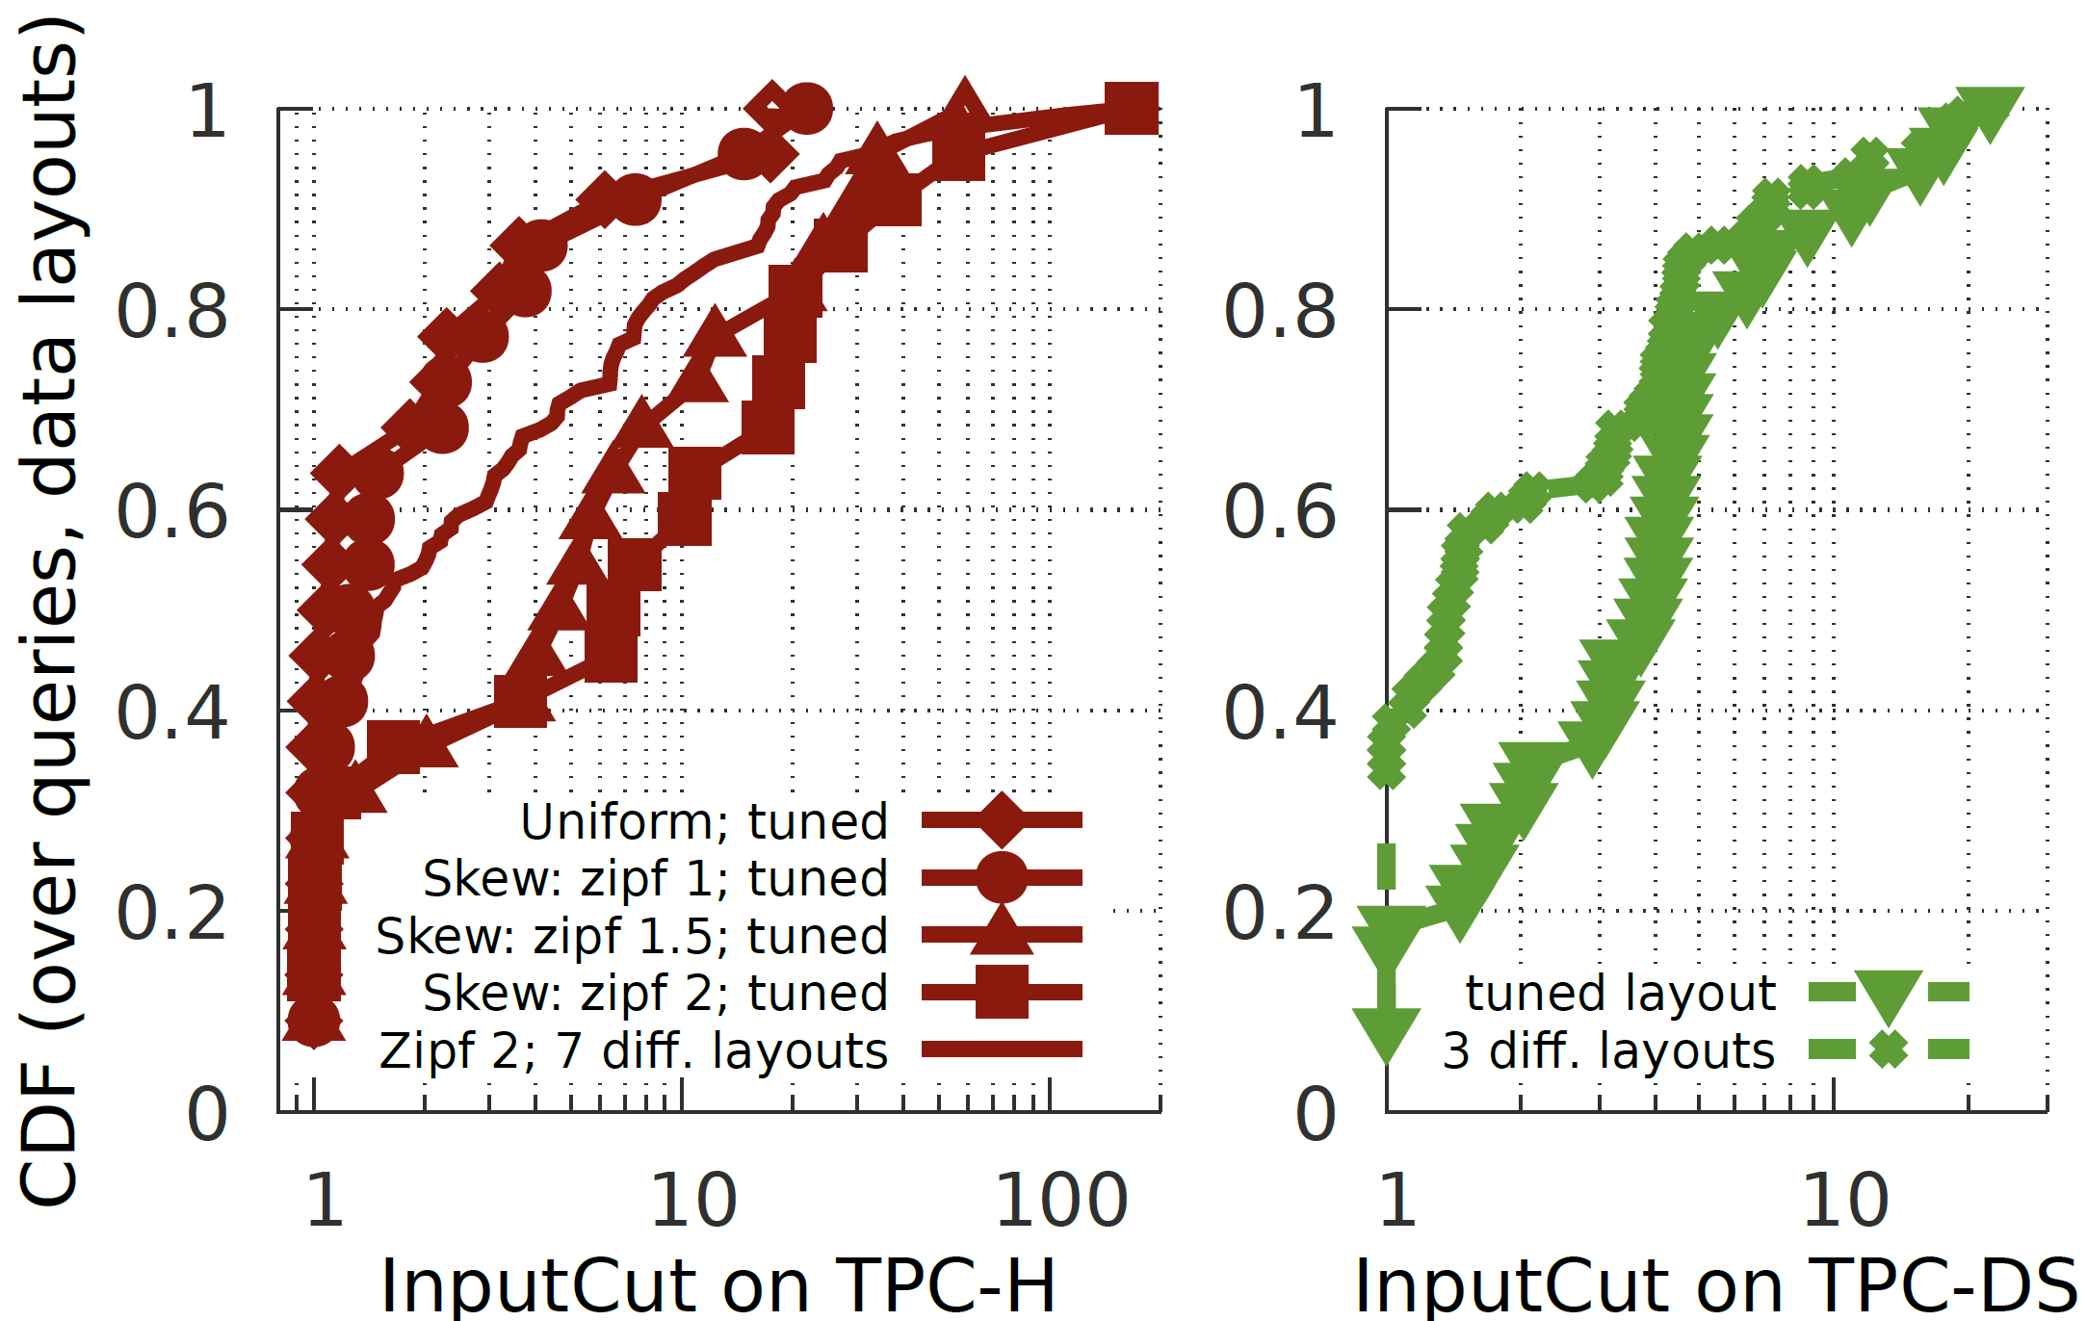
Effect of varying data layouts and skew

Slide 32
Approximate updates to range-sets
Time (in nanoseconds) to update range-set of different number of ranges

Slide 33
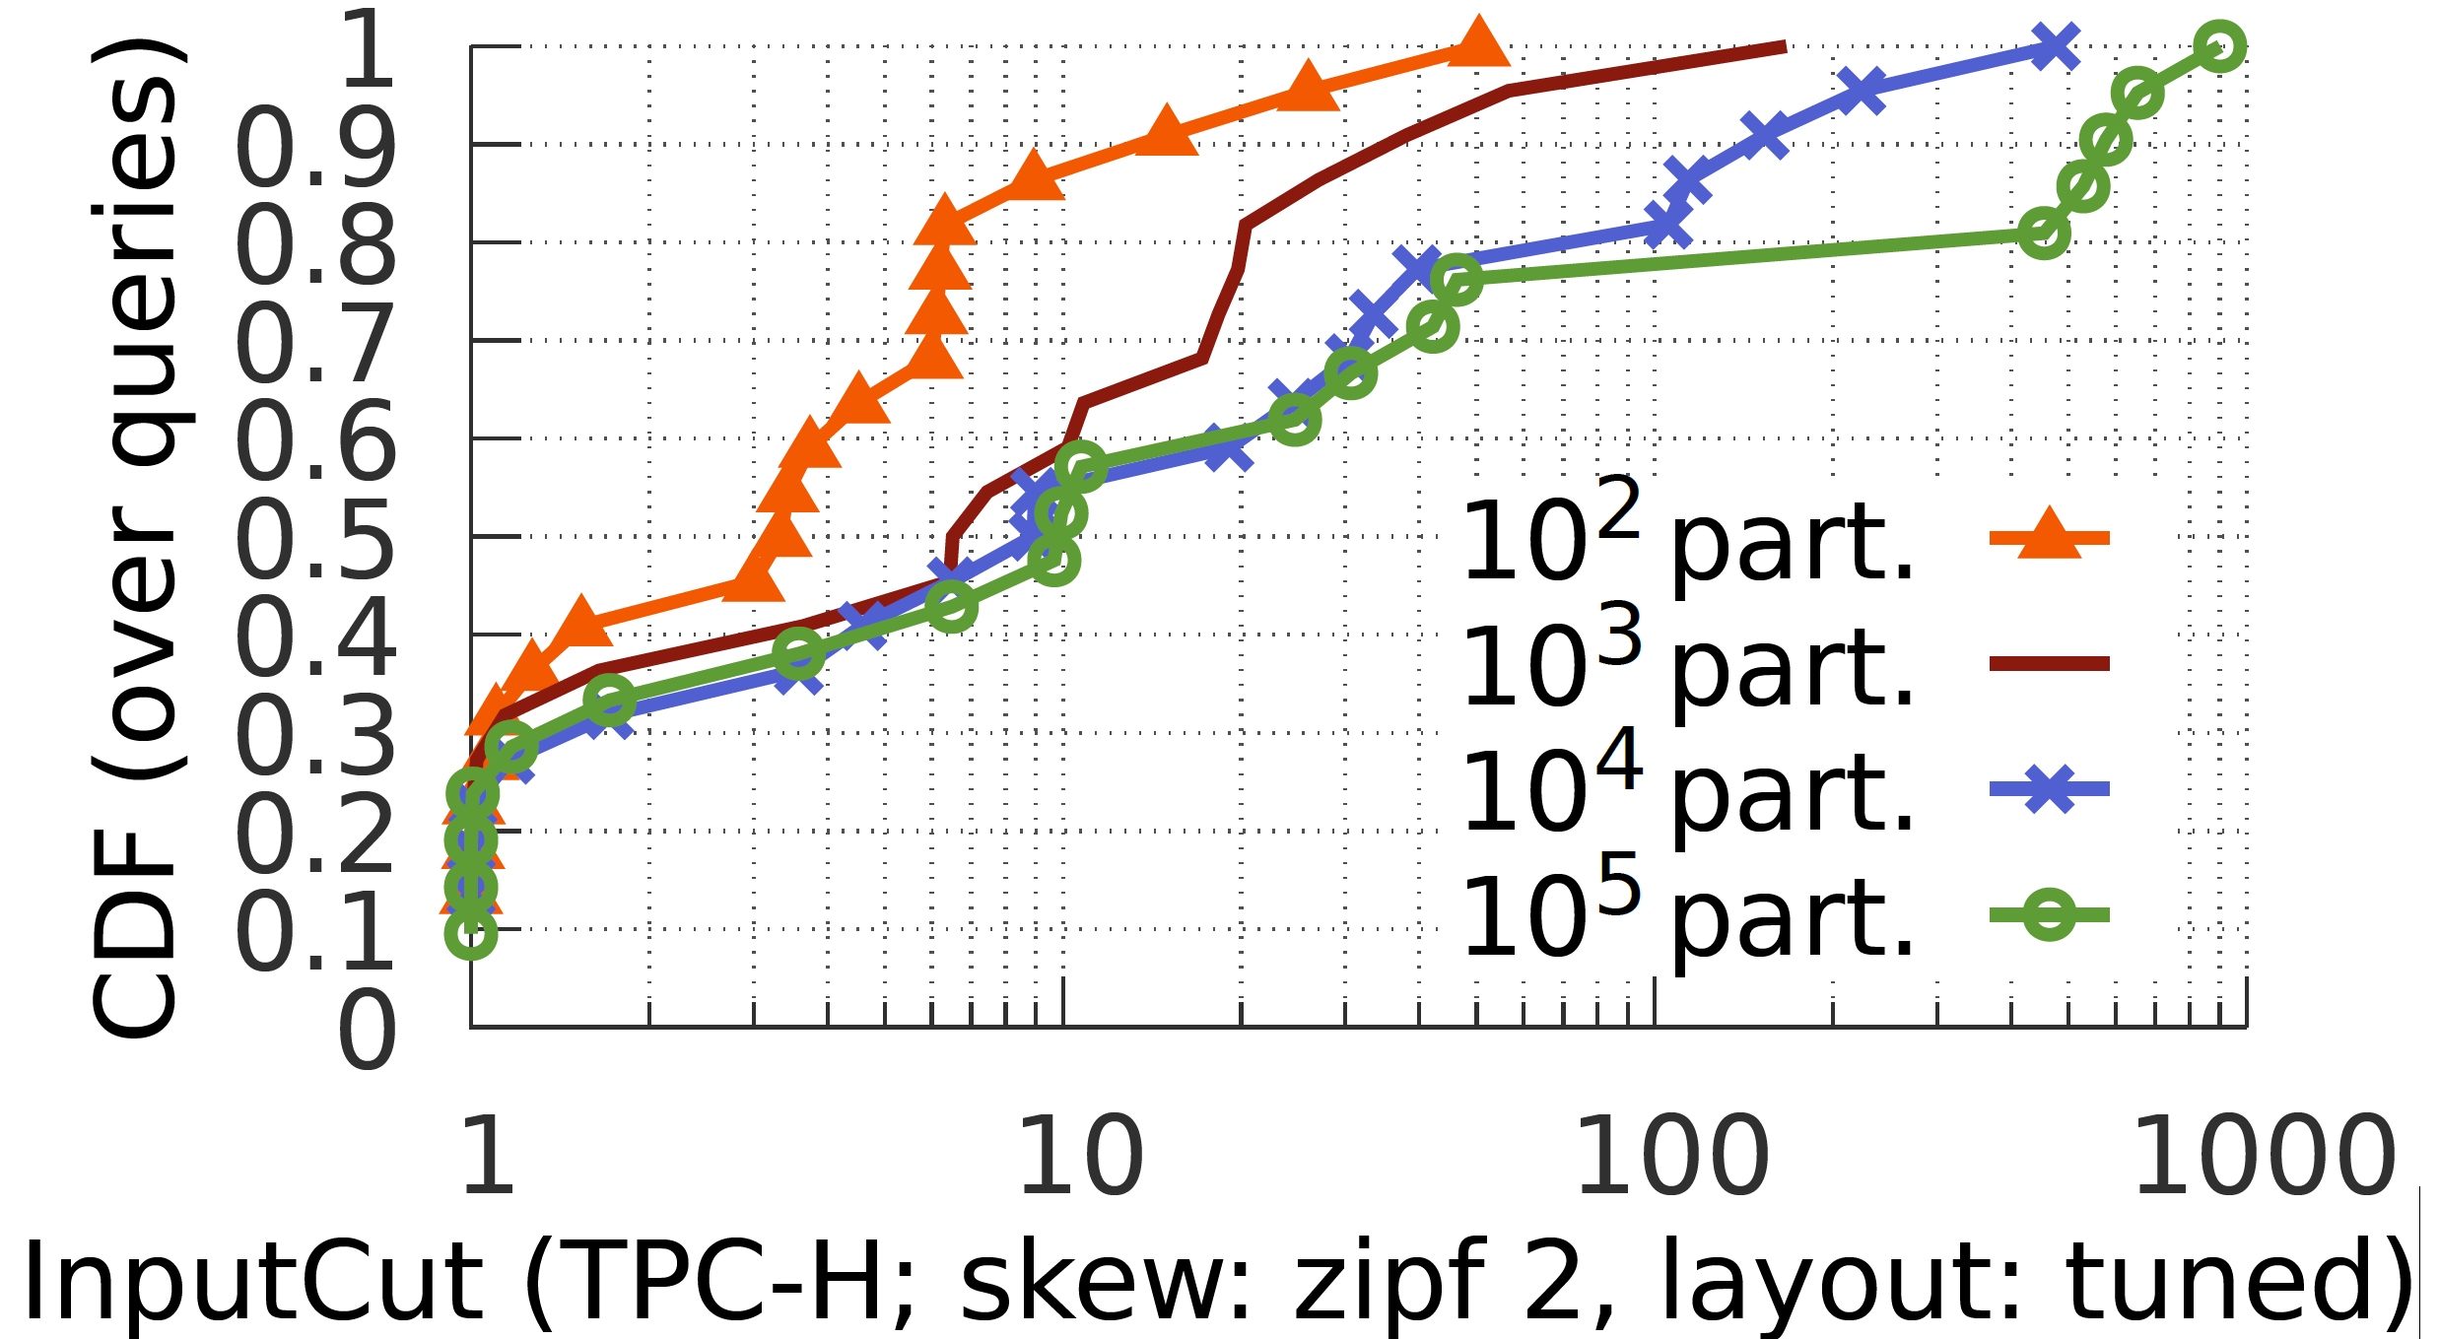
Effect of varying #partitions

Slide 34
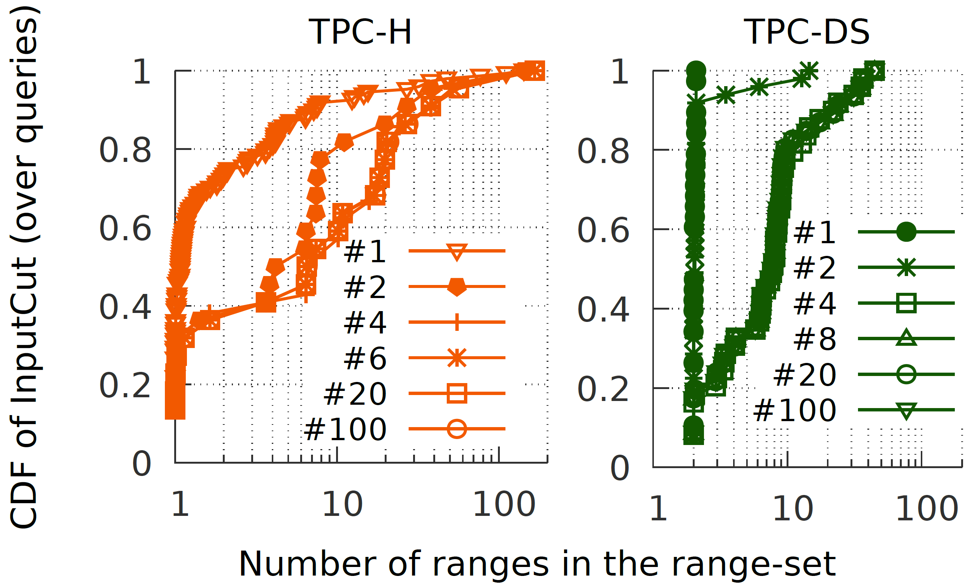
Impact of using different numbers of ranges

Slide 35
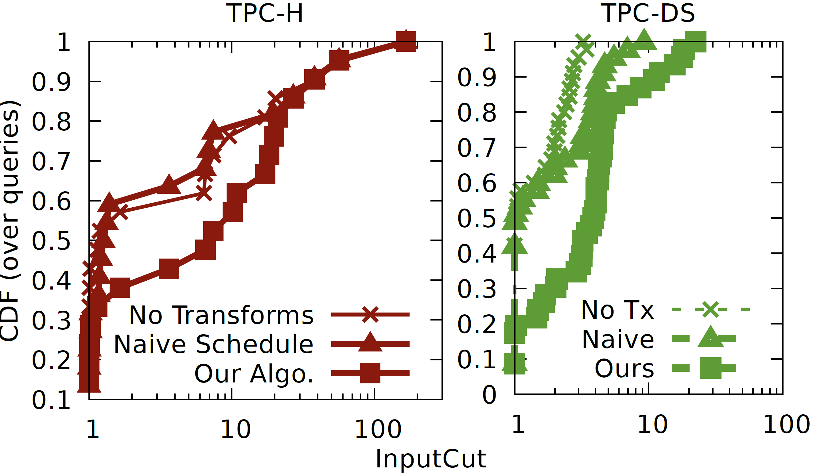
Teasing apart gains from different parts of our scheme

Slide 36
“Delta” relative to sideways-information passing while query executes^{[2]}
$$$$
$$$$
Bloom filters^{[3]} are available only after one join input is fully processed
Fewer plan changes are possible
High execution overheads or low gains
Partition pruning may not happen
diPs are also better when there are
many joins,
other interleaving operators,
predicates on multiple tables,
join columns with high distinctness
$${bloom}_{c}$$
$$σ$$
R
T
[2]: Implemented by all major database vendors
[3]: Or other datastructures such as bitmap filters and bitvectors

Slide 37
Other approaches
State-of-the-art:
Denormalize joins
(so that all predicates are on one table)
Table size bloats due to column repetition
Any given denorm may not contain all queries
(e.g., ~6x larger row-store to cover 16/22 TPC-H queries)
diPs achieve large gains w/o denorm
Workload-aware adaptation of denorm. data layout
(e.g., cluster rows matching the same predicates)
Large speedups possible
Does not generalize to diverse or unseen predicates
diPs do not require layout change
Notes:
Much worse on TPC-DS

Slide 38
diPs offer sideways information passing in the QO
Summary
Input
Output
Operate exclusively during query planning
Rely only on coarse summary statistics
Support arbitrary queries
Query
Query
Fast derivation of diPs for SJ expressions
Use QO rules to move diPs past other ops.
A new stat, range-set, that leads to more cut
(Approximate) updates to stats are trivially easy
Experiments vs strong prod. baselines show
sizable gains with a
small stat size and a
small increase in query optimization time
Tables: $R, T, …$
Partition subsets: $R^{′}, T^{′}, …$
Key ideas
S. Kandula, L. Orr and S. Chaudhuri. Pushing data-induced predicates through joins in big-data clusters. In VLDB 2020.

Slide 39
Treeify
Input
An acyclic join graph
Output A tree-order over that join graph
P
1
P
1
P
1
5
4
3
2
1
1
4
3
2
1
1
2
3
2
1
N
S
L
O
C
N
S
L
O
C
N
S
L
O
C
Starting at a random root, assign heights to nodes
Recursively, substitute current root with a child of that root that lowers total tree height

Slide 41
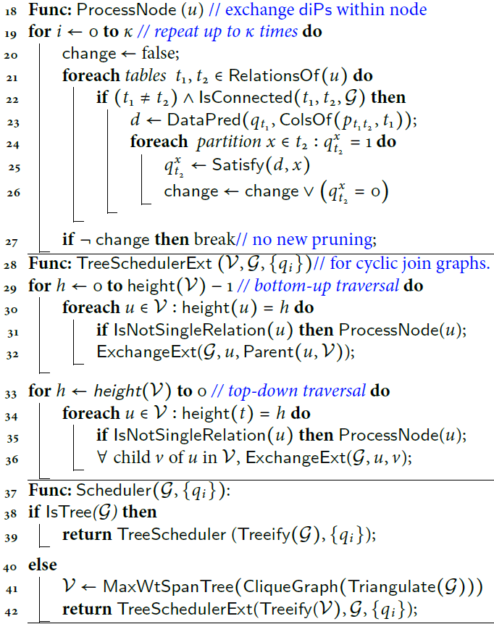
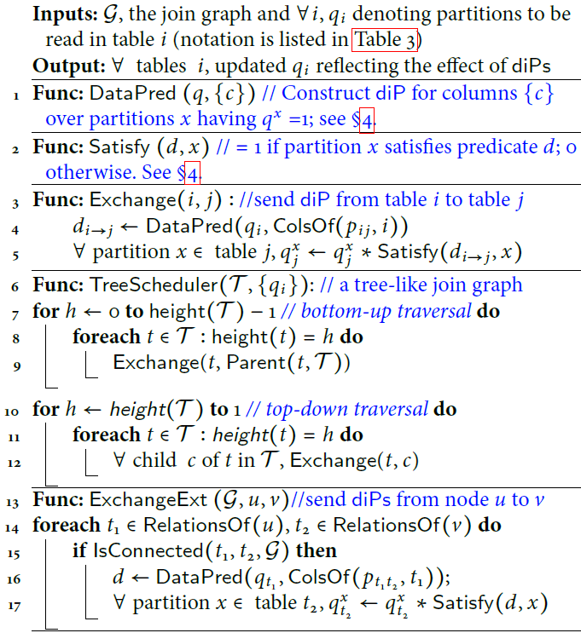
diP schedule pseudocode

