Slide 1
Self-explaining deep models with logic rule reasoning
Seungeon Lee, Xiting Wang, Sungwon Han,
Xiaoyuan Yi, Xing Xie, Meeyoung Cha

Slide 2
We will Discuss About
Why do we need explainability?
What are the current explanation methods?
What do we need to pay attention to when designing an explanation method?

Slide 3
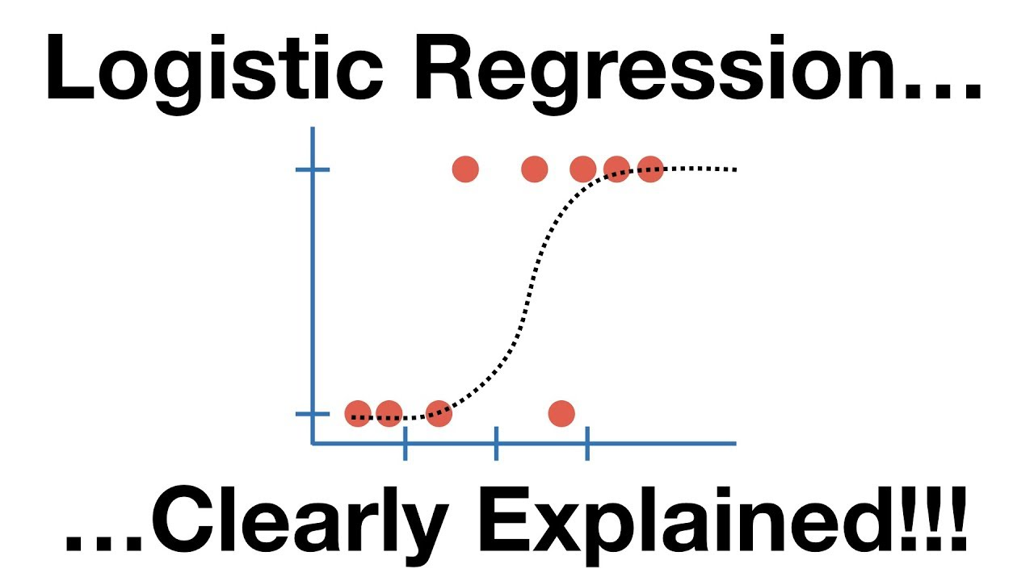
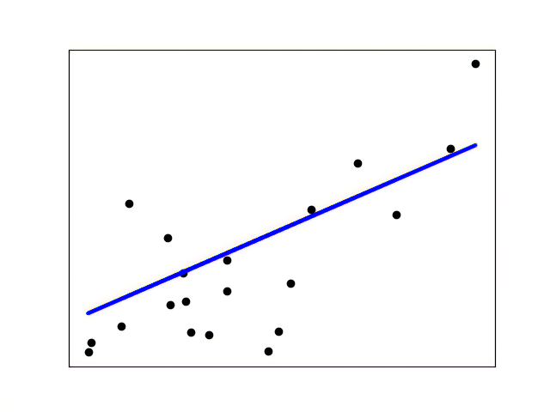
Trust Issues with Deep Models
What is the working mechanism?
Any serious unknown issues?
Performance aligns with real user satisfaction?
How to integrate user feedback?
Customer
Model developer
Deep model

Slide 4
Trust Issues with Deep Models
What is the working mechanism?
Any serious unknown issues?
Performance aligns with real user satisfaction?
Fully transparent model
How to integrate user feedback?
Customer
Model developer
Deep model

Slide 5
Trust Issues with Deep Models
Any legal risks?
Will anyone feel dissatisfied?
…
Fully transparent model
Manager
Lawyers
Mutual understanding between models and humans?
Value others’ influence and voice
Open to criticisms
Model developer
Deep model
What is the working mechanism?
Any serious unknown issues?
Performance aligns with real user satisfaction?
Product manager
Customer
How to integrate user feedback?

Slide 6
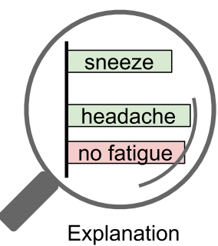
Limitation of Post-Hoc Explanations
The communication capability is inherently limited by their black-box nature
To ensure close collaboration, both human and the model should change
Sometimes
Understanding the model through post-hoc explanations
Can we trust the explanations?
Post-hoc explanations
$$≈$$
Trust?
Frequency
Always an approximation [1]
“General uneasiness” of practitioners [2]
Phase II:
Occasionally One-Way Communication
Practitioner 9 in [2]
Low
Feedback?
How to integrate user feedback?
No systematic method for direct control
Requires model retraining
No guarantee for satisfying user needs
Interpret a black-box model after it has been trained
Computational cost: test the complex black-box model thousands of times to obtain a complete and faithful understanding
“... it’s an attempt to make an estimate. So, it’s making a marginal claim in most cases.”
Can be easily applied to explain any trained model
Both humans and models should make effort to improve
[1] Stop Explaining Black Box Machine Learning Models for High Stakes Decisions and Use Interpretable Models Instead, Nature Machine Intelligence, 2019
[2] Human Factors in Model Interpretability: Industry Practices, Challenges, and Needs, ACM HCI 2020
Credible
Understandable
Relevant
Useful
Bi-
Quality
Direction
Seldom
Medium

Slide 7
Our Method: SELOR
Upgrade a given deep model to a self-explaining version
Trust
Self-
Explaining
with
LOgic rule
Reasoning
Upgrade
No trust issues: the model explains itself
Steerable: we can easily control the model by treating the explanations as handles
Human understandable: predict according to human logic, ensure that the humans are on the same page with the model
Lays the foundation for close collaboration
Upgrade a given deep model to a self-explaining version
Trust: explanations faithful to the model
Control
Familiar
Robust to noise
Logic rules possess the …
Feedback: explanations as handle for control
Advantages in terms of communication
Once the model is upgraded, the bi-direction communication highway is built, and we can leverage it freely
Automatically achieve high human precision

Slide 8
Our Method: SELOR
Explain from the model’s perspective
Do not map to decisions that are reasonable for humans
is, an => positive sentiment
Self-
Explaining
with
LOgic rule
Reasoning
Low Human Precision
Definition: Whether the explanation naturally leads to the prediction according to human perception
Low Human Precision:
User Study of SENN [1]
>30% explanation: humans cannot correctly guess model prediction
(Yelp dataset)
is, an => positive sentiment
awesome => positive sentiment
[1] Towards Robust Interpretability with Self-Explaining Neural Networks, NeurIPS 2018
High Human Precision:

Slide 9
Our Method: SELOR
not BEFORE good => negative sentiment
Logic rules
awesome AND tasty => positive sentiment
Explanations reasonable to humans?
Upgrade a given deep model to a self-explaining version
Self-
Explaining
with
LOgic rule
Reasoning
Close to human decision logic
Widely applied for making predictions
Human precision?
No trust issues: the model explains itself
Steerable: we can easily control the model by treating the explanations as handles
Human understandable: predict according to human logic, ensure that the humans are on the same page with the model
Whether humans find the explanations reasonable and naturally leads to the prediction
Select rules automatically
Select rules that lead to accurate prediction and high human precision
Minimum human effort
Define the form of the rule
Explanations reasonable to humans?
Prediction performance?
e.g., basic unit: word
logical connectives = {AND, OR}
max rule length = 4
Familiar
Robust to noise
Logic rules possess the …
Advantages in terms of communication
Once the model is upgraded, the bi-direction communication highway is built, and we can leverage it freely
Automatically achieve high human precision
The usefulness are inherently limited because most existing self-explaining models are not on the same page with humans
The usefulness are inherently limited because most existing self-explaining models are not on the same page with humans
Is expla, the models will mostly explain from the
LIME Anchor SENN RCN Ours
Cannot derive useful and actionable insights
+48%
SENN
RCN
Ours
LIME
Anchor

Slide 10
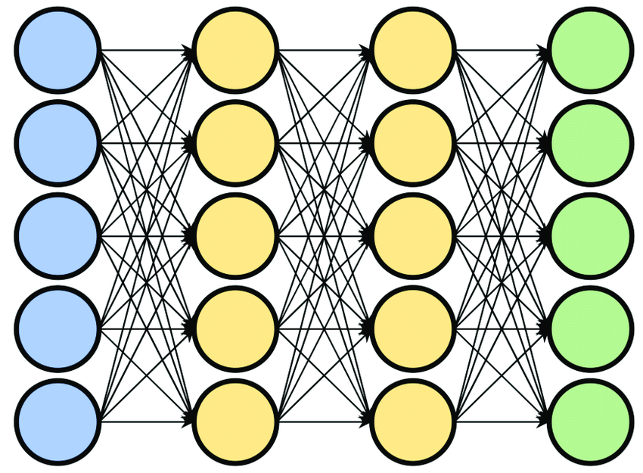
Framework
Input embedding $e$
Model Input $x$
Prediction $y$
The food is awesome, and the service is good
E.g., Softmax + Linear
Positive sentiment
…
Prediction layer
Encoder Network

Slide 11
Framework
awesome AND tasty => positive sentiment
Antecedent
Consequent
(condition for applying the rule)
Antecedent $α$
the
the AND food
service AND food
……
the AND is AND good
and AND the AND is
……
Input embedding $e$
Model Input $x$
The food is awesome, and the service is good
RNN
awesome AND good
…
Antecedent generator
Selects the first part of the rule from all candidates
Candidate: antecedent that satisfies the human given form

Slide 12
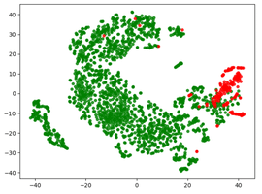
Framework
awesome AND tasty => positive sentiment
Antecedent
Consequent
(model prediction)
Input embedding $e$
Model Input $x$
Antecedent $α$
The food is awesome, and the service is good
RNN
awesome AND good
…
Rule
Consequent estimator
Consequent $y$ (prediction)
1. Find all instances that satisfy $α$
2. 90% of them are positive
3. The consequent is Positive Sentiment (90% probability)
Positive sentiment
(90% probability)

Slide 13
Optimization
Optimize the cross-entropy loss
Automatically find rules that can well distinguish positive and negative samples
High Human Precision
awesome AND good => pos (90% prob)
Small loss
is AND an => positive sentiment (50% prob)
Large loss
Input embedding $e$
Model Input $x$
Antecedent $α$
The food is awesome, and the service is good
RNN
awesome AND good
…
Rule
Consequent estimator
Consequent $y$ (prediction)
1. Find all instances that satisfy $α$
2. 90% of them are positive
3. The consequent is Positive Sentiment (90% probability)
Positive sentiment
(90% probability)

Slide 14
Optimization
Optimize the cross-entropy loss
Automatically find rules that can well distinguish positive and negative samples
High Human Precision
awesome AND good => pos (90% prob)
Small loss
is AND an => positive sentiment (50% prob)
Large loss
Decoded with Gumbel Softmax
Input embedding $e$
Model Input $x$
Antecedent $α$
The food is awesome, and the service is good
RNN
awesome AND good
…
Rule
Consequent estimator
Consequent $y$ (prediction)
1. Find all instances that satisfy $α$
2. 90% of them are positive
3. The consequent is Positive Sentiment (90% probability)
Positive sentiment
(90% probability)

Slide 15
Details About Consequent Estimator
Improve efficiency
Generalize to similar rules
Manage noise?
Sampled
Antecedents
Empirical
Consequent
Pretraining
pos | neg
0.90 | 0.10
awesome AND good
very AND good
……
0.87 | 0.13
Fixed Weight
Neural Consequent Estimator
Antecedent $α$
Consequent $y$
awesome AND good
Transformer
Linear FC
Positive sentiment
(90% probability)
Prediction
layer

Slide 16
Details About Consequent Estimator
Manage noise
Sampled
Antecedents
Empirical
Consequent $\hat{p}$
Antecedent
coverage $n$
$K:$ number of class
$β :$ Automatically learned
Pretraining
pos | neg
0.90 | 0.10
$$p\left(y | α\right)=\frac{\hat{p}n+β }{n+Kβ}$$
awesome AND good
very AND good
……
1,100
5,000
0.87 | 0.13
$n→∞$:$p\left(y | α\right)=\hat{p}$
$n→0$: $p\left(y | α\right)$ is uniform distribution
Fixed Weight
Neural Consequent Estimator
Empirical
Consequent $\hat{p}$
Positive sentiment
(90% probability)
Antecedent $α$
awesome AND good
Transformer
Linear FC
Consequent $y$
Coverage $n$
Prediction
layer
1,100

Slide 17
Results
High Human Precision
Training Cost
User study
Percentage of best
Efficient, differentiable training
Slightly slower than black-box model
+500%
(Adult dataset)
Training Time
Good Prediction Performance
SELOR
$$≈$$
BERT
16%
SELOR
Black-box

Slide 18
Additional Advantages
Generate Explanation Efficiently
Robust to Noisy Labels
Can be Steered w/o Retraining
SELOR vs LIME
1,000x speed-up
SELOR vs Anchor
50,000x speed-up
(BERT base, Yelp)
vegas => positive
$$>$$
SELOR
Black-box
>10% F1 increase when 20% labels are randomly flipped
(BERT base, Yelp)
tasteless => negative

Slide 19
Understanding the Explainable Framework
Deep learning model $f$
$$x → y$$
$$p(y|x)$$
input
output

Slide 20
Understanding the Explainable Framework
Self-explaining deep model $f′$
$$x → α → y$$
$$p\left(y | x\right)=\sum_{α}{p\left(y | α,x\right)p(α|x)}$$
input
output
Explanation
Latent variable
$b:$ human prior
$$p\left(y | x,b\right)=\sum_{α}{p\left(y | α,x,b\right)p(α|x,b)}$$
Explanation constraint 0
Explanations can be understood by humans
Explanation constraint 1
The prediction can be understood by humans
$$p\left(y | x\right)=\sum_{α}{p\left(y | α,x,b\right)p\left(α | x,b\right), } Ω\left(α\right)<S$$
Explanation constraint 2
The model does not “cheat” by directly learning from $x$
$p\left(y | x\right)=\sum_{α}{p\left(y | α\right)p(α|x,b)}$, $Ω\left(α\right)<S$
Avoid explanation overfitting, high human precision, consistency

Slide 21
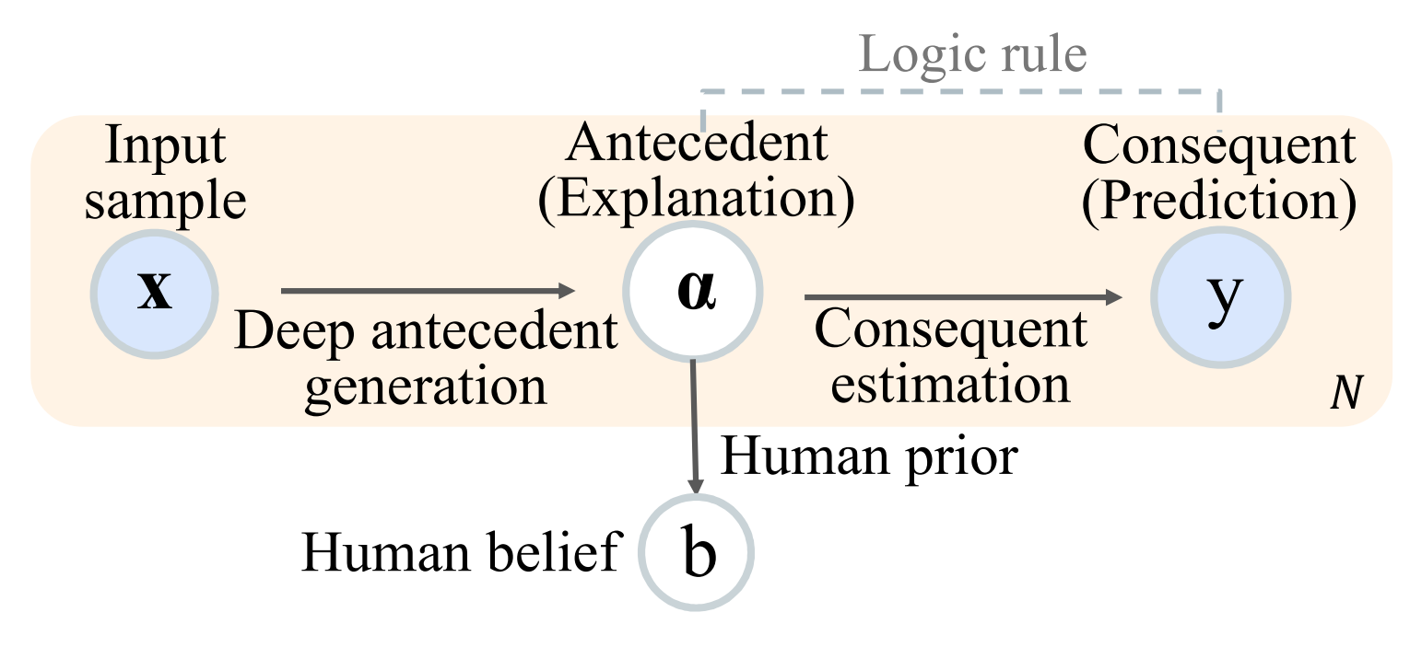
Understanding the Explainable Framework
User-friendly interface
for cognitive alignment
Subconsciousness
(Unexplainable)
Consciousness
(Explainable)
hurt AND black =>
negative sentiment (90% probability)
Explanation is local in the sense that it is tailored for each instance
Explanation is global in the sense that its correctness is verified by testing all training data (human precision, self-consistency)

Slide 22
Limitation and Future Work
Applicability
Experimented with tabular and NLP data
May be used in graphs
Recommender systems? Image? May needs feature learning
Class of rules
We use the simplest class of rules
Low coverage: “awesome AND tasty => positive sentiment” has a coverage of 0.37%
Level of insight: case by case or a global pattern?
not AND good -> negative sentiment
Negation
Positive word

Slide 23
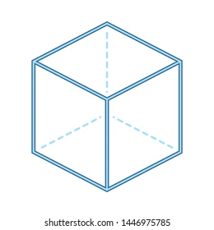
Explainable Machine Reasoning
Initial attempts for achieving close human-close relation
There is so much we should learn from interdisciplinary studies
We need to find better ways to evaluate the reasoning processes
Logic rule: SELOR [NeurIPS 2022]
Knowledge graph: ReMR [WWW 2022], AnchorKG [KDD 2021], ADAC [SIGIR 2020], ECR [IJCAI 2020], DEAML [AAAI 2019]
Social network: SureFact [KDD 2022], FinerFact [AAAI 2021]
Symbolic System
Substructure
Input
Output Prediction
…
Plan II
Interdisciplinary Collaboration
Plan I
Explanation Benchmark Dataset
Psychologists’ view
System 1 Thinking Intuition
Logical Reasoning
System 2 Thinking: Reasoning
① Model design
Neuroscientists’ view
Human Knowledge
② Desirable reasons

Slide 24
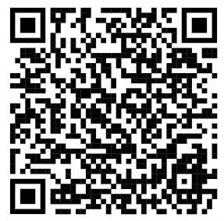
Thanks
My homepage
(see slides here)
Paper
https://arxiv.org/abs/2210.07024
https://www.microsoft.com/en-us/research/people/xitwan/
Code
https://github.com/archon159/SELOR
Xiting Wang
Social Computing Group
Microsoft Research Asia

