Slide 1
Thompson Sampling in Combinatorial Multi-armed Bandits with Independent Arms
Siwei Wang
Microsoft Research Asia

Slide 2
Multi-armed Bandits (MAB)
A set of arms $[1,2,⋯,m]$
Pulling arm $i$ leads to a random reward (with mean $μ_{i}$)
The procedure lasts for $T$ time steps
In each time step, the system
1. pulls an arm
2. receives the random reward
Goal: maximize the cumulative reward or minimize the cumulative regret
Arm 1
Arm 2
Arm m
$$⋯$$
Receive random
reward
Pull arm 1
System
Regret = Best one can do – Real gain

Slide 3
Exploration vs Exploitation
The average value is an unbiased estimator
In bandit problems, the observations depend on the chosen arms
A counter example
Trade-off between exploration and exploitation
Exploration: try the arms that behave bad now but have potential to be the best
Exploitation: stuck in the best arm so far (based on empirical means)
0.1
0.9
1
0
0
$$⋯$$
0

Slide 4
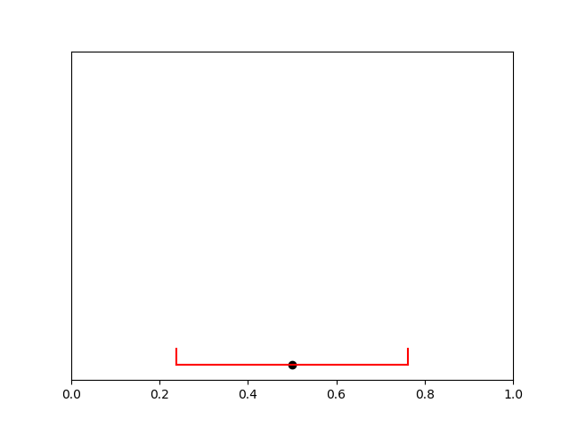
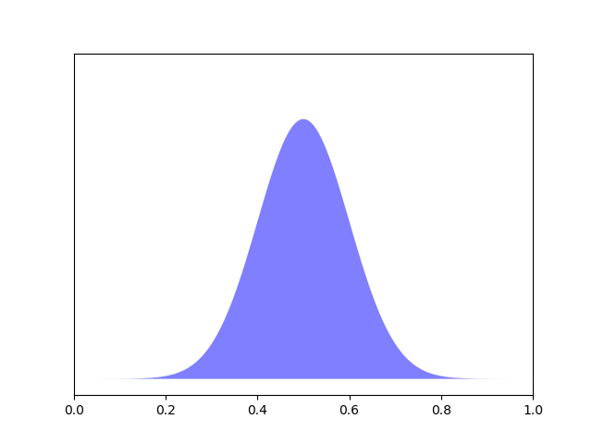
Exploration vs Exploitation
UCB
Compute a confidence region for the ground truth
$[{\hat{μ}}_{i}−rad, {\hat{μ}}_{i}+rad]$ with empirical mean ${\hat{μ}}_{i}$ and confidence radius $\sqrt{n^{−1}\log{T}}$
Choose the estimation to be the upper confidence bound
OFU principle (optimism in the face of uncertainty)
Thompson Sampling
Update a posterior distribution, e.g., $𝒩\left({\hat{μ}}_{i},{\left(n+1\right)}^{−1}\right)$
Draw a random estimation independently from this distribution

Slide 5
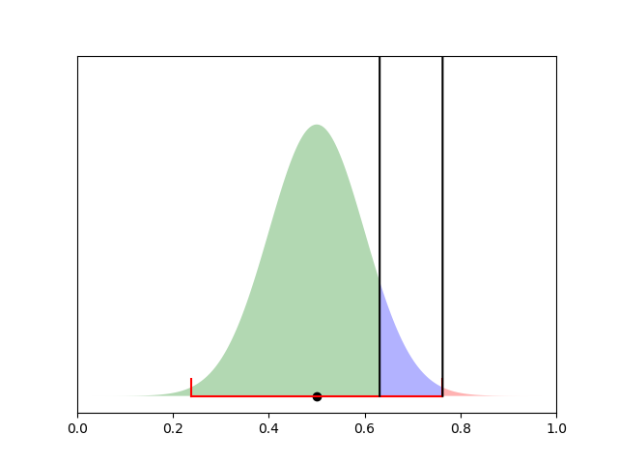
Exploration vs Exploitation
Thompson sampling
Over-exploitation
Proper
Over-exploration
A good algorithm needs
Almost no over-exploration
A positive probability lower bound for the proper region
Over-exploitation
Proper
Over-exploration

Slide 6
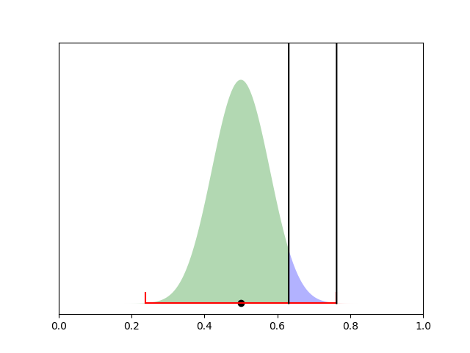
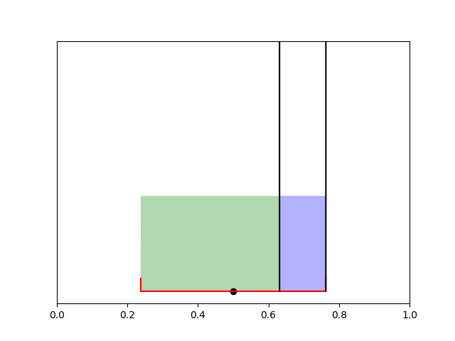
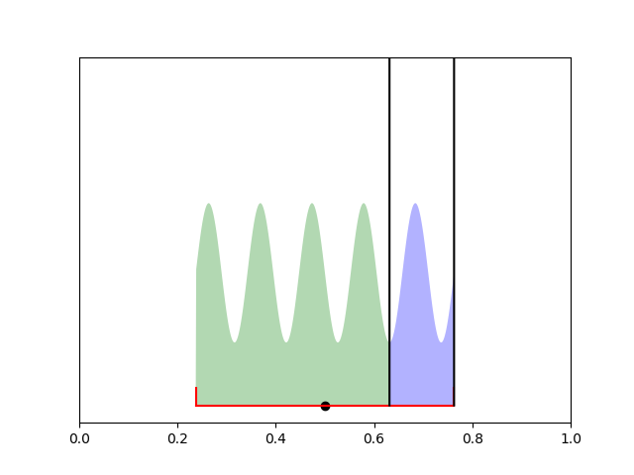
Exploration vs Exploitation
Thompson sampling
We only need the random distribution to spread over the confidence region (with high probability)

Slide 7
Combinatorial MAB (CMAB)
Model setting (CMAB)
A set of base arms $[1,2,⋯,m]$, each base arm $i$ has expected reward $μ_{i}$
A set of super arms $𝒮⊆{\left\{0,1\right\}}^{[m]}$
At each time step $t$
The algorithm chooses one super arm $S\left(t\right)∈𝒮$ to pull
It receives random observations $\{r_{i}\left(t\right):i∈S(t)\}$ and a total reward $\sum_{i∈S(t)}{r_{i}\left(t\right)}$

Slide 8
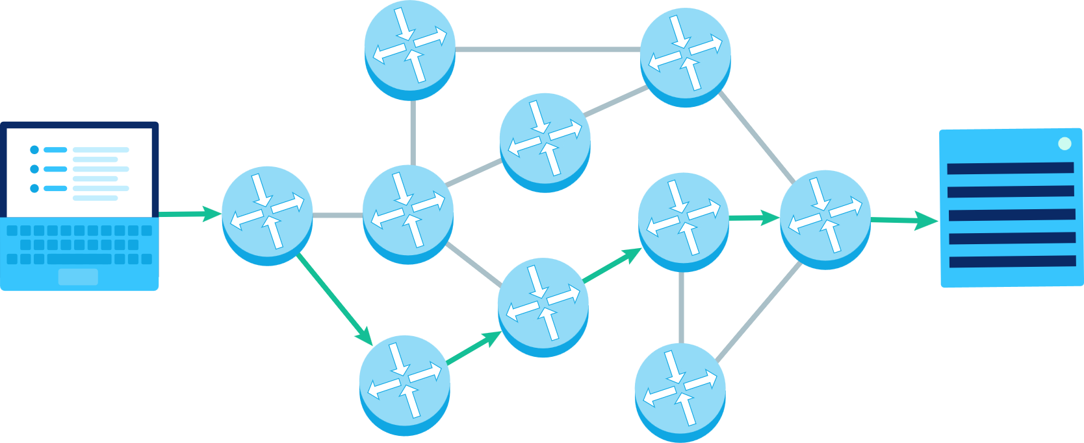
Combinatorial MAB
A concrete example: routing system
Base arms are links (edges)
Super arms are paths (from $s$ to $t$)
Pulling a super arm will receive observations (delays) of all the edges in that path
The goal is to minimize the overall time cost
$$s$$
$$t$$

Slide 9
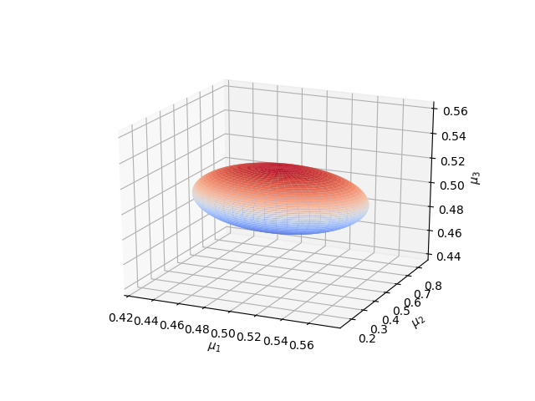
UCB in Combinatorial MAB
Parameters: the expected delay $μ_{i}$ of each link $i$
Confidence region: an ellipsoid $E=\left\{μ: \sum_{i}{{N_{i}\left(μ_{i}−{\hat{μ}}_{i}\right)}^{2}≤}\log{T}\right\}$
0.1
0.1
0.6
0.9
0.4
s
0.3
0.7
t
0.3
0.2
0.1
0.5
0.2
0.8

Slide 10
UCB in Combinatorial MAB
Optimism in the face of uncertainty
In the non-combinatorial case, we find out the best performance of every single arm within the confidence region $E$, and then choose the arm with the best “best performance”
Similarly, in the combinatorial case, we need to find out the best performance of every super arm $S$ within the confidence region $E$, and then choose the super arm with the best “best performance”
Use the projection of $E$ on the dimensions of $S$

Slide 11
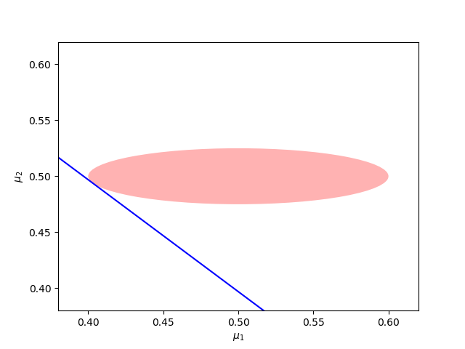
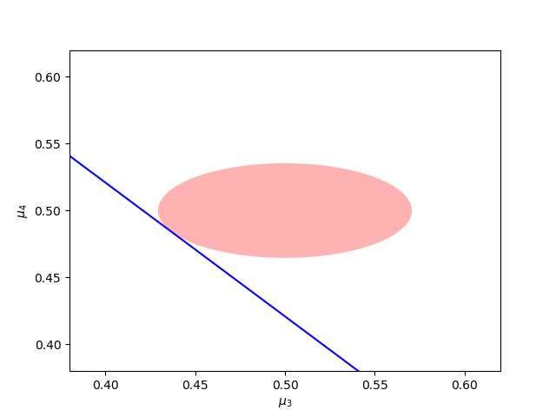
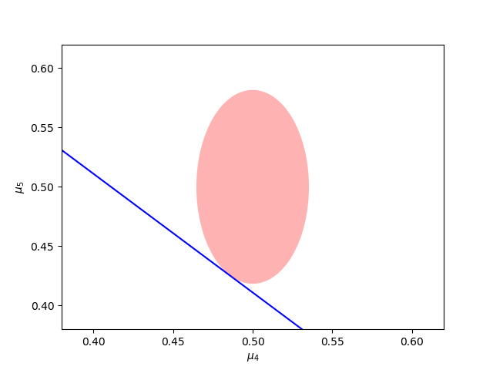
Challenges
Use the projection of $E$ on the dimensions of $S$
This leads to an exponential time cost
Minimum $μ_{1}+μ_{2}$
Minimum $μ_{3}+μ_{4}$
Minimum $μ_{4}+μ_{5}$

Slide 12
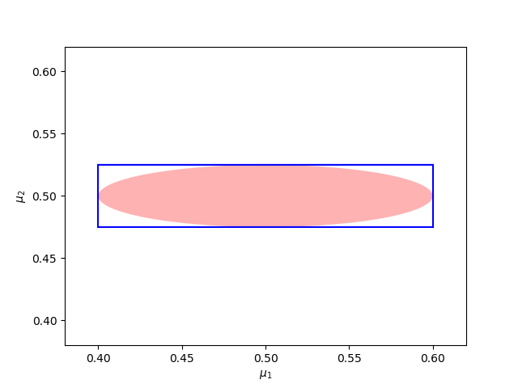
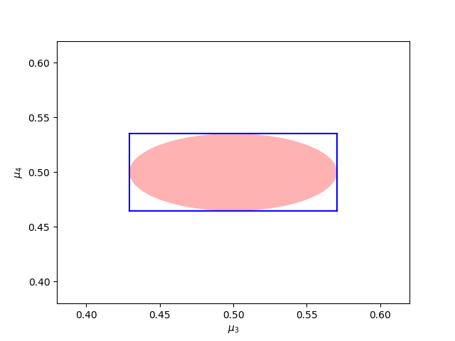
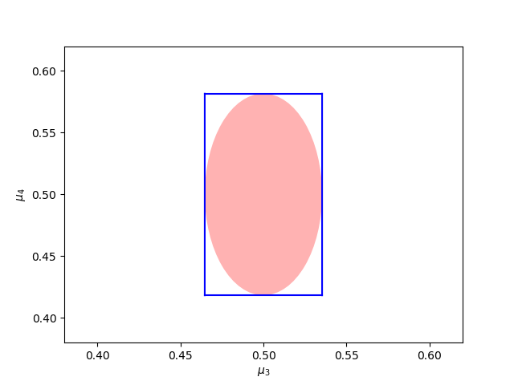
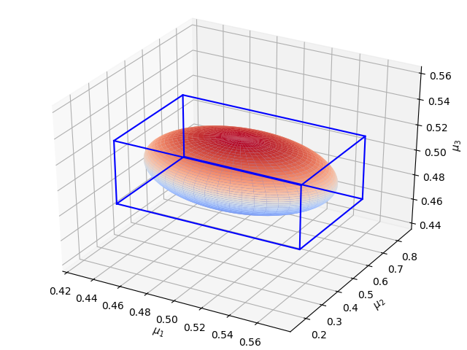
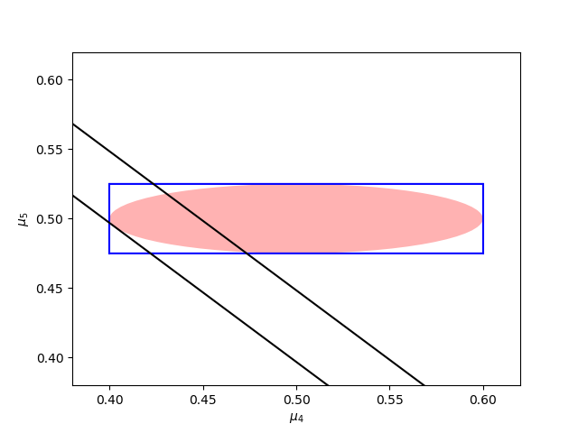
Challenges
Another solution: use a wider confidence region
When the path has length $K$, the severe over-exploration increases the regret by a factor of $K$
Over-exploitation
Proper
Over-exploration

Slide 13
Solution: Thompson Sampling
Draw parameter vector $θ$ from Gaussian distribution $𝒩(\hat{μ},diag(N_{1}^{−1},⋯N_{m}^{−1}))$
The time cost is linear
Choose the best super arm under parameter vector $θ$, i.e., ${argmax}_{S} \sum_{i∈S}{θ_{i}}$
The time cost is polynomial

Slide 14
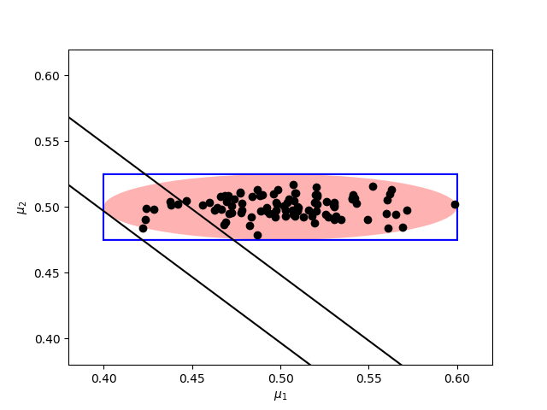
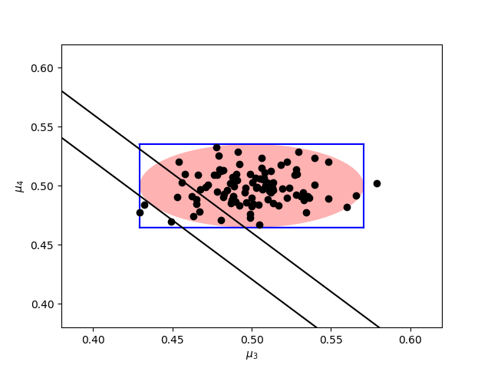
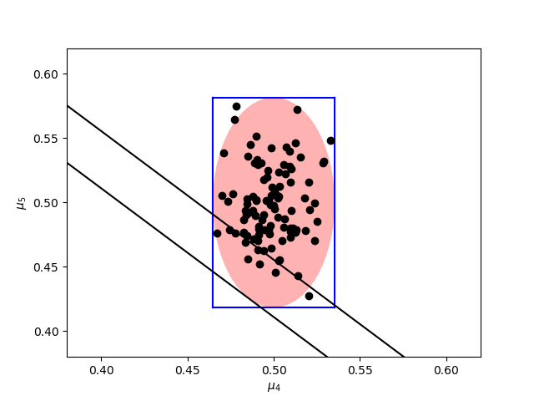
Solution: Thompson Sampling
Recall that in the non-combinatorial case, we want the random samples satisfy
Almost no over-exploration
A probability lower bound for the proper region
These properties are also sufficient in the combinatorial case
Over-exploration
Proper

Slide 15
TS in Combinatorial MAB
Theorem 1. The regret upper bound of applying TS in Combinatorial MAB is $O(m\log{K}\log{T})$
$K$ is the largest size of any super arm
The non-efficient UCB can achieve the same regret upper bound
The efficient UCB can only achieve a regret upper bound of $O(mK\log{T})$

Slide 16
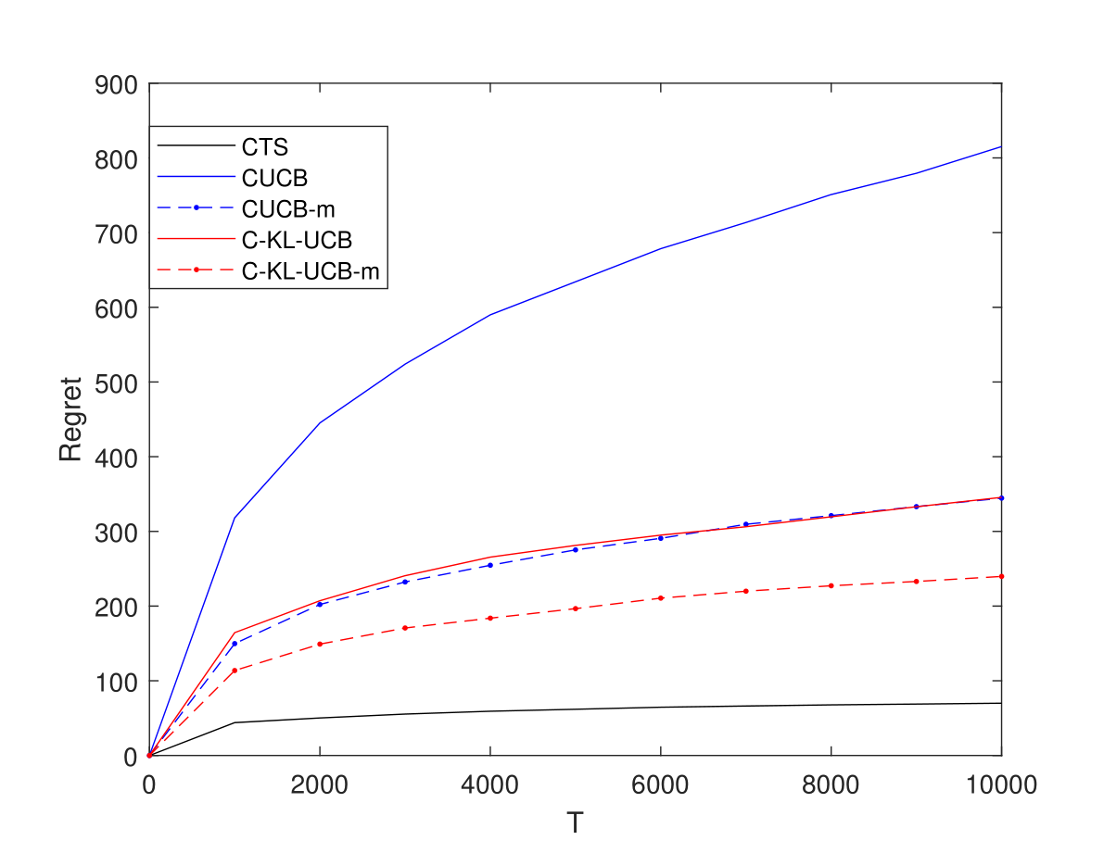
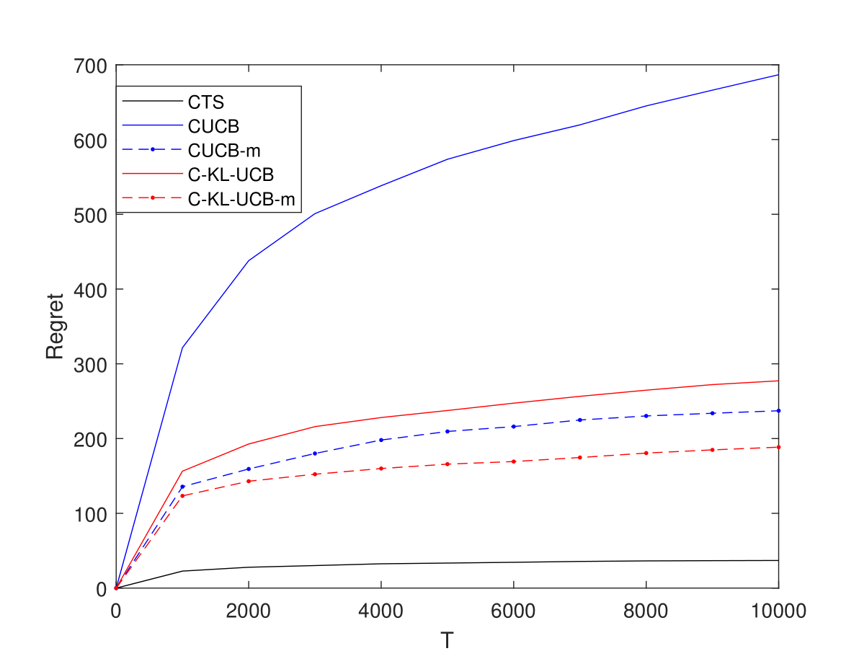
Simulations
Compare our TS-based algorithm (CTS) with other UCB-based ones (CUCB, C-KL-UCB)

Slide 17
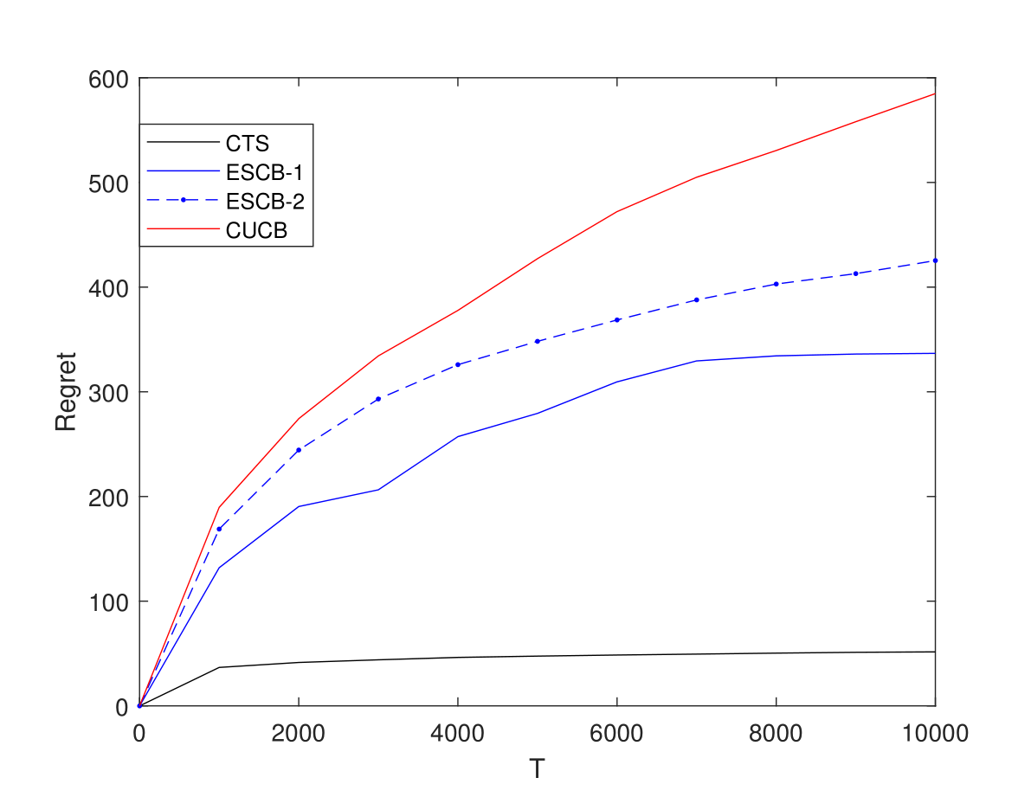
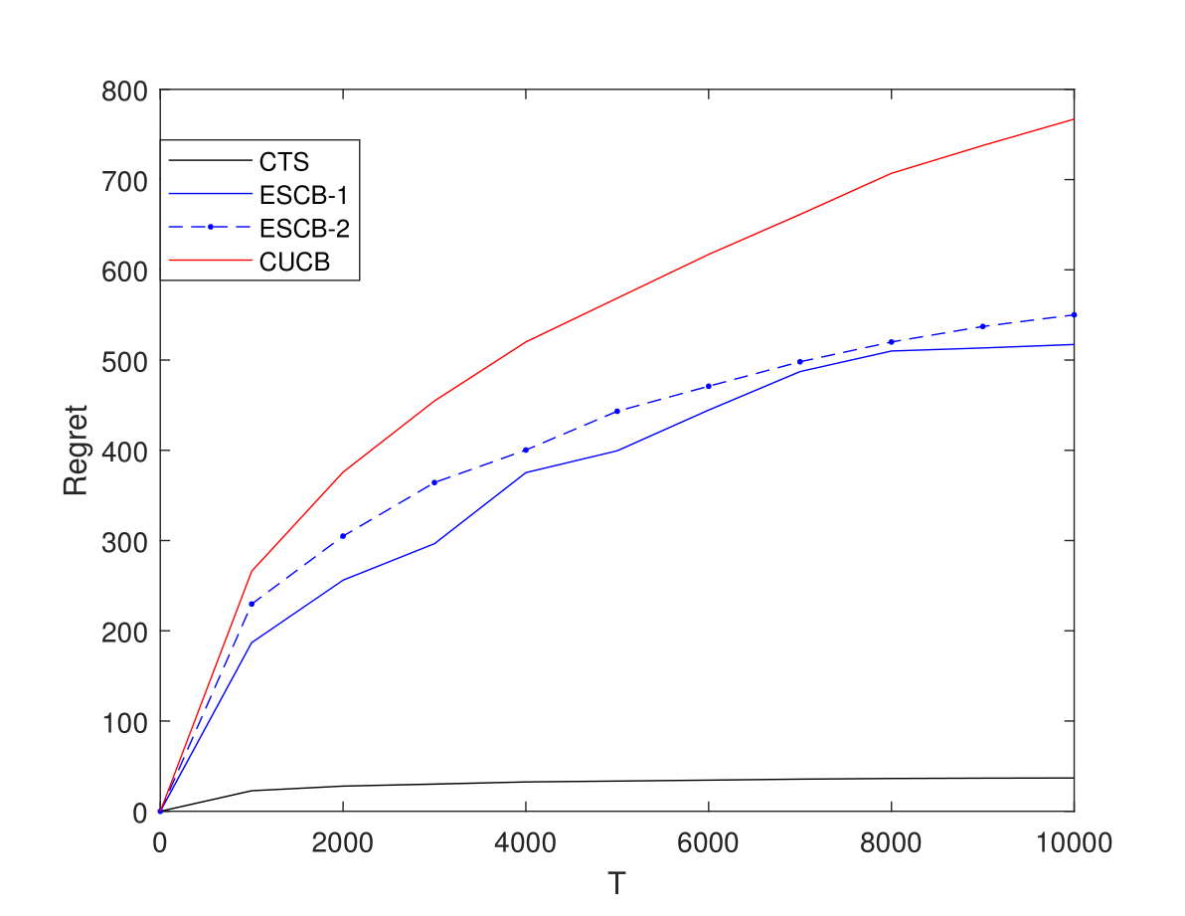
Simulations
Compare our TS-based algorithm (CTS) with other UCB-based ones (CUCB, ESCB)

Slide 18
TS in Pure Exploration of CMAB
Theorem 2. TS-Explore requires sample complexity (the number of observations) $O(mK\log{1/δ})$
$δ$ is the error constraint
The non-efficient UCB-based algorithm can achieve a sample complexity of $O(mK\log{1/δ})$
The efficient UCB-based algorithm requires sample complexity $O(mK^{2}\log{1/δ})$

Slide 19
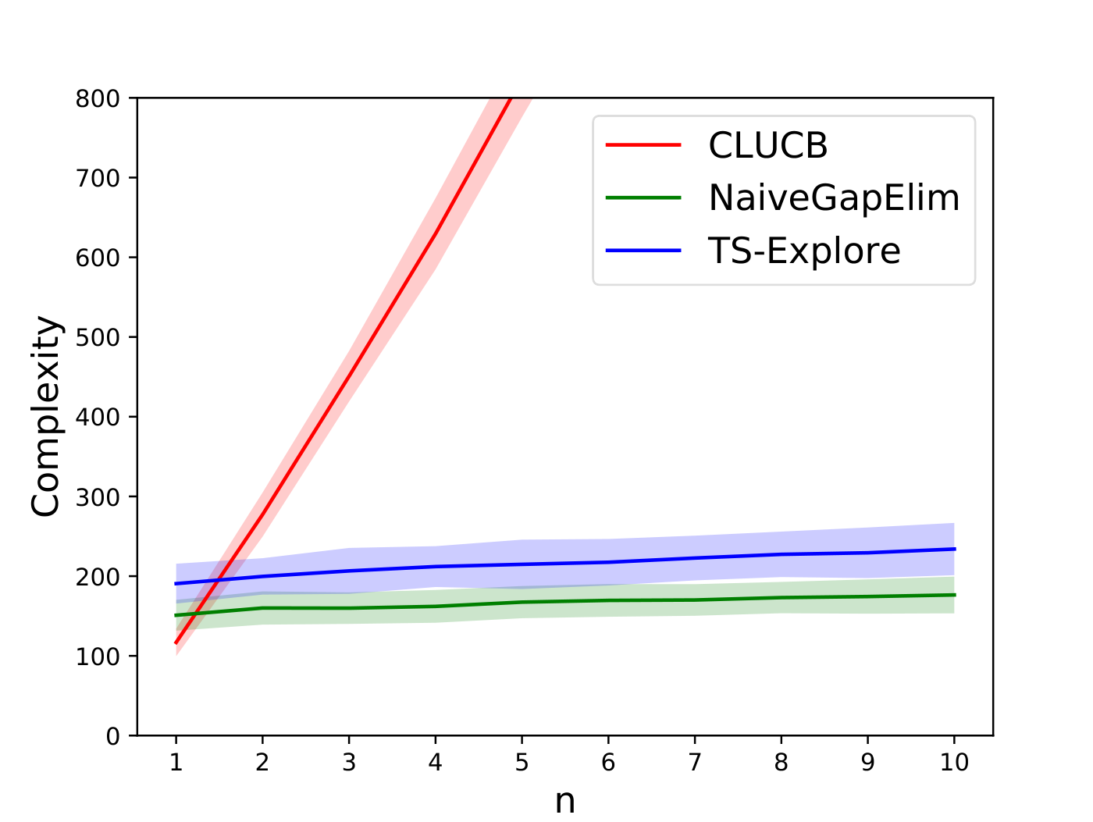
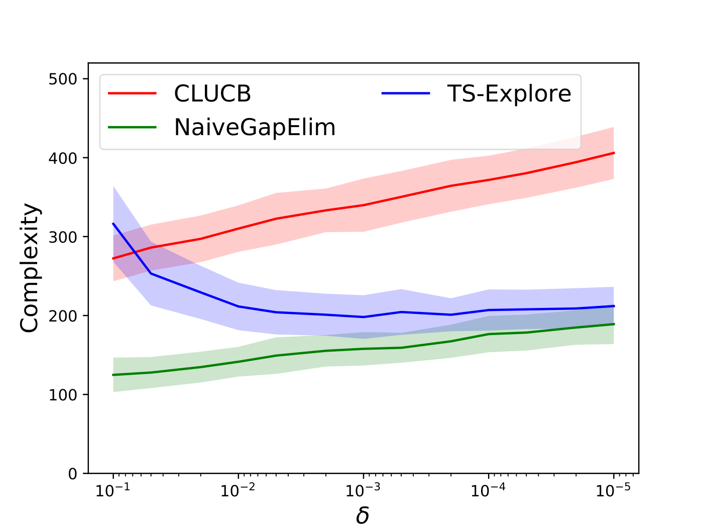
Simulations
Compare the sample complexity of TS-Explore, CLUCB and NaiveGapElim

Slide 20
Conclusion
In CMAB model with independent arms, TS-based algorithms can be either much more efficient, or much more effective than UCB-based algorithms
In TS, we could draw the random point (follow the required constraints) efficiently
Do not need to look for the best point of all the super arms

Slide 21
References
[1] Siwei Wang, Wei Chen, “Thompson Sampling for Combinatorial Semi-Bandits”, ICML 2018
[2] Siwei Wang, Jun Zhu, “Thompson Sampling for (Combinatorial) Pure Exploration”, ICML 2022

Slide 22
Thank You!
Siwei Wang
Microsoft Research Asia

